Slide 1
Chapter 2: ARCHITECTURES
Agmas G..

Slide 2
Architectures
Distributed systems are complex.
In order to manage their intrinsic complexity, distributed systems should be organized properly.
Organization is mostly expressed in terms of its software components.
Different ways to look at organization of distributed systems –two obvious ones:
Software architecture – logical organization (of software components and interconnections)
System architecture – physical realization (the instantiation of software components on real machines)

Slide 3
Architectural style
A architectural style is formulated in terms of
Components,
The way that components are connected to each other,
The data exchanged between components, and finally
How these elements are jointly configured into a system.
A component is a modular unit with well-defined interfaces that is replaceable within its environment.
A connector is a mechanism that mediates communication, coordination, or cooperation among components.
It allows for the flow of control between components
E.g., facilities for remote procedure call, message passing, or streaming data.

Slide 4
Types of Architectural Styles
Common architectural styles of distributed systems
Layered architectures
Object-based architectures
Resource-centered architectures
Event-based architectures
The common technique:
Organize your system into logically different components, and distribute those components over the various machines.
Goal :
Achieving (at a reasonable level) distribution transparency.

Slide 5
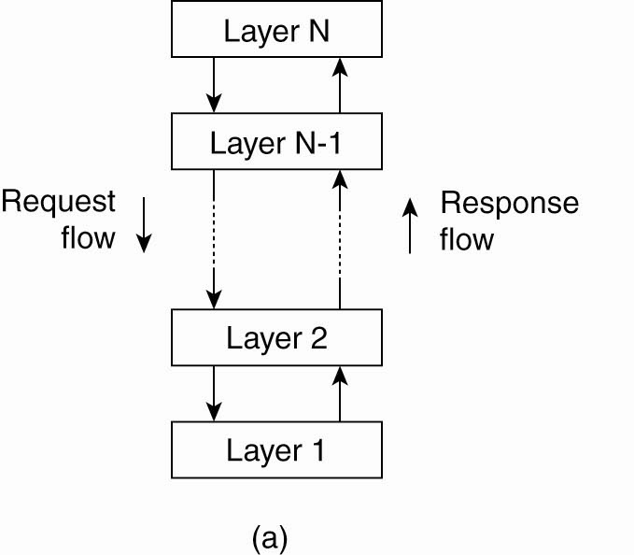
Layered architectural style
It is hierarchical organization
Components are organized in a layered fashion
Component at layer Lj can make a down-call to a component at a lower-level layer Li (with i < j) and generally expects a response.
Only in exception, an up-call is made to higher level component
Each layer exposes an interface to be used by above layers
“Multi-level client-server”
Each layer acts as a
Server: service provider to layers “above”
Client :service consumer of layer(s) “below”
Communication protocol-stacks are a typical examples
OSI Reference model
TCP/IP
Figure 2-1. The (a) layered architectural style

Slide 6
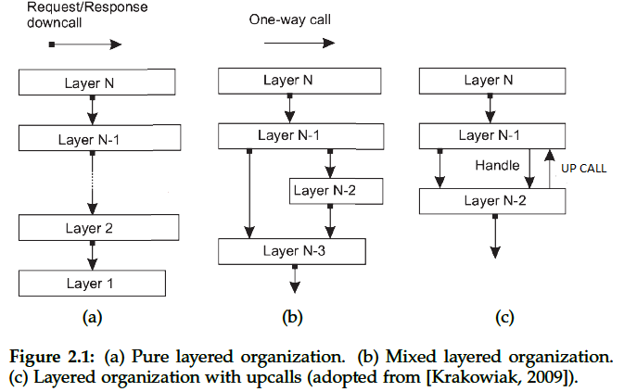
Con’t
The three common cases

Slide 7
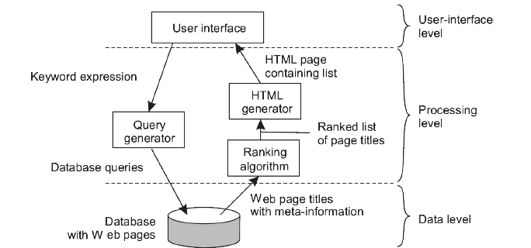
Con’t
Essentially, layered architectural style contains three logical levels commonly know as application layers
The application(user)-interface level
The processing level
The data level

Slide 8
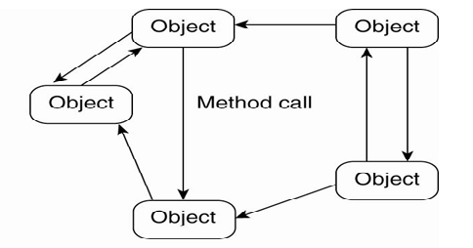
Object-Based Architectures
Components are objects
Objects are easy to be replaced so long as the interface is not touched
It is less structured and hence a relatively loose organization
The calling object might not run on the same machine as the called object
Connectors are RPC and RMI

Slide 9
Con’t
Note:
Object-based architectures are attractive because they provide a natural way of encapsulating data (called an object’s state) and the operations that can be performed on that data (which are referred to as an object’s methods) into a single entity.

Slide 10
Resource-based architectures
Viewed as a huge collection of resources that are individually managed by components.
Resources may be added or removed by (remote) applications, and likewise can be retrieved or modified.
This approach has now been widely adopted for the Web and is known as Representational State Transfer (REST) [Fielding, 2000].
There are four key characteristics of what are known as RESTful architectures [Pautasso et al., 2008]:
Resources are identified through a single naming scheme
All services offer the same interface, consisting of at most four operations, as shown in the following figure.
Messages sent to or from a service are fully self-described
After executing an operation at a service, that component forgets everything about the caller(stateless execution)

Slide 11
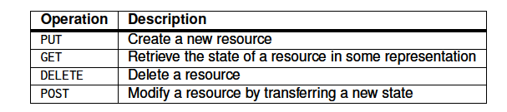
Con’t
The four operations available in RESTful architectures.
Components
Resources
Components, that interact with the resource
Connectors
Queries

Slide 12
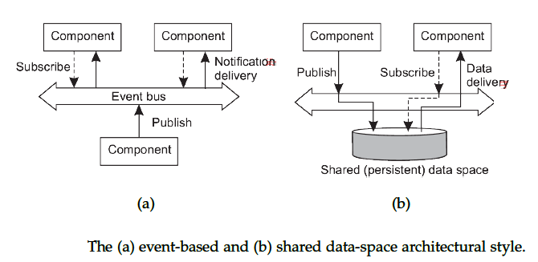
Event–based Architecture
Event based architecture supports publish-subscribe communication
Publisher: components that announce data to be shared
Subscriber: components register their interest for published data.
Decouples sender and receiver (asynchronous communication)
Both parties don’t need to be up at the time of communication
Event can be considered as “a significant change in state”

Slide 13
Con’t
Components:
Can be an instance of a class or simply a module.
Connectors:
Event buses

Slide 14
System Architectures
The software components, their interactions, and their placement leads to an instance of a software architecture, also called a system architecture.
System architecture are of three types:
Centralized - most components located on a single machine
Decentralized - most machines have approximately the same functionality
Hybrid - some combination

Slide 15
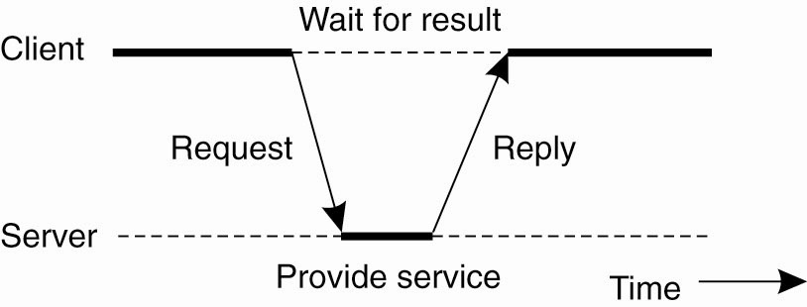
Centralized Architecture
In the basic client-server model, processes in a distributed system are divided into two (possibly overlapping) groups.
Server:- is a process implementing a specific service E.g File server
Client:-is a process that requests a service
Clients and servers can be on different machines
Clients follow request/reply model with respect to using services
Figure General interaction between a client and a server.

Slide 16
Cont...
Communication between a client and a server can be implemented by :
Connectionless protocol when the underlying network is fairly reliable like local-area networks (UDP)
Connection-oriented protocol in WANs, (TCP)
Connectionless communication is efficient
Simply packages a message for the server, identifying the service it wants, along with the necessary input data
But, it is hard for a sender to detect if the message is successfully received
Failure of any sort means no reply
Possibilities:
Request message was lost
Reply message was lost
Server failed either before, during or after performing the service

Slide 17
Cont ...
Common approach to lost request in connectionless communication:
Re-transmission (resending request )
Good for idempotent operations, i.e., operations that could be repeated more than once without harm. E.g., “Return current value of X”
Not good for non idempotent operations like “ increase value of x by 100”
Because, may result in performing the operation twice
In this case reporting an error is appropriate, than resending
For these reason many distributed systems use connection-oriented protocols
Not good enough in LAN as it is slow
However, it fits the unreliable WAN environment
Example, Virtually all internet applications are based on TCP/IP connections

Slide 18
Logical Architecture vs. Physical Architecture
Layer and tier are roughly equivalent terms, but
Layer typically implies software and
Tier is more likely to refer to hardware.
Logical organization is not physical organization.
Physical architecture may or may not match the logical architecture.
Meaning, logically separate components might reside on single machine or on different machines
Clients and servers could be placed on the same node, or be distributed according to several different topologies.
Single-Tier Architecture: dumb terminal/mainframe configuration
Two-Tier Architecture: client/single server configuration
Three-Tier Architecture: each layer on separate machine
Two-tier and three-tier are the most common

Slide 19
Two-Tiered Architecture
Where are the three application-layers placed?
On the client machines, or on the server machines?
A range of possible solutions:
Thin-Client- A client machine only implements (part of) the user-interface level
A server machine implementing the rest, i.e, the processing and data levels
Pros: easier to manage, more reliable, client machines don’t need to be so large and powerful
Con: perceived performance loss at client
Fat-Client - All user interface, application processing and some data resides at the client
Pros: reduces work load at server;
More scalable
Cons: harder to manage by system admin,
Less secure
Other solutions in between thin-client and fat-client

Slide 20
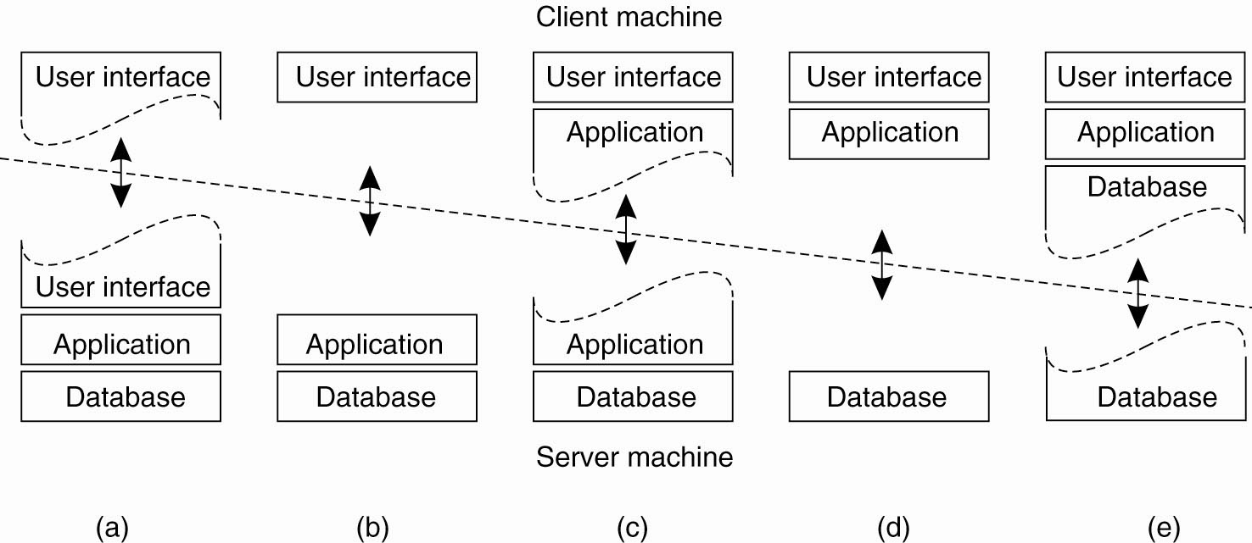
Two-tiered Architectures
Thin client --------→ Fat-client

Slide 21
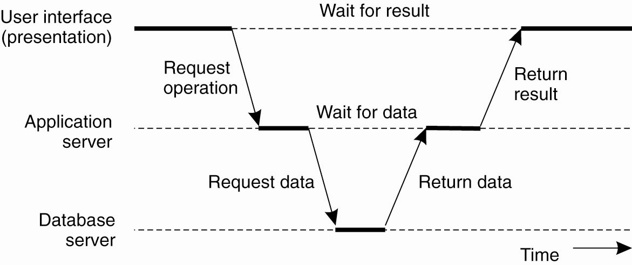
Three-tiered
The server tier in two-tiered architecture becomes more and more distributed
A single server is no longer adequate for modern information systems
This leads to three-tiered architecture
Server may acting as a client
Three-tiered: each of the three layers corresponds to three separate machines.

Slide 22
Decentralized Architectures
Placing logically different components on different machines is called vertical distribution(VD)
User-interface, Processing components and a data level are on different machine
It is similar with the concept of vertical fragmentation in distributed database where
Tables are split into column wise and distributed on different machines
The advantage of VD is that each machine can be tailored for specific type of function

Slide 23
Cont…
An alternative to VD is horizontal distribution(HD)
A client or server may be physically split up into logically equivalent parts
Each part operates on its own share of the complete data set,
This results in balanced work load
Again this one is similar with that of horizontal fragmentation in distributed database where
Tables are split row wise, and subset of rows distributed onto different machines
Peer-to-peer systems are a class of modern architectures that support horizontal distribution.
The functions that need to be carried out are represented by every process that constitute the distributed system

Slide 24
Peer-to-peer systems
P2P systems partitions tasks or work loads between peers
Often, the processes that constitute the system are all equal
Nodes act as both client and server;
Much of the interaction is symmetric.
Advantages of peer-to-peer system
Have better load balancing
More resistant to denial-of-service attacks,
But, harder to manage than client-server systems.

Slide 25
Overlay network
Nodes of the P2P distributed system are connected using overlay network
It is network that is built on top of another network
Nodes are formed by the processes of the network.
Overlay networks in the P2P system:
Define the structure between nodes in the system.
Allow nodes to route requests to locations that may not be known at time of request.
The main question for peer-to-peer system is
How to organize the processes in an overlay network
Their organization can be:
Unstructured P2P:
Structured P2P:
Hybrid P2P:

Slide 26
Unstructured P2P architecture
Largely relying on randomized algorithm to construct the overlay network
Each node has a list of neighbours, which is more or less constructed in a random way
One challenge is how to efficiently locate a needed data item
The two common approaches are
Flooding
Random walk

Slide 27
Cont…
Flooding:
Issuing node u passes request for data d to all neighbors.
Request is ignored when receiving node had seen it before. Otherwise, v searches locally for d (recursively).
Return d if found, Otherwise forward the request to the neighbors
However, this approach causes high signalling traffic over the network
May be limited by a Time-To-Live: a maximum number of hops.

Slide 28
Cont…
Random walk:
Issuing node u passes request for d to randomly chosen neighbor, v.
If v does not have d, it forwards request to one of its randomly chosen neighbors, and so on.

Slide 29
Structured P2P
Nodes are organized following a specific distributed data structure.
The most common one is distributed hash table (DHT)
In such systems, each data item is uniquely associated with a key, in turn used as an index.
Each node is responsible to store data that are associated with subset of these keys
P2P system now responsible for storing (key, value) pairs
Looking up data d with key k means routing request to node with identifier k.
Example
chord

Slide 30
Hybrid Architectures
Many distributed systems require properties from both client-server and peer-to-peer architectures.
So, they put together features from both centralized and decentralized architectures, resulting in hybrid architectures.
Some nodes are appointed special functions in a well organized fashion
Examples
Edge-server systems: placed at the edge of enterprise network
E.g., ISPs, which act as servers to their clients, but cooperate with other edge servers to host shared content
Collaborative distributed systems:
E.g., BitTorrent, which supports parallel downloading and uploading of chunks of a file.
First, interact with client-server system to download the torrent file, and then operate in decentralized manner.

Slide 31

.

Slide 32
End of Chapter 2

