Slide 1
Chapter 4- Naming

Slide 2
Naming
Names play a critical role in all computer systems
Used to share resources
Used to refer to locations
To uniquely identify entities in a distributed system, and more
A name in a distributed system is a string of bits or characters that is used to refer to an entity.
hosts, printers, disks, files, processes, web-pages
An important issue in naming is that a name can be resolved to the entity it refers to.
Name resolution system thus allows a process to access the named entity.
In distributed system, the implementation of a naming system is often distributed across multiple machines.
How distribution is done has impact on the performance

Slide 3
Cont...
Entities can be operated on.
E.g. Printer provides operations for printing, pausing, cancelling etc.
An entity such as a network connection may provide operations for sending and receiving data, setting quality-of-service parameters, requesting the status, and so forth.
To operate on an entity, it is necessary to access it, for which we need an access point.
An access point is yet another, but special, kind of entity in a distributed system.
The name of an access point is called address
E.g. A host running a specific server, its address formed by the combination of IP address and port number
An entity may have multiple access points, and its access point may change
Thus, the address of an access point should not be used to name the entity
For example, when a mobile computer moves to another location, it is often assigned a different IP address than the one it had before.
Likewise, when a person moves to another city or country, it is often necessary to change telephone numbers as well.
In a similar fashion, changing jobs or Internet Service Providers, means changing your e-mail address.
Notes:
In a distributed system, a typical example of an access point is a host running a specific server, with its address formed by the combination of, for example, an IP address and port number (i.e., the server's transport-level address).
An entity may change its access points in the course of time. For example. when a mobile computer moves to another location, it is often assigned a different IP address than the one it had before.
Because an access point is tightly associated with an entity, it would seem convenient to use the address of an access point as a regular name for the associated entity. Nevertheless, this is hardly ever done as such naming is generally very inflexible and often human unfriendly.

Slide 4
Cont...
Therefore, what we need is a name for an entity that is independent from its addresses
i.e., a location-independent name
A location-independent name for an entity E , is independent from the addresses of the access points offered by E .
Identifier
Identifier is a name having the following properties:
P1: Each identifier refers to at most one entity
P2: Each entity is referred to by at most one identifier
P3: An identifier always refers to the same entity (prohibits reusing an identifier)

Slide 5
The Central Theme of Naming
How to resolve names and identifiers to addresses
In principle, a naming system maintains a name-to-address binding in the form of mapping table
However, a centralized table in a large network is not going to work
The name resolution as well as the table is often distributed across multiple machines
E.g., www.admu.edu.et is divided into multiple parts, and several DNS servers are used during the resolution
Will discuss the resolution of the following names
Flat names, structured names, attribute-based names

Slide 6
Flat Names (Identifiers)
An identifier is often a string of random bits
Does not contain any information on how to locate the access point of its associated entity
Problem:- given an essentially unstructured name (e.g., an identifier), how can we locate its associated access point?
Simple solutions (broadcasting)
Home-based approaches
Distributed Hash Tables (structured P2P)
Hierarchical location service

Slide 7
Simple solutions
Two simple solutions to locate the entity given an identifier
Broadcasting and multicasting (e.g., ARP)
Broadcast the ID, requesting the entity to return its current address.
Can never scale beyond local-area networks
Requires all processes to listen to incoming location requests
Forwarding pointers
A popular approach to locate mobile entities
When an entity moves, it leaves a pointer to where it went
Update a client’s reference when present location is found
Advantage:
Dereferencing can be made transparent to client by following the pointer chain

Slide 8
Forwarding Pointers
Disadvantages
Geographical scalability problems:
Chain can be very long for highly mobile entities
Long chains are not fault tolerant
High latency when dereferencing
Need chain reduction mechanisms
Update client's reference when the most recent location is found

Slide 9
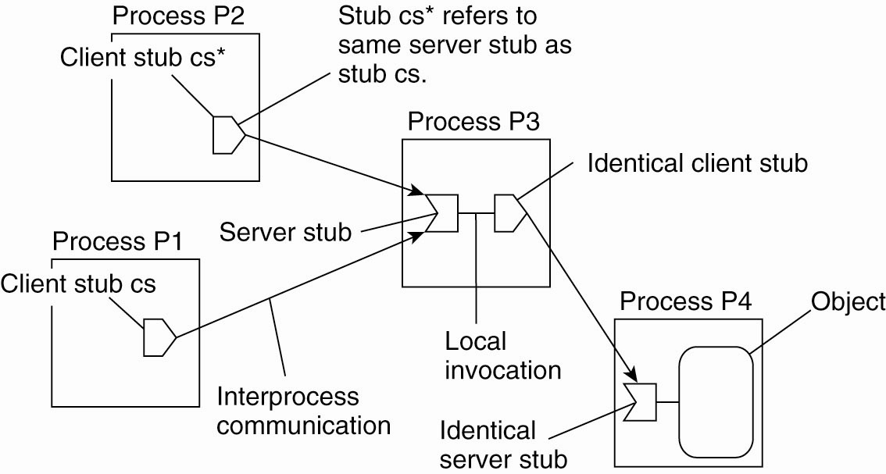
Forwarding Pointers
Figure 5-1. The principle of forwarding pointers using (client stub, server stub) pairs.

Slide 10
Home-based solution
Let the home keep track where the entity is.
Entity’s home address is registered at a naming service.
In practice, the home location is often chosen to be the place where an entity was created.
The home registers the foreign address of the entity.
Clients always contact the home first, and then continue with the foreign location.

Slide 11
Home-Based Approaches
Figure 5-3. The principle of Mobile IP.

Slide 12
Problems With Home-Based Approaches
Home address has to be supported for entity’s lifetime.
Home address is fixed.
Unnecessary burden when the entity permanently moves.
Poor geographical scalability.
Entity may be next to client.

Slide 13
Distributed Hash Table (DHT)- Chord
In DHT-based system,
Each node has an m-bit random identifier
Each entity has an m-bit random key
An entity with key k is located on a node with the smallest identifier that satisfies id >= k, denoted as succ(k)
The main issue in DHT-based systems is to efficiently resolve a key k to the address of succ(k).
Two approaches:
linear approach and finger table
In linear approach, let each node p keep track of the successor succ(p+ 1) as well as its predecessor pred(p)
whenever a node p receives a request to resolve key k, it will simply forward the request to one of its two neighbours
Notes:
This node is referred to as the successor of k and denoted as succ(k).

Slide 14
Finger table
Each node p maintains a finger table FTp[] with at most m entries:
FTp[i] = succ (p+ 2^{i−1})
Note: FTp[i] points to the first node succeeding p by at least 2^{i−1}
To look up a key k, node p forwards the request to node q with index j in the figure table satisfying
q= FTp[ j] ≤ k< FTp[ j+1]
If p < k < FTp[1], the request is also forwarded to FTp[1].

Slide 15
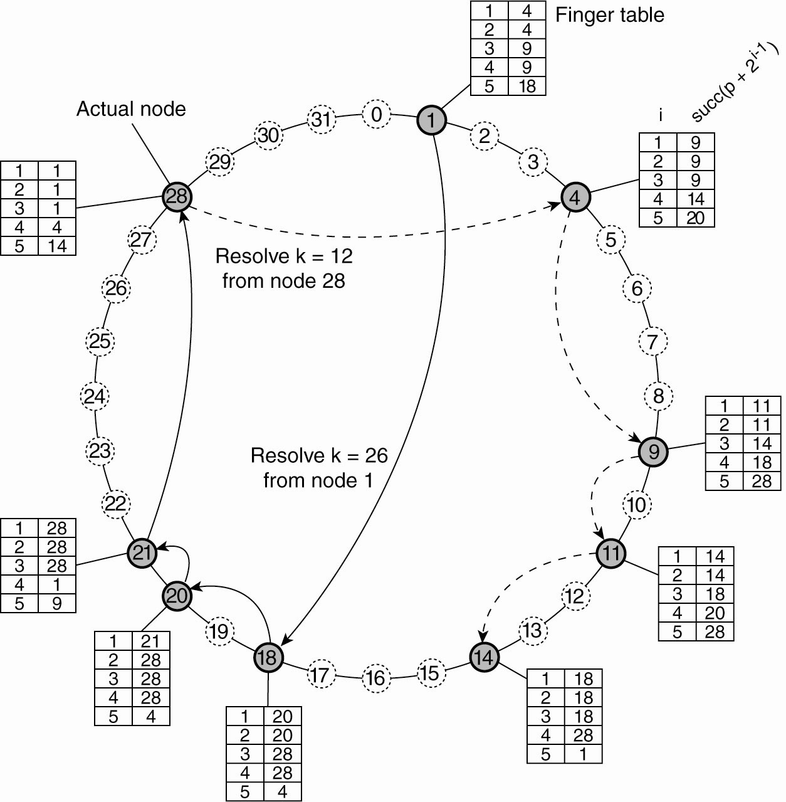
Distributed Hash Tables
Figure 5-4. Resolving key 26 from node 1 and key 12 from node 28 in a Chord system.

Slide 16
Exploiting Network Proximity
Problem:
The logical organization of nodes in the overlay may lead to erratic message transfers in the underlying Internet
Node k and node succ(k +1) maybe very far apart.
Solutions:
Topology-aware node assignment: When assigning an ID to a node, make sure that nodes close in the ID space are also close in the network.
Proximity routing: Maintain more than one possible successor, and forward to the closest.
Proximity neighbour selection: When there is a choice of selecting who your neighbour will be, pick the closest one.

Slide 17
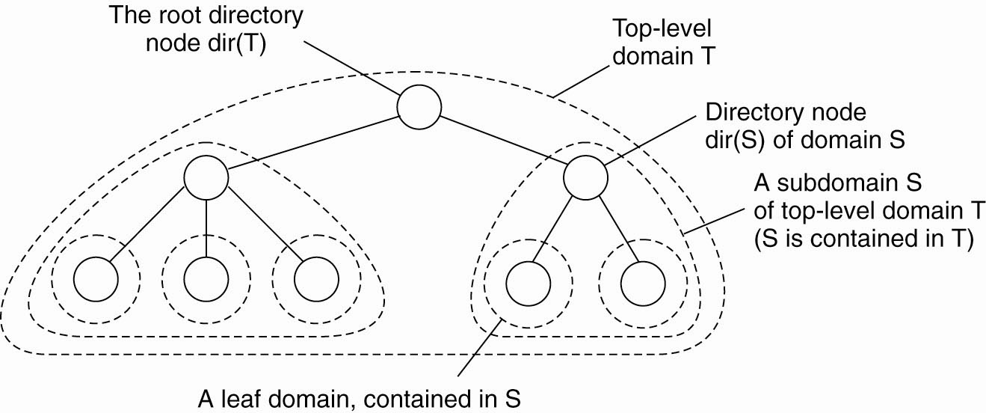
Hierarchical Location Services
The basic idea is to build a large-scale search tree for which the underlying network is divided into hierarchical domains.
Each domain is represented by a separate directory node.
Leaf domains typically correspond to a local-area network or a cell.
The root (directory) node knows all the entities.
Each entity currently in a domain D is represented by a location record in the directory node dir(D) which is the entity’s current address or a pointer.

Slide 18
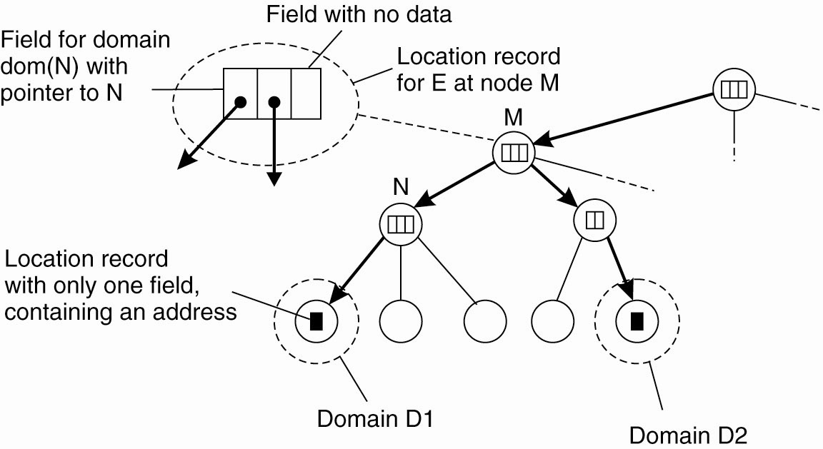
Hierarchical Approaches- organization
The address of an entity E is stored in a leaf or intermediate node.
Intermediate nodes contain a pointer to a child if the sub-tree rooted at the child stores an address of the entity.
An entity may have multiple addresses (e.g., if it is replicated).
An example of storing information of an entity having two addresses in different leaf domains.

Slide 19
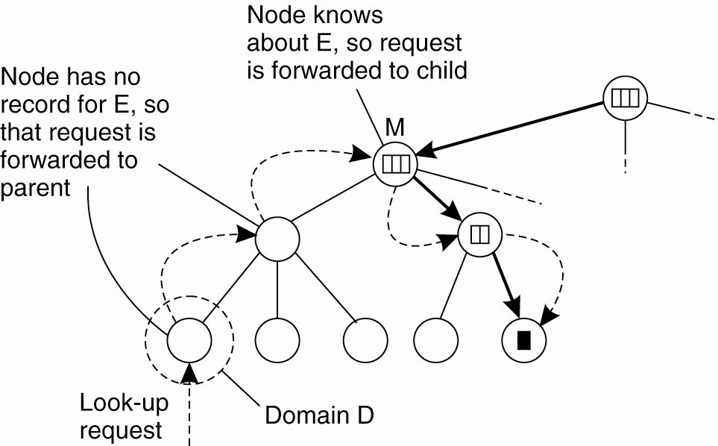
Hierarchical Approaches - Lookup Operation
Start lookup at local leaf node.
If node knows about entity E, follow downward pointer, otherwise go up.
Upward lookup always stops at root.
Looking up a location in a hierarchically organized location service.

Slide 20
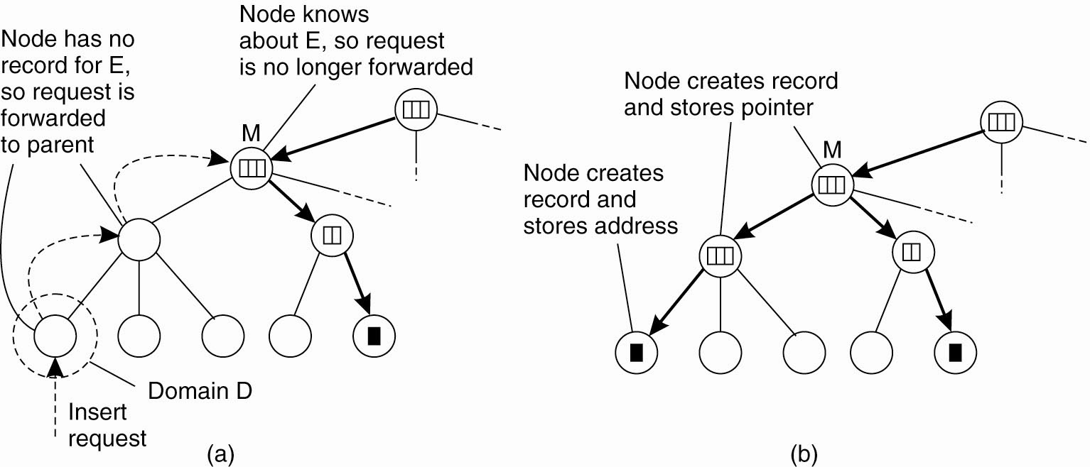
Hierarchical Approaches – Insert operation
Consider an entity E that has created a replica in leaf domain D for which it needs to insert its address.
[A]. An insert request is forwarded to the first node that knows about entity E.
[B]. A chain of forwarding pointers to the leaf node is created.

Slide 21
Structured Naming
Flat names are not convenient for humans to use
As a result, naming systems often support structured names that
Are composed from simple, human-readable names
E.g., file names, Internet domain names
Structured names are often organized into what is called a name space
Holds a collection of valid names recognized by a particular service.
Examples: Phone numbers, DNS, URL etc
It is represented by a labelled, directed graph with two types of nodes, leaf node and directory node

Slide 22
Con’t
A leaf node represents a named entity and has the property that it has no outgoing edges.
A leaf node generally stores information on the entity it is representing–for example, its address–so that a client can access it.
A directory node has a number of outgoing edges, each labeled with.
Each node in a naming graph is considered as yet another entity in a distributed system, and, in particular, has an associated identifier.
A directory node stores a table in which an outgoing edge is represented as a pair (node identifier, edge label). Such a table is called a directory table.

Slide 23
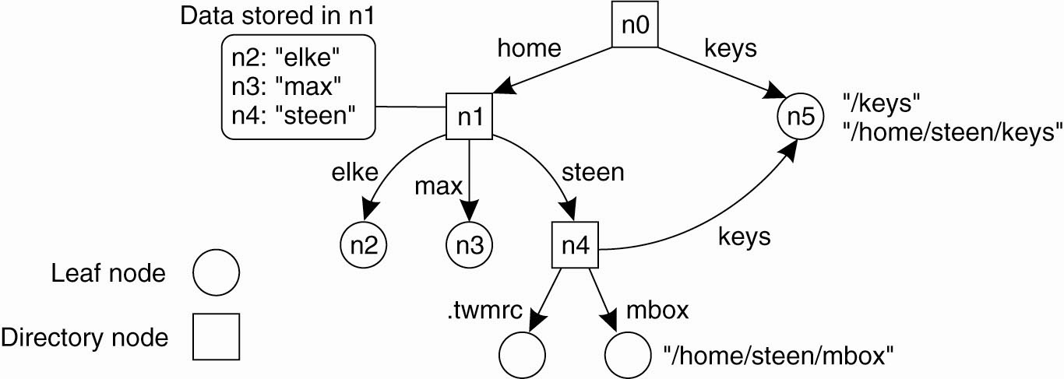
Con’t
A general naming graph with a single root node.
Note:- A directory node contains a (directory) table of (node identifier, edge label) pairs.

Slide 24
Name Resolution
Name spaces offer a convenient mechanism for storing and retrieving information about entities by means of names.
More generally, given a path name, it should be possible to look up any information stored in the node referred to by that name.
The process of looking up a name is called name resolution.
Name resolution refers to the process of looking up a name.
To resolve a name we need a directory node.
Problem:
How do we actually find that (initial) node?
Solution:
Closure Mechanism: the mechanism to select the implicit context from which to start name resolution.
Examples:
- www.admu.edu.et: start at a DNS name server
- /home/steen/mbox: start at the local file server
Start from well know root directory, or start from home directory
Notes:
Knowing how and where to start name resolution is generally referred to as a closure mechanism. Essentially, a closure mechanism deals with
selecting the initial node in a name space from which name resolution is to start

Slide 25
Linking and Mounting
Aliases are commonly used in a name space
An alias is another name for the same entity.
In naming graphs, there are basically two different ways to implement an alias : hard link and a symbolic link
Hard Link
Multiple absolute path names refer to the same node in a naming graph.
names resolved by following a specific path in a naming graph from one node to another.
For example in the above diagram, in which node n5 can be referred to by two different path names. Both path names /keys and /home/steen/keys
Symbolic Link
It represent an entity by a leaf node, say N, but instead of storing the address or state of that entity, the node stores an absolute path name.
For example, as it can be shown in the following figure the path name /home/steen/keys, which refers to a node containing the absolute path name /keys, is a symbolic link to node n5.

Slide 26
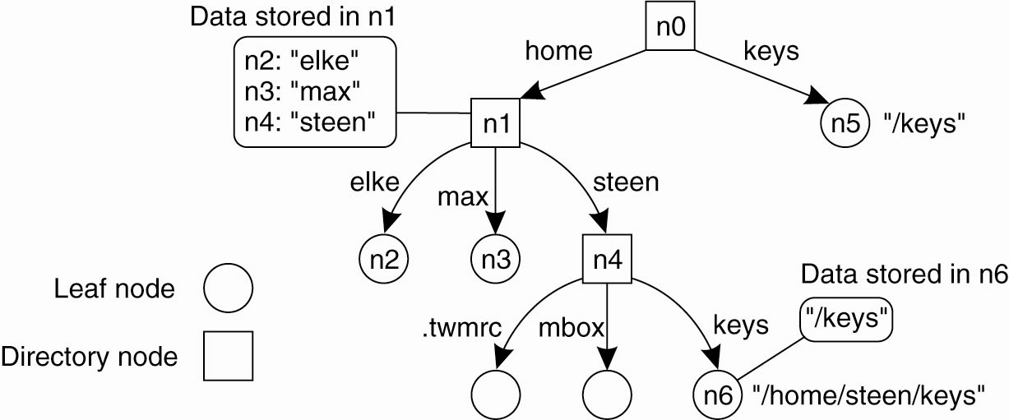
Linking and Mounting
The concept of a symbolic link explained in a naming graph.

Slide 27
Linking and Mounting
A collection of name spaces can be distributed across different machines.
Each name space implemented by separate servers
To mount a foreign name space in a distributed system requires at least the following information:
The name of an access protocol.
The name of the server.
The name of the mounting point in the foreign name space.

Slide 28
Linking and Mounting
The organization of a file system on the client machine is partly shown in the following figure.
The root directory has a number of user-defined entries, including a subdirectory called /remote.
This subdirectory is intended to include mount points for foreign name spaces such as the user’s home directory at VU University.
To this end, a directory node named /remote/vu is used to store the URL nfs ://its.cs.vu.nl/home/steen.
Now consider the name /remote/vu/mbox.
This name is resolved by starting in the root directory on the client’s machine and continues until the node /remote/vu is reached.
The process of name resolution then continues by returning the URL nfs ://its.cs.vu.nl/home/steen, in turn leading the client machine to contact the file server its.cs.vu.nl by means of the NFS protocol, and to subsequently access directory /home/steen.
Name resolution can then be continued by reading the file named mbox in that directory, after which the resolution process stops.

Slide 29
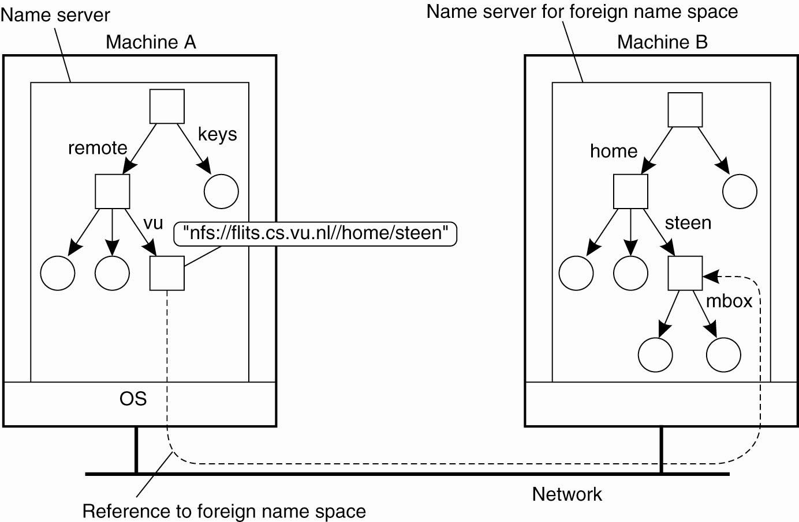
Linking and Mounting
Mounting remote name spaces through a specific access protocol.

Slide 30
Implementation of a Name Space
A name space is often implemented by name servers
In LAN, a single name server is often good enough
In large-scale distributed system, the implementation of a name space is often distributed over multiple name servers
A name space for large-scale distributed systems is often organized hierarchically
Global layer
often stable, represents organizations or groups of organizations
Administrational layer
Represents groups of entities in a single organization or admin. unit
Managerial layer
Nodes often change frequently, e.g., hosts in a local network
May be managed by system administrators or end users

Slide 31
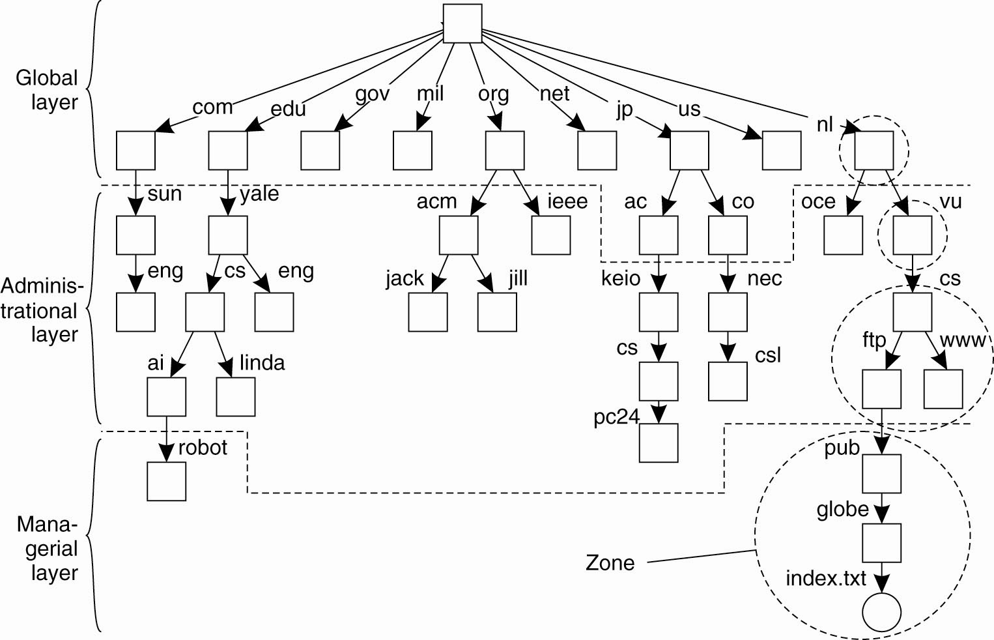
Name Space Distribution
An example partitioning of the DNS name space, including Internet-accessible files, into three layers.

Slide 32
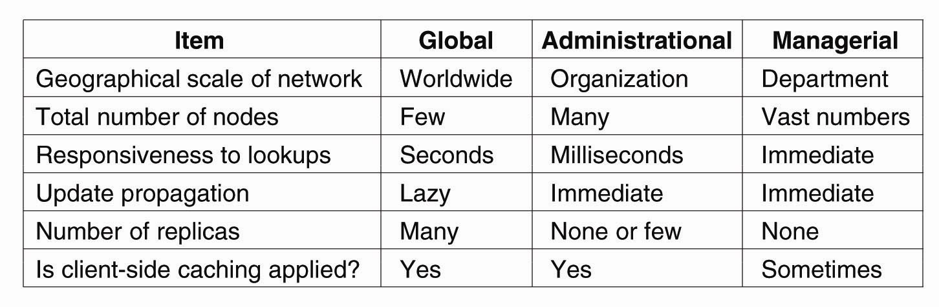
Name Space Distribution
A comparison between name servers for implementing nodes from a large-scale name space partitioned into a global layer, an administrational layer, and a managerial layer.

Slide 33
Implementation of Name Resolution
Assume that the (absolute) path name
root: <nl, vu, cs, ftp> is to be resolved.
Using URL notation, this path would correspond to ftp://cs.vu.nl
Two ways to implement name resolution
Iterative name resolution
Hands over the complete name to the root name server.
Intermediate result(i.e., the address of the next name server in the hierarchy) is returned back to the client’s name resolver.
The resolution process continues iteratively until the complete path is resolved.
Recursive name resolution
Intermediate results are passed to next name server in the hierarchy.
This process continues recursively until the complete path is resolved.

Slide 34
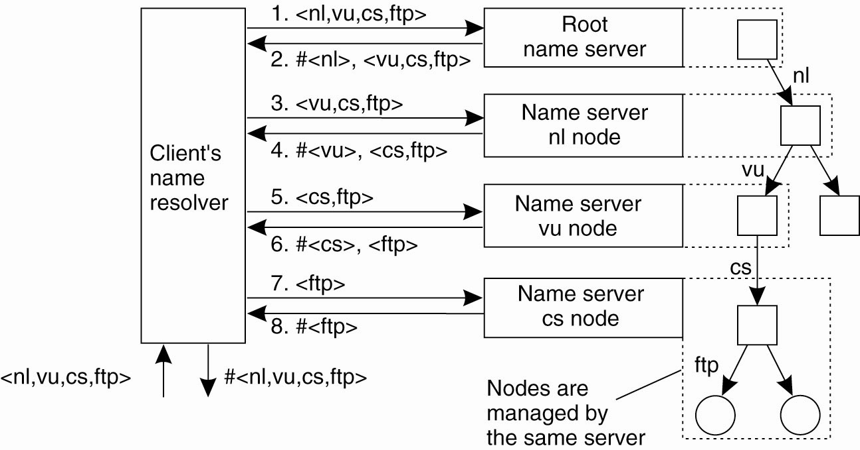
Implementation of Name Resolution
The principle of iterative name resolution.

Slide 35
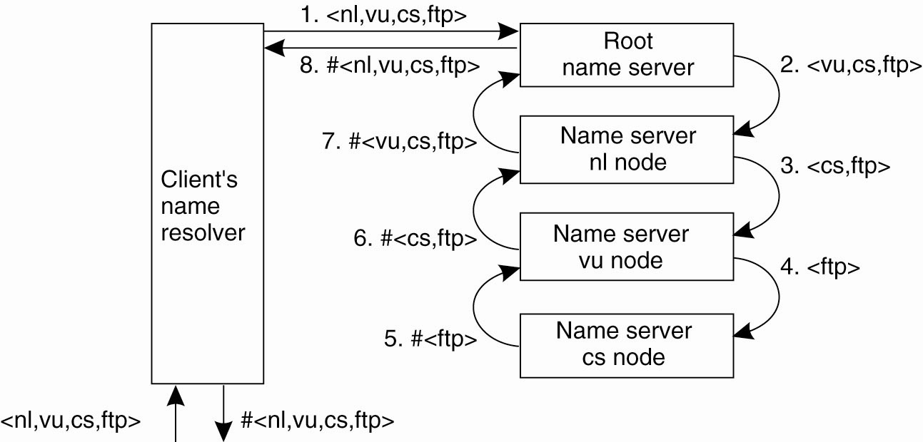
Implementation of Name Resolution
The principle of recursive name resolution.

Slide 36
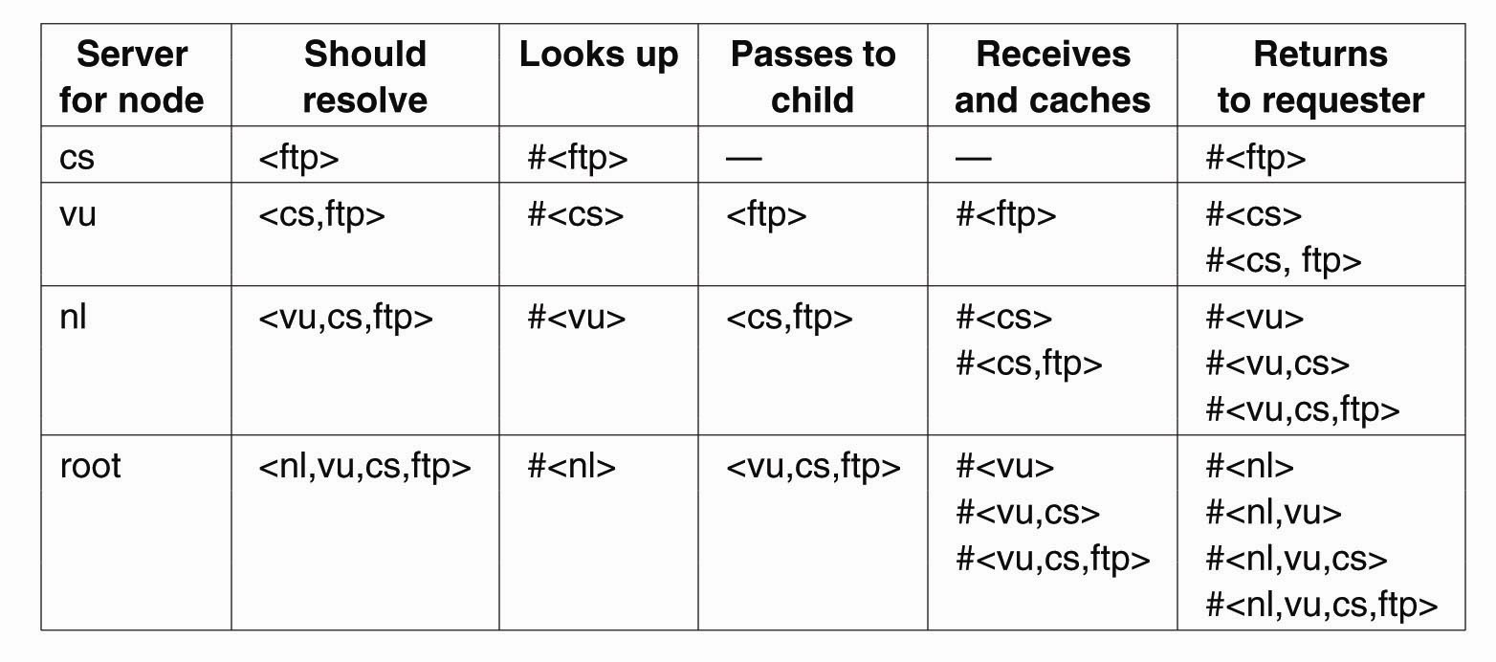
Iterative Vs Recursive Resolution
Recursive name resolution of <nl, vu, cs, ftp>.
Name servers cache intermediate results for subsequent lookups.

Slide 37
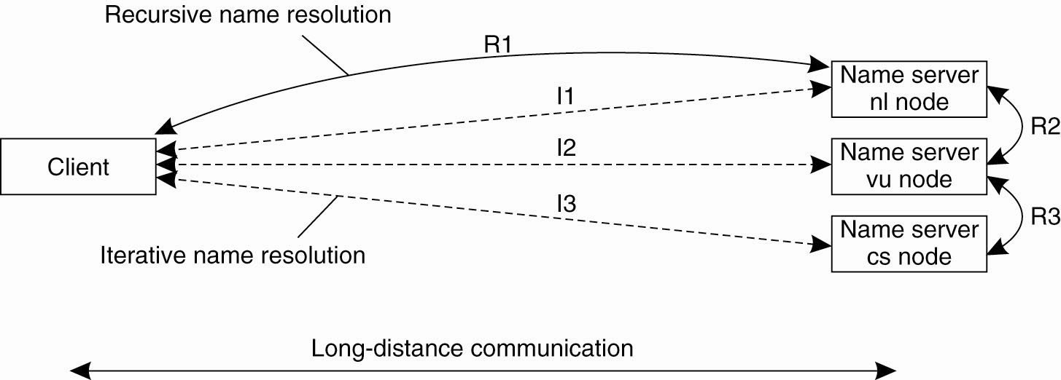
Iterative Vs Recursive Resolution
The comparison between recursive and iterative name resolution with respect to communication costs.

Slide 38
Domain name system
DNS is one of the largest distributed naming services in use today.
Used for looking up host addresses and mail servers.
The DNS name space is hierarchically organized as a rooted tree.
A sub-tree is called a domain;
a path name to its root node is called domain name.
In practice, the DNS namespace can be divided into a global layer and administrational layer.
The managerial layer, which is generally formed by local file systems, is formally not part of DNS.
A node is the DNS name space often represents several entities at the same time, e.g., a domain and a zone.
The content of a node is formed by a collection of resource records.

Slide 39
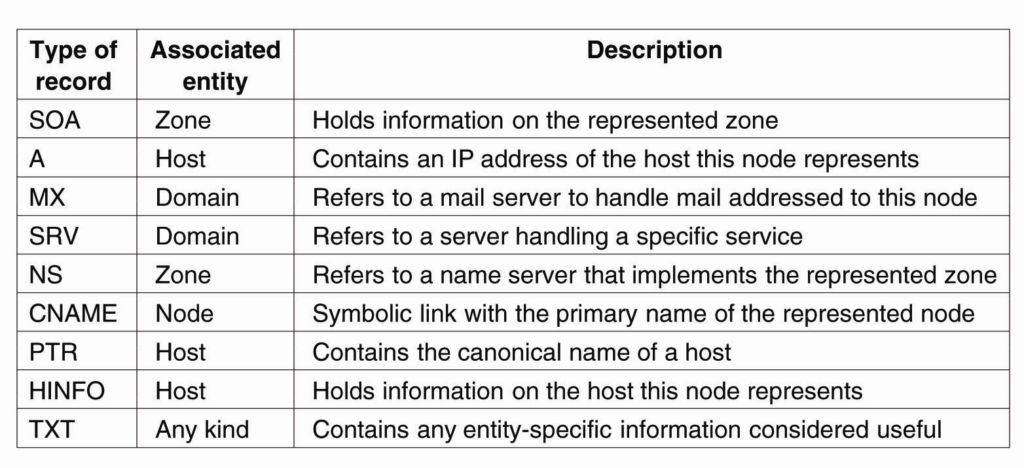
The DNS Name Space
The most important types of resource records forming the contents of nodes in the DNS name space.

Slide 40
Attribute Based Naming
Attribute-based naming name and lookup entities by means of their attributes
Also known directory service (yellow page)
Attribute-based naming
Each entity is associated with a collection of attributes
The naming system provides one or multiple entities that match a user’s description
Problem
Lookup operations can be extremely expensive,
As it demands to match requested attribute values, against actual attribute values
Done by inspecting all entities (in principle)

Slide 41
End of Lecture 5

