Slide 1
Chronic Kidney Disease Prediction
Ipek Kizil

Slide 2
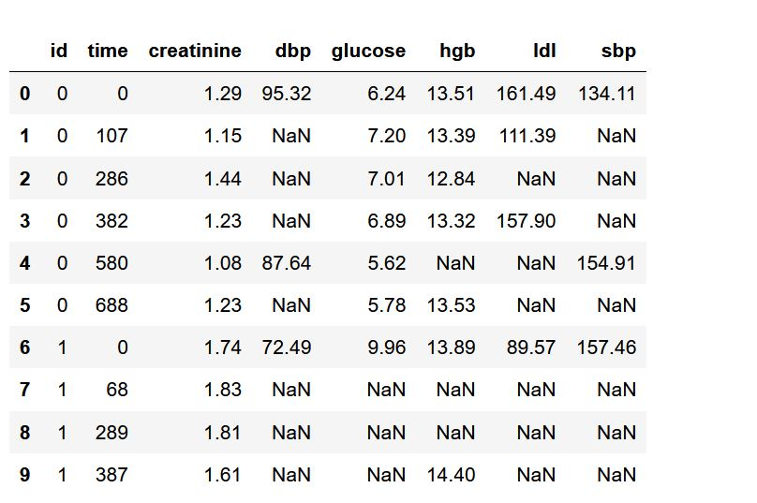
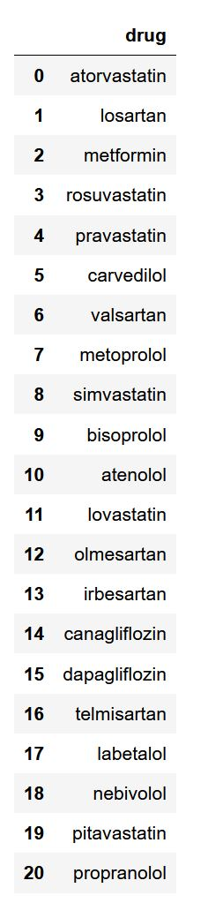
Overall Data Statistics
300 patients
5 different biomarker
lab measurements
21 different drug intake information
CKD progress statement

Slide 3
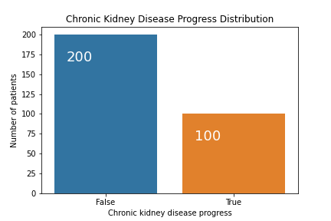
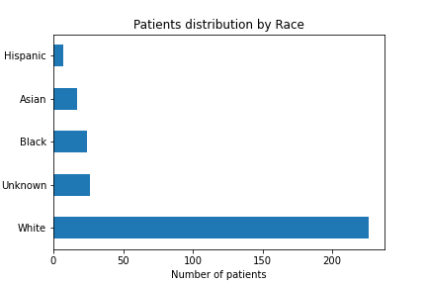
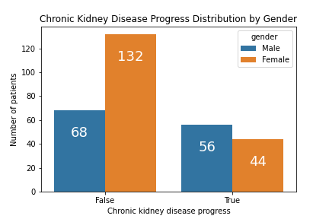
Patient Statistics

Slide 4
Features
Time in days
Patient’s biomarkers measured at the corresponding time (creatinine, diastolic blood pressure, systolic blood pressure, hemoglobin level, glucose, low-density lipoprotein )
Whether patient progress in the CKD stage or not

Slide 5
Data Preprocessing
Data Interpolation
  Data points occurs at the irregular time points. Thus, I have used forward linear interpolation to standardize the data for machine learning algorithms
Data normalization
  Different features had different magnitudes. Thus, I have standardized the data by using min-max scaling approach.
Train test split
  I’ve splited data into training and test with non-overlapping patient ids

Slide 6
Approach
To predict whether a patient will progress in CKD staging given their past longitudinal information, I followed two approaches:
  First approach, I extracted features from the longitudinal data for each patient as time series and applied standard LSTM.
  Second approach, in addition to first approach I added static data to the last state of LSTM before classification.

Slide 7
Approach (Cont.)
Since the data has the time series characteristics, I have used RNN/LSTM.
Since the time dimension is very high, e.g. 700, I have used LSTM which overcomes the gradient vanishing and exploding problems.
Model characteristics:
  Average pooling with window size k.
  2-layer LSTM where each layer is followed by a layer normalization.
  The last LSTM state is fed into a classification layer.
  Each LSTM layer includes dropout to reduce overfitting.

Slide 8
Training
I have used binary cross entropy loss as training objective
Due to class imbalance, weighting for each class is used.
Adam optimizer with learning rate 0.001 is used.
Weight decay with 0.0001 weight has been used to reduce overfitting.
Early stopping is used to end training when training objective does not improve for 5 epochs.
Max epoch is 100, mini-batch size is 64.

Slide 9
Evaluation Setting
I have used k-fold cross validation (k=5). All the results are average over each iteration.
Metrics for evaluation: Accuracy, Precision and Recall
  I have used precision and recall additional to accuracy since there is a data imbalance.
  Precision and Recall is evaluated for class 1 which shows that patient’s chronic kidney disease will progress.

Slide 10
Results
Data Setting: Only Biomarkers
average accuracy cross-validation 0.69
average precision cross-validation 0.53
average recall cross-validation 0.64
Data Setting: Biomarkers + Medication History
average accuracy cross-validation 0.64
average precision cross-validation 0.48
average recall cross-validation 0.53

Slide 11
Results
Data Setting: Biomarkers + Medication History + Patient Features
average accuracy cross-validation 0.63
average precision cross-validation 0.47
average recall cross-validation 0.51

Slide 12
Conclusion
The results are only xxx percent better than chance level.
The main problem is overfitting due to lack of data.
Data imbalance makes this problem even harder.
Irregularly spaced time series is another challenge to deal with.

