Slide 1

SMART INDIA HACKATHON 2026
AirOps
AI-Powered Air Operations Decision Support
Problem Statement ID – 26249
Problem Statement Title – Air Power – Predictive Maintenance & Fleet Availability
Theme – Transportation & Logistics
PS Category- Software
Team ID - 143430
Team Name - THULYA

Slide 2
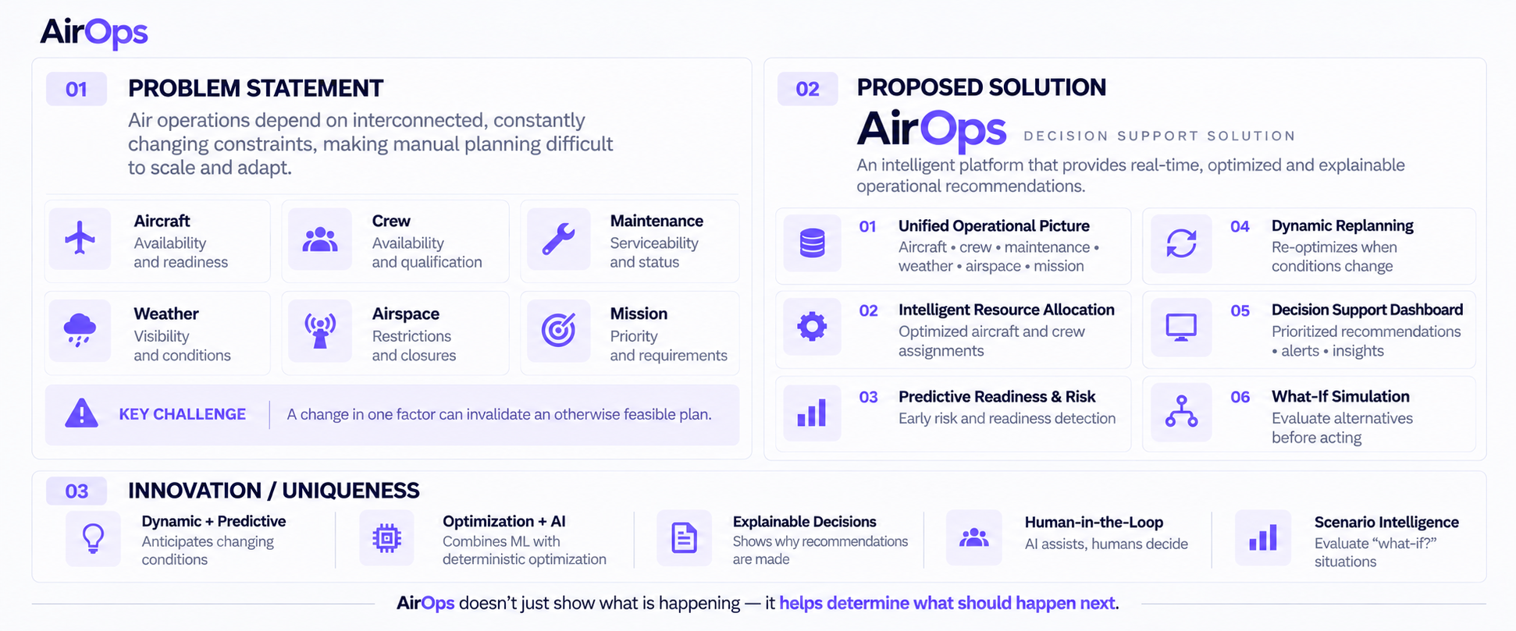
AirOps – AI Powered Air Operations Decision Support
THULYA

Slide 3
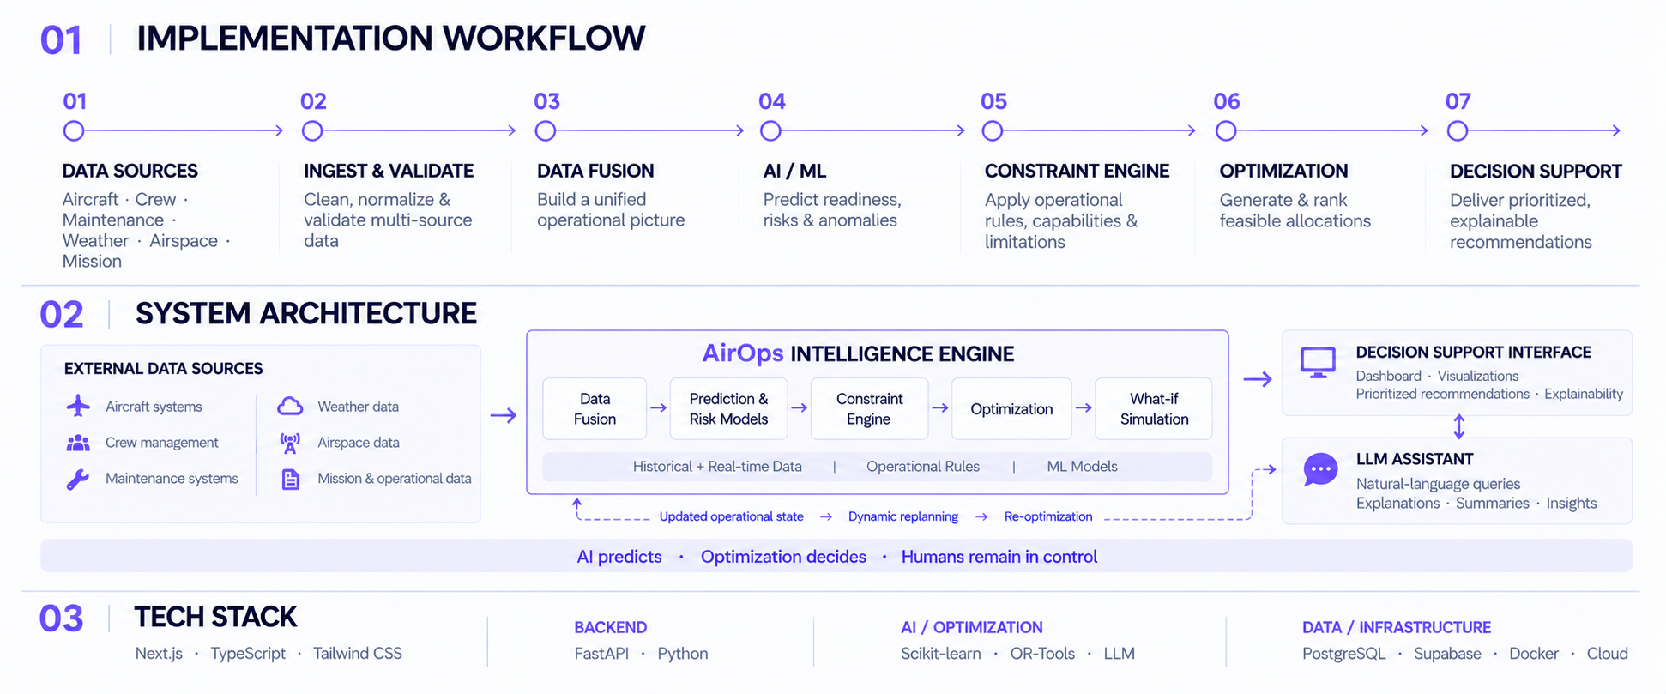
TECHNICAL APPROACH
THULYA

Slide 4
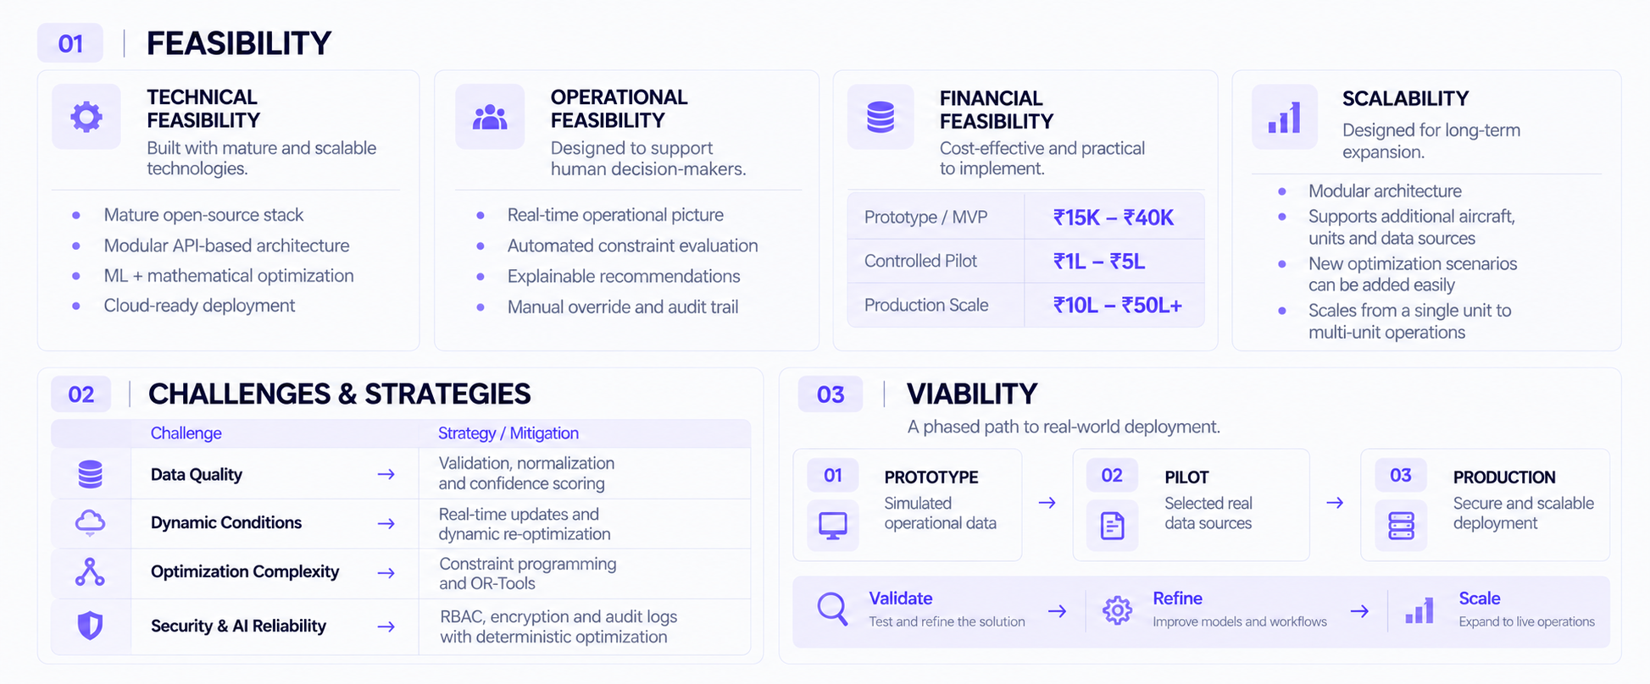
FEASIBILITY AND VIABILITY
THULYA

Slide 5
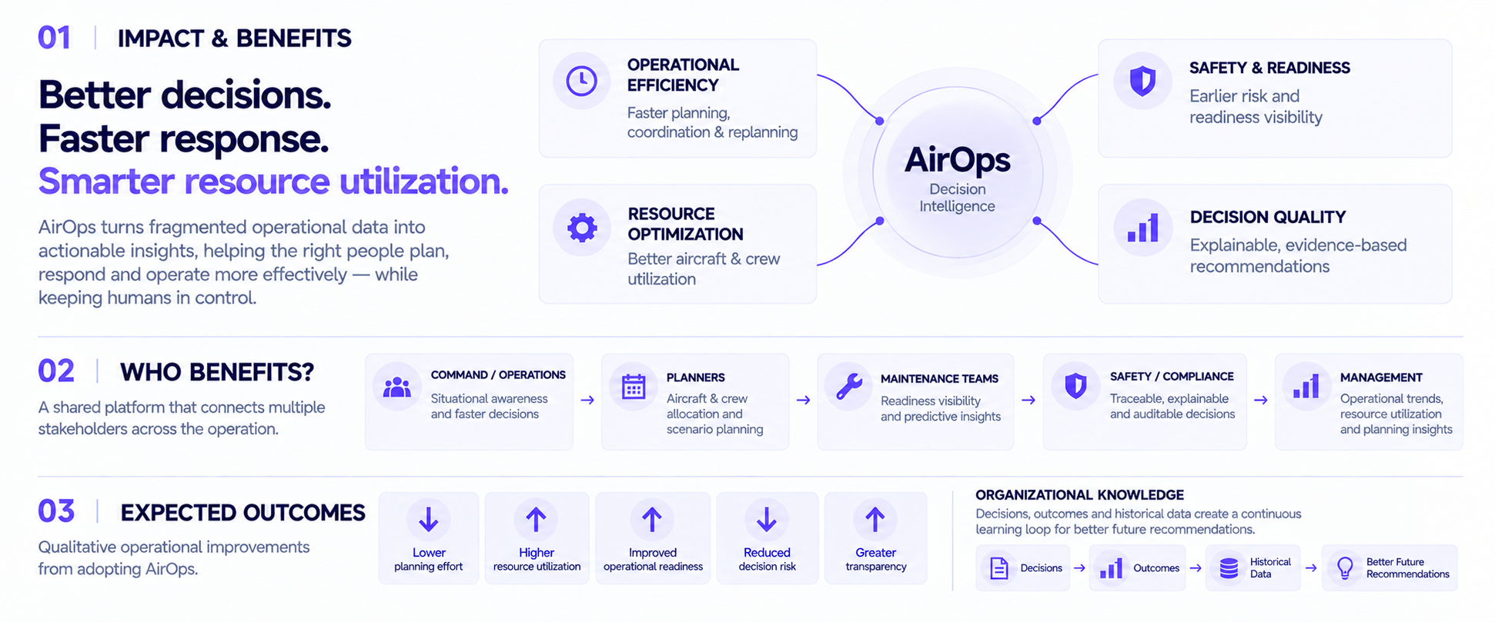
IMPACT AND BENEFITS
THULYA

Slide 6
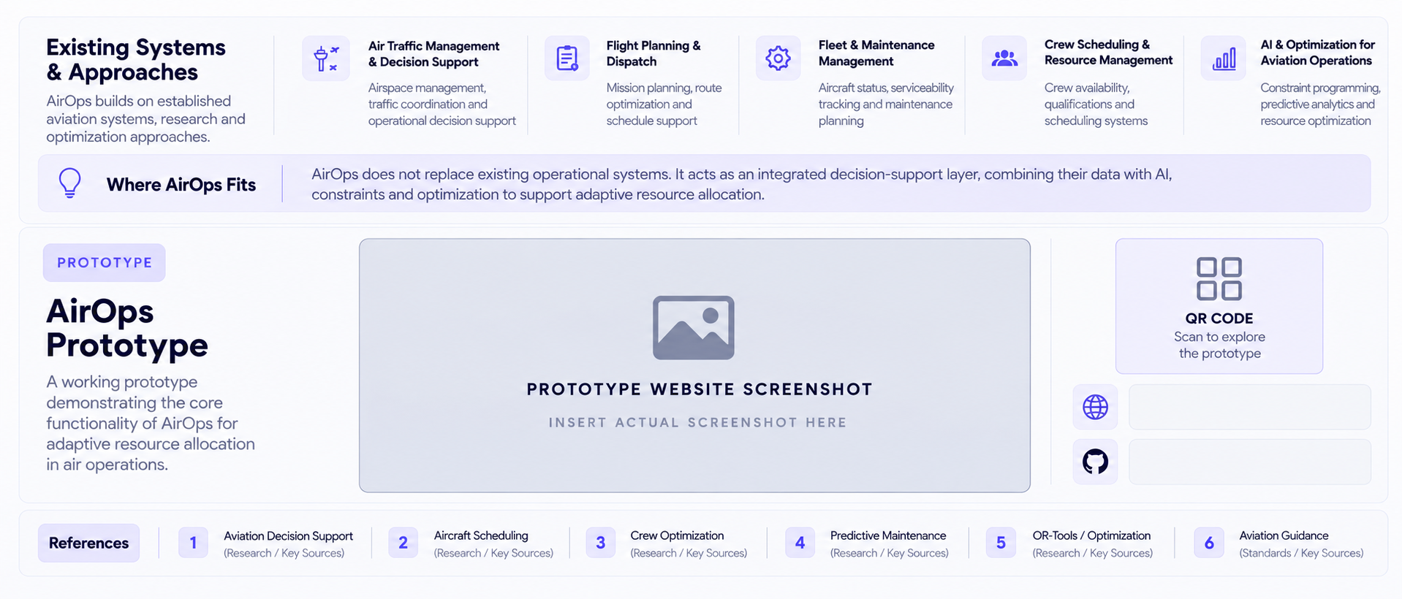
RESEARCH AND REFERENCES
THULYA

