Slide 1
Delivery Date Prediction
Khaled Jafar
August 14, 2016

Slide 2
Project Overview
Project overview:
The goal of this project is to create a machine learning algorithm that can be implemented real time into the order process to provide customers with the best delivery date target.
The delivery date would be provided to the customer at the time the order is placed.
Problem statement:
The current method of setting the estimated delivery date for customer orders is a manual process that results in ~64% of orders arriving within the delivery window with a high number of orders arriving early to the customer site.
Early order arrivals can create issues for customer especially when customers are not prepared to receive the orders.
The approach will be to understand which variables (over 100 variables are collected at time of order receipt) have the greatest impact on delivery date and to build a model that utilizes the most impactful variables to accurately predict delivery date without a negative impact to late deliveries.

Slide 3
Key Metrics for Success
Key Metrics:
The key metrics that will be used to measure success of this project are the following:
Order On-time %: % of orders that are delivered within the delivery date window provided to the customer. The desire is to have this number exceed 80%. This metric will be measured in the following way:
(Quantity orders that are delivered within the delivery window communicated to the customer / Total orders)
Order Late %: % of orders that are delivered late to the delivery date window provided to the customer. The desire is to have this number below 5%. This metric will be measured in the following way:
(Quantity orders that are delivered late to delivery date communicated to the customer / Total orders)

Slide 4
Key Features to be Explored for Predictive Model
The key variables to explore are the following:
dayofweek: This represents the what hour of the day the order was placed
SSC_Code: This represents if the order is pulled out of existing stock or if it is a custom build order
local_ship_code_desc: This represents the delivery method to the customer (e.g. Next Day, 2nd Day, 3-5 Day standard delivery)
order_revenue_amt: This represents the revenue of the order
Build_Facility: This is the facility that the product will be built in. Will be NULL if the product is stocked off the shelf.
Merge_Facility: Determine the facility location where an order requires to be merged with another product prior to delivery to the customer (if merge is required)
Warehousing_Flag: Determines if a customer requested that we build and warehouse the product prior to delivering it
Mfg_Lead_Time: The amount of time needed in manufacturing based on the part in the order that has the longest lead time
Freight_Lead_Time: The amount of time put aside for the logistics leg of the delivery to the customer
Payment_Type: This represents how the customer will be paying for the order (e.g. credit card …)

Slide 5
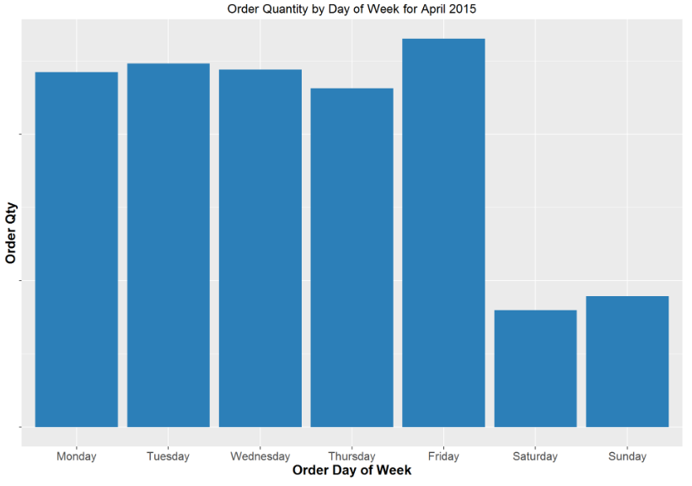
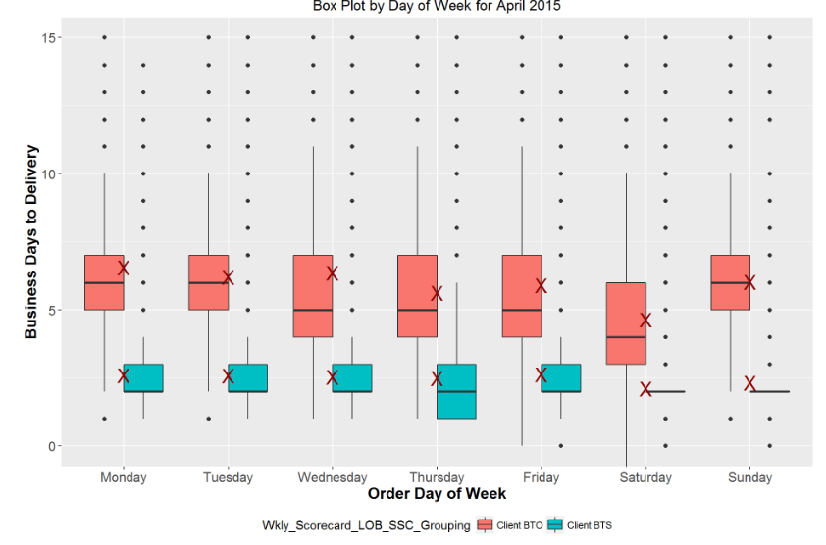
Data Exploration Overview and Insights – Day of Week
Consistent volume on weekdays with a big drop on weekends (weekends have ~30% of the weekday order volume)
Client BTO consistently takes more time (as expected) thank Client BTS from order to delivery; for Client BTO Wednesday, Thursday and Friday has lower median but 3rd quartile similar to other days. Saturday is the exception with lower median and 3rd quartile. Possibly due to having more time to build and stage before Monday

Slide 6
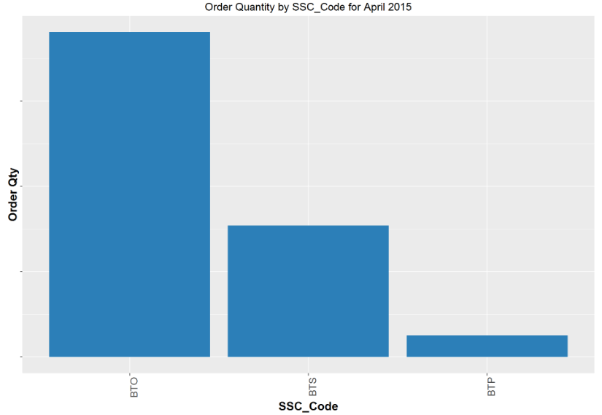
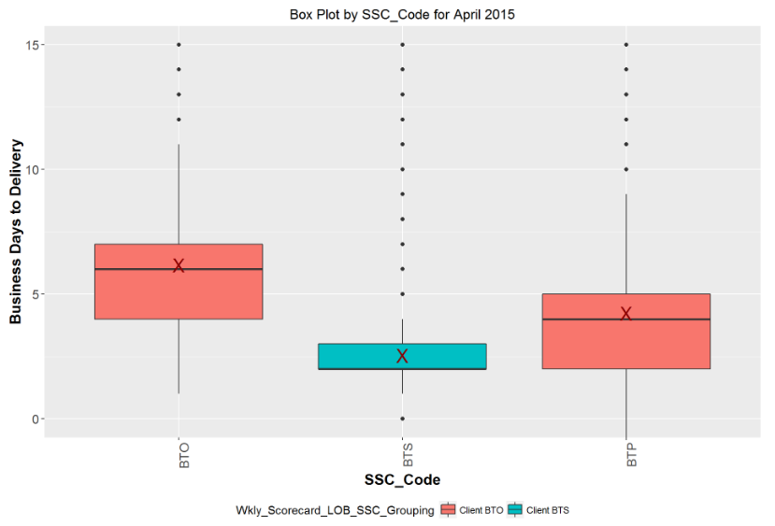
Data Exploration Overview and Insights – Supply Chain Code
Most orders fall under the BTO supply chain method
BTS has faster delivery time than BTO as expected

Slide 7
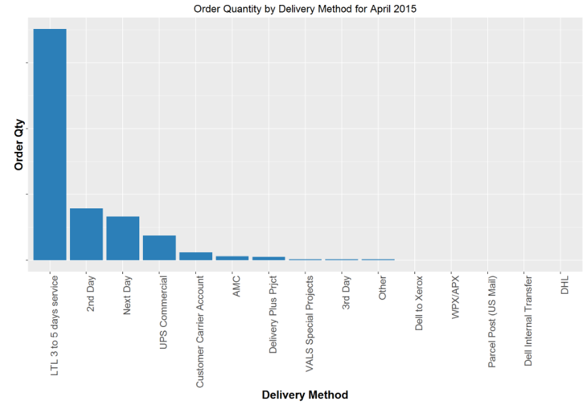
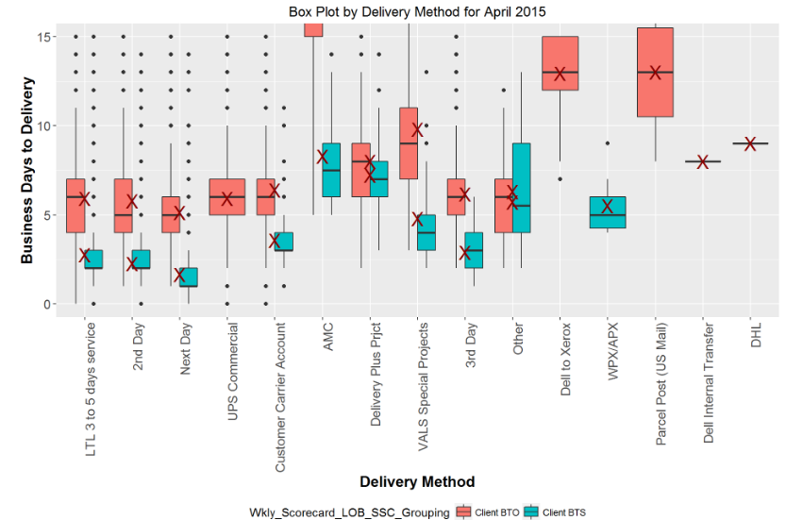
Data Exploration Overview and Insights – Delivery Method
Majority of orders ~63% are through 3-5 days standard ground. 2nd Day and Next Day service round out the top 3 for a combined ~90% of all order deliveries.
Delivery method is interesting since we would have expected a bigger gap between 3 to 5 days ship method and 2 day ship method
The median is lower on 2 day but the 25% to 75% is very similar. Next Day is lower as you would expect. This may be an area to explore BTS has faster delivery time than BTO as expected

Slide 8
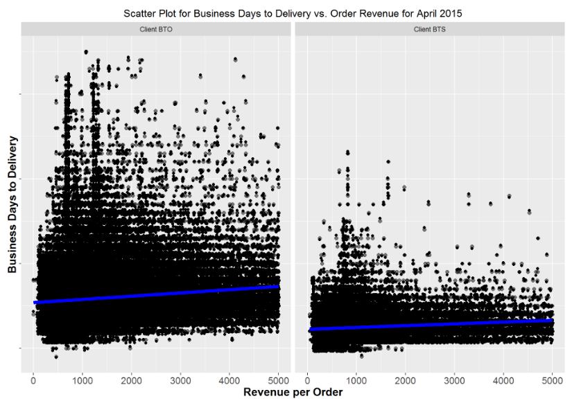
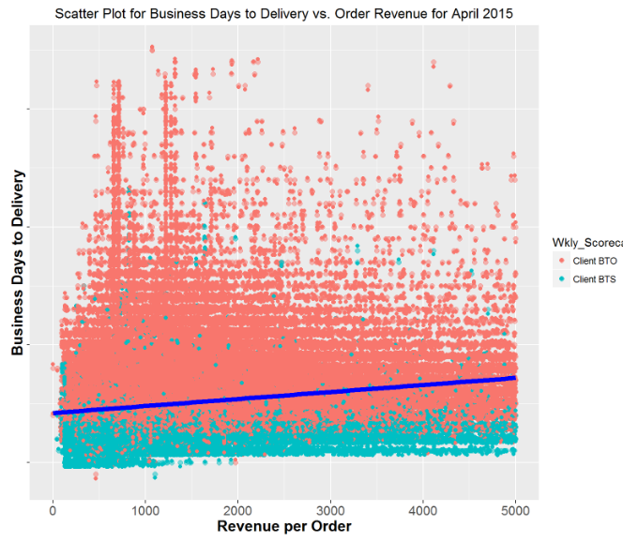
Data Exploration Overview and Insights – Revenue per Order
As expected Client BTS has lower business days across price points.
We se a little stronger trend line on BTO when compared to BTS (Business Days to Deliver vs. Revenue per Order

Slide 9
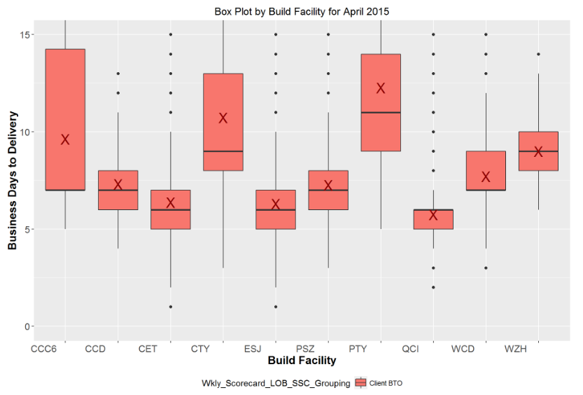
Data Exploration Overview and Insights – Build Facility
3 Build facilities (CCC6, CTY and PTY) have the longest time to delivery
This longer delivery time is due to facility location being out of region

Slide 10
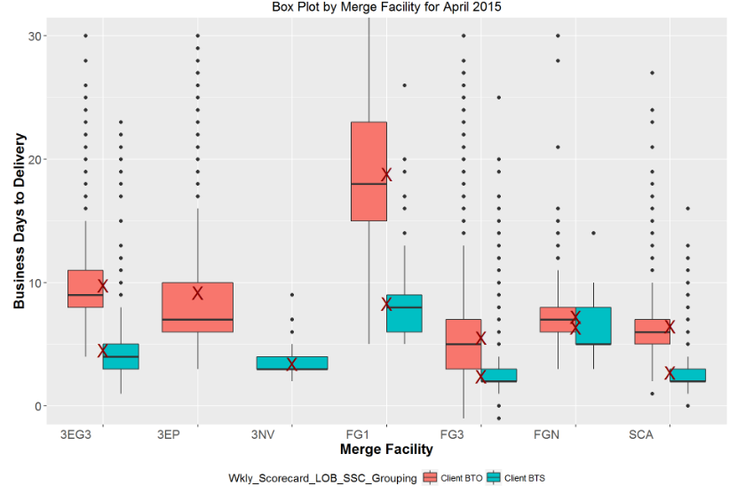
Data Exploration Overview and Insights – Merge Facility
BTO is consistently higher in business days to delivery across merge facilities when compared to BTS
FG1 merge facility has the highest number of days to delivery

Slide 11
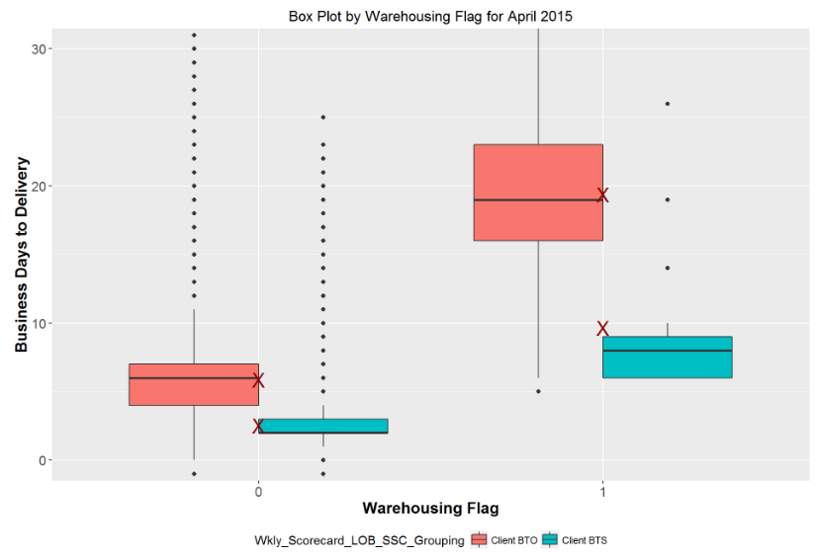
Data Exploration Overview and Insights – Warehousing
Those orders that are marked for warehousing have a mean of ~ 9 days longer delivery for BTO and ~ 7 days for BTS orders

Slide 12
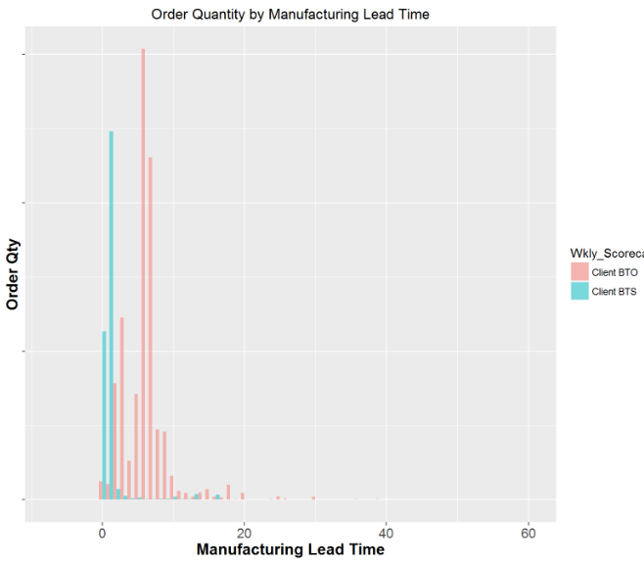
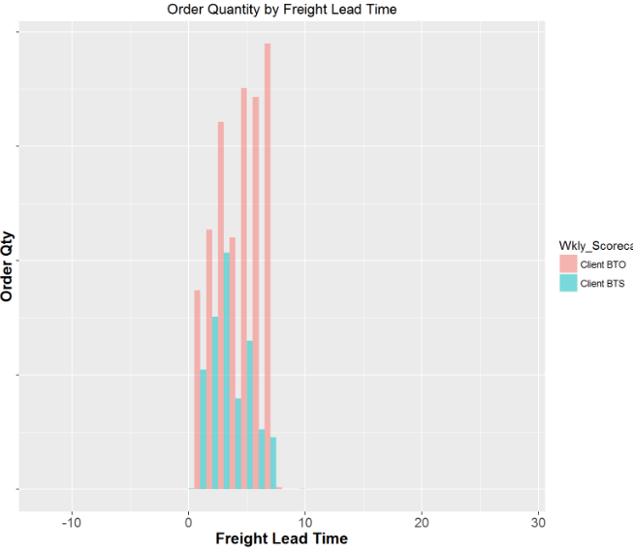
Data Exploration Overview and Insights – Lead Time
Manufacturing Lead Time: BTS has a larger number of orders with a lower manufacturing lead time while BTO seems to be bi-modal with longer manufacturing lead time than BTS orders
Freight Lead Time: Client BTO orders are skewed to the right when it comes to the number of days for logistics while BTS is more normally distributed

Slide 13
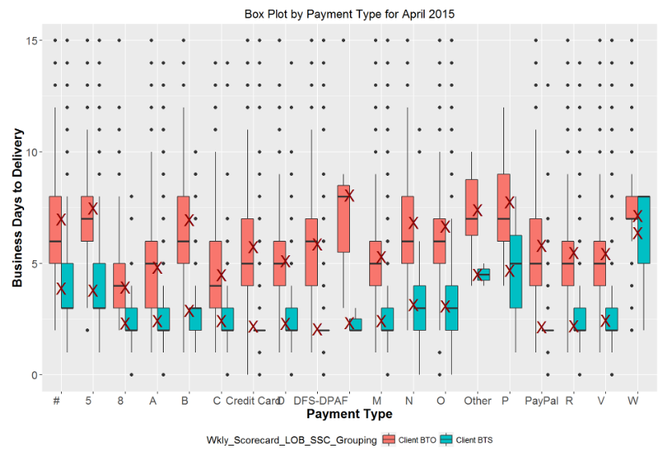
Data Exploration Overview and Insights – Payment Type
Some differences across payment types. #, 5, P and W payment types stand out

Slide 14
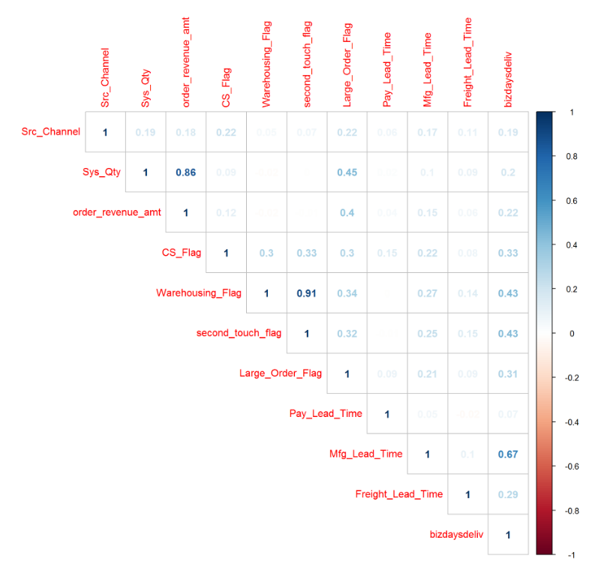
Feature Correlation – Numerical Features
Focusing on the target variable (bizdaysdeliv), we find that Mfg_Lead_Time has a strong correlation to it at 0.67 followed by Warehousing_Flag and second_touch_flag both at 0.43
We can also see that Warehousing_Flag and second_touch_flag are highly correlated to one another, and since we met with the business process subject matter experts we determined that Warehousing_Flag would be the one to keep in the model.
Another strong correlation between independent features is Sys_Qty to order_revenue_amt and to Large_Order_Flag. Again based on the deep understanding of the process, we will only use Sys_Qty in our prediction model.

Slide 15
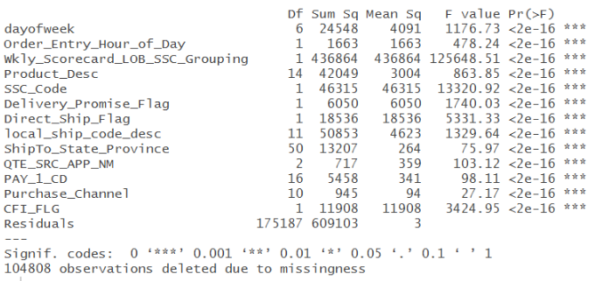
Analysis of Variance for Categorical Features
ANOVA was used to understand the relation of the categorical variables and the target variables
ANOVA showed that all of the features had a p value less than 0.05 resulting in their significance.
Also the product related features (Product_Desc, SSC_CD, Wkly_Scorecard_LOB_SSC_Grouping), the shipment method and CFI flag the features with the highest mean square.

Slide 16
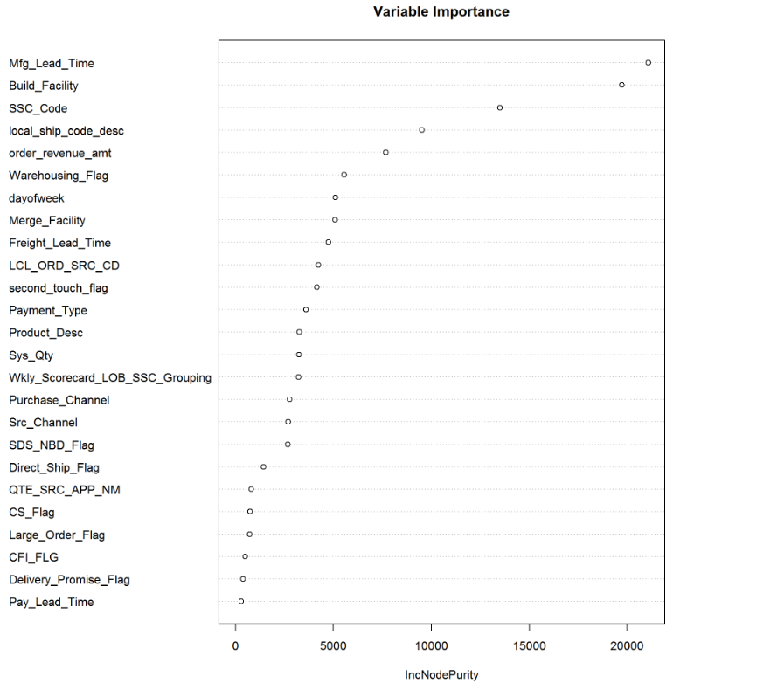
Model Feature Selection
With over 50 features to choose from, the next step was to determine which features had the largest impact on the target variable (quantity of business days from order date to delivery date). a Random Forest model was used as a first pass to determine variable importance.
Mfg_Lead_Time, Build_Facility, SSC_Code, local_ship_code_desc, order_revenue_amt are the top 5 variables in terms of importance to delivery days.

Slide 17
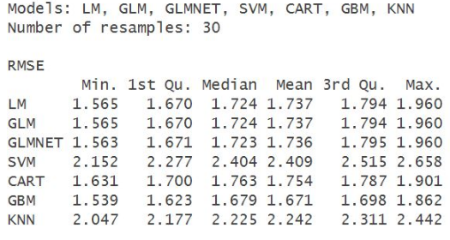
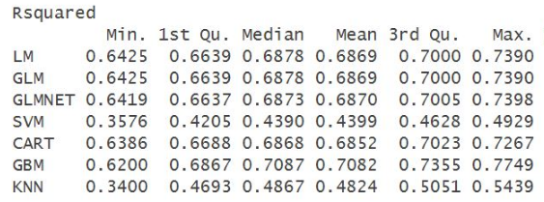
Model Selection
Since we are trying to predict the number of business days from order date to delivery date, we need to use a regression modeling technique to do this kind of prediction (vs. using a classification modeling technique).
Multiple different models were tried including Linear Models, GLM, GLMNET, Support Vector Machine (SVM), CART (Regression Trees), GBM and K nearest Neighbor (KNN)
RMSE and R-squared were used as the key metrics in identifying the model(s) that performed best on the training data. Below is a summary of each model’s performance.
GBM was found to have the best performance with the lowest RMSE of 1.67 days and an R squared value of ~0.71.

Slide 18
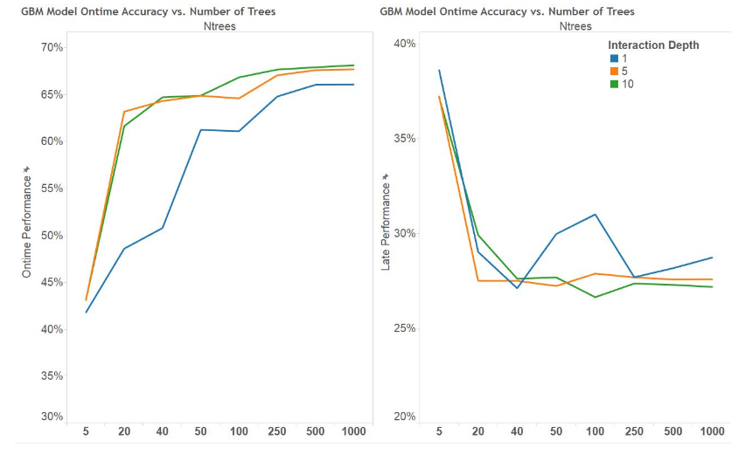
GBM Model Tuning
The GBM model was then tuned against the test data set using 3 parameters: We can tune over the number of trees (i.e., boosting iterations), the complexity of the tree (indexed by interaction.depth) and the learning rate (also known as shrinkage)
A gmb.grid was used to test multiple combinations of these 3 parameters testing against the on-time performance and late performance when using the business days to delivery
The results showed that 250 trees with an interaction depth of 5 and shrinkage of 0.05 would be an optimal parameters to use.

Slide 19
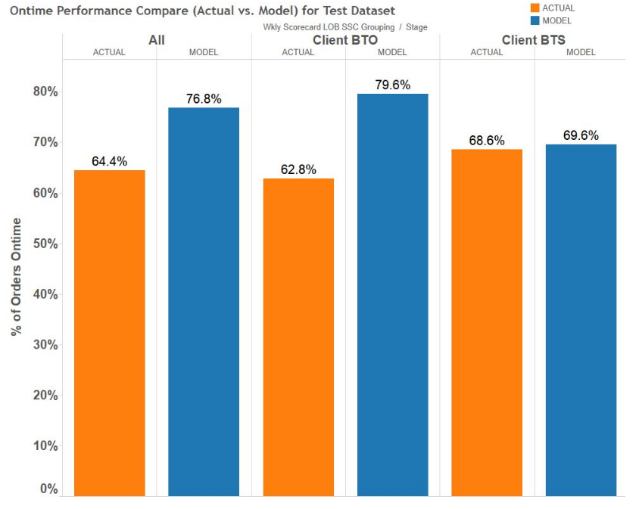
Final Results Compared to Current Performance
Utilizing the GBM optimized parameters, the model was run against the test data and found that ontime performance improved from 64.4% to 76.8% (~19% improvement over the current process performance)
Reaching this level performance included adding 1 extra business day to the model prediction to offset late deliveries

Slide 20
Project Summary & Next Steps
A few key feature were found to have significant impact on the target variable. Manufacturing Lead Time which determines the time required for the parts needed to build the system, Build Facility (determines physical location of build facility), SSC code meaning if the order can pulled from stock or will require special build, and customer shipment method were found to be among the key features.
These features were applied against multiple models and GBM was found to have the best performance. The model was tuned to 250 trees with an interaction depth of 5 and shrinkage of 0.05 for the optimal parameters. Utilizing this model we were able to improve performance by 19% from 64.4% ontime delivery to 76.8%.
We did find that in some cases by improving on-time performance we saw degradation in late performance which could have a potential negative impact on customer experience.
Another limitation is that the current order delivery process has high variability due to multiple sources of process variation. In order to get the best ontime performance, it will require that we deploy this model but also to reduce or eliminate the in the process variation.
Next Steps:
The key next steps include the following:
Determine if we can better set the window range used to communicate delivery times to our customers based on more probabilistic range logic using a probability density function. We will need to ensure that any new range logic is competitive and acceptable to our customer base.
Integrate the tuned GBM model into our real time process workflow
Monitor model performance and continue to tune it as needed

Slide 21
Appendix

Slide 22
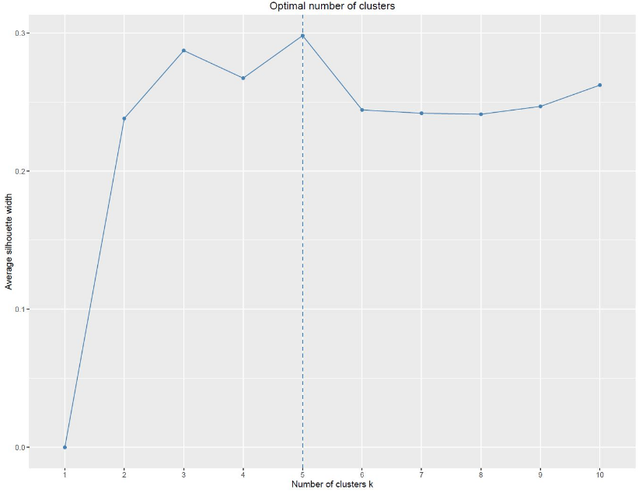
Cluster Analysis
One thought was to cluster the order data to determine if there were unique and meaningful clusters that could be identified and then build predictive models for each cluster to see if we could improve ontime performance.
Since the features used were mixed of mixed types (e.g.nominal and factor, all the pairwise dissimilarities (distances) between observations in the data set were calculated using “gower” distance. A hierarchical clustering algorithm was used.
To determine the optimal number of clusters, a silhouette width was calculated. 5 clusters were found to be the optimal number.

Slide 23
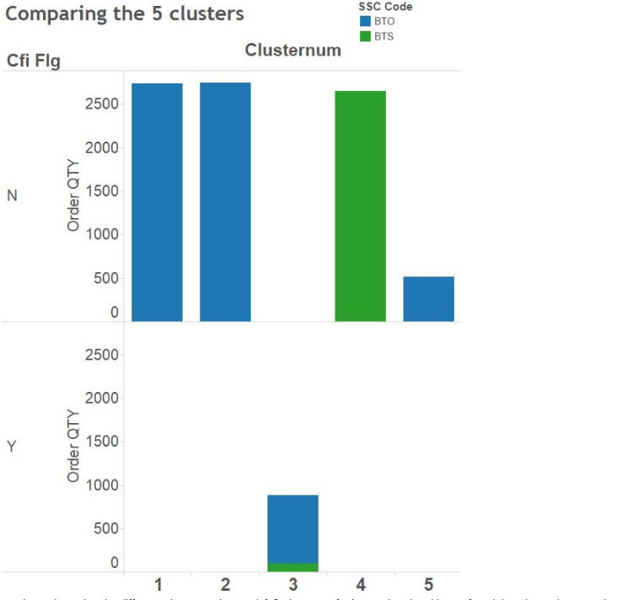
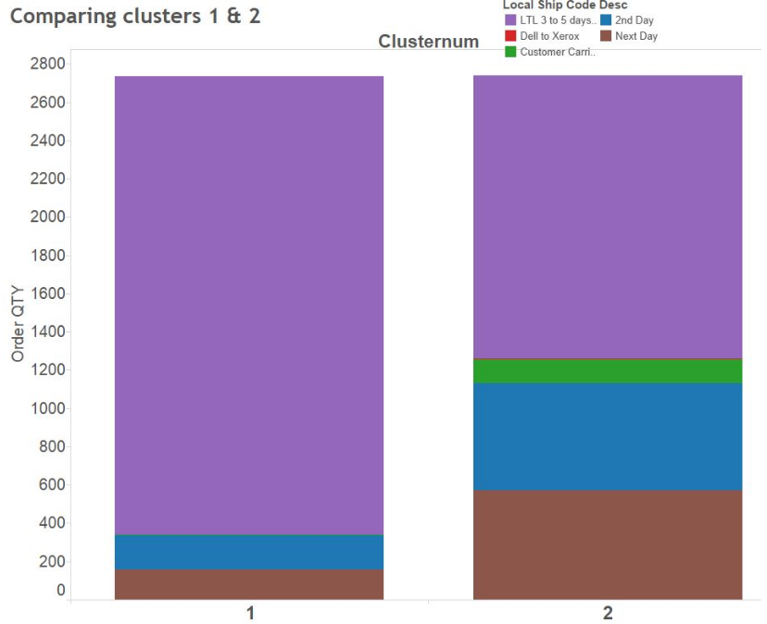
Cluster Analysis
In order to better understand each cluster, they were plotted and analyzed
Clusters 1, 2 consisted of BTO product that were non CFI, Cluster 3 was heavy BTO product with CFI while Cluster 4 was found to be mainly composed of BTS
In order to determine the difference between clusters 1 & 2, they were further analyzed and it was found that cluster 1 was made up mainly 3-5 day shipment method while cluster 2 was composed more of premium next day and 2nd day shipment.

Slide 24
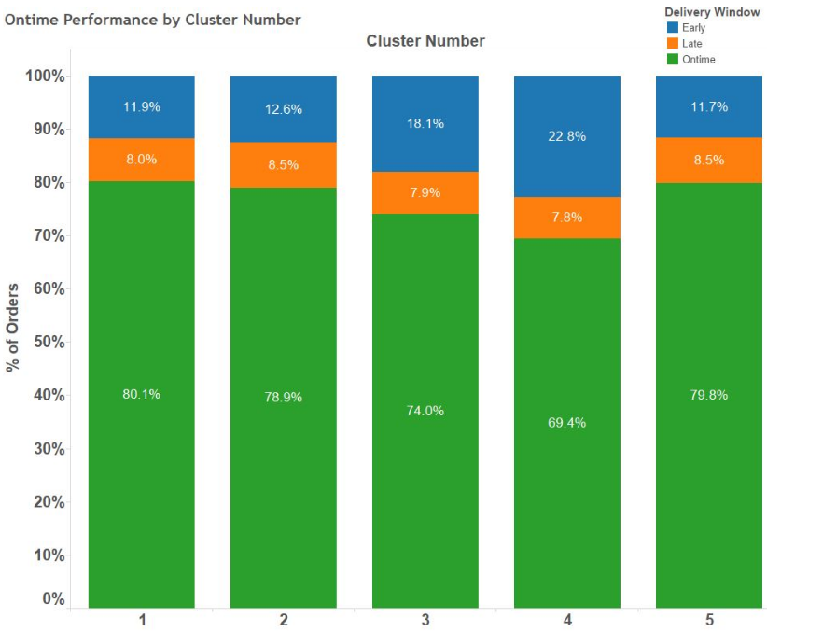
Cluster Analysis
Clusters 1 & 2 both BTO showed similar performance while Cluster 4 (BTS) showed lower on-time performance as expected. The CFI BTO cluster #3 showed a little worse performance than the non CFI BTO clusters (1 & 2).

Slide 25
Other Features that were Explored for Predictive Model
Order_Entry_Hour_of_Day: This represents what day hour of the day the order was placed
Wkly_Scorecard_LOB_SSC_Grouping: High level product category
Product_Desc: This represents the type of product on the order
Delivery_Promise_Flag: This represents which IT system was used to determine the EDD
Direct_Ship_Flag: This represents if the order will be directly shipped to the customer or if it requires to be merged at a merging facility prior to being shipped to the customer
ShipTo_State_Province: This represents the US state the order is being delivered to
PAY_1_CD: Represents primary method of payment for the order
QTE_SR_APP_NM: Represents system used to create the quote before the order was submitted
Purchase_Channel: This represents how the customer purchased the order( online, offline, etc…)
second_touch_flag: This represents if the order required a second touch for added services prior to customer shipment which may cause delays
CFI_FLG: Incremental services added in manufacturing prior to shipment to customer
Sys_Qty : This represents the system quantity on the order
Pay_Lead_Time: The amount of time put aside for the customer payment to complete processing
LCL_ORD_SRC_CD: The source system that the order has been placed in
Src_Channel : This is the channel number the customer belongs to
SDS_NBD_Flag: Determines if the order needs to be shipped the same day the order is placed or not
CS_Flag: Determines if a custom service is required for the order
Large_Order_Flag: Determines if an order is composed of a large number of systems or high revenue amount

