Slide 1


Data structure project
The n queen problem using backtracking
KLEI JAHAJ
ANNGJELOS GOGA

Slide 2
What is this problem about
First of all, how does a queen move?
Move horizontally: The queen can move any number of squares to the left or right in the same row.
Move vertically: The queen can move any number of squares up or down in the same column.
Move diagonally: The queen can move any number of squares along a diagonal line that passes through its current position.
What is the problem about?
This problem involves placing N chess queens on an N x N chessboard such that no two queens threaten each other.
The N-Queens problem is a classic problem in computer science and has been the subject of much research and study.

Slide 3

HOW DOES BACKTRACKING WORK TO SOLVE THIS PROBLEM?
The Backtracking Algorithm
Backtracking is a common technique used to solve problems where there are many possible solutions, but not all of them are valid.
The basic idea of backtracking is to start with a partial solution and incrementally build it up until a complete solution is found or it is determined that no complete solution is possible.
If a partial solution is found to be invalid, the algorithm "backs up" and tries a different solution.
The backtracking algorithm is well-suited to solving the N-Queens problem.

Slide 4
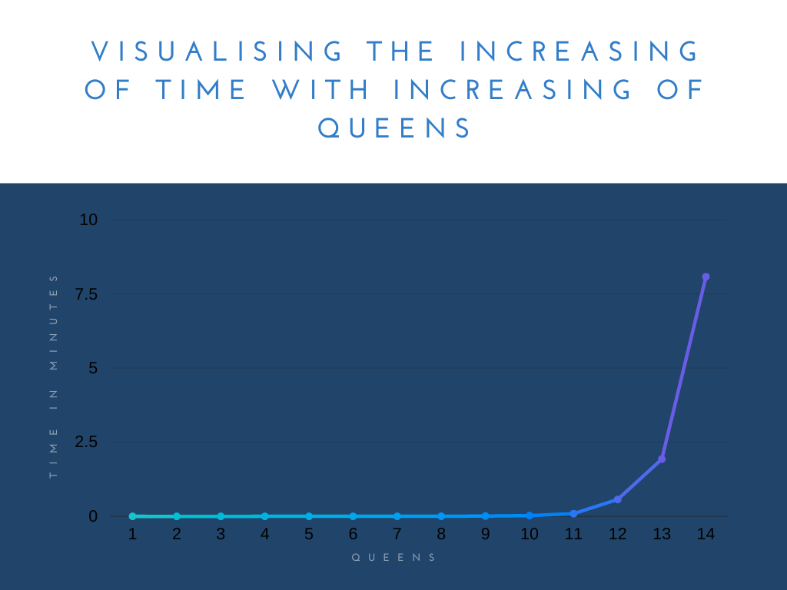
Time for computing n queens
As we can see in the graph, with the increasing of the board and queens the time to be computed gets from exponentially higher.(According to ChatGPT it would take 3 weeks for 16 queens with the best algorithm and modern hardware.

