Slide 1


Tutorial: Model-based Software Development for Sequential, Concurrent, Distributed, and Containerized Reactive Systems
Juergen Dingel (Queen’s U., Canada)
Karim Jahed (Queen’s U., Canada)
FDL’21
Sept 8, 2021
All material available at
https://kjahed.github.io/FDL21

Slide 2
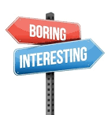
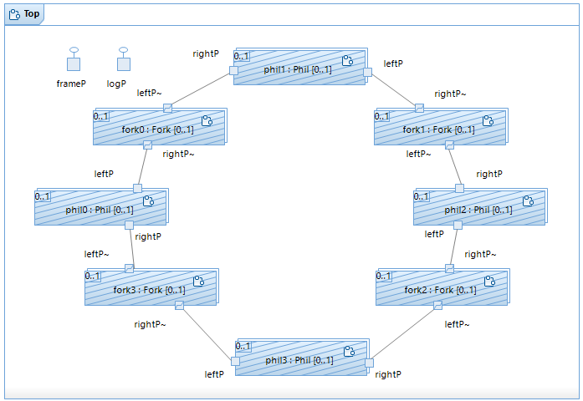
Goal of Tutorial
Inform
MBSD for reactive systems w/ UML-RT
Part 1: sequential, concurrent (JD)
Core concepts and key principles
Execution semantics
Single- vs multi-threaded execution
Support for dynamic (runtime) change
Part 2: distributed, containerized (KJ)
Containers and container management
Inspire
‘Oldies, but Goldies’
abstraction & automation
graphical modeling
the ‘actor model’
MBSD for distributed systems

Slide 3
Resources
Material: https://kjahed.github.io/FDL21
Tools:
IBM RSARTE
Download and installation instructions: see ‘Material’ page
Licenses: send me email at ‘dingel@cs.queensu.ca’
Web interface (experimental)
Go to: https://rtpoet.jahed.ca (any username/password combination ok)
Model input: text only
Code generation & execution
C++: build and run from console
JavaScript: build and run from console (w/ execution animation on state machine)
Instructions on ‘Material’ page

Slide 4

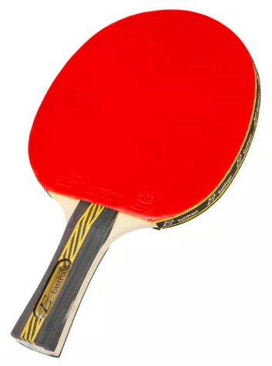
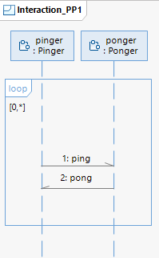
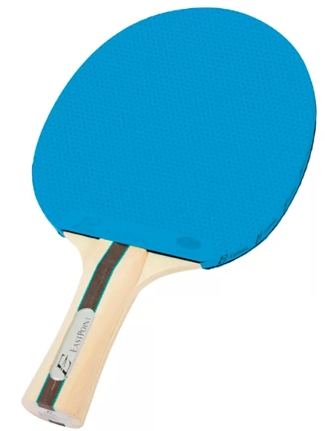
Example 1: Forever PingPong (1)
ping
pong
ping
. . .
pinger
ponger

Slide 5
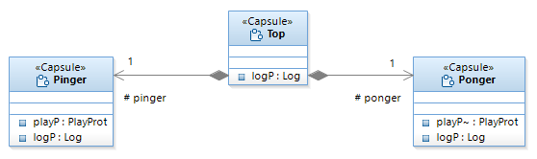
Example 1: Forever PingPong (2)
Notes:
- structure w/ class diagram 1

Slide 6
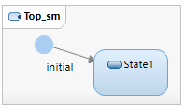

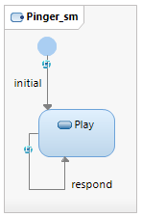
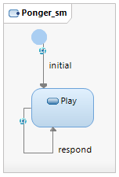


Example 1: Forever PingPong (3)
on _ at _ and [true]
on _ at _ and [true]
on pong at playP and [true]
on ping at playP and [true]
Notes:
structure & behaviour 1
Qs: What is PlayProt? What does ‘~’ mean in ‘playP~’ in ‘Ponger’?

Slide 7
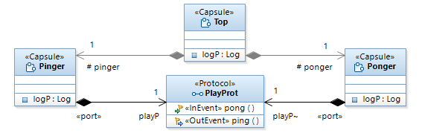
Example 1: Forever PingPong (4)
on _ at _ and [true]
on _ at _ and [true]
on pong at playP and [true]
on ping at playP and [true]
Notes:
Structure & behaviour 2: protocols
Qs: Is there actually a connection between ‘Pinger’ and ‘Ponger’?

Slide 8
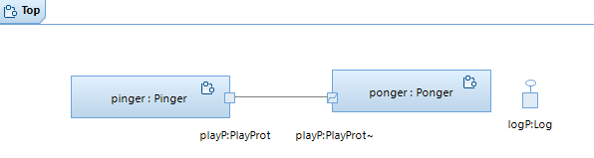
Example 1: Forever PingPong (5)
on _ at _ and [true]
on _ at _ and [true]
on pong at playP and [true]
on ping at playP and [true]
Notes:
Structure and behaviour 3: Composite structure diagrams

Slide 9



UML-RT: Key Constructs
capsule
part (capsule instance)
connector
port
composite structure diagram
on _ at _ and [true]
on _ at _ and [true]
trigger
transition name
port
guard
on pong at playP and [true]
on ping at playP and [true]
action (action code, effect)
in action language (here: C++)
Notes:
Structure w/ composite structure diagram
Difference b/w class diagram and composite structure diagram?

Slide 10
UML-RT: Tools
Commercial
IBM RSARTE
HCL Rtist
Protos eTrice
Open source
Eclipse Papyrus-RT
Web interface
Research prototype (language servers, containerization, etc)

Slide 11
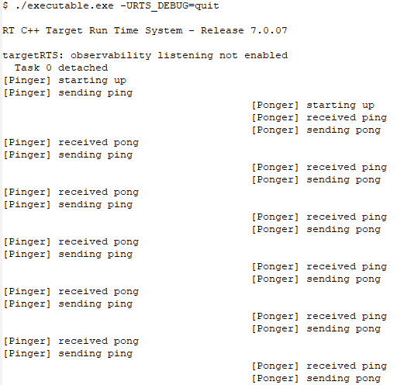
RSARTE Demo: Forever PingPong
Showing: editing, building, executing
Variations
In Pinger: No initial ‘ping’ message
In Ponger: ‘pong’ sent 1 second after receipt of ‘ping’
Notes:
Things to try:
Remove initial ‘ping’ message ➔ deadlock
Add timer to Ponger

Slide 12
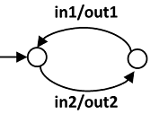
UML-RT: Key Takeaways 1
Key principles
Encapsulation, interfaces, specialization (subclassing)
Interaction via message-passing (no shared data)
Event-driven execution
Resources managed by runtime system (RTS)
Message passing, logging, capsule instantiation timers, …
Graphical modeling
in1
in1
…
in2
in2
…
inputs
outputs
out2
out1
out2
…

Slide 13
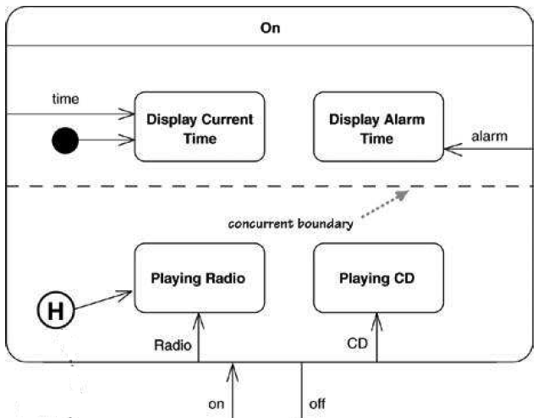
UML-RT: Key Takeaways 2
Compared to UML (e.g., IBM Rhapsody)
No orthogonal regions (and states) in state machines
Connectors
binary
end ports always have matching types
“enable communication” [UML Spec]
Now: message passing b/w single thread
Later: message passing b/w multiple threads, processes, containers, or nodes

Slide 14
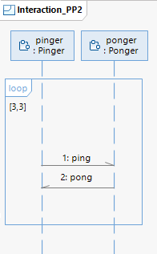
Example 2: 3xPingPong (1)
ping
pong
ping
pong
. . .
ping
pong
pinger
ponger
Notes:
- Q: what needs to change?

Slide 15
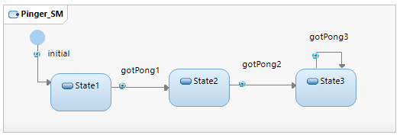

Example 2: 3xPingPong (2)
on _ at _ and [true]
on _ at _ and [true]
on pong at playP and [true]
on pong at playP and [true]
on ping at playP and [true]

Slide 16
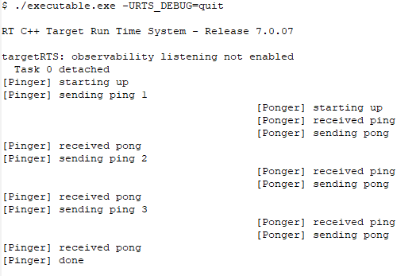
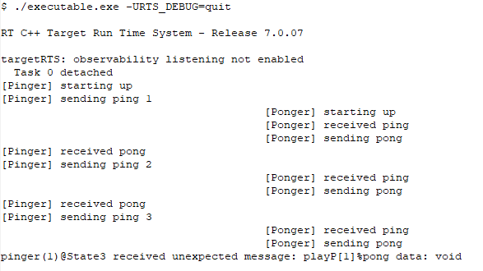
RSARTE Demo: 3xPingPong
Variations
Remove trigger in ‘gotPong3’ transition in ‘pinger’
Notes:
Things to try:
In pinger ‘gotPong3’ transition: remove or remove trigger
➔ ‘unexpected message’ pong at playP of pinger

Slide 17
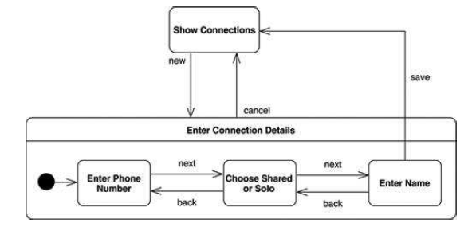
UML-RT: Key Takeaways 3
Event-driven execution
Every execution step by capsule C is caused by a message delivered to C (including, e.g., timeout messages)
Challenge: when message m is delivered to state machine of C, C is able to handle m
group transitions (out of composite states)
defer/recall
M. Fowler. UML Distilled. 3rd Ed. 2004.

Slide 18
Example 3: 3xPingPong + Choice (1)
pinger
ponger
Notes:
- Q: what needs to change?

Slide 19
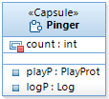
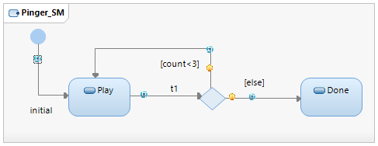
Example 3: 3xPingPong + Choice (3)
on _ at _ and [true]
on _ at _ and [true]
on pong at playP and [true]
on pong at playP and [true]
on ping at playP and [true]
Notes:
Diamond is called ‘choice point’ (different shape in animation of web interface)
How to fix/complete transitions?

Slide 20
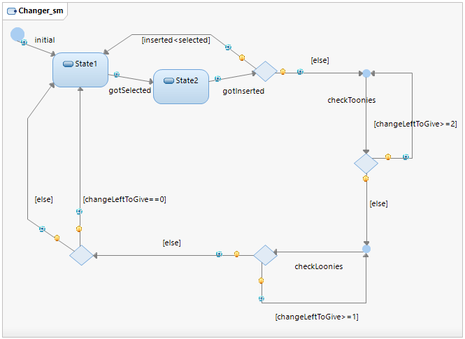
UML-RT: Key Takeaways 4
State machines
pseudo states (e.g., choice
junction, history)
=> transition chains
Execution semantics
Run-to-completion
“A message is delivered to the statemachine of an object only after the processing of the previous message has completed”
=> No ‘intra-object’ concurrency
Very common atomicity assumption (e.g., UML 2, JavaScript, Erlang, …)
Event loop in controller in RTS:
WHILE (1) {
m = dequeue(mq);
IF can find transition t such that enabled(m,t,currRTState) THEN
currRTState = execChain(t,currRTState);
ELSE
report ‘Unexpected message m’;}

Slide 21
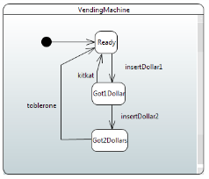
Execution Semantics 1
Application
RTS
Target OS (Linux,Windows,OS X)
Target HW
RT Controller w/ message queue mq
Controller main loop
Shared structures & services
<actStates,vars,mq> := execInits();
WHILE (1) {
m = dequeue(mq);
IF can find transition t such that enabled(m,t,<actStates,vars,mq>) THEN
<actStates,vars,mq> = execChain(t,<actStates,vars,mq>);
ELSE
report ‘Unexpected message m’;
}
WHERE
enabled(m,t,<actStates,vars,mq>) =
source(t) is active, trigger(t) matches m, and eval(guard(t),vars)=‘true’
execChain(t,<actStates,vars,mq>) =
<actStates,varVals,mq> := exec(effect(t),<actStates,vars,mq>);
WHILE target(t) is choice point {
find t’ such that source(t’)=target(t) and eval(guard(t’),vars)=‘true’;
<actStates,vars,mq> := exec(effect(t),<actStates,vars,mq>);
t = t’;
}
RETURN <actStates,vars,mq>;

Slide 22
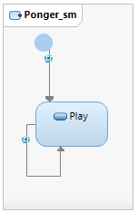
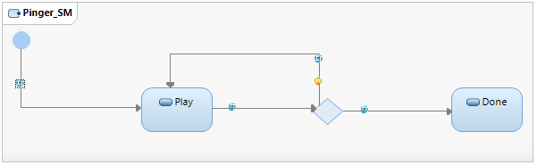
Execution Semantics 2
_[count<3]/send(ping);
count++;
_[]/send(ping);
count=1;
pong[]/_
_[!(count<3)]/_
ping[]/send(pong);
actStates vars mq
_,_ count=_ []
Play,Play count=1 [ping]
[pong]
count=2 [ping]
[pong]
count=3 [ping]
[pong]
Done,Play []
pinger
ponger
pinger

Slide 23
Demo: Execution Semantics
Things to try
In its initial transition, pinger sends 2 ‘ping’ messages
Notes:
Things to try:
In initial transition, pinger sends 2 ping messages
➔ ‘unexpected message’ pong at playP of pinger while in state ‘Done’ (fix: add transition to Done)

Slide 24
Execution Semantics 3
_[count<3]/send(ping);
count++;
_[]/send(ping);
send(ping);;
count=2;
pong[]/_
_[!(count<3)]/_
ping[]/send(pong);
actStates valVars mq
_,_ count=_ []
Play,Play count=2 [ping,ping]
[ping,pong]
[pong,pong]
count=3 [pong,ping]
Done,Play [ping]
[pong]
[] “unexpected msg”
pinger
ponger
ponger
pinger
pinger
ponger
pinger

Slide 25
UML-RT: Key Takeaways 5
Single threaded execution
One controller with one message queue
Multi threaded execution
Per thread: One controller with one message queue
Application
RTS
RT Controller 1
w/ message queue
. . .
RT Controller n
w/ message queue
Target OS (Linux)
Target HW
Shared structures & services

Slide 26
Example: Multi-Threaded Execution
_[count<3]/send(ping);
count++;
_[]/send(ping);
send(ping);;
count=2;
pong[]/_
_[!(count<3)]/_
ping[]/send(pong);
actS vars mq1 (pinger thread) mq2 (ponger thread)
_,_ count=_ [] []
Play,Play count=2 [] [ping,ping]
[pong] [ping]
pinger
ponger
Play,Play count=3 [] [ping,ping]
Play,Play count=2 [pong,pong] []
ponger
pinger
Play,Play count=3 [pong] [ping]

Slide 27
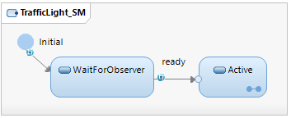
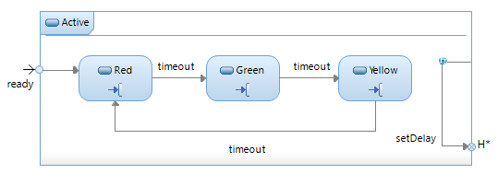
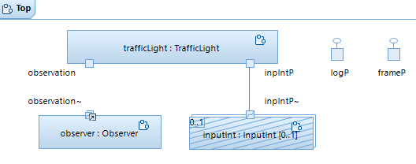

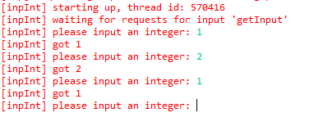
Example: Multi-threaded Execution

Slide 28
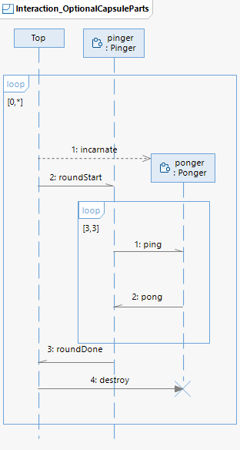
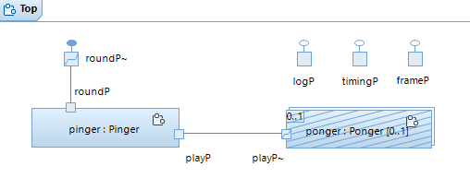
Example 4: 3xPingPong + Dynamic Instantiation

Slide 29
UML-RT: Key Takeaways 6
Support for change at runtime
Capsule
instantiation/destruction (optional capsule instances), see previous slide
import/deport (plugin capsule instances)
Connector creation/destruction
Publish/subscribe
Research
Live modeling [Live21]
Leveraging containerization [Cont21]
[Live21] M. Bagherzadeh, K. Jahed, B. Combemale, J. Dingel. Live modeling in the context of state machine models and code generation. Software and Systems Modeling 20 (3), 795-819. 2021
[Cont21] K. Jahed, J. Dingel. Generating Resilient Distributed Runtime Infrastructures for Executable Component and Connector Models. Draft. 2021

Slide 30
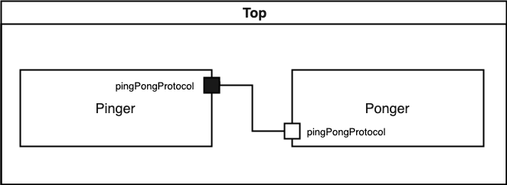

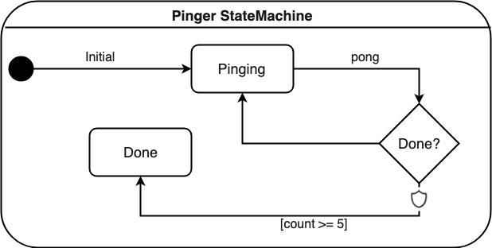
Automatic Distribution & Deployment: Motivation
Many successful executable modeling languages (e.g., UML-RT) don’t have the toolkit necessary* to generate truly distributed applications, despite being distributed in nature.

Slide 31
Automatic Distribution & Deployment: Goals
Leveraging design models and existing toolkits to automatically transform executable components and connectors models into distributed applications.
Requirements:
Re-use of existing toolkit (runtime system, code generator, etc.)
Model-level transformation only
Ideally, requires no changes to the existing toolkit .
Must support all the common features of C&C languages
Component addition/removal.
Dynamic connectors.
Etc.
Must respect the language execution semantic.

Slide 32
Automatic Distribution & Deployment: KubeRT
We use a model transformation process to transform the input model to a set of standalone models whose collective distributed execution yields the same result as the input model.
We use containerization technology (i.e., Docker) to bundle the application components into easily deployable units.
We use Kubernetes as distributed runtime system to automatically deploy, monitor, recover, and scale the application components. Kubernetes also facilitates communication between components and enforces the language semantics.

Slide 33
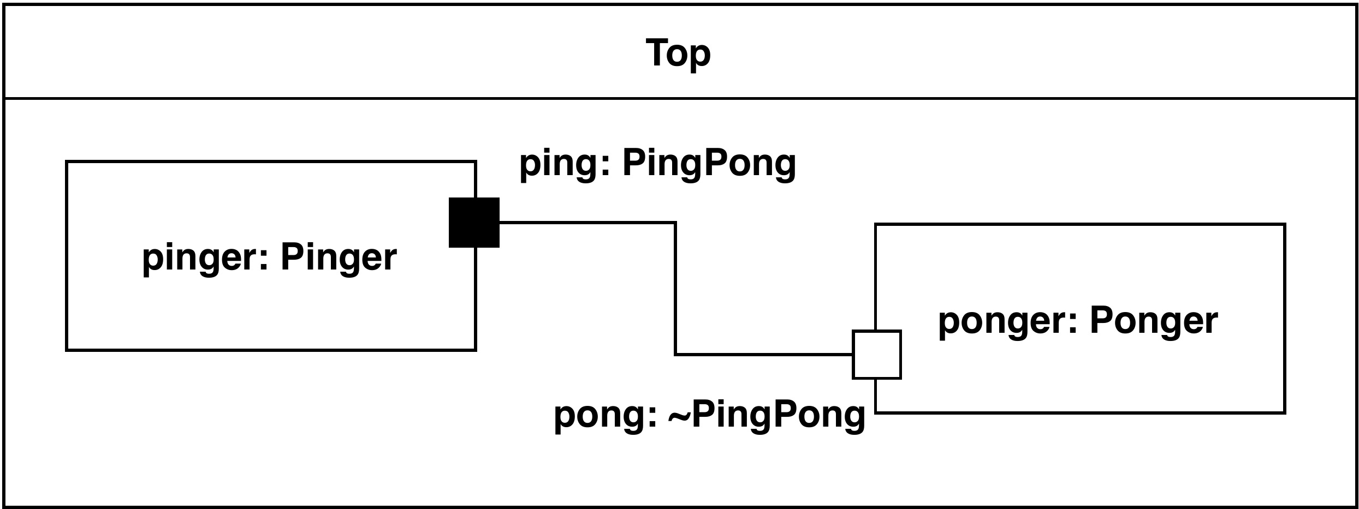
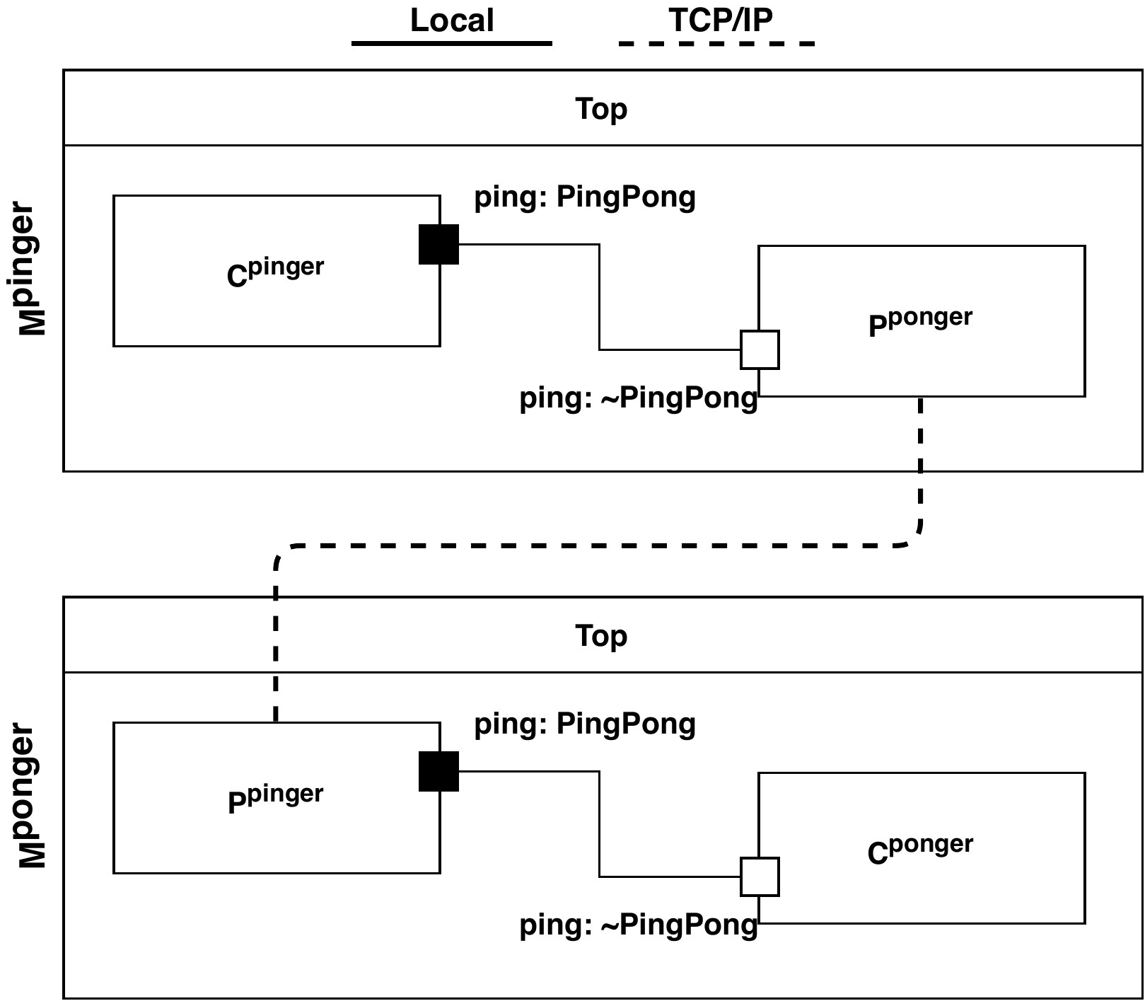


Automatic distribution & Deployment – Example
pinger.exe and ponger.exe can now be deployed and executed manually.
However, it still requires manual configuration:
Dependencies
Application configuration
Transformation
Code generation
.c
Compilation
pinger.exe
Code generation
.c
Compilation
ponger.exe

Slide 34


Automatic distribution & Deployment – Example cont’d
“Docker is a set of platform as a service products that use OS-level virtualization to deliver software in packages called containers. Containers are isolated from one another and bundle their own software, libraries and configuration files.”
Containerization
pinger.exe
pinger.docker
Containerization
ponger.exe
ponger.docker

Slide 35

Automatic distribution & Deployment – Example cont’d
“Kubernetes, also known as K8s, is an open-source system for automating deployment, scaling, and management of containerized applications.”
Containerization
Deployment
pinger.exe
pinger.docker
Containerization
Deployment
ponger.exe
ponger.docker

Slide 36
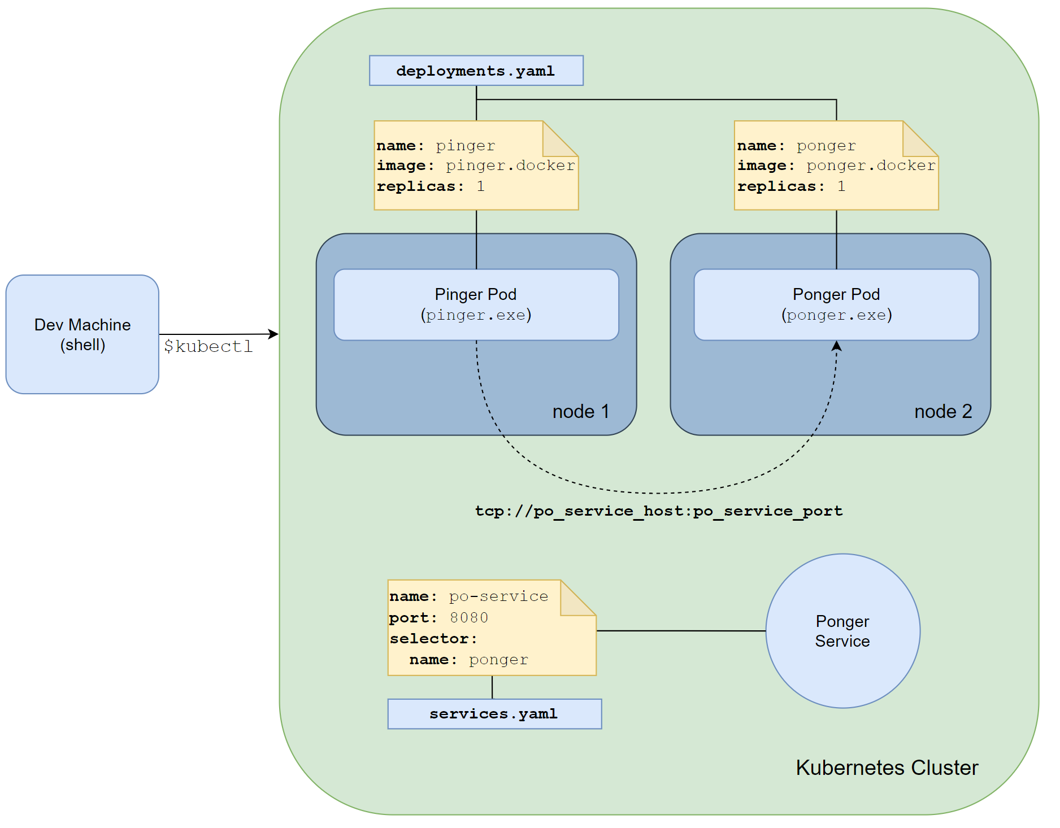
Automatic distribution & Deployment – Example cont’d

Slide 37
Automatic distribution & Deployment – KubeRT’s features
Automatic distribution & deployment
Reuse of existing execution toolchains
Failure recovery
Message Re-ordering
Autoscaling (for specific applications)

Slide 38
Automatic distribution & Deployment – Future work
Dynamic deployment adaptation
Industrial applications typically require a more constrained deployment process to satisfy certain application-specific functional and non-function requirements in a cost-effective way.
Such applications require finer control over the physical deployment.
We plan on extending KubeRT to allow the high-level specification of deployment requirements at the model level, and leverage Kubernetes to satisfy these requirements.

Slide 39
Conclusion
MBSD for reactive systems with UML-RT
Part 1: sequential, concurrent (JD)
Core concepts and key principles
Execution semantics
Single- vs multi-threaded execution
Support for dynamic (runtime) change
Part 2: distributed, containerized (KJ)
Containers and container management (KJ)

Slide 40
Resources
Tutorial material: https://kjahed.github.io/FDL21/
Papers on UML-RT
Lots, including: overview [1], formal semantics [2]
Papers on MDE
Even more, including: state-of-practice [3,4], adoption [5]
Course on MDSD
https://www.cs.queensu.ca/~dingel/cisc836_W21 (I’d be happy to share resources etc)
[1] Selic, Using UML for modeling complex real-time systems. Workshop on Languages, Compilers, and Tools for Embedded Systems (LCTES’98), 1998, pp. 250–260.
[2] Posse, Dingel. An executable formal semantics for UML-RT. SoSyM 15(1):179-217. Feb 2016
[3] Whittle, Hutchinson, Rouncefield. The state of practice in model-driven engineering. IEEE Software 31 (3), 79-85. 2014.
[4] G Liebel, N Marko, M Tichy, A Leitner, J Hansson . Model-based engineering in the embedded systems domain: an industrial survey on the state-of-practice. Software & Systems Modeling 17 (1), 91-113
[5] Selic. What will it take? A view on adoption of model-based methods in practice. Software and Systems Modeling (SoSyM) 11(4):513-526. 2012.

Slide 41
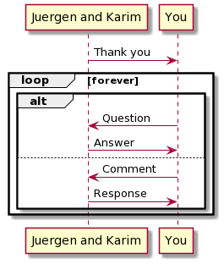
The End
dingel@cs.queensu.ca
jahed@cs.queensu.ca
Notes:
@startuml
participant “Juergen and Karim" as JK
participant "You" as you
JK -> you: Thank you
loop forever
alt
you -> JK: Question
JK -> you: Answer
else
you -> JK: Comment
JK-> you: Response
end
end
@enduml

