Slide 1
SIMULATION-ONLY RESEARCH PROJECT — SKY130 / ngspice
Statistical Characterization of a Gm-C Continuous-Time Filter
in the Open-Source SKY130 PDK
A Monte Carlo and PVT-Corner Study, with Full Open-Source Release

Slide 2
Objective of the Project
To statistically characterize — not just verify at a single nominal point — how much a second-order Gm-C low-pass filter's cutoff frequency, quality factor, and passband ripple actually vary once realistic device mismatch and PVT conditions are accounted for, entirely within the free, open-source SKY130 process.
1
2
3
Design a working Gm-C filter
Quantify statistical spread via Monte Carlo
Quantify PVT robustness
Two cascaded OTA-based transconductor-capacitor integrator stages (each with a diode-connected mirror load, tail current source, and CMFB loop), plus an output buffer, targeting fc = 1 kHz, Q = 0.9 — built entirely from SKY130 device models in Xschem.
Run 500+ randomized mismatch simulations using SKY130's built-in statistical device models; report the resulting distributions of fc, Q, and ripple — the paper's central deliverable.
Sweep the same filter across process corners (tt/ss/ff), supply voltage (±10%), and temperature (−20°C to 85°C) to establish worst-case, non-random performance shift.
4
5
6
Cross-validate the results
Fill a verified literature gap
Release everything openly
Check AC-domain Monte Carlo/PVT findings against an independent transient-domain measurement, guarding against single-method artifacts.
No published work combines statistical characterization + open-source PDK + complete filter + released netlists — this project sits at that four-way intersection (see Slide 5).
All netlists, Monte Carlo seeds, and analysis scripts published on GitHub — a reusable reference artifact for the open-silicon community, not just a set of numbers.
Statistical Characterization of a Gm-C Filter in SKY130
2

Slide 3
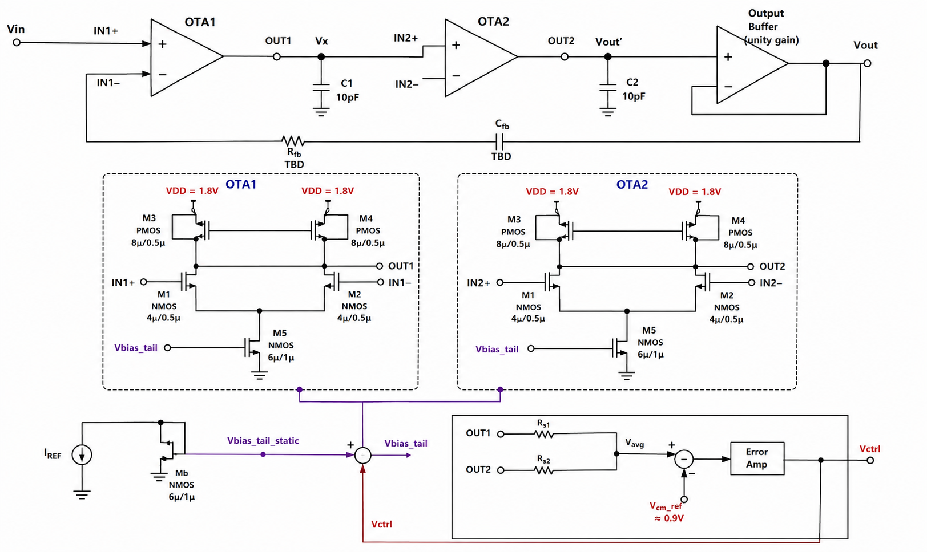
Circuit Under Test
Two-stage Gm-C second-order low-pass filter — full transistor-level schematic (SKY130)
Statistical Characterization of a Gm-C Filter in SKY130
3

Slide 4
Circuit Architecture — Key Sub-Blocks
OTA1 / OTA2 (Integrators)
Tail Current Bias (Shared)
M1/M2 differential pair (4µ/0.5µ) · M3 diode-connected, M4 mirror (8µ/0.5µ PMOS load) · M5 tail (6µ/1µ). Identical structure, cascaded via Vx.
I_REF into Mb (diode-connected, 6µ/1µ) → Vbias_tail_static, mirrored to both OTAs' M5 gates via a summing node.
CMFB Loop
Global Feedback + Output Buffer
Rs1/Rs2 average OUT1/OUT2 → compared vs. Vcm_ref (≈0.9V) → Error Amp → Vctrl, summed into the shared tail-bias node. Keeps output common-mode stable.
R_fb/C_fb (values TBD — solved from target Q=0.9) route Vout back to OTA1's second input; unity-gain buffer isolates Vout' from the load.
Statistical Characterization of a Gm-C Filter in SKY130
4

Slide 5
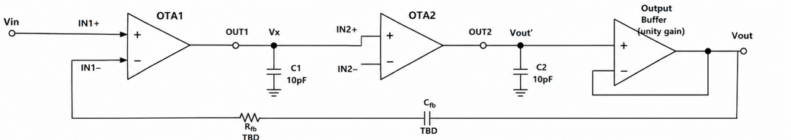
Detailed Circuit Breakdown — Signal Flow
Vin enters OTA1, integrates through two OTA-C stages, exits through a unity-gain buffer
Vin → OTA1: the input signal drives OTA1's non-inverting input (IN1+)
IN1− carries the global feedback signal. OUT1/Vx → OTA2: OTA1's output charges C1 (10pF), and this integrated node Vx directly drives OTA2's non-inverting input.
OUT2/Vout' → Buffer → Vout: OTA2's output charges C2, then a unity-gain buffer isolates this internal node from the external load before the final output.
Statistical Characterization of a Gm-C Filter in SKY130
4b

Slide 6
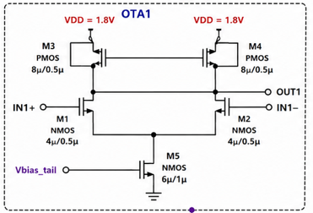
Detailed Circuit Breakdown — Input Differential Pair (M1, M2)
Identical structure in both OTA1 and OTA2
Devices
M1, M2 — NMOS, sky130_fd_pr__nfet_01v8, W/L = 4µ/0.5µ
Role
Converts the differential input voltage (IN+/IN−) into a differential drain current — this is the transconductance (gm) stage that gives the OTA its name
Connections
Gates = IN1+/IN1− (the two OTA inputs). Sources joined at one common node, which drops to M5's drain (the tail). Drains feed up into M3/M4 (the mirror load)
Why 4µ/0.5µ
Sized via gm/ID methodology to hit the target gm ≈ 63 µA/V needed for fc = 1kHz with C1/C2 = 10pF — larger devices reduce mismatch (Pelgrom's law) at the cost of more parasitic capacitance
Statistical Characterization of a Gm-C Filter in SKY130
4c

Slide 7
Detailed Circuit Breakdown — PMOS Current-Mirror Load (M3, M4)
The active load that converts differential current into a usable output voltage
Devices
M3, M4 — PMOS, sky130_fd_pr__pfet_01v8, W/L = 8µ/0.5µ
M3 — diode-connected
Gate tied directly to its own drain. This sets a fixed reference voltage that establishes the mirror's bias point — a self-biasing configuration, not an externally supplied one
M4 — mirror device
Gate tied to M3's gate (not its own drain), so it copies M3's gate-source voltage. Since M1's current sets M3's operating point, M4 mirrors that same current onto M2's side — but any imbalance in M1/M2's currents shows up as a voltage swing at OUT1
Why PMOS (not NMOS)
Sources connect to VDD, which lets the drains sit at a mid-rail voltage suitable for driving the next stage — a standard choice for an NMOS-input differential pair
Statistical Characterization of a Gm-C Filter in SKY130
4d

Slide 8
Detailed Circuit Breakdown — Tail Current Source (M5)
Sets the total bias current available to the differential pair
Device
M5 — NMOS, sky130_fd_pr__nfet_01v8, W/L = 6µ/1µ
Role
Drain connects to the M1/M2 common-source node; source to ground. Acts as a current sink, fixing the total current that M1 and M2 must share between them
Gate drive
Gate = Vbias_tail — NOT a fixed voltage, but the summed output of the shared bias-mirror (Vbias_tail_static) and the CMFB correction (Vctrl). See Slide 4g.
Why this matters for gm
The tail current directly sets M1/M2's operating point and therefore their transconductance gm — since fc = gm/C, this single node is the primary handle for tuning the filter's cutoff frequency electronically
Statistical Characterization of a Gm-C Filter in SKY130
4e

Slide 9
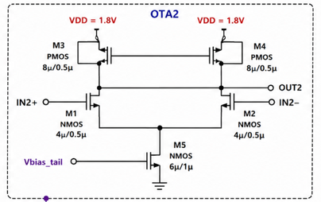
Detailed Circuit Breakdown — OTA2 (Identical Structure, Cascaded)
Same M1–M5 topology as OTA1, driven by Vx instead of Vin
Why identical: matching OTA1 and OTA2's device sizes exactly is what makes the second-order response mathematically predictable — the transfer function H(s) assumes both integrator stages share the same gm/C ratio.
Only difference — inputs: IN2+ = Vx (from OTA1's output/C1 node) instead of Vin; IN2− carries whatever OTA2's own local feedback requires.
Shared resources: OTA2's M5 gate receives the same Vbias_tail signal as OTA1's — both tail currents are set from one shared bias-mirror and one shared CMFB loop (Slide 4g), keeping both stages' operating points locked together.
Statistical Characterization of a Gm-C Filter in SKY130
4f

Slide 10
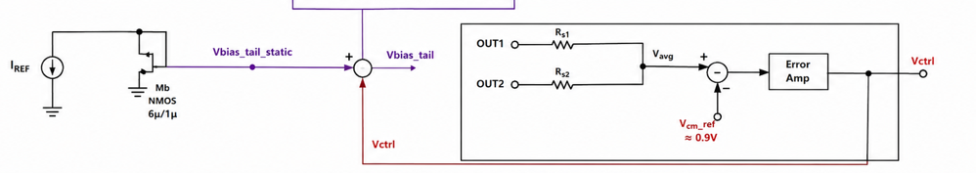
Detailed Circuit Breakdown — Shared Bias Generator + CMFB Loop
The two support circuits that make both OTAs actually work in simulation
I_REF → Mb (diode-connected)
A reference current (bandgap/off-chip, unspecified) flows into Mb, an NMOS diode-connected the same way M3 is — this sets Vbias_tail_static, a fixed reference bias current
Rs1/Rs2 → Vavg
Two resistors average OUT1 and OUT2 — the actual output nodes of both OTAs — producing a measure of the circuit's common-mode (average) output level
Vavg vs. Vcm_ref → Error Amp → Vctrl
The averaged output is compared against a fixed reference (≈0.9V, i.e. VDD/2) through an error amplifier, producing a correction signal Vctrl
Summing node: Vbias_tail_static + Vctrl → Vbias_tail
The static bias and the dynamic CMFB correction combine at ONE explicit summing junction — this is what actually drives both OTAs' M5 gates, preventing the two signals from fighting over the same node
Statistical Characterization of a Gm-C Filter in SKY130
4g

Slide 11
Literature Landscape
Statistical rigor and open-source accessibility have never appeared together at the filter level — until now
Study / Source | Statistical Char.? | Open PDK? | Filter-Level? | Scripts Released?
Aiello et al. — Linear Transconductance OTA [2] | No | Yes | No (device only) | No
Kumngern et al. — 5th-Order Butterworth [1] | Yes (200 MC) | No (TSMC 0.18µm) | Yes | No
SKY130_CT-DSM [3] | No | Yes | No (sub-block) | Partial
AnalogGym (ICCAD 2024) [4] | Framework-level | Yes | N/A | Yes (framework)
SKY130 PVT/MC tooling [5,7] | Yes (cell-level) | Yes | No | Yes (tooling)
PROPOSED STUDY (this work) | Yes (500+ MC + full PVT) | Yes | Yes | Yes (full release)
Sensors 2020 has the statistical rigor but not the open process; open-SKY130 work has the open process but not the statistical rigor. The proposed study is the only entry combining all four properties.
Statistical Characterization of a Gm-C Filter in SKY130
12

Slide 12
Literature References Mapped to Project Components
Each reference is cited for a specific role in the design, methodology, or positioning of this project
Ref. | Source | Role in This Project
[1] | Kumngern et al., Sensors 2020 (5th-Order Butterworth LPF, TSMC 0.18µm) | Methodology template — the 200-run Monte Carlo protocol this project's 500+ run campaign directly adopts and extends (Slide 4: Monte Carlo & PVT methodology)
[2] | Aiello et al. — Linear Transconductance OTA, Open SKY130 PDK | Confirms SKY130 is a credible transconductor-level design platform; the closest prior open-SKY130 OTA work, but stops at the device level (Slide 3: OTA1/OTA2 building blocks)
[3] | SKY130_CT-DSM (GitHub repository) | Flags SKY130's large flicker-noise coefficient — a modeling limitation carried into this project's honest-limitations section (Slide 4: known SKY130 constraints)
[4] | AnalogGym, ICCAD 2024 (arXiv:2409.08534) | Documents open-PDK subthreshold modeling weaknesses generally — grounds this project's decision to cross-validate AC vs. transient results rather than trust one method
[5] | SkyWater SKY130 PDK Documentation | Source of the device models and Monte Carlo/mismatch parameter structure used directly in every simulation (Slide 3: schematic devices M1–M5, Mb)
[6] | IEEE INDICON 2026 Call for Papers | Defines the target venue, submission deadline (31 Aug 2026), and track scope driving the project timeline
[7] | VLSIDA SKY130 Tutorials — Device Models, Binning, Monte Carlo Mismatch | Confirms SKY130 ships corner files (tt/ss/ff) alongside Monte Carlo terms — basis for this project's combined MC + PVT sweep methodology
[9,10] | Silva-Martinez & Vazquez-Gonzalez; Chen et al. (Gm-C/RC tuning under PVT) | Establishes PVT sensitivity (up to 30% time-constant drift uncorrected) as a well-recognized concern — motivates why this project's PVT sweep matters beyond mismatch alone
Statistical Characterization of a Gm-C Filter in SKY130
13

Slide 13
The Gap This Project Fills
GAP IDENTIFIED
HOW THIS PROJECT ADDRESSES IT
Open-SKY130 OTA work exists only at the device level, never assembled into a complete filter.
Two SKY130 transconductor stages are cascaded into a working 2nd-order Gm-C LPF with an output buffer, evaluated as an integrated system.
Statistical (Monte Carlo/PVT) characterization of Gm-C filters exists only in proprietary nodes (e.g., TSMC 0.18µm).
The identical methodology — 500+ MC runs + tt/ss/ff, ±10% supply, −20 to 85°C corners — is applied natively inside the open SKY130 PDK.
Open-source SKY130 filter/OTA papers report only a single nominal-case simulation.
The central deliverable is the full distribution (mean, σ, corner extremes) of fc, Q, and ripple — not one operating point.
No reproducible, openly released netlist/script package exists for SKY130 filter-level statistical analysis.
Every netlist, testbench, MC seed, and analysis script is released on GitHub — histograms are exactly regenerable.
Known SKY130 modeling limitations (flicker noise, subthreshold precision) are rarely stated as explicit boundaries.
These limitations are declared upfront and revisited wherever they could affect a specific reported number.
Statistical Characterization of a Gm-C Filter in SKY130
14

Slide 14
Why This Matters: PVT Sensitivity Is a Known, Quantified Problem
Published figures on how badly uncorrected continuous-time filters drift
30%
50%
2.2%
Typical RC time-constant drift from process variation and temperature alone in uncorrected continuous-time filters [9]
Maximum frequency-response deviation at extreme PVT conditions reported across multiple studies [9,10]
Best-in-class average tuning error achieved by a dedicated auto-tuning scheme in 55nm CMOS [10] — the bar this project's baseline is measured against
The gap: every one of these figures comes from a proprietary process (TSMC, STM PD-SOI, 55nm commercial nodes). No equivalent quantified baseline exists for how badly an open-source SKY130 Gm-C filter drifts — this project produces that missing number.
Sources: Chen et al., "A High-Accuracy RC Time-Constant Auto-Tuning Scheme," Micromachines 15(1):166, 2024 (55nm, master-slave tuning, 2.21% avg / 3.67% max error) · Leynes et al., automatic tuning circuit literature (TSMC 0.35µm, ~30% uncorrected drift, up to 50% at extremes)
Statistical Characterization of a Gm-C Filter in SKY130
15

Slide 15
Methodology — How the Monte Carlo Sweep Actually Runs
SKY130's mismatch infrastructure, as documented by the open-source-silicon community
1
Enable mismatch mode
Testbench includes .param mc_mm_switch=1 at the top — this is the switch that activates SKY130's per-device AGAUSS-based mismatch models, confirmed via the open_pdks project's own maintainer notes [11].
2
Select the statistical corner
Include sky130.lib.spice mc (or the tt_mm/ss_mm variant) rather than a fixed tt/ss/ff corner — this pulls in the Gaussian-distributed device parameters instead of fixed typical values [11,12].
3
Randomize per run
Set .option SEED=<value> (or SEED=random) before each of the 500+ runs — every run then draws a fresh set of randomly perturbed device parameters from the same underlying distributions [11].
4
Extract fc, Q, ripple per run
Each run's AC response is post-processed (Python) to extract the −3dB cutoff frequency, quality factor, and passband ripple — raw data dumped per run rather than relying on in-simulator measurement, for easier debugging and verification.
Note: mismatch coefficients (e.g., vth0_slope) live in the model files but have no independently published silicon-measured validation for SKY130 — motivating this project's Pelgrom cross-check (Slide 11).
Statistical Characterization of a Gm-C Filter in SKY130
16

Slide 16
Methodology — PVT Corner Sweep
Monte Carlo and PVT corners are complementary, not redundant — best practice combines both
Monte Carlo (device mismatch)
PVT Corners (global/systematic)
Samples local, random, device-to-device variation
500+ runs, each with independently perturbed transistor parameters
Reveals the spread a real fabrication batch would show
Captures what corner analysis alone would miss
Process: tt (typical), ss (slow-slow), ff (fast-fast)
Supply: VDD ±10% (1.62V – 1.98V)
Temperature: −20°C to 85°C
Bounds worst-case, die-to-die systematic shift — not random
SKY130-specific tooling and tutorials confirm the process ships separate corner files (typical/slow/fast) alongside built-in Monte Carlo mismatch terms, structured to support exactly this combined approach [7,11].
Statistical Characterization of a Gm-C Filter in SKY130
17

Slide 17
Cross-Validation — Can SKY130's Statistical Models Be Trusted?
The project's central methodological safeguard
The problem: SKY130's mismatch coefficients are embedded in the PDK's model files, but no independently published, silicon-measured mismatch dataset exists to verify them against — a documented limitation, not a hidden one.
Pelgrom hand-calculation
Extract the mismatch slope coefficient (e.g., vth0_slope) directly from the SKY130 model file; hand-compute the expected σ(Vth) vs. 1/√(WL) using the classical Pelgrom matching law; confirm the 500-run Monte Carlo reproduces this independent prediction.
Cross-simulator check (stretch goal)
Where feasible, re-run key Monte Carlo results in a second, independent simulator to confirm findings are not an artifact of one tool's specific implementation of SKY130's mismatch models.
AC vs. transient cross-check
Key AC-domain results (e.g., cutoff frequency) are cross-checked against an independent transient-domain measurement of the same circuit, guarding against method-specific artifacts.
Statistical Characterization of a Gm-C Filter in SKY130
18

Slide 18
Planned Results and Figure List
Every figure maps directly to one of the project's six objectives (Slide 2)
# | Figure | Purpose
1 | Nominal AC response (magnitude, phase) | Confirms baseline design meets fc=1kHz, Q=0.9 before statistics begin
2 | Monte Carlo histogram — cutoff frequency (500+ runs) | Central statistical deliverable — quantifies fc spread
3 | Monte Carlo histogram — quality factor Q | Quantifies Q spread across the same population
4 | Monte Carlo histogram — passband ripple | Completes the three-parameter statistical characterization
5 | PVT corner bar chart (fc shift, 5 corners) | Bounds worst-case systematic drift vs. random mismatch
6 | Pelgrom hand-calc overlay on MC data | Cross-validates SKY130's mismatch model against independent theory
7 | AC vs. transient cross-check plot | Confirms results aren't a single-method artifact
T-I | Summary statistics table (mean, σ, corner extremes) | The designer-facing takeaway — the paper's headline reference table
Statistical Characterization of a Gm-C Filter in SKY130
19

Slide 19
Risks and Mitigations
Grounded in documented, real-world friction reported by the SKY130 community
Risk | Evidence | Mitigation
SKY130 Monte Carlo/mismatch setup has documented rough edges | Community threads report actual ngspice errors from parameter/device-name collisions requiring manual model-file patches [13] | Budget real contingency time; fallback to 200-run campaign (matches Kumngern et al. [1] precedent) if needed
Mismatch coefficients are unverified against real silicon | No published room-temperature silicon-measured mismatch dataset exists for SKY130 [3,14] | Pelgrom hand-calculation cross-check (Slide 11) bounds trust in the models independently
INDICON 2026's 31 Aug deadline is tight | Confirmed date leaves 6–7 weeks total for design + simulation + writing | Front-loaded timeline (Slide 13); PVT sweep can trim to fewer corners if week 5 slips
A closely matching open-SKY130 study is found in a fresh search | Open-SKY130 analog work is proliferating quickly through 2025–2026 | Narrow to a specific sub-angle (tuning-scheme robustness, cross-simulator validation) while keeping core MC infrastructure
Statistical Characterization of a Gm-C Filter in SKY130
21

Slide 20
Target Venues
PRIMARY TARGET
Submission opens 22 Jun 2026 · deadline 31 Aug 2026 · notification 2 Nov 2026 · camera-ready 16 Nov 2026. Track: Electronic Devices, Circuits, VLSI, and Embedded Systems
IEEE INDICON 2026
Secondary target
2025 pattern: submission closed 30 Aug, notification 10 Sept (2026 dates to be confirmed on official site)
IEEE iSES 2026
Additional option
Sept 11–13, 2026, MNIT Jaipur — includes a Graduate Research Forum for student work
IEEE INDISCON 2026
Statistical Characterization of a Gm-C Filter in SKY130
22

Slide 21
Full Reference List
[1] M. Kumngern, K. Aupithak, F. Khateb, T. Kulej, "0.5V Fifth-Order Butterworth Low-Pass Filter Using Multiple-Input OTA for ECG Applications," Sensors, 20(24):7343, 2020.
[2] F. Aiello et al., "Design of a Linear Transconductance OTA using the Open Sky130 Process Design Kit," ResearchGate preprint / SForum 2023.
[3] michaelk99, "SKY130_CT-DSM," GitHub repository, accessed 2026.
[4] Z. Li et al., "AnalogGym: An Open and Practical Testing Suite for Analog Circuit Synthesis," Proc. IEEE/ACM ICCAD, 2024, arXiv:2409.08534.
[5] SkyWater Technology and Google, "SKY130 Open Source PDK Documentation — Simulation," skywater-pdk.readthedocs.io/en/main/sim.html, accessed 2026.
[6] IEEE India Council, "INDICON 2026 Call for Papers," 2026.
[7] VLSI Design Automation (UCSC), "SKY130 PDK: Device Models, Binning, and Monte Carlo Mismatch," Chip Tutorials, GitHub, accessed 2026.
[8] S. Lee and B. Razavi, "Gm-C Filters and Their Applications in RF Front-Ends and Read Channels," general reference.
[9] Arcel G. Leynes et al., "A Simple On-Chip Automatic Tuning Circuit for Continuous-Time Filter," TSMC 0.35µm CMOS — reports ~30% RC time-constant drift from PVT, up to 50% at extremes.
[10] Y. Chen et al., "A High-Accuracy RC Time-Constant Auto-Tuning Scheme for Integrated Continuous-Time Filters," Micromachines, 15(1):166, 2024 — 55nm CMOS, 2.21% avg / 3.67% max tuning error.
[11] open_pdks project (R. Timothy Edwards), community threads on mc_mm_switch, SEED randomization, and mismatch coefficient structure, open-source-silicon.dev, 2021–2022.
[12] lhrodovalho, AICSP2022RAIL testbench example (tb_ol_ac_df_mc.spice), GitHub — reference ngspice mismatch testbench structure.
[13] open-source-silicon.dev community thread on ngspice parameter/device-name collisions in SKY130 mismatch simulation, documenting real setup friction.
[14] Beall et al., "DC Cryogenic Modeling of Open-Source SkyWater 130nm MOSFETs at 77K Using BSIM4," arXiv:2604.21625 — confirms no experimentally validated mismatch/corner data exists for SKY130 even in extended studies.
Statistical Characterization of a Gm-C Filter in SKY130
23

