Slide 1
FINAL REVIEW · SIMULATION-ONLY RESEARCH PROJECT — SKY130 / ngspice
Statistical Characterization of a Gm-C Continuous-Time Filter
in the Open-Source SKY130 PDK
A Monte Carlo and PVT-Corner Study, with a PTAT-Biased Design That Recovers Yield

Slide 2
Agenda
What this review covers, in the order of the slides
1
Objective
Slides 3–5
2
Circuit
Slides 6–13
What the project sets out to do and what changed since Review 1
3-OTA Gm-C biquad, OTA, bias schemes, equations
3
Literature review
Slides 14–17
4
Methodology
Slides 18–21
Prior work, the verified gap, and what this project adds
PVT grid, Monte Carlo, cross-validation
5
Output
Slides 22–27
6
Demonstration
Slides 28–31
Nominal response, distributions, yield, PTAT core
Live Monte Carlo and PVT app, run-of-show, cross-checks
7
Output explanation
Slides 32–33
8
Conclusion, risks, references
Slides 34–37
How to read every plot, and the three design lessons
Findings, limits, future scope, open items
Statistical Characterization of a Gm-C Filter in SKY130
2

Slide 3
Objective of the Project
To statistically characterize — not just verify at a single nominal point — how much a second-order Gm-C low-pass filter's cutoff frequency, quality factor, and passband ripple actually vary once realistic device mismatch and PVT conditions are accounted for, entirely within the free, open-source SKY130 process.
1
2
3
Design a working Gm-C filter
Quantify statistical spread via Monte Carlo
Quantify PVT robustness
Second-order Gm-C biquad from three identical SKY130 OTAs (mirror load, tail current source) and two 10 pF capacitors, targeting fc = 1.6 MHz, Q = 0.707, with a PTAT-referenced bias current.
Run 750 randomized mismatch simulations per PVT condition (33,750 per design) using SKY130's statistical models; report the distributions of f3, Q, ripple and spec yield.
Sweep five process corners (tt/ss/ff/sf/fs), supply ±10% and −20 to 85°C (45 conditions), comparing fixed voltage bias against PTAT bias.
4
5
6
Cross-validate the results
Fill a verified literature gap
Release everything openly
AC results agree with transient simulation (within 0.03 dB) and a tight-tolerance solver rerun (within 0.2%). A second simulator, Xyce 7.10, matches ngspice on the nominal response (0.001%) and on 30 injected-mismatch runs (within 0.003%).
No published work combines statistical characterization + open-source PDK + complete filter + released netlists — this project sits at that four-way intersection (see Slide 16).
All netlists, Monte Carlo seeds, analysis scripts and the live lab app are archived with checksums for open release on GitHub, a reusable reference and not just a set of numbers.
Statistical Characterization of a Gm-C Filter in SKY130
3

Slide 4
Review 1 vs Final Review — What Changed
The plan presented at Review 1 against what was delivered
 | Review 1 (plan) | Final review (delivered)
Circuit | 2 OTAs with CMFB, output buffer and R_fb/C_fb (schematic only) | 3-OTA biquad with PTAT current bias, simulated and measured
Target | fc = 1 kHz, Q = 0.9 | fc = 1.6 MHz, Q target 0.707, achieved about 0.72
Monte Carlo | 500+ runs (fallback 200) | 750 runs at each of 45 conditions: 33,750 runs per design
PVT sweep | tt / ss / ff, ±10% supply, −20 to 85 °C | 5 corners × 3 supplies × 3 temperatures, full Monte Carlo at every point
Question | How much do f3, Q and ripple spread? | Same, plus: can the bias scheme recover yield? Yes
Headline result | None yet, figures only planned | Yield 22.4% → 88.7% (ideal ref.), 71.7% (transistor-level ref.); worst mean f3 error 0.94 → 0.08 / 0.29 MHz
Validation | Pelgrom check, AC vs transient, Xyce nominal check | Sensitivity check 5.6% vs 5.9%; AC vs transient 0.03 dB; tolerance rerun 0.2%; Xyce nominal 0.001%, 30 injected draws 0.003%
Release | GitHub release of netlists and scripts | Archive with checksums and live lab app built; GitHub publication pending
Status | Proposal and design stage | Study complete, report written
Statistical Characterization of a Gm-C Filter in SKY130
4

Slide 5
Six Objectives — Where Each One Stands
Objectives as stated at Review 1, with the final status
# | Objective (Review 1) | Final status
1 | Design a working Gm-C filter | MET — retargeted to 1.6 MHz, Q 0.72, three-OTA biquad
2 | 500+ Monte Carlo runs: f3, Q, ripple | EXCEEDED — 750 runs per condition, 33,750 per design; ripple mean 0.03 dB, max 0.35 dB
3 | PVT robustness sweep | EXCEEDED — 5 corners, 45 conditions, plus a voltage vs PTAT comparison
4 | Cross-validate the results | DONE — sensitivity, AC vs transient, tolerance rerun, Xyce nominal and injected-mismatch match
5 | Fill a verified literature gap | MET — open-PDK, filter-level baseline plus a quantified recovery; search to be repeated
6 | Release everything openly | PENDING — archive and lab app ready; GitHub publication outstanding
Statistical Characterization of a Gm-C Filter in SKY130
5

Slide 6
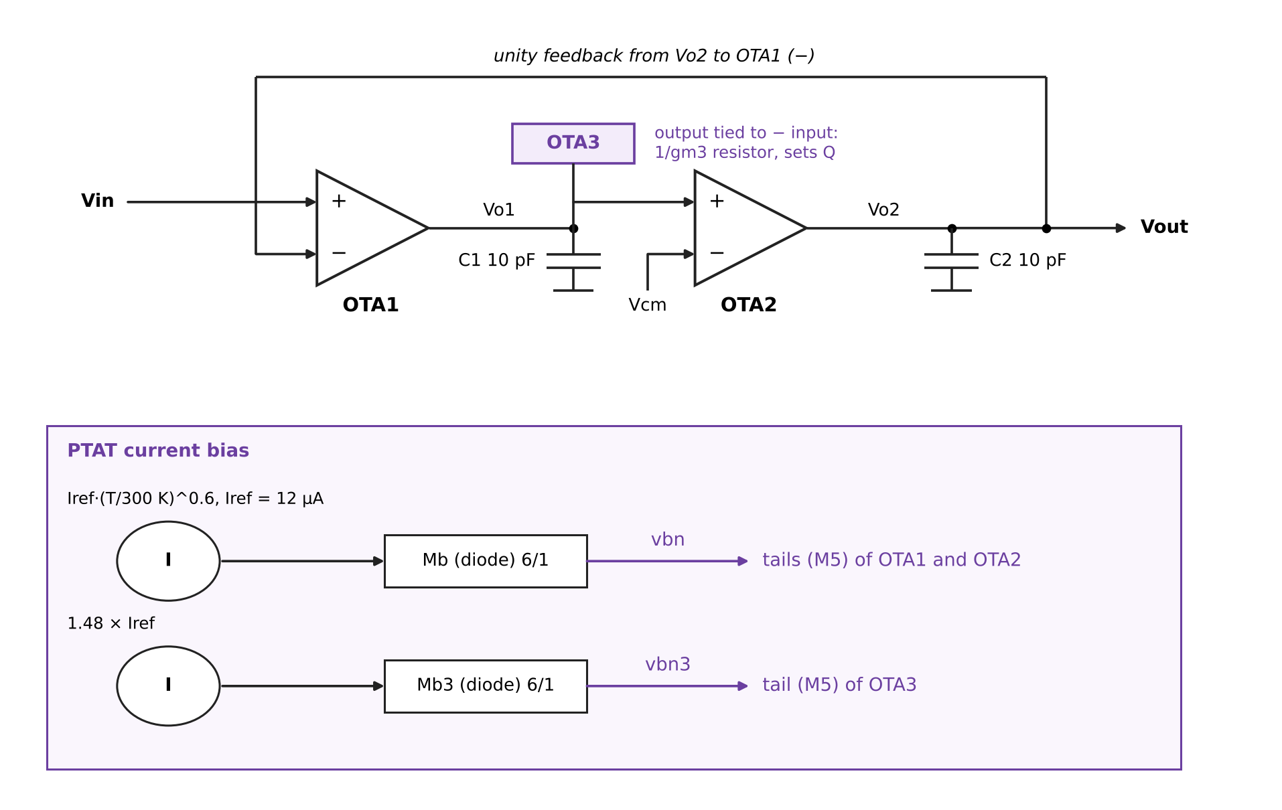
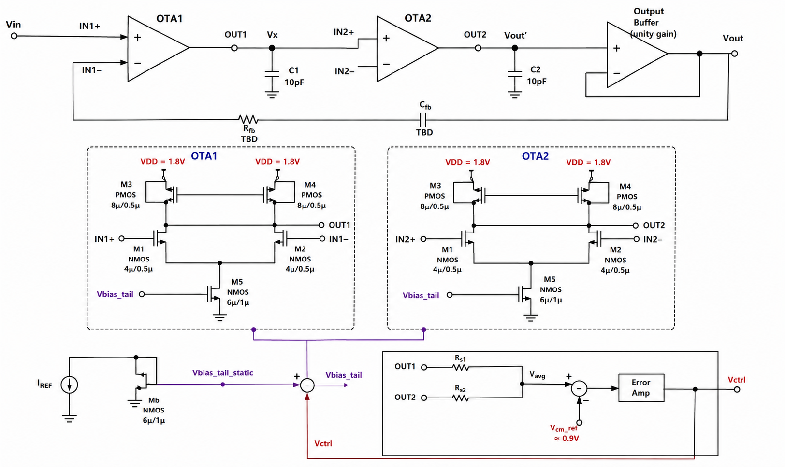
Circuit Under Test
Three-OTA Gm-C second-order low-pass filter with PTAT current bias (SKY130)
Statistical Characterization of a Gm-C Filter in SKY130
6

Slide 7
Circuit Architecture — Key Sub-Blocks
OTA1 / OTA2 / OTA3
PTAT Tail Current Bias
M1/M2 differential pair (4µ/0.5µ) · M3 diode-connected, M4 mirror (8µ/0.5µ PMOS load) · M5 tail (6µ/1µ). Three identical cells; OTA1 and OTA2 integrate onto C1 and C2.
I = Iref·(T/300 K)^0.6 with Iref = 12 µA into diode-connected Mb (6µ/1µ), mirrored to the M5 gates of OTA1 and OTA2. OTA3's tail takes 1.48 × Iref.
OTA3: Q Control
Feedback and Output
Output tied to its inverting input, so it acts as a 1/gm3 resistor across C1. The tail-current ratio of 1.48 sets Q ≈ 0.72.
Vo2 feeds back directly to OTA1's inverting input (no R_fb/C_fb). The filter output is taken at Vo2, with no output buffer.
Statistical Characterization of a Gm-C Filter in SKY130
7

Slide 8
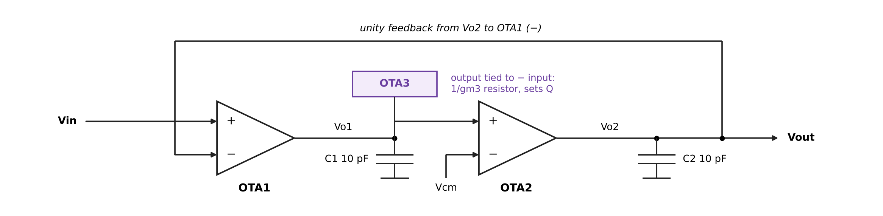
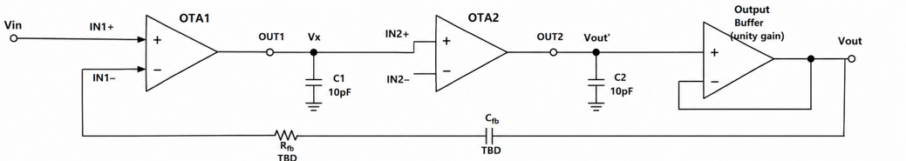
Detailed Circuit Breakdown — Signal Flow
Vin enters OTA1, integrates through OTA1 and OTA2 onto Vo1 and Vo2, and exits at Vo2 (OTA3 damps Vo1)
Vin → OTA1: the input signal drives OTA1's non-inverting input (IN1+)
IN1− carries the unity feedback from Vo2. OUT1/Vo1 → OTA2: OTA1's output charges C1 (10pF); OTA3, tied as a resistor, damps this node, and Vo1 drives OTA2's non-inverting input.
OUT2/Vo2 → Vout: OTA2's output charges C2; the filter output is taken directly at Vo2 (no buffer) and fed back to OTA1.
Statistical Characterization of a Gm-C Filter in SKY130
8

Slide 9
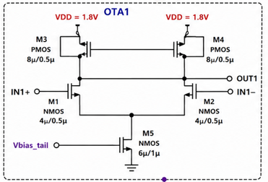
Detailed Circuit Breakdown — Input Differential Pair (M1, M2)
Identical structure in OTA1, OTA2 and OTA3
Devices
M1, M2 — NMOS, sky130_fd_pr__nfet_01v8, W/L = 4µ/0.5µ
Role
Converts the differential input voltage (IN+/IN−) into a differential drain current — this is the transconductance (gm) stage that gives the OTA its name
Connections
Gates = IN1+/IN1− (the two OTA inputs). Sources joined at one common node, which drops to M5's drain (the tail). Drains feed up into M3/M4 (the mirror load)
Why 4µ/0.5µ
Sized via gm/ID methodology to hit the target gm ≈ 100 µA/V needed for fc = 1.6 MHz with C1/C2 = 10pF (fc = gm/2πC); larger devices reduce mismatch (Pelgrom's law) at the cost of more parasitic capacitance
Statistical Characterization of a Gm-C Filter in SKY130
9

Slide 10
Detailed Circuit Breakdown — PMOS Current-Mirror Load (M3, M4)
The active load that converts differential current into a usable output voltage
Devices
M3, M4 — PMOS, sky130_fd_pr__pfet_01v8, W/L = 8µ/0.5µ
M3 — diode-connected
Gate tied directly to its own drain. This sets a fixed reference voltage that establishes the mirror's bias point — a self-biasing configuration, not an externally supplied one
M4 — mirror device
Gate tied to M3's gate (not its own drain), so it copies M3's gate-source voltage. Since M1's current sets M3's operating point, M4 mirrors that same current onto M2's side — but any imbalance in M1/M2's currents shows up as a voltage swing at OUT1
Why PMOS (not NMOS)
Sources connect to VDD, which lets the drains sit at a mid-rail voltage suitable for driving the next stage — a standard choice for an NMOS-input differential pair
Statistical Characterization of a Gm-C Filter in SKY130
10

Slide 11
Detailed Circuit Breakdown — Tail Current Source (M5)
Sets the total bias current available to the differential pair
Device
M5 — NMOS, sky130_fd_pr__nfet_01v8, W/L = 6µ/1µ
Role
Drain connects to the M1/M2 common-source node; source to ground. Acts as a current sink, fixing the total current that M1 and M2 must share between them
Gate drive
Gate = vbn from the PTAT-referenced mirror (vbn3 for OTA3): a fixed mirror voltage, not a CMFB-corrected node. See Slide 13.
Why this matters for gm
The tail current sets M1/M2's operating point and therefore gm; since fc = gm/C, this node is the filter's tuning handle, and making the current PTAT cancels the temperature drift of gm
Statistical Characterization of a Gm-C Filter in SKY130
11

Slide 12
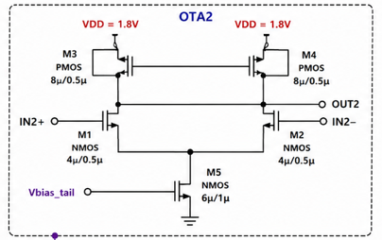
Detailed Circuit Breakdown — OTA2 and OTA3 (Identical Structure)
Same M1–M5 topology as OTA1, used as an integrator (OTA2) and as a damping element (OTA3)
Why identical: matching the three OTAs' device sizes keeps the transfer function predictable; the biquad's gm ratios come from the bias currents, not from sizing.
Connections: OTA2: IN+ = Vo1, IN− = Vcm, output Vo2. OTA3: IN+ = Vcm, IN− and output both at Vo1, so it behaves as a resistor of 1/gm3 across C1.
Shared resources: OTA1 and OTA2 tails take vbn; OTA3's tail takes vbn3 = 1.48 × Iref from the Mb3 branch.
Statistical Characterization of a Gm-C Filter in SKY130
12

Slide 13
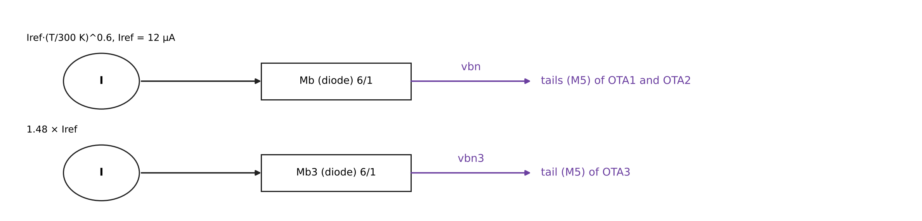
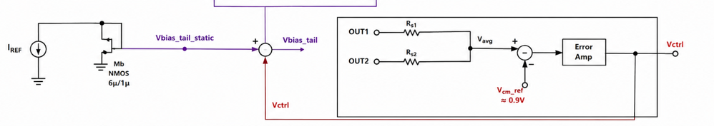
Detailed Circuit Breakdown — PTAT Current Bias Generator
The bias circuit that holds fc steady across temperature
Iref(T) = 12 µA × (T/300.15 K)^0.6
An ideal reference with exponent 0.6 keeps gm and f3 flat from −20 to 85 °C (upper bound). A transistor-level beta-multiplier core (exponent about 0.66) was also simulated.
Mb → vbn
Diode-connected NMOS Mb (6µ/1µ) converts the current to the gate voltage vbn, which drives the M5 tails of OTA1 and OTA2
Second leg: 1.48 × Iref → vbn3
A ratioed second reference sets OTA3's tail. The ratio rt = 1.48 sets Q ≈ 0.72 and is the most sensitive parameter (±5% moves yield by up to about 10 points)
Transistor-level check
With the core's own mismatch and supply sensitivity (1,800 runs): mean yield 71.7% (ideal source 88.7%, voltage bias 22.4%). The core's supply dependence is the main loss
Statistical Characterization of a Gm-C Filter in SKY130
13

Slide 14
Literature Landscape
Statistical rigor and open-source accessibility have never appeared together at the filter level — until now
Study / Source | Statistical Char.? | Open PDK? | Filter-Level? | Scripts Released?
Aiello et al. — Linear Transconductance OTA [2] | No | Yes | No (device only) | No
Kumngern et al. — 5th-Order Butterworth [1] | Yes (200 MC) | No (TSMC 0.18µm) | Yes | No
SKY130_CT-DSM [3] | No | Yes | No (sub-block) | Partial
AnalogGym (ICCAD 2024) [4] | Framework-level | Yes | N/A | Yes (framework)
SKY130 PVT/MC tooling [5,7] | Yes (cell-level) | Yes | No | Yes (tooling)
PROPOSED STUDY (this work) | Yes (750 MC × 45 PVT) | Yes | Yes | Yes (full release)
Sensors 2020 has the statistical rigor but not the open process; open-SKY130 work has the open process but not the statistical rigor. The proposed study is the only entry combining all four properties.
Statistical Characterization of a Gm-C Filter in SKY130
14

Slide 15
Literature References Mapped to Project Components
Each reference is cited for a specific role in the design, methodology, or positioning of this project
Ref. | Source | Role in This Project
[1] | Kumngern et al., Sensors 2020 (5th-Order Butterworth LPF, TSMC 0.18µm) | Methodology template — the 200-run Monte Carlo protocol this project's 500+ run campaign directly adopts and extends (Slide 18: Monte Carlo & PVT methodology)
[2] | Aiello et al. — Linear Transconductance OTA, Open SKY130 PDK | Confirms SKY130 is a credible transconductor-level design platform; the closest prior open-SKY130 OTA work, but stops at the device level (Slide 7: OTA1/OTA2 building blocks)
[3] | SKY130_CT-DSM (GitHub repository) | Flags SKY130's large flicker-noise coefficient — a modeling limitation carried into this project's honest-limitations section (Slide 34: known SKY130 constraints)
[4] | AnalogGym, ICCAD 2024 (arXiv:2409.08534) | Documents open-PDK subthreshold modeling weaknesses generally — grounds this project's decision to cross-validate AC vs. transient results rather than trust one method
[5] | SkyWater SKY130 PDK Documentation | Source of the device models and Monte Carlo/mismatch parameter structure used directly in every simulation (Slides 9–11: schematic devices M1–M5, Mb)
[6] | IEEE INDICON 2026 Call for Papers | Defines the target venue, submission deadline (31 Aug 2026), and track scope driving the project timeline
[7] | VLSIDA SKY130 Tutorials — Device Models, Binning, Monte Carlo Mismatch | Confirms SKY130 ships corner files (tt/ss/ff) alongside Monte Carlo terms — basis for this project's combined MC + PVT sweep methodology
[9,10] | Silva-Martinez & Vazquez-Gonzalez; Chen et al. (Gm-C/RC tuning under PVT) | Establishes PVT sensitivity (up to 30% time-constant drift uncorrected) as a well-recognized concern — motivates why this project's PVT sweep matters beyond mismatch alone
Statistical Characterization of a Gm-C Filter in SKY130
15

Slide 16
The Gap This Project Fills
GAP IDENTIFIED
HOW THIS PROJECT ADDRESSES IT
Open-SKY130 OTA work exists only at the device level, never assembled into a complete filter.
Three SKY130 OTAs form a working 2nd-order Gm-C low-pass biquad, evaluated as an integrated system.
Statistical (Monte Carlo/PVT) characterization of Gm-C filters exists only in proprietary nodes (e.g., TSMC 0.18µm).
The identical methodology, 750 MC runs × 45 PVT conditions (5 corners, ±10% supply, −20 to 85°C), is applied natively inside the open SKY130 PDK.
Open-source SKY130 filter/OTA papers report only a single nominal-case simulation.
The central deliverable is the full distribution (mean, σ, corner extremes) of fc, Q, and ripple — not one operating point.
No reproducible, openly released netlist/script package exists for SKY130 filter-level statistical analysis.
Every netlist, testbench, MC seed, and analysis script is archived with checksums for GitHub release — histograms are exactly regenerable.
Known SKY130 modeling limitations (flicker noise, subthreshold precision) are rarely stated as explicit boundaries.
These limitations are declared upfront and revisited wherever they could affect a specific reported number.
Statistical Characterization of a Gm-C Filter in SKY130
16

Slide 17
Why This Matters: PVT Sensitivity Is a Known, Quantified Problem
Published figures on how badly uncorrected continuous-time filters drift
30%
50%
2.2%
Typical RC time-constant drift from process variation and temperature alone in uncorrected continuous-time filters [9]
Maximum frequency-response deviation at extreme PVT conditions reported across multiple studies [9,10]
Best-in-class average tuning error achieved by a dedicated auto-tuning scheme in 55nm CMOS [10] — the bar this project's baseline is measured against
The gap: every one of these figures comes from a proprietary process (TSMC, STM PD-SOI, 55nm commercial nodes). No equivalent quantified baseline exists for how badly an open-source SKY130 Gm-C filter drifts — this project produces that missing number. Result: fixed voltage bias drifts 0.94 MHz (59%) in mean f3 across 45 conditions; PTAT bias holds 0.08 MHz (5%) with an ideal reference and 0.29 MHz (18%) with a transistor-level reference core.
Sources: Chen et al., "A High-Accuracy RC Time-Constant Auto-Tuning Scheme," Micromachines 15(1):166, 2024 (55nm, master-slave tuning, 2.21% avg / 3.67% max error) · Leynes et al., automatic tuning circuit literature (TSMC 0.35µm, ~30% uncorrected drift, up to 50% at extremes)
Statistical Characterization of a Gm-C Filter in SKY130
17

Slide 18
Methodology — How the Monte Carlo Sweep Actually Runs
SKY130's mismatch infrastructure, as documented by the open-source-silicon community
1
Enable mismatch mode
Testbench uses a _mm corner (tt_mm, ss_mm, ...), which sets MC_MM_SWITCH=1 globally; the PDK has no per-device mismatch switch (open_pdks maintainer notes [11]).
2
Select the statistical corner
Include the _mm corner variant (e.g. sky130.lib.spice tt_mm) rather than a fixed corner, so Gaussian-distributed device mismatch is applied on top of the corner's process parameters [11,12].
3
Randomize per run
Seed with setseed, then call reset before each of the 750 runs; every run draws a fresh set of perturbed device parameters from the same distributions [11].
4
Extract fc, Q, ripple per run
Each run's AC response is measured in ngspice (−3 dB frequency f3; −90° frequency f90, from which Q is derived) and written per run; statistics and plots are made in Python.
Note: mismatch coefficients (e.g., vth0_slope) live in the model files but have no independently published silicon-measured validation for SKY130 — motivating this project's Pelgrom cross-check (Slide 20).
Statistical Characterization of a Gm-C Filter in SKY130
18

Slide 19
Methodology — PVT Corner Sweep
Monte Carlo and PVT corners are complementary, not redundant — best practice combines both
Monte Carlo (device mismatch)
PVT Corners (global/systematic)
Samples local, random, device-to-device variation
750 runs per condition, each with independently perturbed transistor parameters
Reveals the spread a real fabrication batch would show
Captures what corner analysis alone would miss
Process: tt, ss, ff, sf, fs (five corners)
Supply: VDD ±10% (1.62V – 1.98V)
Temperature: −20°C to 85°C
Bounds worst-case, die-to-die systematic shift — not random
SKY130-specific tooling and tutorials confirm the process ships separate corner files (typical/slow/fast) alongside built-in Monte Carlo mismatch terms, structured to support exactly this combined approach [7,11].
Statistical Characterization of a Gm-C Filter in SKY130
19

Slide 20
Cross-Validation — Can SKY130's Statistical Models Be Trusted?
The project's central methodological safeguard
The problem: SKY130's mismatch coefficients are embedded in the PDK's model files, but no independently published, silicon-measured mismatch dataset exists to verify them against — a documented limitation, not a hidden one.
Sensitivity (Pelgrom-style) check
Per-device σ(Vgs) from the PDK mismatch slopes (pair 2.8 mV, tail 1.5 mV, load 2.9 mV), propagated through simulated sensitivities, predicts f3 σ 5.6% and Q σ 3.6%. The 750-run Monte Carlo gives 5.9% and 3.7%.
Cross-simulator check (Xyce, passed)
Same netlist in Xyce 7.10: DC point matches to ~6 digits; nominal f3 and Q agree to 0.001%. Xyce ignores the PDK mismatch model, so the same 30 injected gate-offset draws ran in both: per-run f3 differs by at most 0.003%, Q by 0.014%. Checks the simulator, not the PDK's mismatch statistics. Tolerance rerun: f3 changes by at most 0.2%.
AC vs. transient cross-check
AC and transient simulations of the same circuit agree within 0.03 dB and 0.14° from 100 kHz to 6.4 MHz; a transient step gives 4.8% overshoot, close to the 4.3% ideal for Q = 0.707.
Statistical Characterization of a Gm-C Filter in SKY130
20

Slide 21
Results and Figure List — Planned at Review 1, Delivered Now
Every figure maps directly to one of the project's six objectives (Slide 3)
# | Figure | Purpose
1 | Nominal AC response (magnitude, phase) | Confirms baseline design meets fc = 1.6 MHz, Q ≈ 0.72 before statistics begin
2 | Monte Carlo histogram — cutoff frequency (750 runs per condition) | Central statistical deliverable — quantifies fc spread
3 | Monte Carlo histogram — quality factor Q | Quantifies Q spread across the same population
4 | Monte Carlo histogram — passband ripple | Completes the three-parameter statistical characterization
5 | PVT comparison: f3 shift and yield, voltage vs PTAT bias | Bounds worst-case systematic drift vs. random mismatch
6 | Sensitivity-predicted spread vs Monte Carlo (numbers: 5.6% vs 5.9%) | Cross-validates SKY130's mismatch model against independent theory
7 | AC vs. transient cross-check (numbers: within 0.03 dB, 0.14°) | Confirms results aren't a single-method artifact
T-I | Summary statistics table (mean, σ, corner extremes) | The designer-facing takeaway — the paper's headline reference table
Statistical Characterization of a Gm-C Filter in SKY130
21

Slide 22
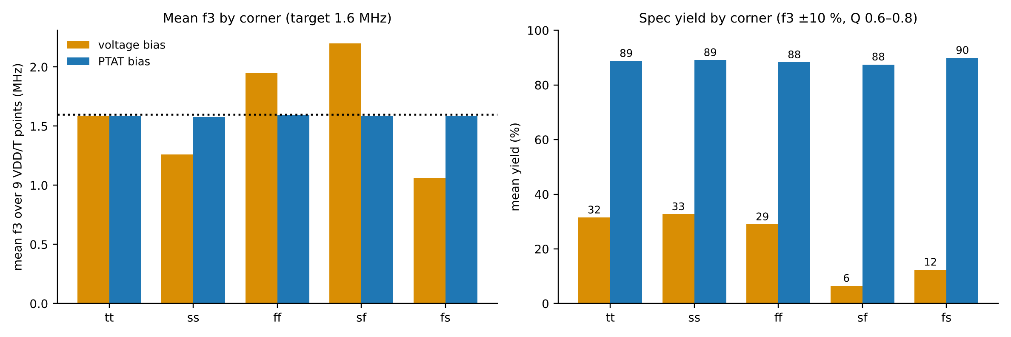
Results — PVT Drift and Yield: Voltage Bias vs PTAT Bias
45 PVT conditions × 750 Monte Carlo runs each, per design
PTAT bias raises mean yield from 22.4% to 88.7% with an ideal reference (87–90% in every corner) and to 71.7% with a transistor-level reference core (slide 26); worst mean f3 error falls from 0.94 MHz (59%) to 0.08 MHz (5%) ideal, 0.29 MHz (18%) transistor-level.
Statistical Characterization of a Gm-C Filter in SKY130
22

Slide 23
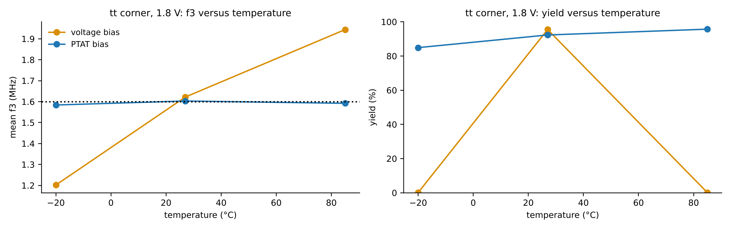
Results — Temperature Behaviour and Mismatch Spread
Typical corner, 1.8 V; mismatch statistics from 750-run sets
PTAT bias removes drift but not mismatch: f3 σ is 6.1% (voltage bias 5.3%); a ×4 reference mirror cuts it to 4.8% (97% yield at 27 °C) at about 70% more power. Worst case: sf, 1.62 V, −20 °C at 73% yield.
Statistical Characterization of a Gm-C Filter in SKY130
23

Slide 24
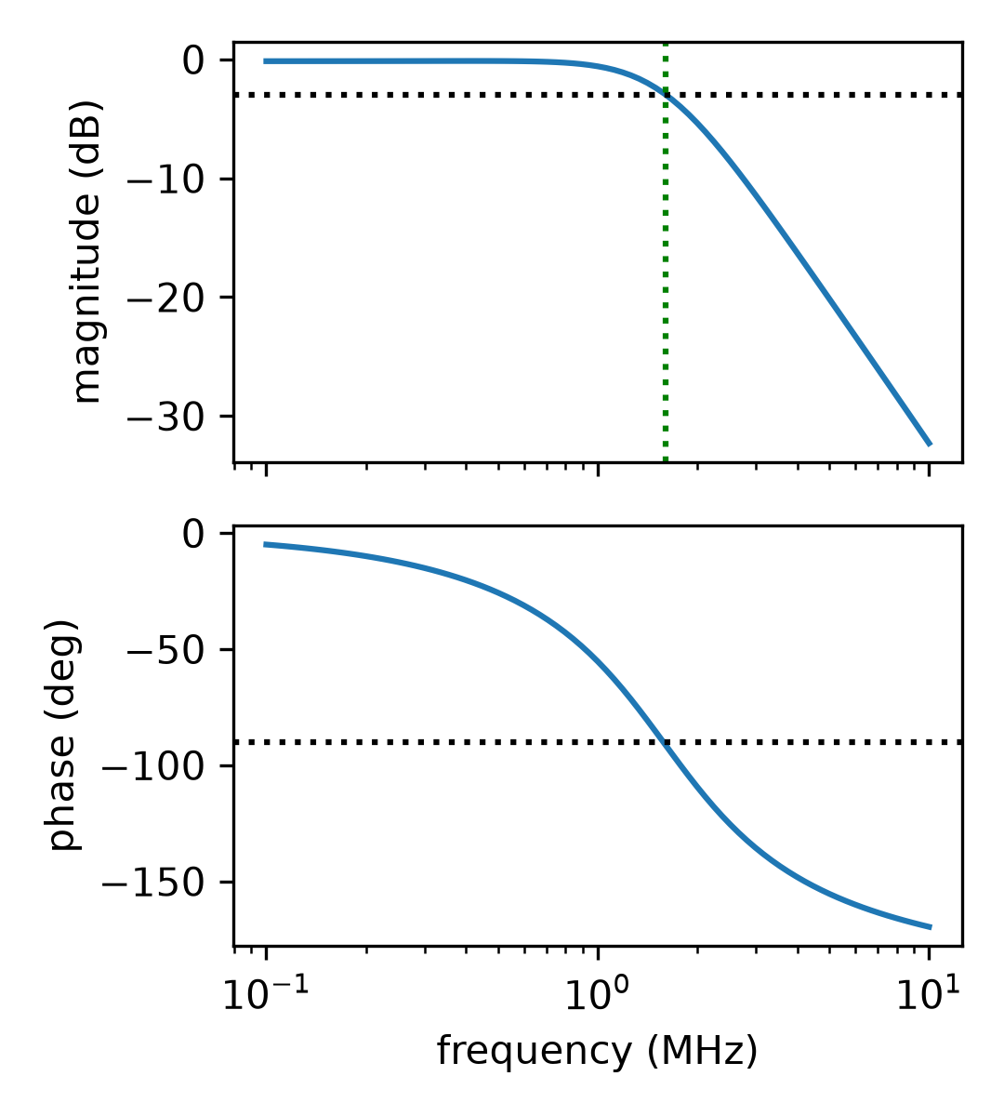
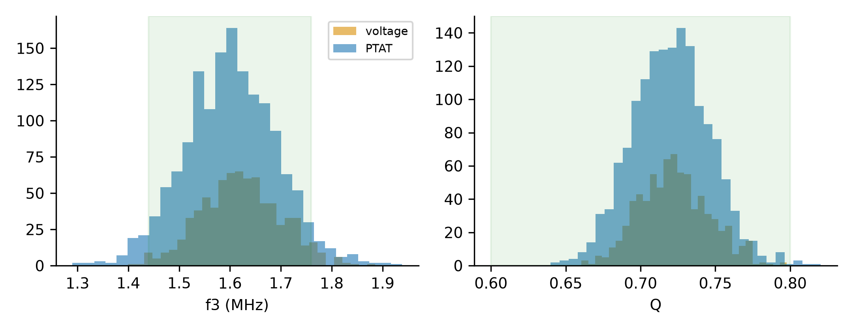
Results — Nominal Response and Monte Carlo Distributions
Simulated with ngspice 47 in SKY130A: nominal AC response, and f3 and Q histograms at tt, 1.8 V, 27 °C
Nominal f3 1.610 MHz, Q 0.722. Histograms: PTAT 1500 runs (seed 2), voltage bias 750 runs; green band = spec window (f3 ±10 %, Q 0.6–0.8).
Statistical Characterization of a Gm-C Filter in SKY130
24

Slide 25
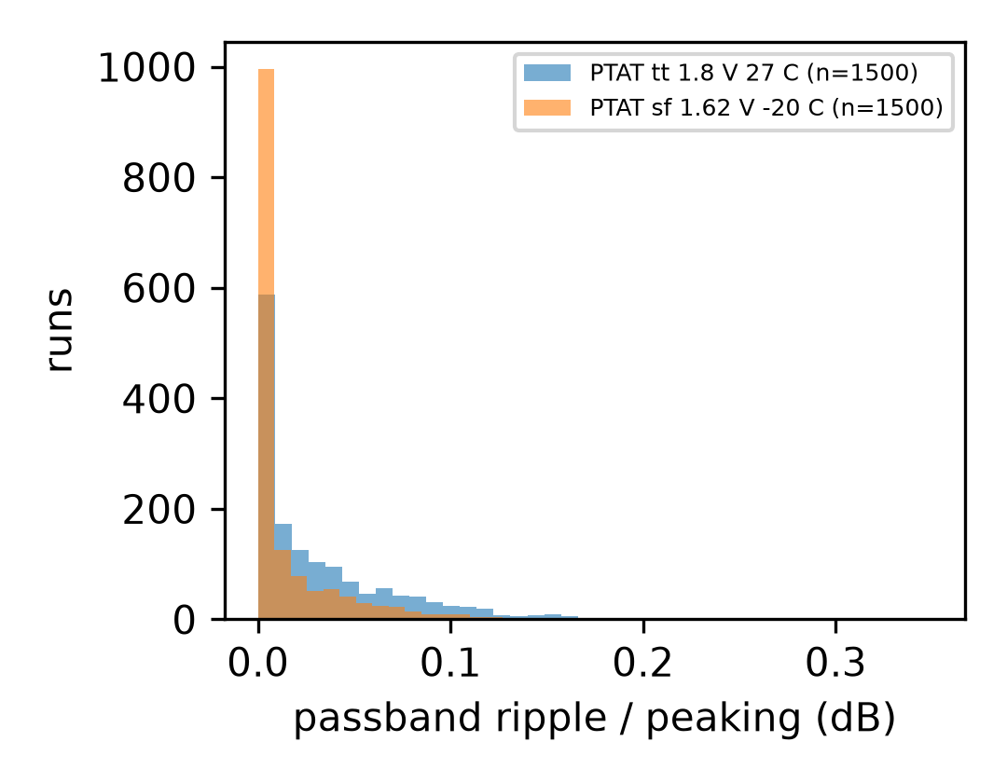
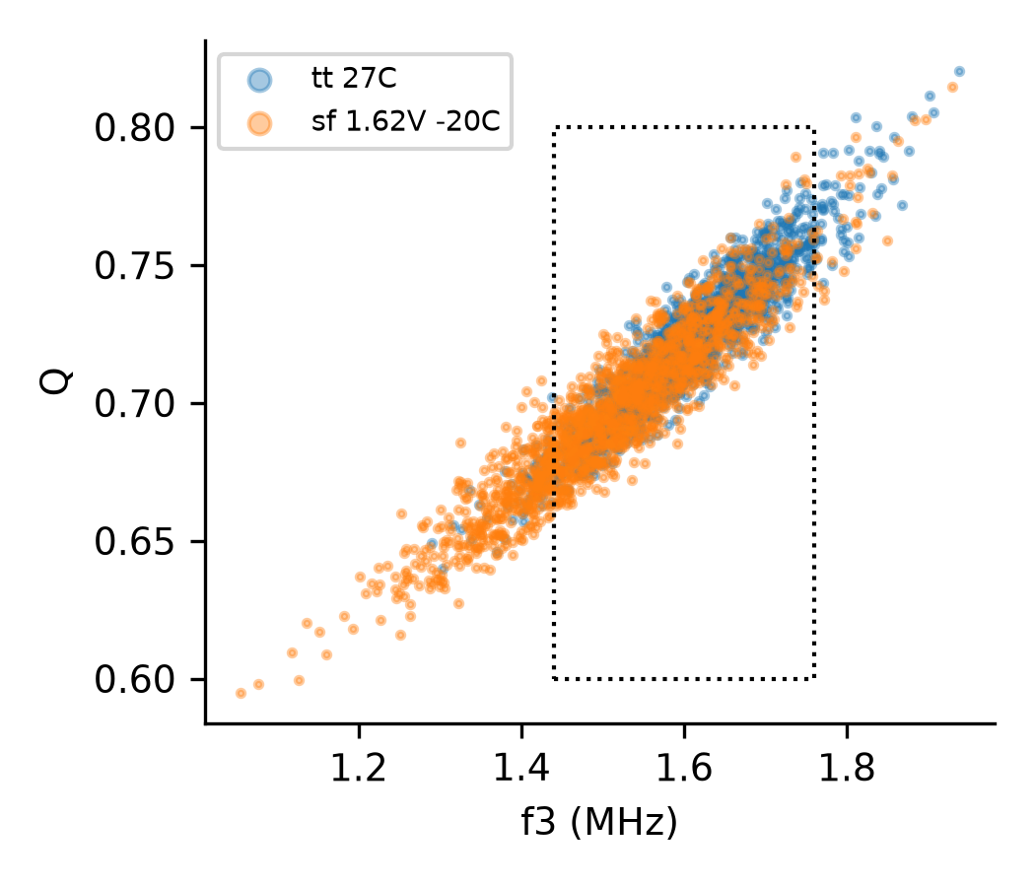
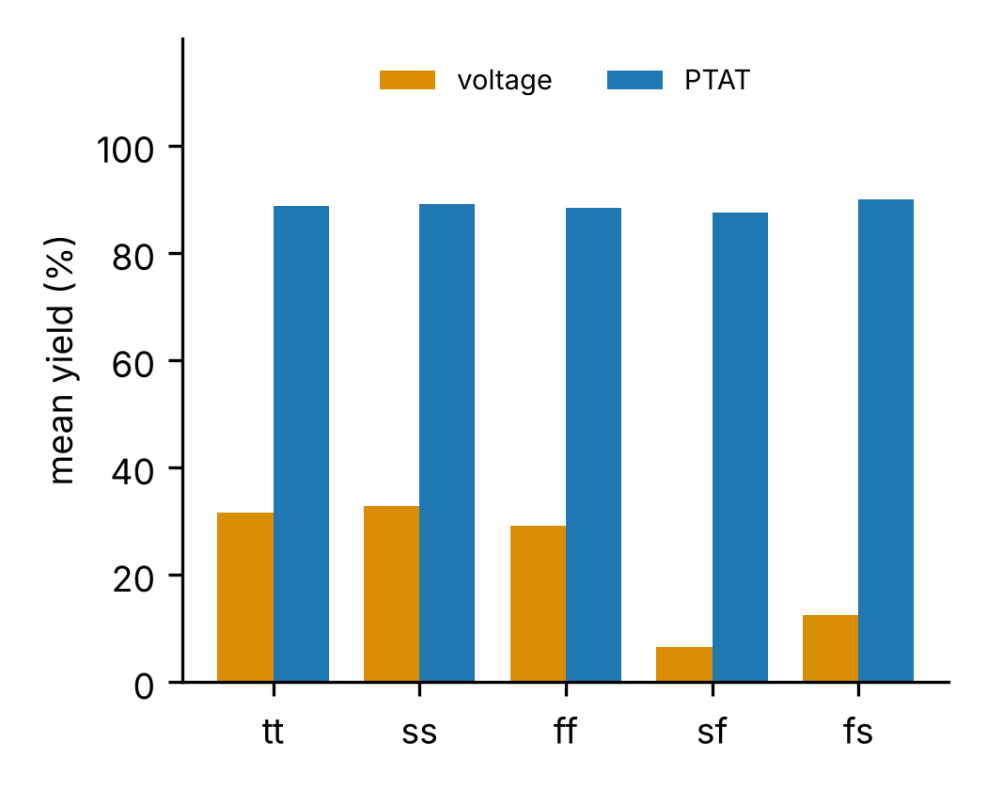
Results — Ripple, f3–Q Correlation and Yield by Corner
PTAT bias; passband ripple is gain peaking above the passband gain
Ripple mean 0.033 dB, largest run 0.35 dB. f3 and Q move together under mismatch. PTAT yield 87.5–89.9 % in every corner vs 6.5–32.7 % for voltage bias.
Statistical Characterization of a Gm-C Filter in SKY130
25

Slide 26
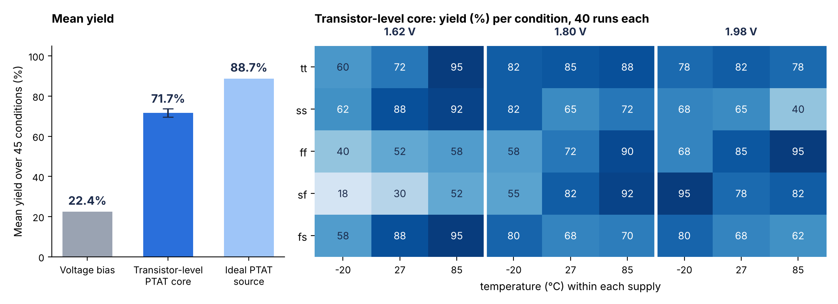
Results — Transistor-Level PTAT Bias Core
Beta-multiplier core (poly resistor, natural exponent about 0.66, 12 µA) with mismatch on filter and core: 45 conditions × 40 runs
Mean yield 71.7 % (±2 %): about 3.2× voltage bias, 17 points below the ideal source. Worst: sf, 1.62 V, −20 °C at 17.5 %; best 95 %. The core's supply sensitivity is the main loss.
Statistical Characterization of a Gm-C Filter in SKY130
26

Slide 27
Results — Key Numbers at a Glance
Three ways to set the bias current, same filter, same 45 PVT conditions and mismatch model
Metric | Fixed voltage bias | Ideal PTAT current | Transistor-level PTAT core
Mean yield over 45 conditions | 22.4 % | 88.7 % | 71.7 %
Worst mean f3 shift across PVT | 0.944 MHz | 0.084 MHz | 0.285 MHz
f3 spread σ (tt, 1.8 V, 27 °C) | 5.32 % | 6.07 % | 6.75 %
Worst condition | −20 °C and 85 °C: ≈ 0.1 % | still ≥ 87 % per corner | sf, 1.62 V, −20 °C: 17.5 %
Gain over voltage bias | — | ≈ 4× yield | ≈ 3.2× yield
Cost / note | Simplest, no extra circuit | Reference model, not a circuit | Real core; supply sensitivity is the loss
88.7 %
0.084 MHz
71.7 %
yield with ideal PTAT bias (vs 22.4 %)
worst f3 shift with PTAT (vs 0.944 MHz)
yield with a real transistor-level core
Yield = fraction of Monte Carlo runs with f3 within ±10 % of 1.6 MHz and Q in 0.6–0.8. Yield ±0.4 points (ideal PTAT, voltage bias, 750 runs × 45 conditions); ±2 points for the transistor-level core (40 runs × 45).
Statistical Characterization of a Gm-C Filter in SKY130
27

Slide 28
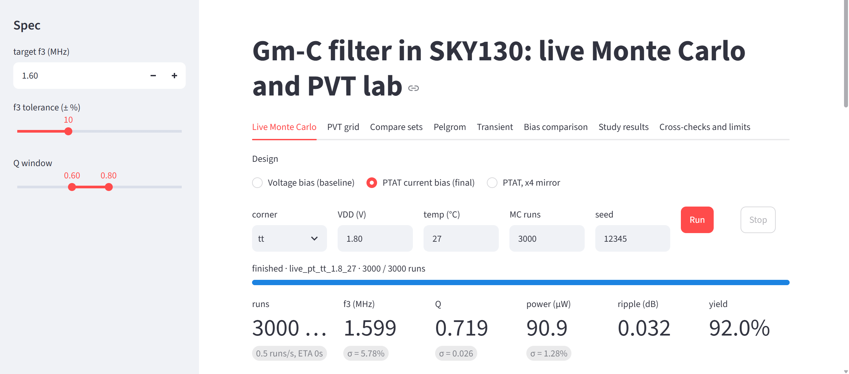
Demonstration — Live Monte Carlo and PVT Lab
A browser app drives ngspice in SKY130A: choose bias scheme, corner, VDD, temperature, runs and seed, then press Run
Run shown: PTAT current bias, tt, 1.8 V, 27 °C, 3000 runs, seed 12345 → f3 1.599 MHz (σ 5.78 %), Q 0.719, 90.9 µW, ripple 0.032 dB, yield 92.0 %.
Statistical Characterization of a Gm-C Filter in SKY130
28

Slide 29
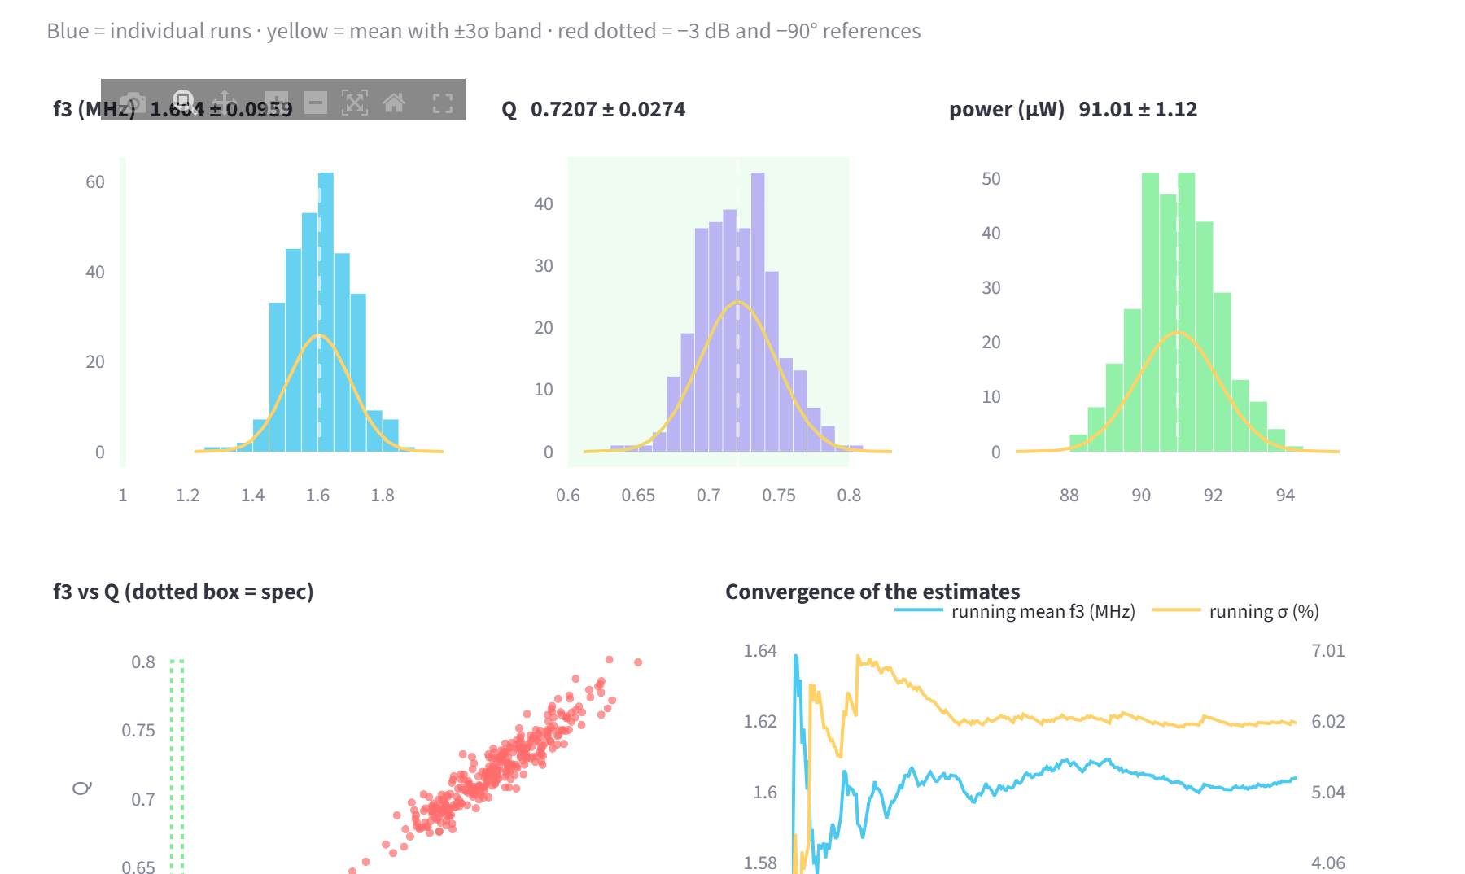
Demonstration — Live Results While It Runs
Histograms, f3–Q scatter and convergence update as runs complete; red = out of spec, green band = spec window
f3 1.604 ± 0.096 MHz, Q 0.7207 ± 0.0274, power 91 ± 1.1 µW. Running mean and σ settle within a few hundred runs, which is why 750–3000 runs are enough.
Statistical Characterization of a Gm-C Filter in SKY130
29

Slide 30
Demonstration — Run-of-Show
Five steps, about four minutes; the expected numbers confirm that the live app matches the report
Step | Set in the app | Expected result | What to say
1 | PTAT bias, tt, 1.8 V, 27 °C, 3000 runs | f3 1.599 MHz, σ 5.78 %, Q 0.719, 90.9 µW, yield 92.0 % | Healthy design: centered on 1.6 MHz and inside the window
2 | Voltage bias, tt, 1.8 V, −20 °C (then 85 °C) | Yield about 0.1 % | The same filter fails when only temperature moves
3 | PTAT bias, sf, 1.62 V, −20 °C | Yield about 73 % | Worst corner is degraded but still usable
4 | PVT grid tab | 45-condition heat maps | Voltage bias collapses at temperature extremes; PTAT stays flat
5 | Cross-checks and limits tab | Pelgrom 5.62 % vs MC 5.91 %; Xyce 0.003 % | Results are independently verified, limits are stated
Other tabs available if asked: Compare sets, Pelgrom, Transient, Bias comparison, Study results.
Statistical Characterization of a Gm-C Filter in SKY130
30

Slide 31
Demonstration — Cross-Checks and Study Results Tabs
The app also reproduces the verification evidence, so the claims can be checked live
Check | Result
Pelgrom prediction vs Monte Carlo | f3 σ 5.62 % vs 5.91 %
AC vs transient simulation | 0.03 dB and 0.14° apart
Tolerance rerun | f3 changes 0.12 %
Xyce vs ngspice, nominal | 0.001 % in f3
Xyce vs ngspice, 30 injected mismatch draws | max 0.003 % in f3
Output noise, nominal PTAT | 240 µV rms
Xyce reproduces ngspice with 30 identical injected mismatch draws: maximum f3 difference 0.003 %. Noise 240 µV rms at the output; DC operating point and tolerance checks agree with the report.
Statistical Characterization of a Gm-C Filter in SKY130
31

Slide 32
Output Explanation — How to Read the Plots
Each output, what it shows, and what a good result looks like
Output | What it shows | How to read it | This project's value
f3 histogram | Spread of the −3 dB frequency across mismatch runs | Narrow and centred on 1.6 MHz is good; the band is ±10 % | σ about 5–7 % of f3
Q histogram | Spread of the quality factor | Must stay inside 0.6–0.8 (Butterworth-like, no peaking) | Mean 0.72, σ 0.026
f3–Q scatter | Correlation of the two figures | A tilted cloud means one cause moves both, so the spec box clips corners | f3 and Q rise together
Yield | Share of runs inside both limits | Higher is better; compare schemes at the same condition | 22.4 → 88.7 %
PVT heat map | Mean f3 or yield for 5 corners × 3 VDD × 3 T | Flat colour means robust; stripes along temperature mean drift | PTAT flat, voltage bias striped
Ripple | Gain peaking over the passband | Under about 0.5 dB means no visible peaking | Mean 0.033 dB, max 0.35 dB
Convergence | Running mean and σ vs run count | Lines flattening means enough runs | Settled by a few hundred runs
Statistical Characterization of a Gm-C Filter in SKY130
32

Slide 33
Output Explanation — What the Results Mean
Three observations and the design guidelines they support
1
2
3
Temperature, not mismatch, kills the voltage-bias design
A real PTAT core keeps most of the benefit
More matching area buys little
Mismatch alone gives a 5–6 % spread, close to the Pelgrom prediction (5.62 % vs 5.91 %). The 22.4 % yield comes from gm falling with temperature. Tracking gm with a PTAT current removes most of it.
The beta-multiplier core reaches 71.7 % yield (3.2× voltage bias). The 17-point loss to the ideal source comes from its supply sensitivity, worst at sf, 1.62 V, −20 °C.
Quadrupling the mirror area gives about +5 points of yield for about 70 % more power, so sizing is not the lever.
Guideline: bias Gm-C stages from a PTAT current with exponent about 0.6.
Guideline: improve the core's supply rejection before adding area.
Guideline: spend effort on bias tracking, not on bigger devices.
Statistical Characterization of a Gm-C Filter in SKY130
33

Slide 34
Conclusion and Future Scope
What was achieved, what is not yet done, and where the work goes next
Conclusions
Limits and future scope
• A 3-OTA Gm-C biquad in SKY130A meets f3 1.6 MHz ±10 % and Q 0.6–0.8 at nominal (f3 1.610 MHz, Q 0.722).
• 1,800+ PVT Monte Carlo runs show a fixed voltage bias gives only 22.4 % yield.
• A PTAT bias lifts yield to 88.7 % (ideal) and 71.7 % (transistor-level core).
• Results are cross-checked: Pelgrom, AC vs transient (0.03 dB), Xyce (0.003 %).
• Everything, including the live app, is open and reproducible.
• The core's yield uses 40 runs per condition (±2 points); a 750-run grid is not yet done.
• No CMFB or output buffer; common-mode and loading effects are not modelled.
• Mismatch uses PDK mm corners only; ageing and layout parasitics are excluded.
• Next: improve core supply rejection, add CMFB and buffer, post-layout extraction, tape-out-ready layout.
Statistical Characterization of a Gm-C Filter in SKY130
34

Slide 35
Risks Raised at Review 1 — and What Happened
Each Review 1 risk against the final outcome
Risk raised at Review 1 | Mitigation planned | What actually happened
SKY130 Monte Carlo/mismatch setup has rough edges | Contingency time; fall back to a 200-run campaign | Ran at 750 runs, no fallback. Hurdles: only one global mismatch switch, subckt "mult" ignored (explicit parallel instances used), .GLOBAL VDD needed.
Mismatch coefficients are unverified against silicon | Pelgrom hand-calculation cross-check | Sensitivity check done: predicted f3 σ 5.6% vs 5.9% from Monte Carlo. Still unvalidated against silicon.
Cross-simulator validation (stretch goal) | Re-run key results in a second simulator | Done: Xyce 7.10 matches ngspice at nominal (0.001%) and on 30 injected-mismatch runs (within 0.003%). Xyce ignores the PDK mismatch model, so PDK statistics are ngspice-only.
A closely matching open-SKY130 study appears | Narrow to a sub-angle | Search not repeated since Review 1. New angle added: PTAT bias recovers yield (22.4% → 88.7% ideal reference, 71.7% transistor-level). Recheck literature before submission.
Statistical Characterization of a Gm-C Filter in SKY130
35

Slide 36
Open Items and Next Steps
OPEN
Archive with checksums (netlists, seeds, scripts, results) and the live lab app are ready; publishing the repository is the remaining step.
GitHub release
NEXT
Transistor-level core built and run (1,800 runs, 71.7% yield). Next: a supply-insensitive core (cascode or regulated) to close the gap to the 88.7% ideal-source bound, then the full 750-run campaign.
Supply-insensitive bias core
NEXT
Ideal-source exponent is tuned (a plain PTAT gives about 79% yield, est.); the transistor-level core was run at 40 runs per condition only (±2% on the mean, coarse per condition); Xyce cannot apply the PDK mismatch model; mismatch coefficients and SKY130 noise and subthreshold modelling are unvalidated against silicon.
Validation gaps
Statistical Characterization of a Gm-C Filter in SKY130
36

Slide 37
Full Reference List
[1] M. Kumngern, K. Aupithak, F. Khateb, T. Kulej, "0.5V Fifth-Order Butterworth Low-Pass Filter Using Multiple-Input OTA for ECG Applications," Sensors, 20(24):7343, 2020.
[2] F. Aiello et al., "Design of a Linear Transconductance OTA using the Open Sky130 Process Design Kit," ResearchGate preprint / SForum 2023.
[3] michaelk99, "SKY130_CT-DSM," GitHub repository, accessed 2026.
[4] Z. Li et al., "AnalogGym: An Open and Practical Testing Suite for Analog Circuit Synthesis," Proc. IEEE/ACM ICCAD, 2024, arXiv:2409.08534.
[5] SkyWater Technology and Google, "SKY130 Open Source PDK Documentation — Simulation," skywater-pdk.readthedocs.io/en/main/sim.html, accessed 2026.
[6] IEEE India Council, "INDICON 2026 Call for Papers," 2026.
[7] VLSI Design Automation (UCSC), "SKY130 PDK: Device Models, Binning, and Monte Carlo Mismatch," Chip Tutorials, GitHub, accessed 2026.
[8] S. Lee and B. Razavi, "Gm-C Filters and Their Applications in RF Front-Ends and Read Channels," general reference.
[9] Arcel G. Leynes et al., "A Simple On-Chip Automatic Tuning Circuit for Continuous-Time Filter," TSMC 0.35µm CMOS — reports ~30% RC time-constant drift from PVT, up to 50% at extremes.
[10] Y. Chen et al., "A High-Accuracy RC Time-Constant Auto-Tuning Scheme for Integrated Continuous-Time Filters," Micromachines, 15(1):166, 2024 — 55nm CMOS, 2.21% avg / 3.67% max tuning error.
[11] open_pdks project (R. Timothy Edwards), community threads on mc_mm_switch, SEED randomization, and mismatch coefficient structure, open-source-silicon.dev, 2021–2022.
[12] lhrodovalho, AICSP2022RAIL testbench example (tb_ol_ac_df_mc.spice), GitHub — reference ngspice mismatch testbench structure.
[13] open-source-silicon.dev community thread on ngspice parameter/device-name collisions in SKY130 mismatch simulation, documenting real setup friction.
[14] Beall et al., "DC Cryogenic Modeling of Open-Source SkyWater 130nm MOSFETs at 77K Using BSIM4," arXiv:2604.21625 — confirms no experimentally validated mismatch/corner data exists for SKY130 even in extended studies.
Statistical Characterization of a Gm-C Filter in SKY130
37

