Slide 1
Walkaround Horizon Algorithm
Will Richard
CS 350
5/14/09

Slide 2
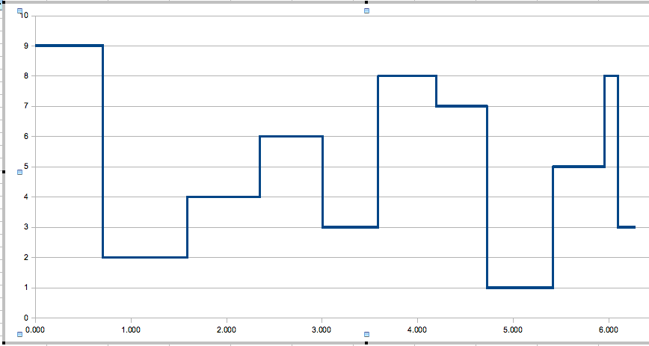
Review of Horizons

Slide 3
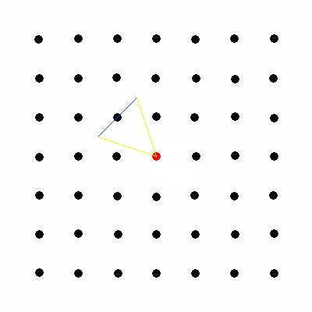
Review of the Mergesort-like algorithm (divide and conquer)

Slide 4
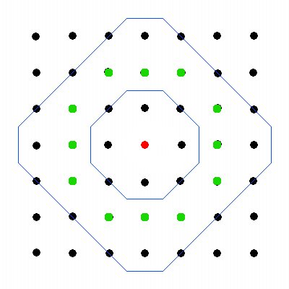
Review of the Mergesort-like algorithm (divide and conquer)

Slide 5
Running time of Mergesort-like
Creating and merging all the horizons takes O(n) time
To find if a point is visible or not, must search the horizon → using binary search, O(nlgn)
Overall: O(nlgn)

Slide 6
Review of Merging Horizons
Given 2 horizons, output a “net” horizon.
Step through each one in order and create a new horizon based on what is the highest value at any given angle from each.

Slide 7
Layers

Slide 8
Walking one layer

Slide 9
More detailed explanation of algorithm

Slide 10
Running Time Walkaround
Traversing all the points by layer in increasing angle order: O(n)
Merging all layers together – O(n) worst case
Need to do this for sqrt(n) layers, worst case
Overall worst case: O(n sqrt(n))

Slide 11
Running time in Practice
In practice, need to compute horizon for much fewer than sqrt(n) layers
Overall in practice: O(n)

Slide 12
Optimizing Mergesort like

Slide 13
Mergesort-like vs Walkaround

Slide 14
Accuracy Comparison

