Slide 1


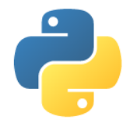

Data Science Using Python, R and Excel

Slide 2
What is Data Science?
Hypothesis driven study
Data driven study
Do smokers make better salesmen?
Do women make better managers?

Slide 3

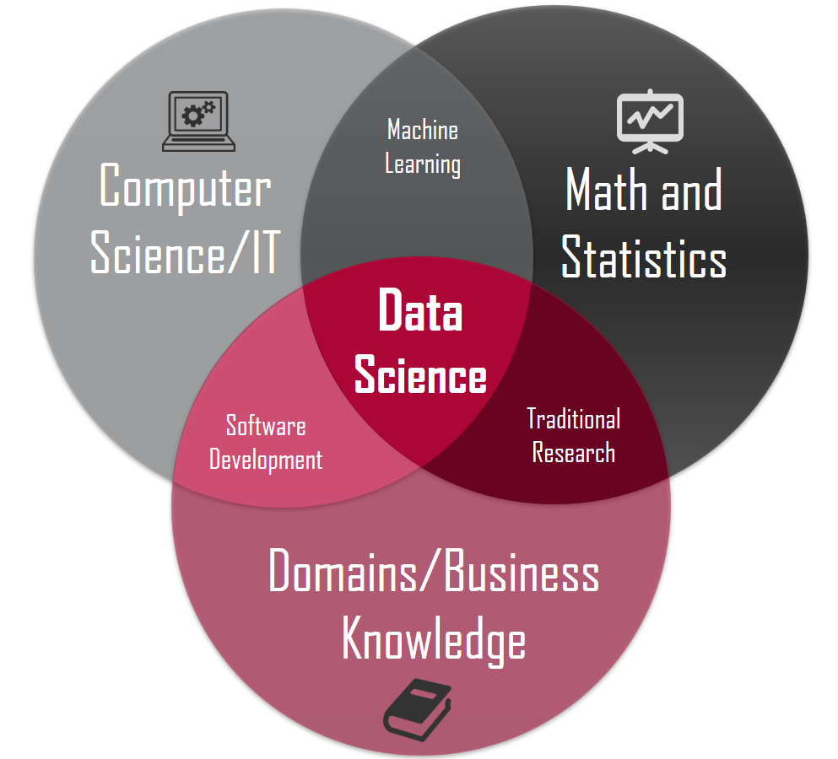
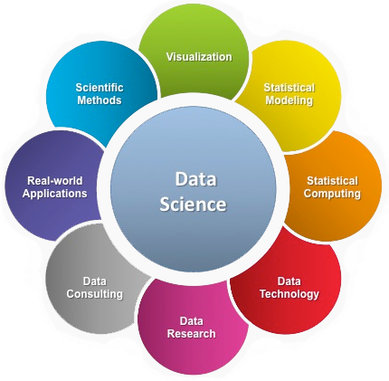



Data Science

Slide 4
Our Key Focus
We will focus on understanding and applying concepts.
Business context
Statistical/Mathematical Concepts
Apply these concepts in real life case studies

Slide 5
Understanding the business context is very important
Management may be interested in knowing why the customers are leaving.
Knowing coding alone will not help.
You need to know what analysis to be performed, what data to be collected, and after analysis how to communicate the results.
Same with examples like:
A new retail company wants to know where to setup the stores?
What products to recommend to its customers?
Whom to give discount coupons?
You also need to know where the business will benefit using data science

Slide 6
Be realistic…
For every vacancy in a data science job, there are around 1000 applications.
So, you need to stand out from the crowd.
This is where business skills and statistics/maths skills add value.
Add projects to your CV.
Participate in various data science competitions.
Join Kaggle.com.
Take the project in this program seriously.

Slide 7
A good project consists of
A good question
Preferably from your domain knowledge
Do not choose questions that can be answered using popular datasets like Titanic dataset
Data to answer that question

Slide 8
What you need to be good at…
Subject Matter
Statistics/Maths
Coding (R or Python)
In that order
Don’t fall into the GIGO trap

Slide 9
Software…
R or Python or Excel?
How comfortable are you with Programming? With R? With Python?

Slide 10
What we will cover…
Week No | Date | Content
1 | 04-Feb-23 | Introduction to the Program
1 | 04-Feb-23 | Installing R, Python, Jupyter Notebook and R Studio, Use of R and Python using cloud options
 | Understanding the Computing Environment
2 | 11-Feb-23 | Introduction to R
3 | 18-Feb-23 | Introduction to R
4 | 25-Feb-23 | Introduction to Python
5 | 04-Mar-23 | Introduction to Python
6 | 11-Mar-23 | Advanced Functions/Features in Excel
 | Sources of Data
7 | 18-Mar-23 | Important Data Sources
8 | 25-Mar-23 | Scrapping Data from Websites
 | Data Wrangling in R and Python
9 | 01-Apr-23 | Data Wrangling in R
10 | 08-Apr-23 | Data Wrangling in Python/R
11 | 15-Apr-23 | Data Wrangling in Python
12 | 22-Apr-23 | Making Data Tidy: Case Study
 | Introduction to SQL
13 | 22-Apr-23 | Introduction to SQL
14 | 29-Apr-23 | Accessing Data in R/Python using SQL Queries
15 | 06-May-23 | Using BigQuery to run SQL queries
 | Data Visualization
16 | 13-May-23 | Visualizing Data in R
17 | 20-May-23 | Visualizing Data in Python
 | Text Analysis
18 | 27-May-23 | Cleaning Text Data, Introduction to Regular Expression
19 | 03-Jun-23 | Sentiment Analysis, Text Summarisation
 | Time Series Forecasting
20 | 10-Jun-23 | Understanding Properties of Time Series Data
21 | 17-Jun-23 | Forecasting Using Prophet
 | Supervised Machine Learning
22 | 24-Jun-23 | Understanding the Maths of Machine Learning
23 | 01-Jul-23 | Building Machine Learning Models (Regression and Classification)
24 | 08-Jul-23 | Hyperparameter Tuning, Auto-ML
25 | 15-Jul-23 | Maching Learning in HR
 | Unsupervised Machine Learning
26 | 22-Jul-23 | Building recommendation models
27 | 29-Jul-23 | Segmenting customers using cluster analysis
 | Deep Learning
28 | 05-Aug-23 | Understanding the Maths of Deep Learning
29 | 12-Aug-23 | Building a Deep Learning Model to Predict Stock Prices
 | Cloud Computing
30 | 19-Aug-23 | Data Science Using GCP
31 | 26-Aug-23 | Data Science Using GCP/AWS
32 | 02-Sep-23 | Data Science Using AWS

Slide 11
Points to keep in mind
Participants in this program have come with diverse backgrounds.
So the initial sessions will be introductory.
We will not cover everything possible in R or Python.
Try to get involved with all the case studies irrespective if your area of interest.
If you are new to programming, it will take some time to get a feel of R or Python.
Keep in mind privacy issues while using data
We will have one assignment that needs to be submitted at the end of the program.

Slide 12
Good Resources on Python
https://wiki.python.org/moin/BeginnersGuide/NonProgrammers

Slide 13

A good book on R

Slide 14
Using Python
You can download in your computer
Python
Anaconda
You can use cloud resources
Google colab
Kaggle.com
Jupyter.org
Replit.com
Remember that a mac comes pre-installed with Python2.

Slide 15
Installing Python 3
Can install directly or via Anaconda
Let’s install it now.
https://www.python.org/downloads/
https://www.anaconda.com/products/individual

Slide 16
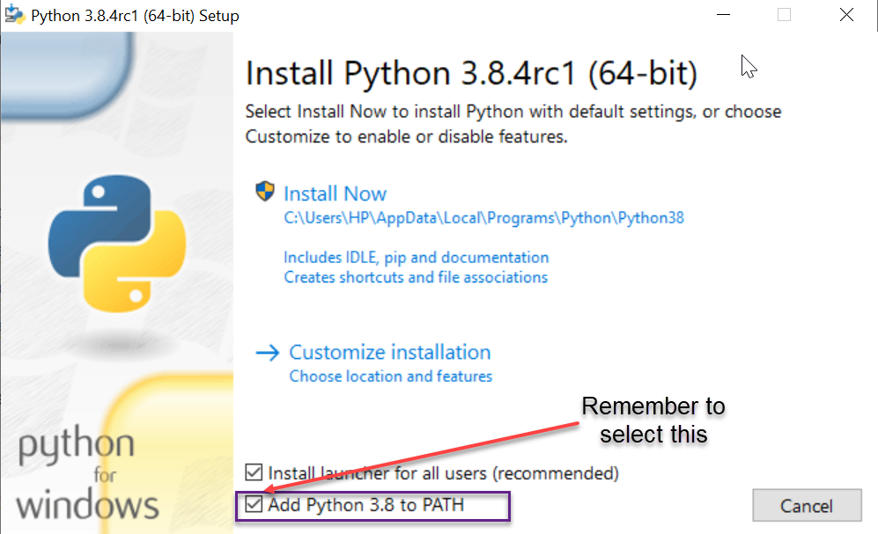
Add Python to Path

Slide 17
Installing R
Cloud versions available at
https://rstudio.com/products/cloud/
We need to install R.
https://cran.r-project.org/bin/windows/base/
You should also install R-studio
https://rstudio.com/products/rstudio/download/
Let’s install it now.

Slide 18
