Slide 1


Slide 2

Kris Jamsa

Slide 3
Scenario
You are supporting the Client Management team that leads the U.S. Department of Homeland Security account for Ventera. You, along the account management and the delivery team, have met the customer a few times and have gathered the following pain points around implementing immigration forms:
They are currently using Oracle as their data store (leveraging Oracle Spatial for geospatial data), and they would like to get away from it to leverage open-source alternatives. However, one of their biggest challenges is how data auditing is performed and stored. The current implementation is deeply coupled with Oracle, and they need a scalable solution before they can implement an open-source solution.
They plan to move to a microservices-based architecture, but they want a clean solution for data synchronization across microservices architecture.
The immigration forms have complex data validations that change with versions and are dependent on the geolocation of the client interface. Currently, the logic is manually coded in the UI and the Services. This leads to a lot of errors, duplication of code, and unnecessary complexity.
You have brainstormed with the Client Manager and have arrived at the conclusion that you will need to provide a detailed architecture diagram and roadmap for moving the solution to the cloud to take advantage of microservices and scalability. You have communicated to the Client Manager to get on the schedule of the stakeholders, to have a 1-hour demo and discussion of the architecture diagram and proposed roadmap for implementation.

Slide 4
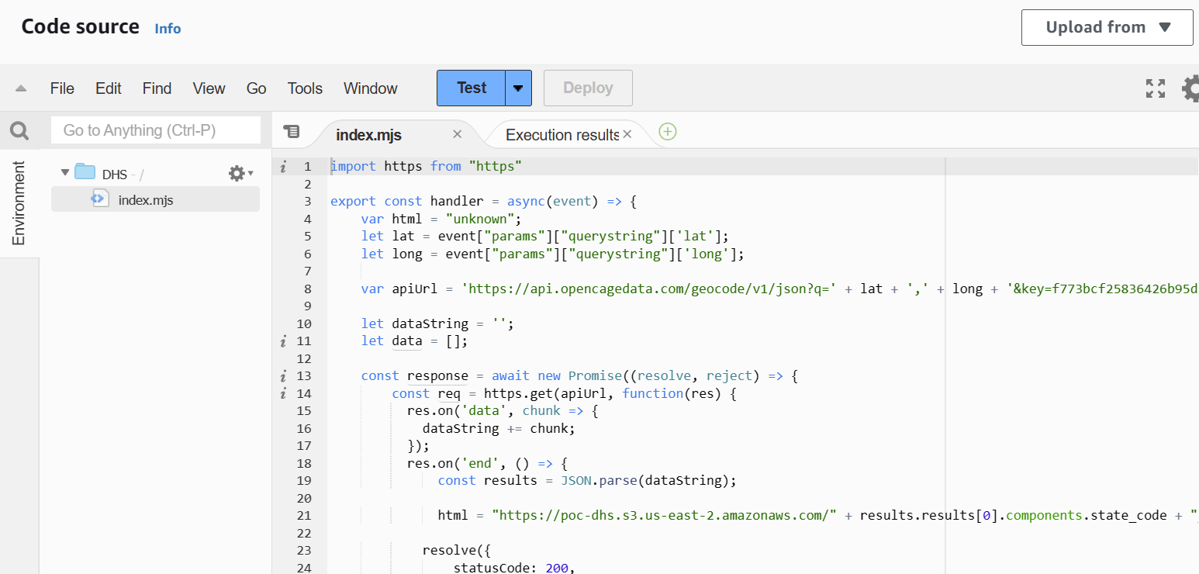
Bonus Code Included

Slide 5
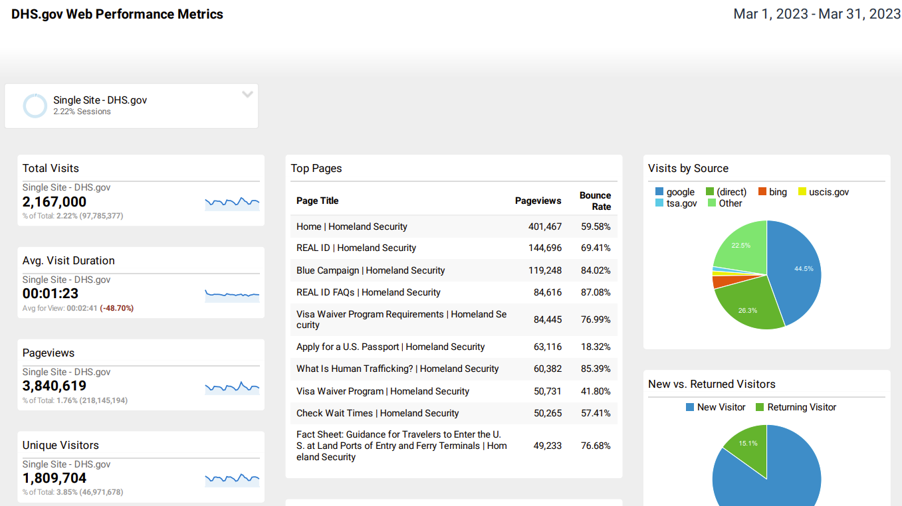
Getting Some Traffic Insights

Slide 6

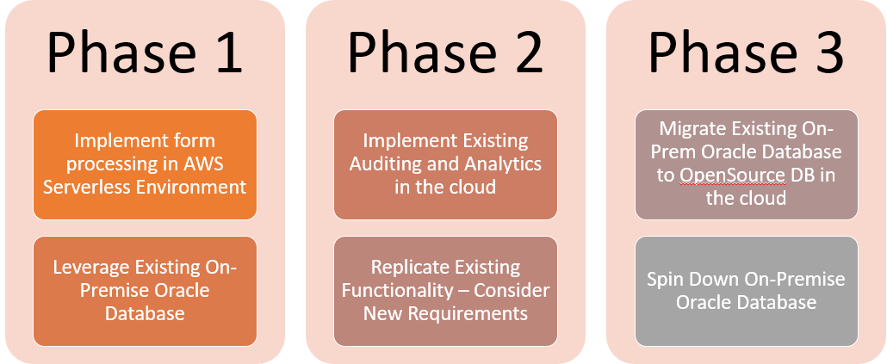
Project Roadmap

Slide 7
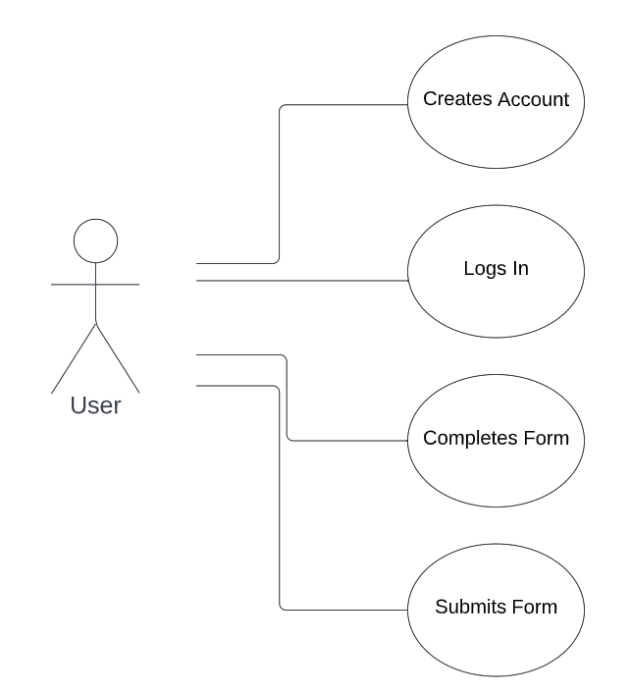

User Interactions

Slide 8
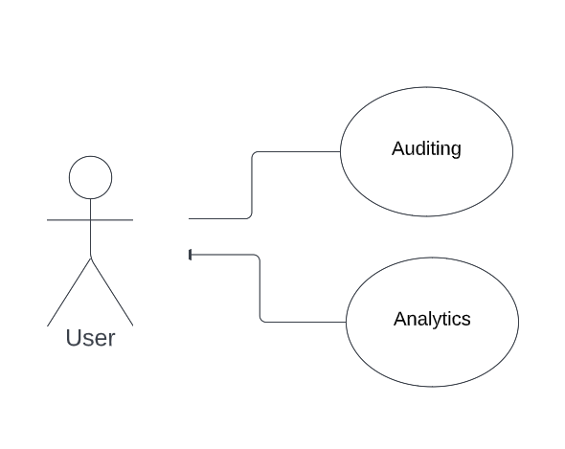
DHS Interactions (assumes login account)

Slide 9
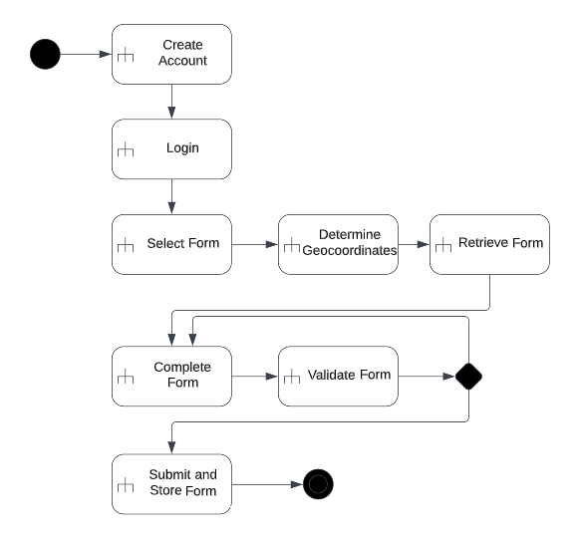
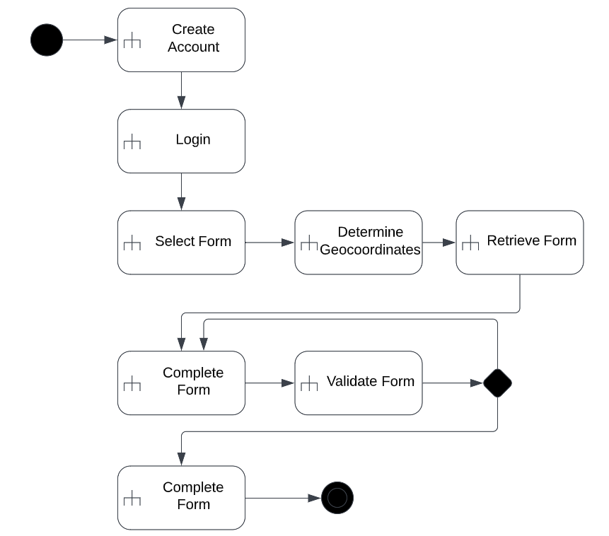
User Activities

Slide 10

My Process
Create Proof of Concept
Create simple client UI with geocoding
Spin up Nodejs Server
Write Nodejs backend
Test-Driven Design

Slide 11

Primary Design Goals
Serverless
Scalable
Robust/Redundant
Cost Effective
AWS-based
High Performance/low latency
Secure

Slide 12
Additional Design Goals
Maximize Code Reuse
Support Continuous Development and Integration
Port Oracle On-Site Database
Low Administrative Overhead
Easy to Update
Auditable
Analytics

Slide 13
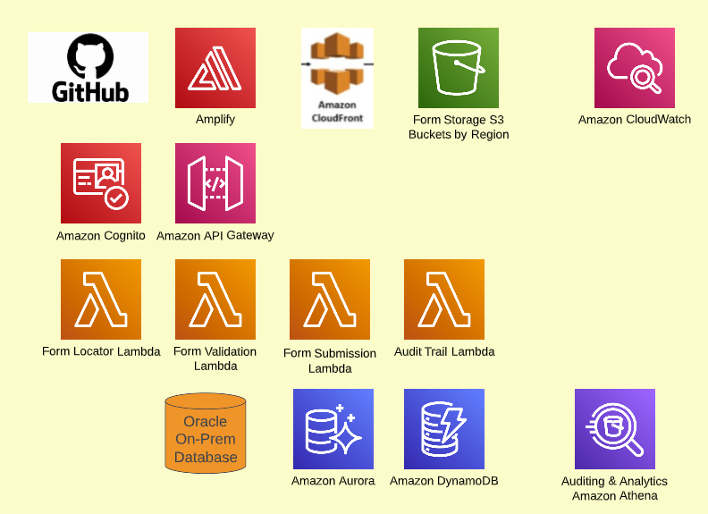
High-Level Architecture

Slide 14
100% Serverless (No EC2, VMs, or containers)
Amplify
Lambdas/API gateway
S3 buckets with optional CloudFront cache
AuroraDB
DynamoDB
Athena (auditing and analytics)
Monitored by CloudWatch

Slide 15
Scalability/Robustness
Amplify – autoscale/replicated
API gateway – autoscale/high availability
S3 buckets – distributed by region/replication/optional cache
AuroraDB – autoscale/high availability
DynamoDB – autoscale/high availability

Slide 16
Security Considerations
Assume user has account through DHS
Else leverage Cognito
Restrict access to API gateway calls
IAM secret keys
Restrict access to databases
IAM secret keys
Audit/Analytics login through Cognito for DHS personnel
Restrict S3 bucket access

Slide 17

Developer Considerations
Standard form field validation via JavaScript (client side)
Advanced form validation through Lambda-based API
Amplify tied to github for frontend
Simple sandbox model for testing and deployment

Slide 18
Taking the Proof of Concept for a Test Drive aka “Test-Driven Interview” https://dev1277.de0y6cnmxz8wq.amplifyapp.com

Slide 19
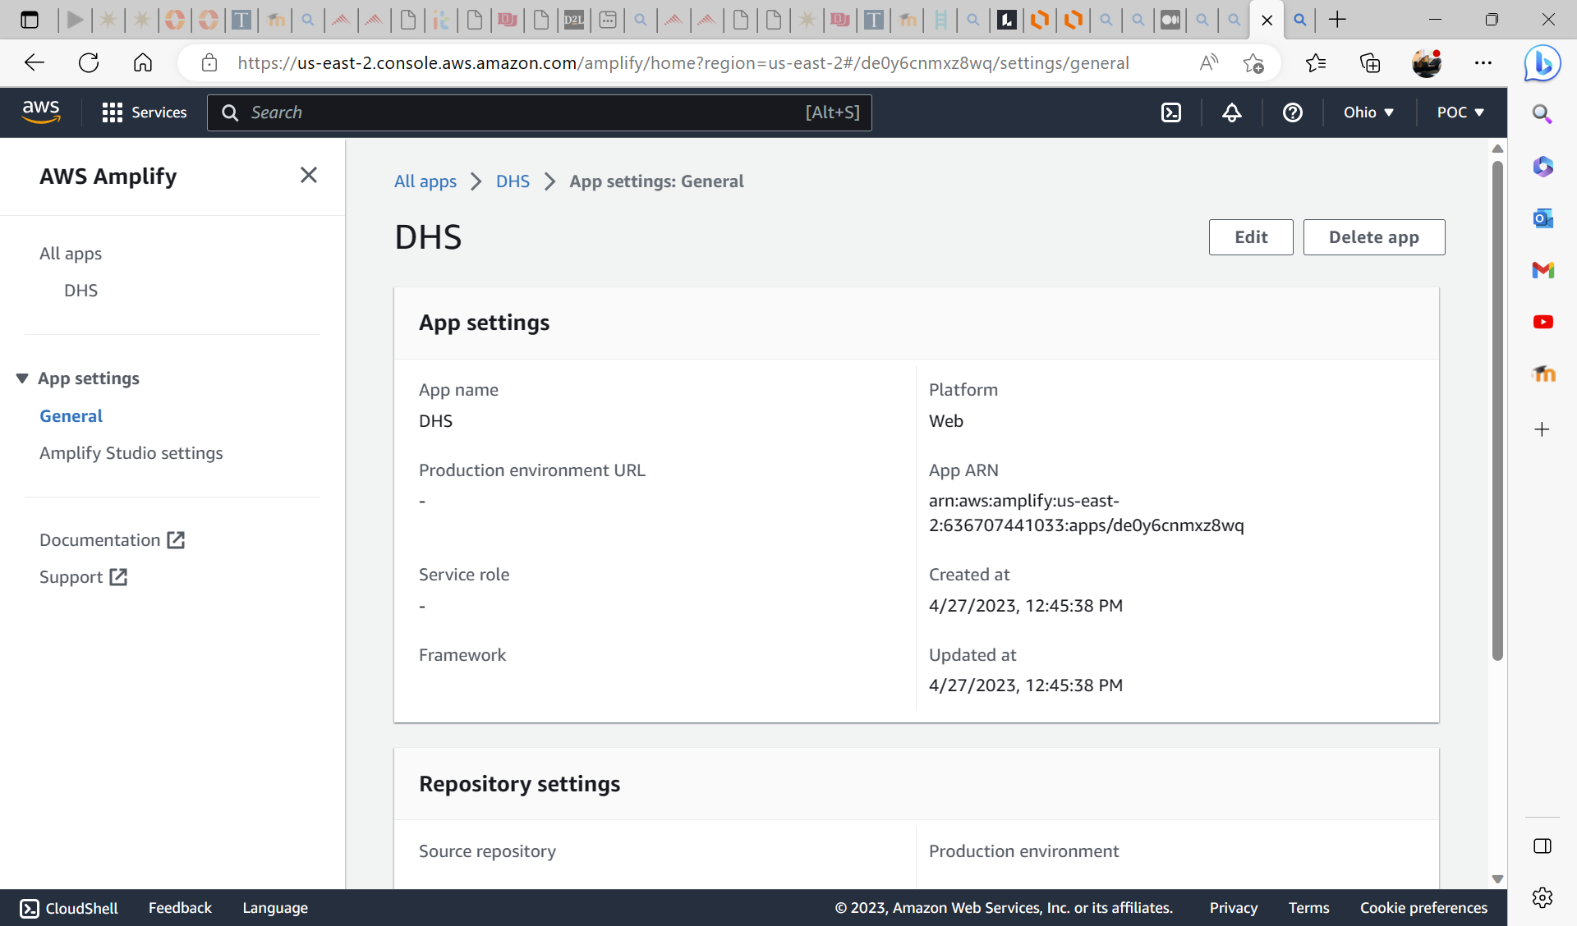
Amplify Front End – Form Selection and Geocoordinates

Slide 20
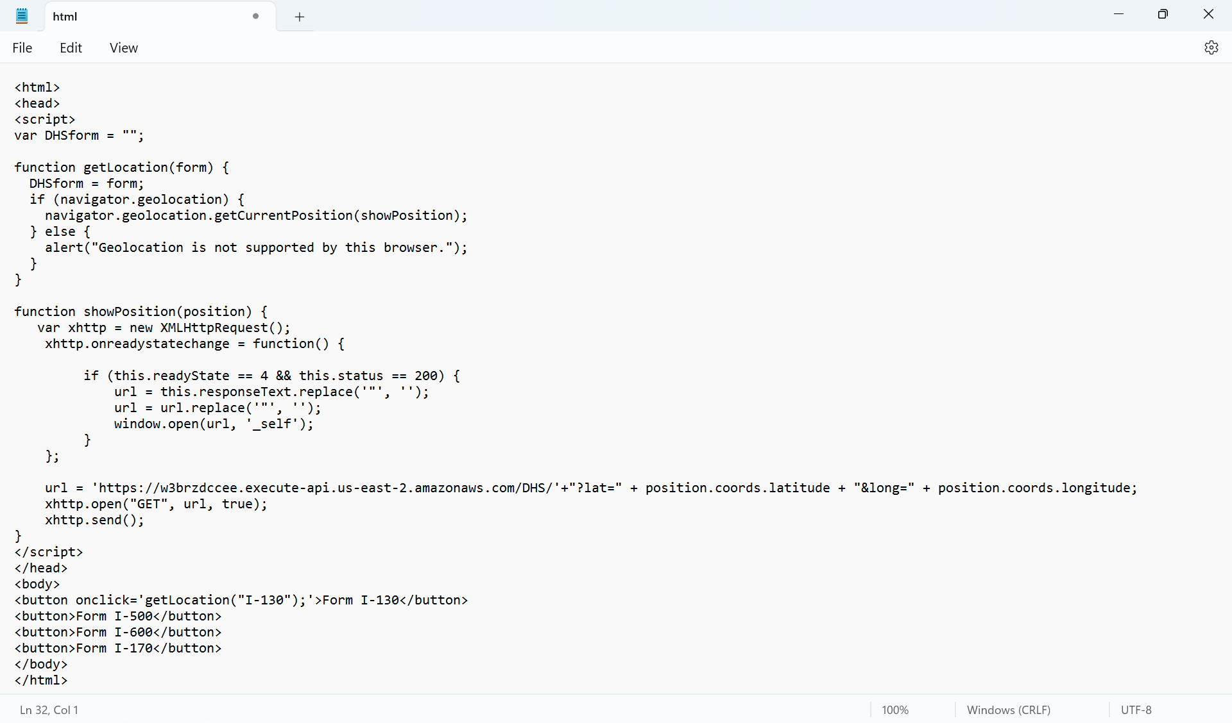
Index.html

Slide 21
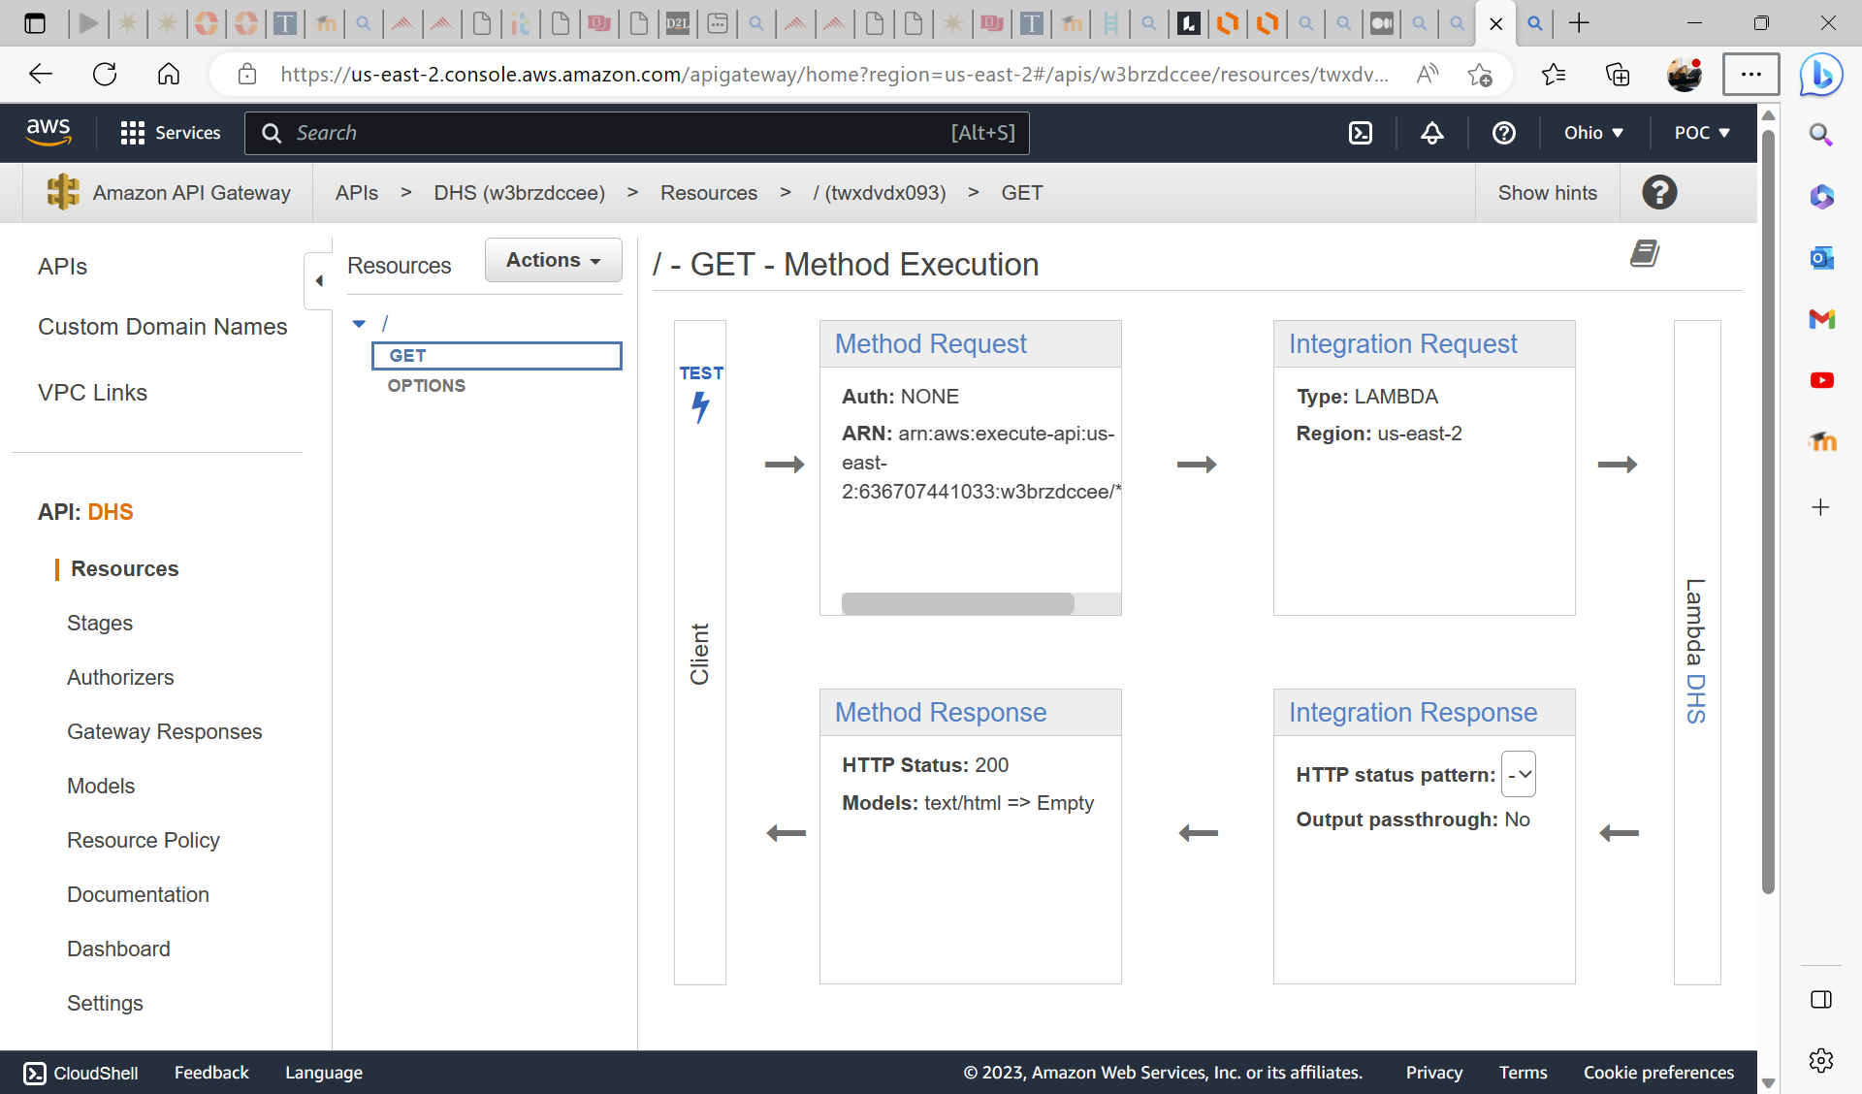
API Gateway – Exposes Lambda APIs

Slide 22
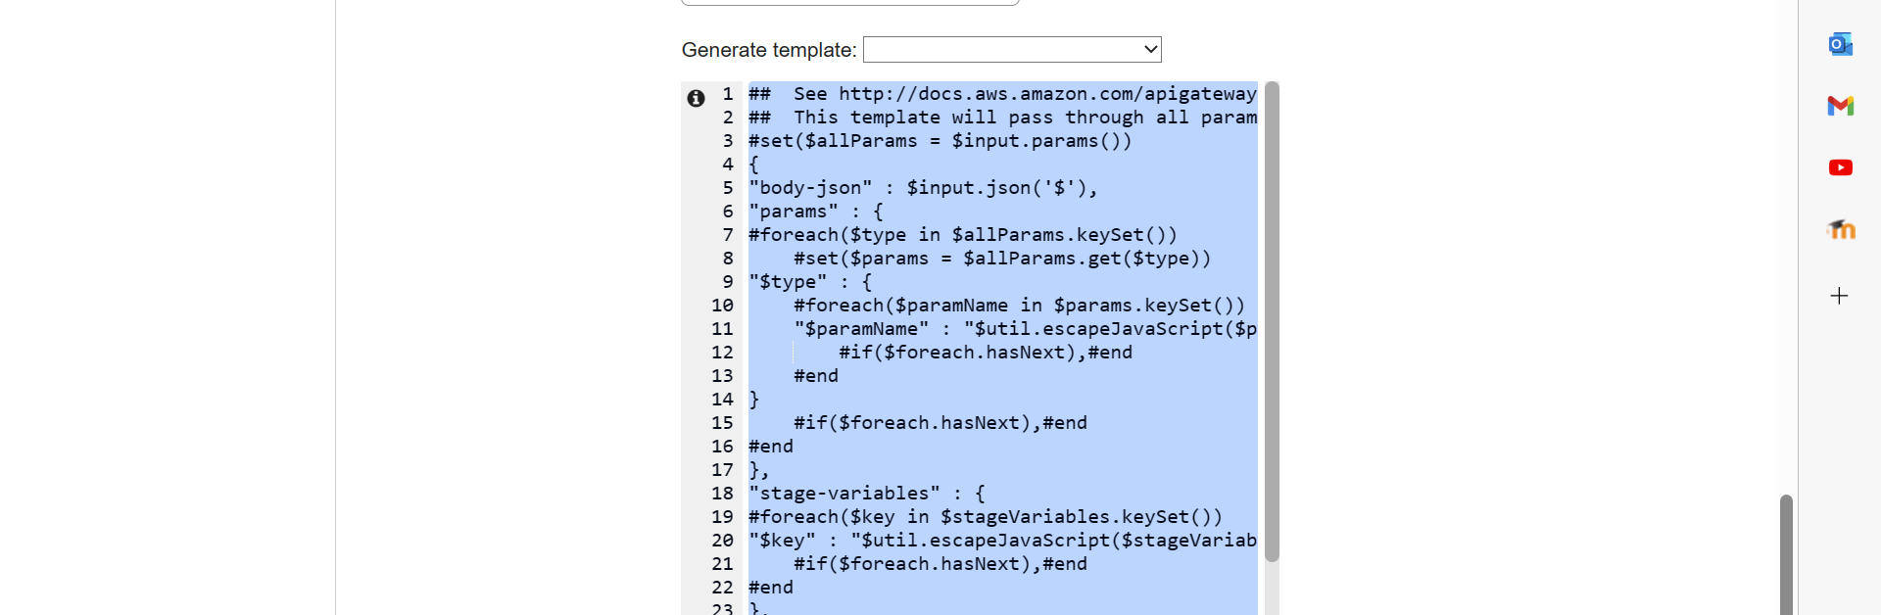
Passing Query String to Lambda

Slide 23
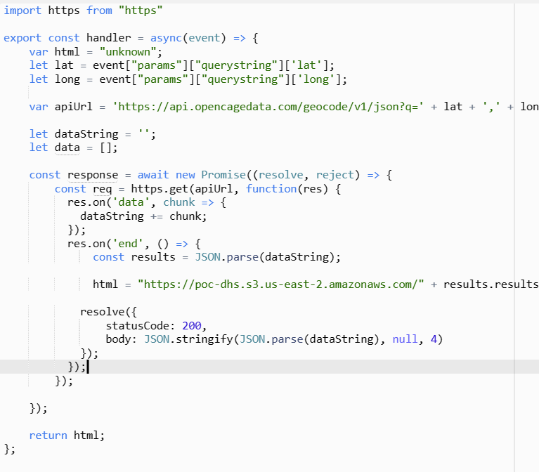
Lambda – Use Geocoordinates to Determine State and Identify Form

Slide 24
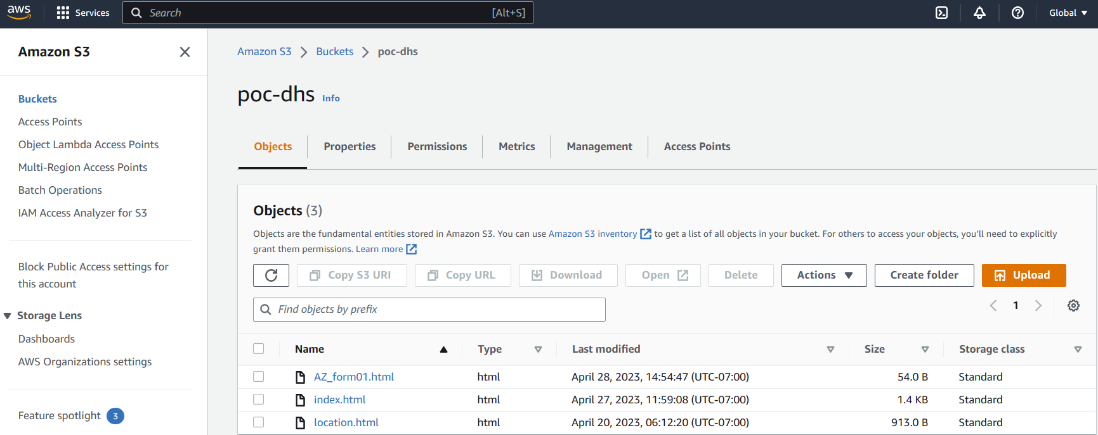
S3 Buckets – Hold DHS Forms

Slide 25

Lessons Learned
100% serverless is doable, but slowed development
Amplify has a learning curve
Possible to leverage Amplify backend to eliminate Lambdas
Eliminate API call with lat/long to identify state – json state boundaries
Challenging to test at scale
Good requirements matter
Need to check out Amazon Location Services
Developing in AWS was fast/easy

Slide 26

Thoughts on On-Premise Oracle Database
Oracle is expensive on-prem or in the cloud
Option 1: Spin up Oracle cloud-based server – expensive
Option 2: Migrate to lower-cost database in the cloud
How much existing Oracle code?
How many applications tie to it?
How are they currently running analytics/auditing
Can they have down time?

Slide 27

Questions

