Slide 1
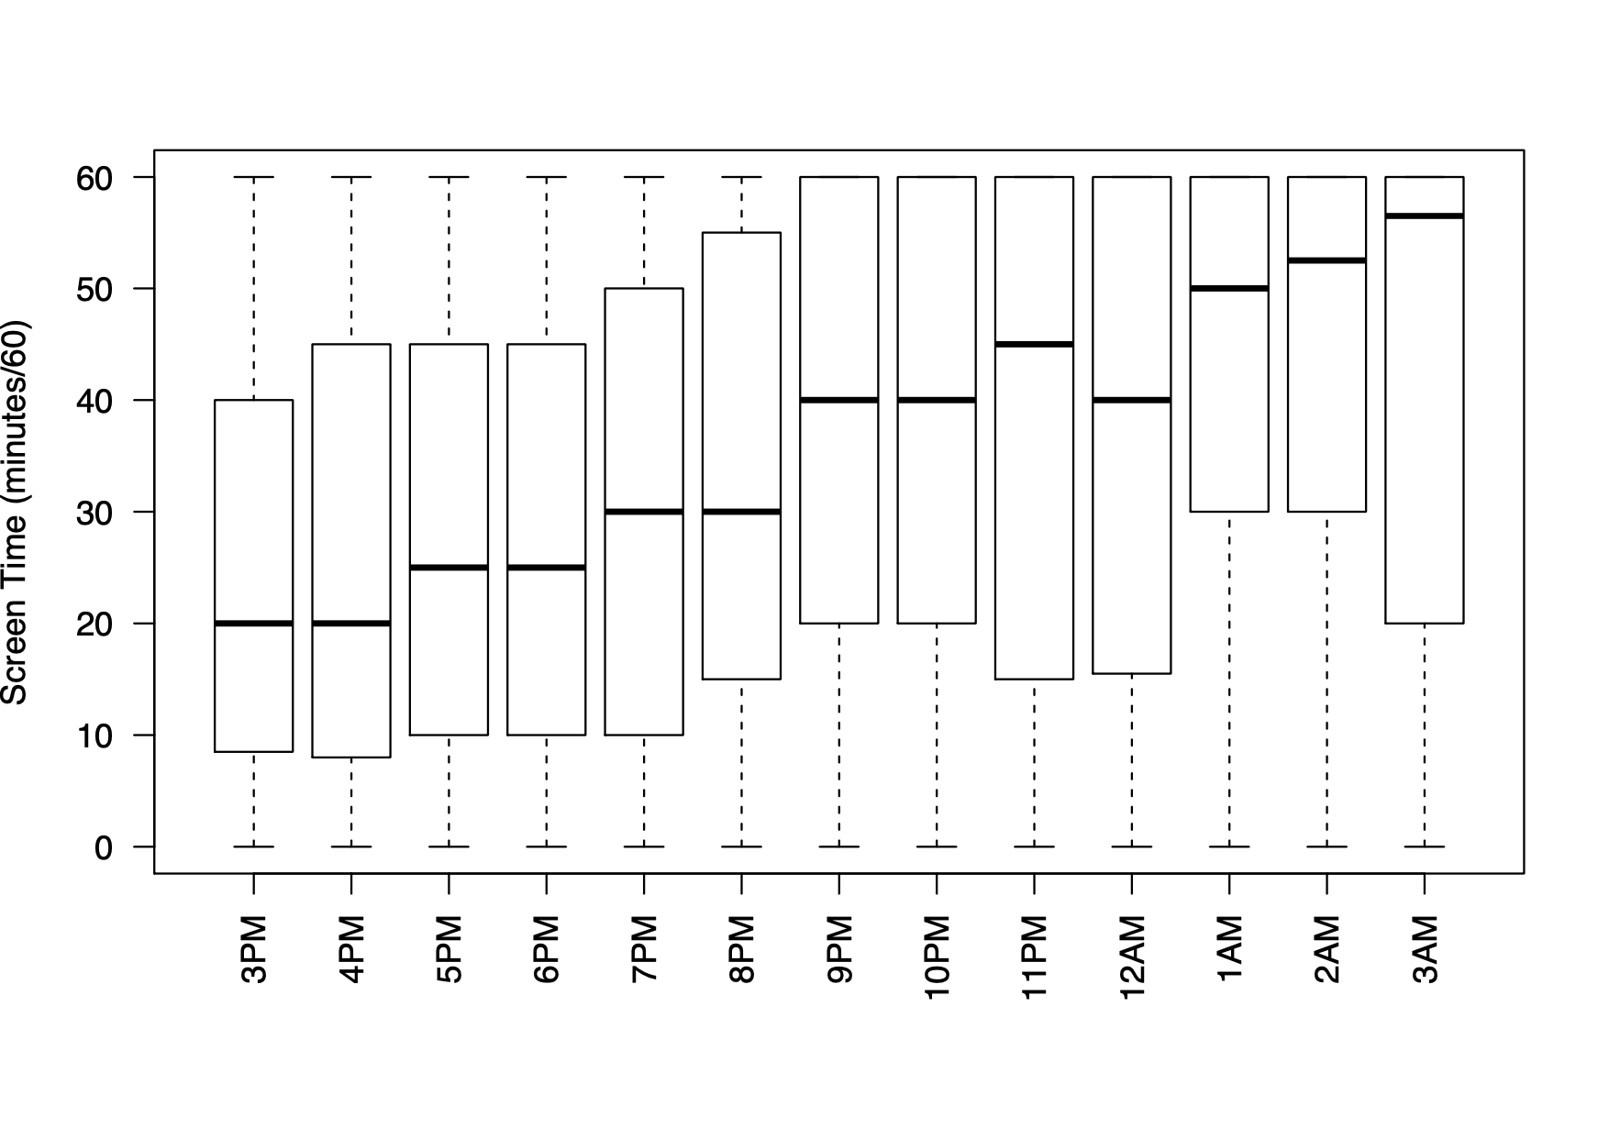
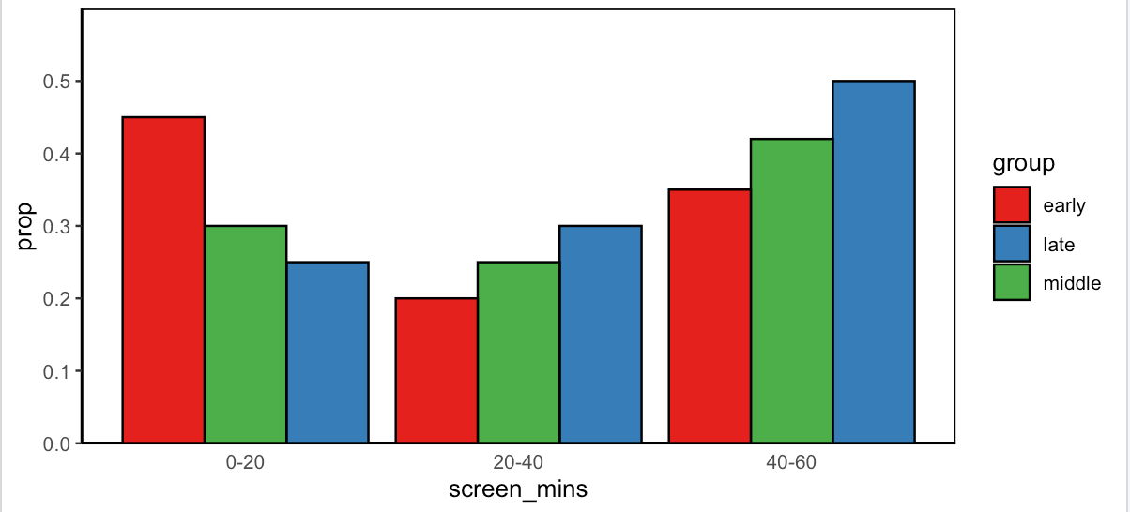
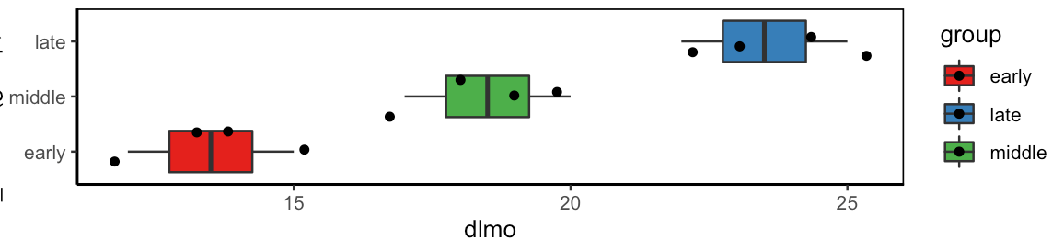
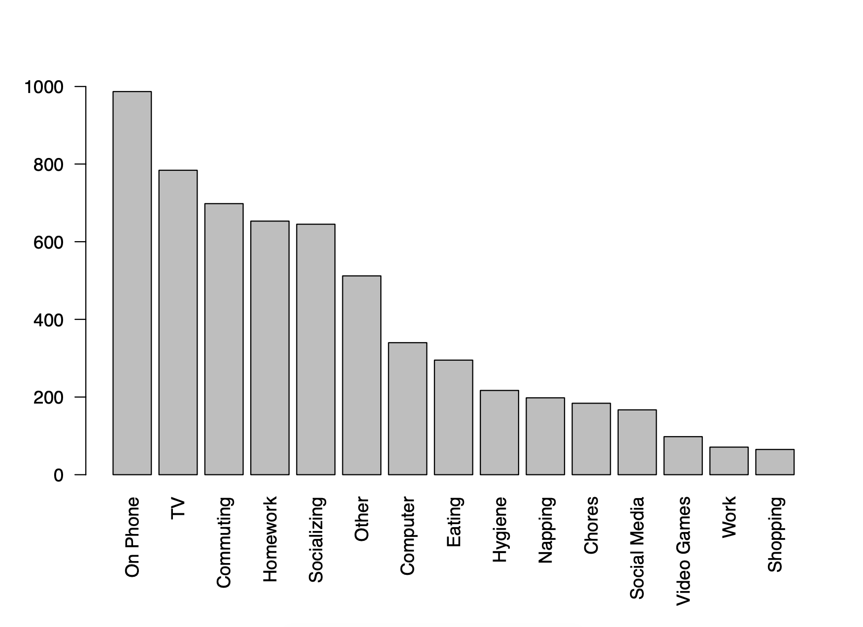
In a sample of short sleeping teenagers, phone use was least likely in a group with early melatonin onset
Reported Time-Use around Melatonin Onset in High-School-Aged Adolescents
Kristopher Janevski, B.A., Charmane I. Eastman, Ph.D, Stephanie J. Crowley, Ph.D
Biological Rhythms Research Lab, Department of Psychiatry & Behavioral Sciences
Analyses
Aims
We examined reported activities in the hour around the DLMO and the 2 hourly responses that followed on weeknights to determine the most common activities (n=1380)
Logistic regression tested whether frequency of activities predicted whether a participant’s DLMO fell within the earliest (n=15; 19:31 ± 00:44), middle (n=16; 20:49 ± 00:20), or latest (n=15; 22:29±1:15) tertile.
Older adolescents are an especially vulnerable population to insufficient sleep as pubertal changes regulating sleep coincide with early high school start times
Adolescents show heightened alertness in the evening close to the time of their Dim Light Melatonin Onset (DLMO), a marker of circadian (~24-h) timing.
Around DLMO is when the circadian system is most responsive to light that shifts rhythms later.
We examined reported activities and screen time of adolescents around DLMO.
Discussion
Overall, reported activities that consumed the most time were cell phone use (19.5%), homework (18.3%), and watching TV (15.1%).
Adolescents who reported more homework, were more likely to have a DLMO in the middle tertile compared to the earliest and latest tertiles. Cell phone use was least likely in adolescents in the earliest DLMO tertile. TV watching did not predict DLMO group.
Screen time conclusions go here
Methods
Design, Settings, and Participants
Forty-six adolescents (14.2-17.9 years; 24 females) who reported ≤7 h sleep on school nights and late bedtimes (school-night ≥ 23:00; non-school night ≥ midnight)
Data Collection
Participants slept at home on their usual school-year sleep schedule for 2 weeks.
Participants reported their main activity via text message every hour from 4PM until self-selected bedtime.
After these 2 weeks, their DLMO was measured via saliva in the laboratory
Adolescents who had the earliest DLMOs spent less time on their phones when light has the greatest delaying effect. These data may indicate that light from cell phone screens may delay circadian phase in this age group. Alternatively, cell phone use may be more likely if adolescents cannot fall asleep due to a later circadian cue for sleep onset.
Conclusions
This analyses was done one baseline data, we hope to see how the intervention changed this behavior
The study was approved by the Rush University Medical Center's Institutional Review Board.
Notes
Funding: National Institute of Health - R01HL112756 (SJC)
Contact: kristopher_janevski@rush.edu

Slide 2
Reported Time-Use around Melatonin Onset in High-School-Aged Adolescents
Kristopher Janevski, B.A., Charmane I. Eastman, Ph.D, Stephanie J. Crowley, Ph.D
Biological Rhythms Research Lab, Department of Psychiatry & Behavioral Sciences, Rush University Medical Center
Evening cell phone (tech) use by teenagers predicts they will have a late sleep hormone rhythm
Aims
Results
Un
Forty-six adolescents (14.2-17.9 years; 24 females) who reported ≤7 h sleep on school nights and late bedtimes (school-night ≥ 23:00; non-school night ≥ midnight)
Methods
Design, Settings, and Participants
Forty-six adolescents (14.2-17.9 years; 24 females) who reported ≤7 h sleep on school nights and late bedtimes (school-night ≥ 23:00; non-school night ≥ midnight)
Exposures
home on their usual school-year sleep schedule for 2 weeks. Participants reported their main activity via text message every hour from 16:00 until self-selected bedtime.
After these 2 weeks, their DLMO was measured in the laboratory
Measured Outcomes
Neuropathology of Alzheimer’s disease:
Amyloid load
Neuronal neurofibrillary tangles
Discussion
Conclusions
Affiliations:
¹Rush Institute for Healthy Aging, Rush University Medical Center, Chicago, IL
²Tufts Human Nutrition Research Center on Aging, Tufts University, Boston, MA
³Rush Alzheimer Disease Center, Rush University Medical Center, Chicago, IL
Funding: National Institute of Health (1R01HL112756-01A1)
*Contact: kristopher_janevski@rush.edu

