Slide 1
O podwójnych
standardach

Slide 2
OOCSS
SMACSS
BEM
...

Slide 3
.main-headline { ... }
vs
body > #container > header > .wrapper > .main-headline { ... }

Slide 4
- Niezależność od struktury
- Czytelność

Slide 5
request('/books/', body => {
const authorName =
body.items[0].volumeInfo.authors[0];
});

Slide 6
request('/books/', body => {
if(body &&
body.items &&
body.items[0] &&
body.items[0].volumeInfo &&
// jezuchryste.jpeg
…
});

Slide 7
request('/books/', body => {
let authorName = null;
try {
authorName =
body.items[0].volumeInfo.authors[0];
} catch(e) { }
});

Slide 8
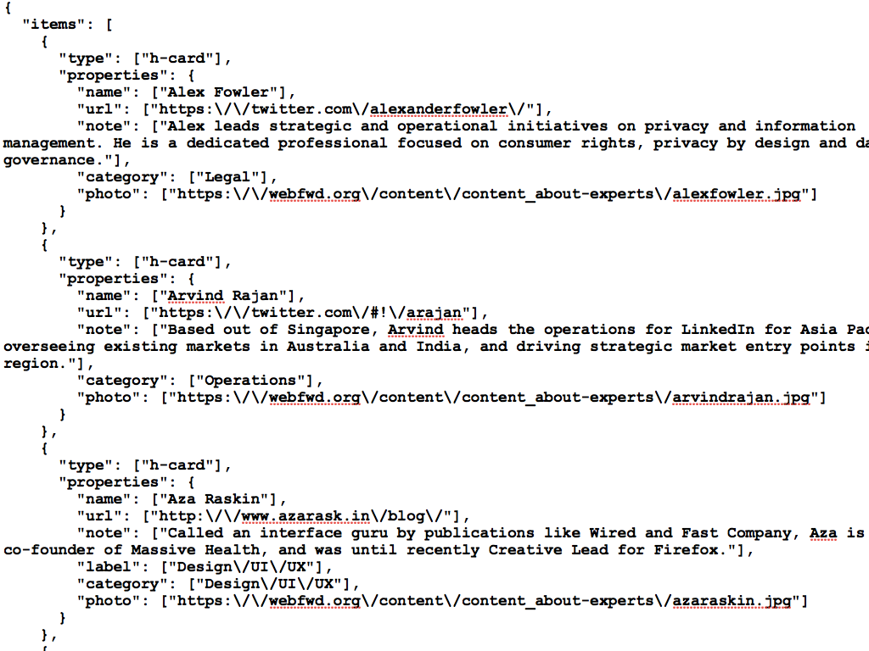

Slide 9
JSONPath

Slide 10
request('/books/', body => {
const authorName =
jp('$..authors[0]', body);
...
});

Slide 11


