Slide 1
EXPERIMENT 12
TCP, UDP Exploration Solution
ALGORITHM
Step 1: Generate traffic to populate Address Resolution Protocol (ARP) tables
Step 2: Generate web (HTTP) traffic
Step 3: Generate FTP traffic
Step 4: Generate DNS traffic
step 5: Generate Email traffic
Step 6: Verify that the traffic is generated and ready for simulation.
Step 7: Examine multiplexing as the traffic crosses the network

Slide 2
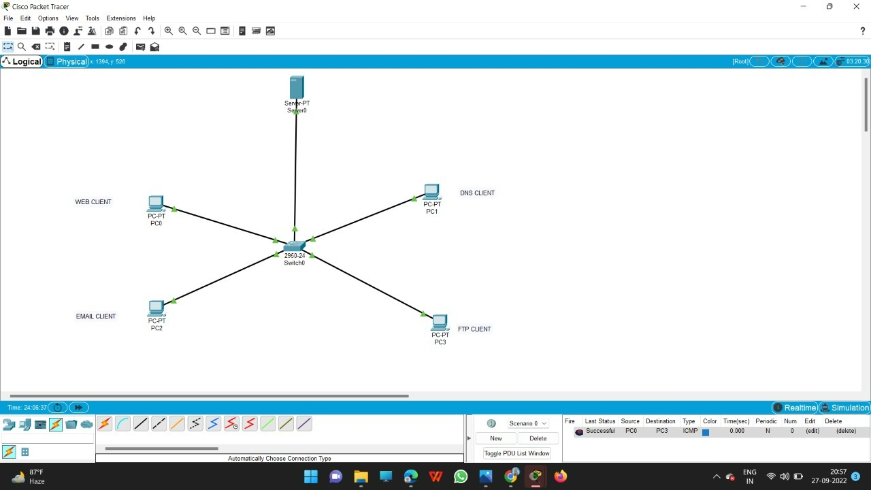
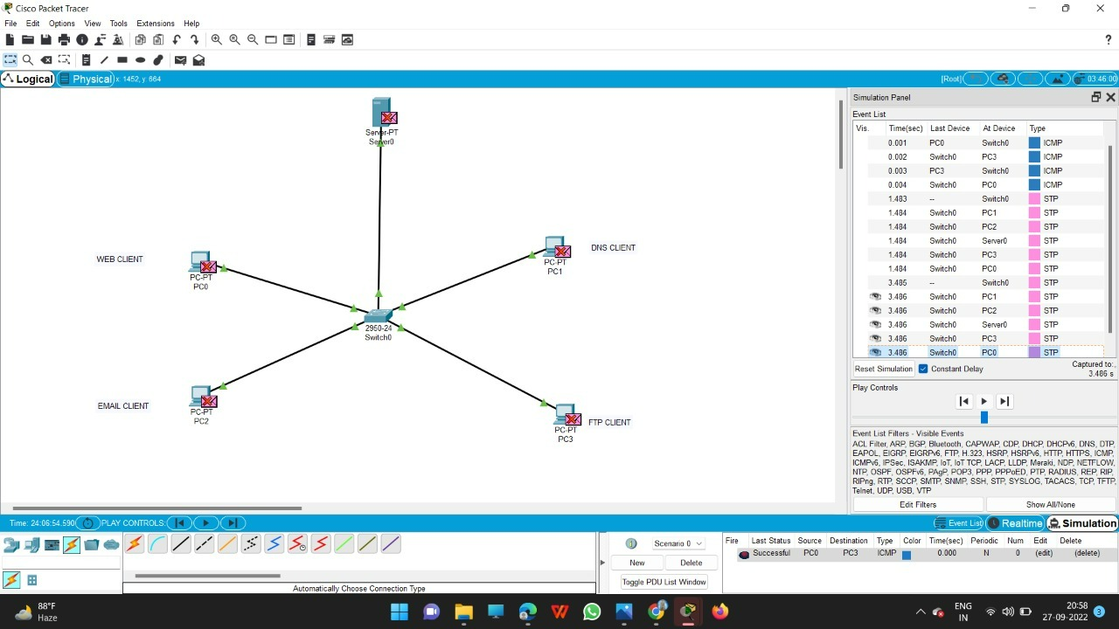

Slide 3
