Slide 1
EXPERIMENT 11 :
Functionalities of TCP, UDP
ALGORITHM:
Step 1 Arrange the need pc and laptops and necessary competitions
Step 2 Take the data from the application layer
Step 3 Then it divides the data into a several packets, provides numbering to these packets, and finally transmits these packets to the destination.
Step 4 Check the IP address and the host’s subnet mask
Step 5 Then simulation it until it show the output as successful

Slide 2
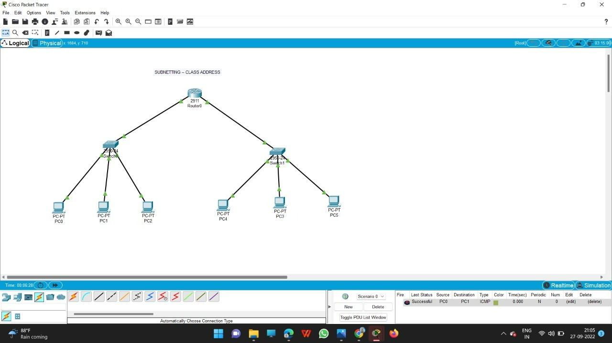

Slide 3
