Slide 1
Final PROJECT: A STREETVIEW NAMED DESIRE (MNIST)
KARAN BHARGAVA

Slide 2
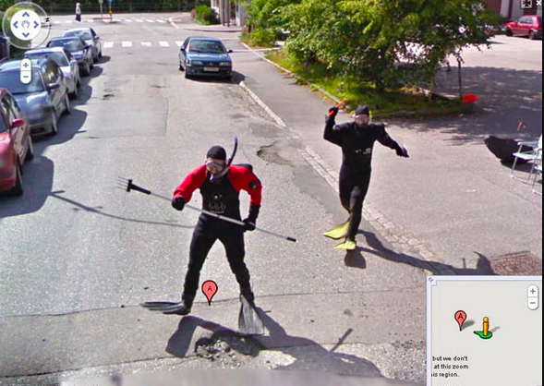
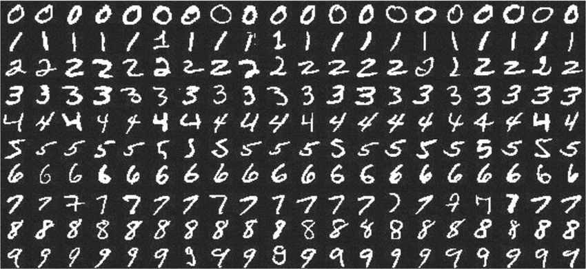
Purpose:
CNN Streetview to MNIST
How versatile is a CNN?
Train it on streetview digits
Test it on MNIST

Slide 3

Challenges:
Streetview Data is Noisy
Distracting digits
Lighting
Angles
Colors
“perfect digits” vs “imperfect handwriting”

Slide 4

Plan of Attack: ‘Trust the Pre-Process’
Switch from RGB to GrayScale to reduce dimensionality
Edge Detect to remove ‘noise’ based on luminosity
Reduce Noise via Mean Reduction and Normalization
Reduces unnecessary pixels that are redundant or give little info

Slide 5
Model Overview:
Convolutional Neural Network
2 convolutional layers
Relu activation functions
1 fully connected layer
Final 10 node layer to classify using Softmax
Rmsprop optimizer
Categorical crossentropy loss function
(similar to MNIST CNN Practice 4 architecture)

Slide 6
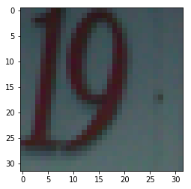
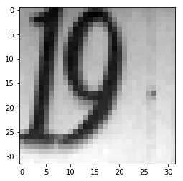
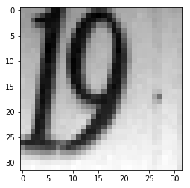
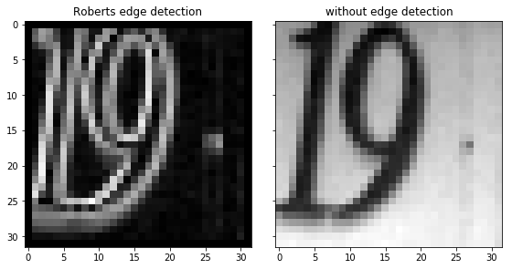
Pre-Process:

Slide 7
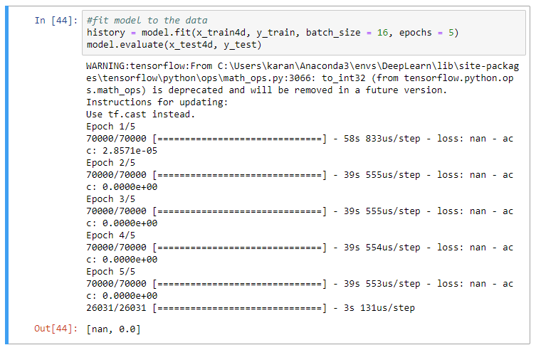
Performance: started from the bottom now I’m here

Slide 8
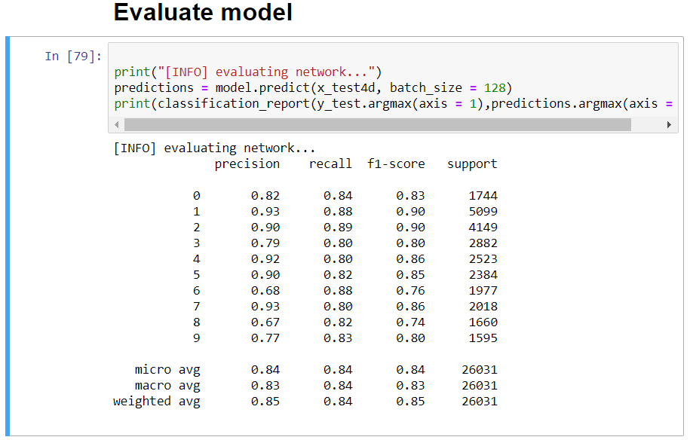
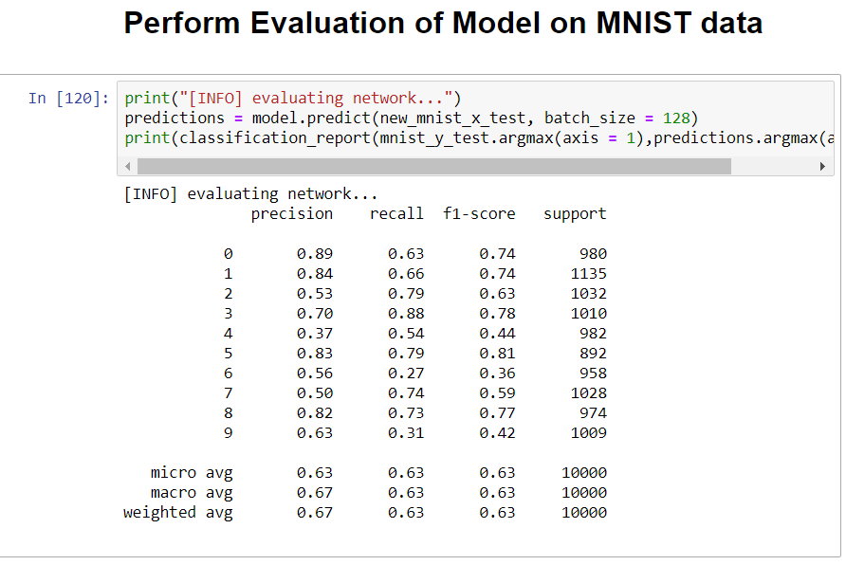
Base Model Success
85% acc training
67% acc test

Slide 9
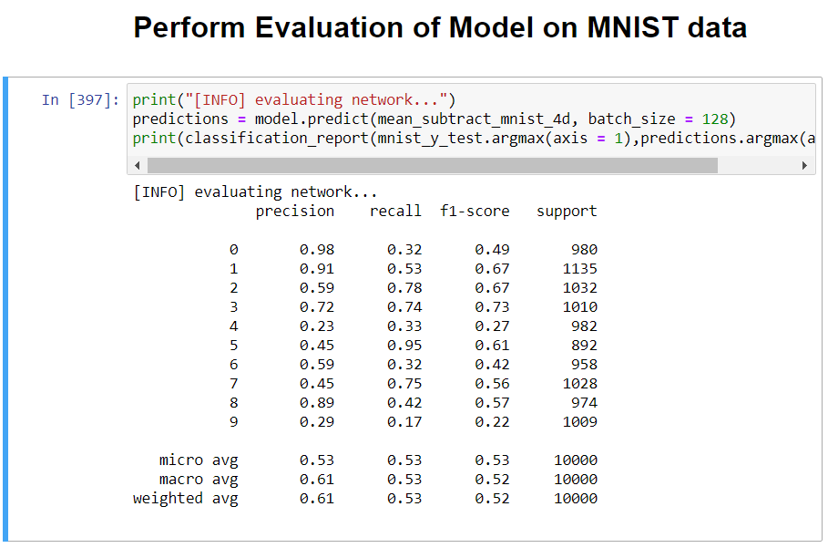
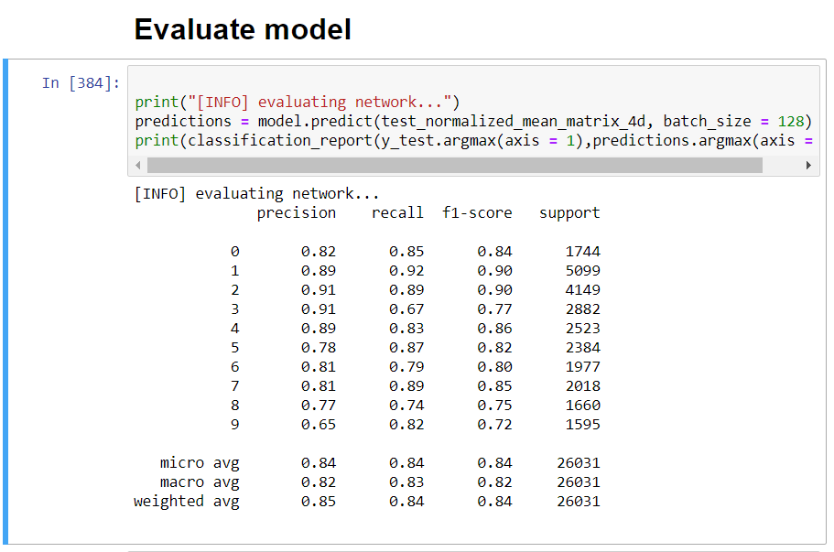
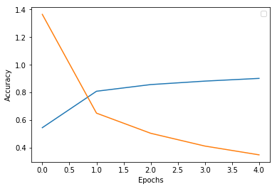
Mean Subtraction/Normalization
85% acc training, 61% acc test

Slide 10
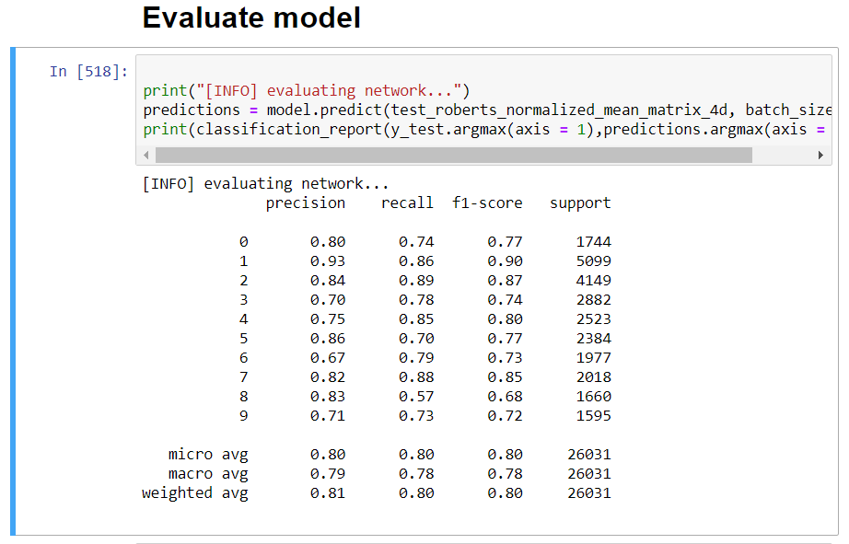
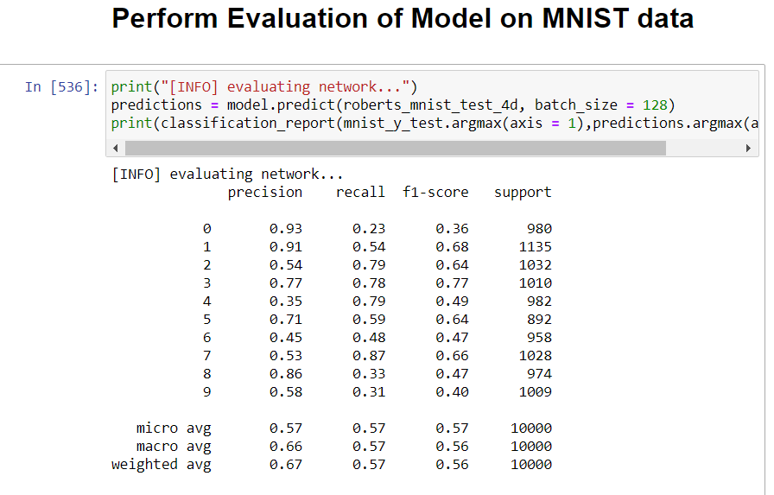
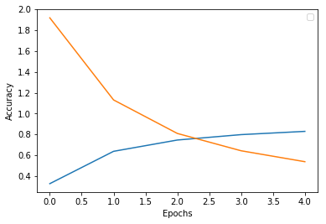
Roberts Edge Detection
81% acc training, 67% acc test

Slide 11

Assessment:
Cause of error
Distracting digits (Roberts edge)
Training size
Number of epochs

Slide 12

Applications:
Generalizable number detection
Education
Character recognition for alphabet and languages
Reading bank checks and other financial documents

