Slide 1
Final PROJECT: A STREETVIEW NAMED DESIRE (MNIST)
KARAN BHARGAVA

Slide 2
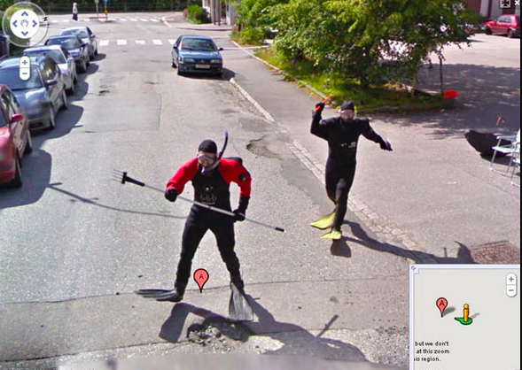
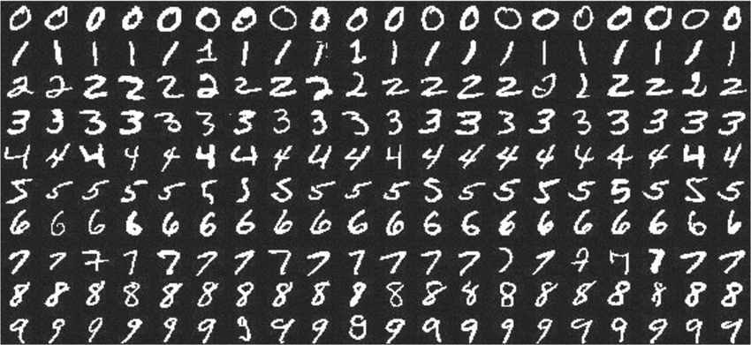
Purpose:
CNN Streetview to MNIST
How versatile is a CNN?
Train it on streetview digits
Test it on MNIST

Slide 3

Challenges:
Streetview Data is Noisy
Distracting digits
Lighting
Angles
Colors
“perfect digits” vs “imperfect handwriting”

Slide 4
Plan of Attack:

Slide 5
Model Overview:

Slide 6
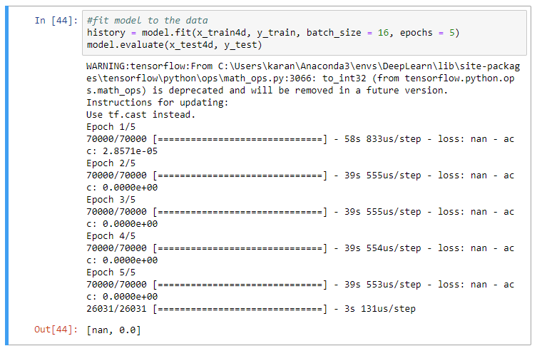
Performance: started from the bottom now I’m here

Slide 7
Takeaways:

