Slide 1
Cloud Computing
Cloud Architecture
FRB ECM Exam - Azure Environment
August 2026
1
Ally Confidential

Slide 2
CONFIDENTIALITY OF INFORMATION
The information contained herein are privileged and/or confidential commercial or financial information.
This information is protected from disclosure under the Freedom of Information Act.
Any public disclosure of this information would significantly harm Ally, its competitive position, or its customers.
Ally requests prior notification and an opportunity to respond if any person submits a Freedom of Information Act or similar request.
2
Ally Confidential

Slide 3
Agenda
Cloud Architecture
August 2026
Cloud Networking
Azure Cloud Adoption Framework
Azure Networking Overview & Landing Zones
Virtual Network (VNet) Isolation
Multi-Subscription Isolation
Network Security Design - Same Region
Network Security Design - Cross Region
Network Performance Reviews
Enabling Application Adoption (CI/CD)
Cloud Resiliency
Multi-Region Architecture
Load Balancing & Elasticity
Additional Topics
Identity & Access Management
Policy Governance & Compliance
Application Log Flow & Monitoring
Hybrid DNS Integration
GitLab Integration & CI/CD
NAOTest Tenant Architecture
Note: This deck covers the Azure environment.
Azure uses Subscriptions (vs AWS Accounts),
VNets (vs VPCs), and ExpressRoute (vs Direct Connect).
3
Ally Confidential

Slide 4
Cloud Networking
4
Ally Confidential

Slide 5
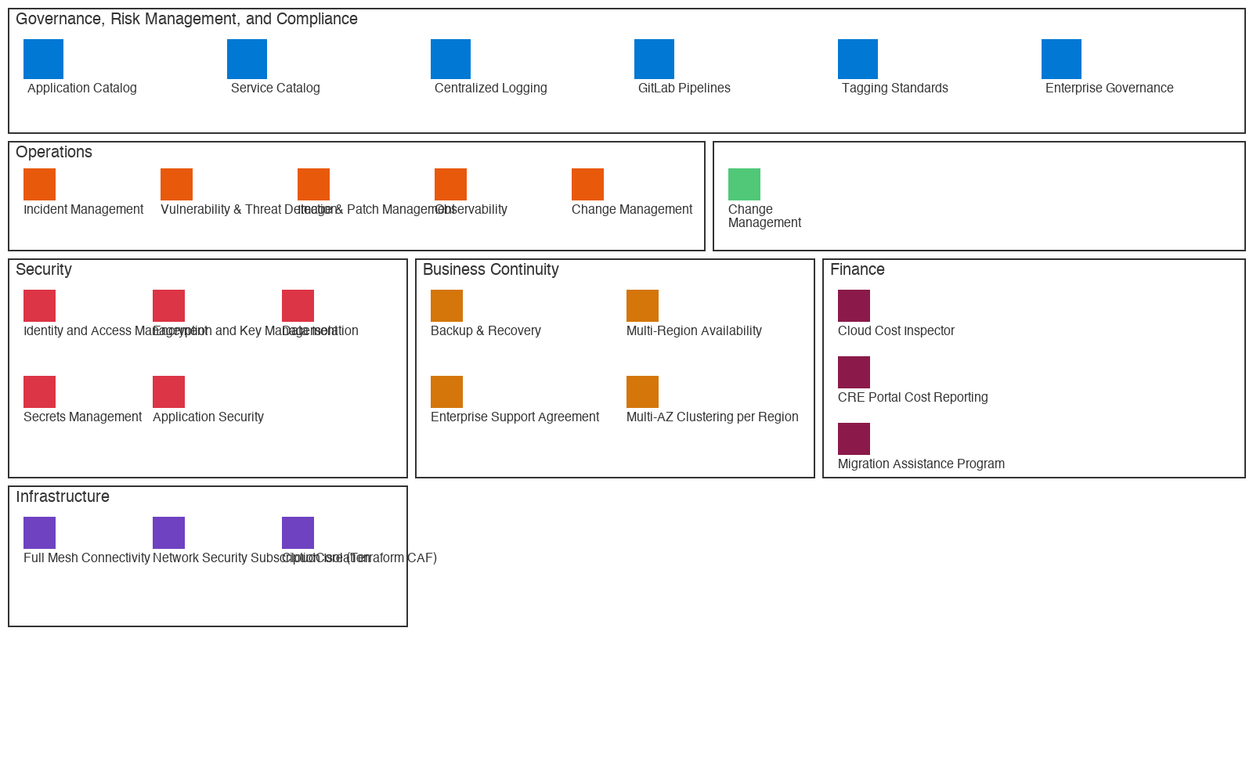
Cloud Adoption Framework
Ally accelerates business value through a tailored, multi-pillar framework leveraging Terraform CAF enterprise-scale for Azure.
Infrastructure
Accelerates delivery of innovative customer capabilities through agile, automated, and governed cloud infrastructure.
Security
Secures the cloud with defense-in-depth to protect customers using Azure Policy, NSGs, Palo Alto, and Defender.
Operations
Enables efficient operations with Azure Monitor, Event Hubs, Splunk integration, and automated alerting.
Governance
Ensures compliance through Azure Policy, tagging standards, and centralized management groups.
5
Ally Confidential

Slide 6
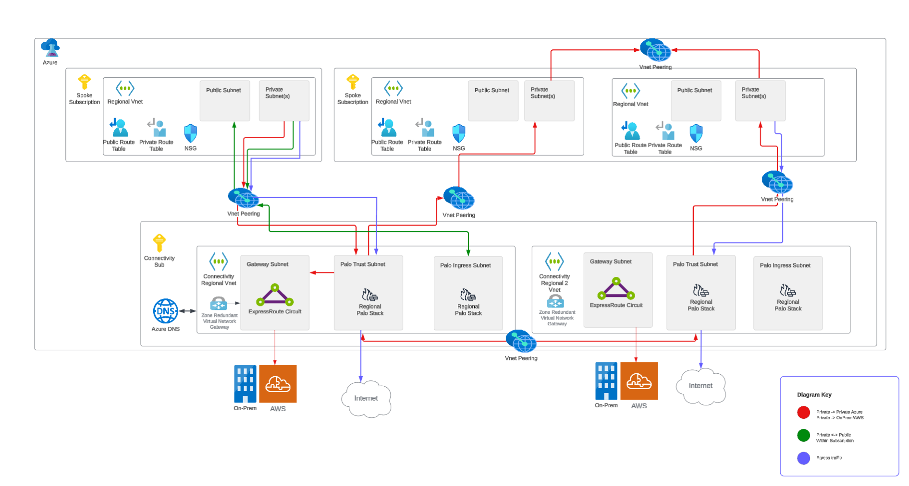
Cloud Networking
Ally provides robust cloud connectivity with secure access controls, isolated networks, monitored activity, and redundant routing.
Secure Administrative Access Controls for All Networking Components
Network & Workload Isolation w/ NSGs Per Subscription & Environment
Monitoring of Abnormal Network Activity w/ SOC Integration
Redundant Routing and Connectivity w/ Low Latency via ExpressRoute
6
Ally Confidential

Slide 7
Network Security Architecture
Ally enables comprehensive security through defense-in-depth inspection inside of each Azure landing zone via Palo Alto firewalls.
Azure Landing Zone Network Security Model:
• Dedicated Palo Alto Firewalls per landing zone in Connectivity Subscription
• Two deployment stacks: Trusted (internal/cross-sub) and Untrusted (internet-facing)
• All traffic leaving or entering a Subscription is routed to the applicable Palo stack
• Firewall Policy inspects and processes all traffic - denied unless explicitly allowed
• Network Security Groups (NSGs) provide per-subnet traffic filtering
• Route Tables (UDRs) override default Azure routing to force traffic through Palo
• Private Endpoints ensure PaaS services are only accessible via internal network
Traffic Flow Directions:
• North/South: Internet ingress/egress via Untrusted Palo stack
• South: On-premises via ExpressRoute through Trusted Palo stack
• East/West: Cross-subscription traffic inspected by Trusted Palo stack
• Same Environment East: VNet peering within same subscription (direct)
7
Ally Confidential

Slide 8
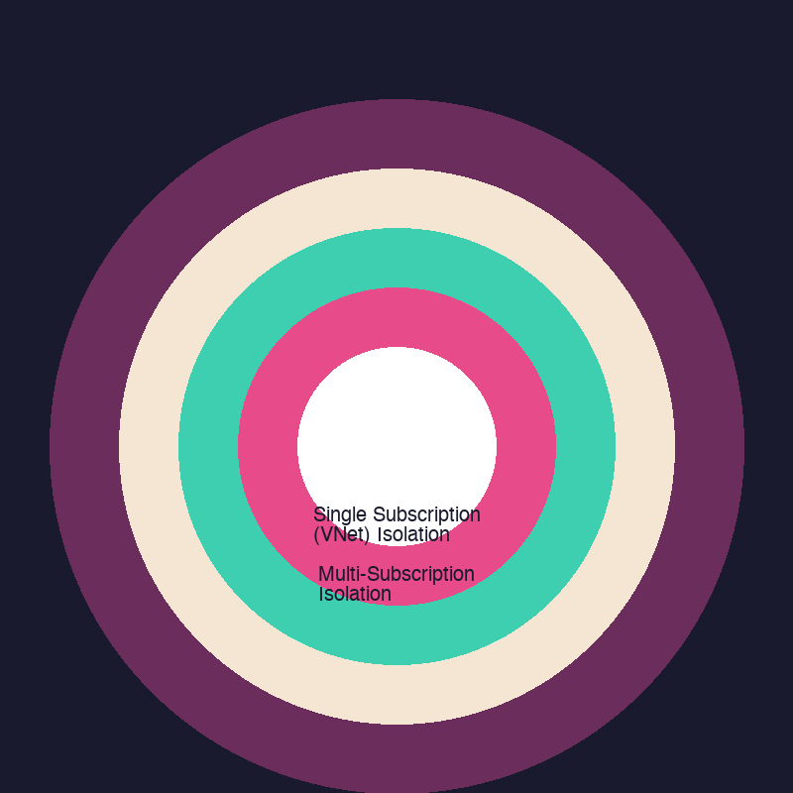
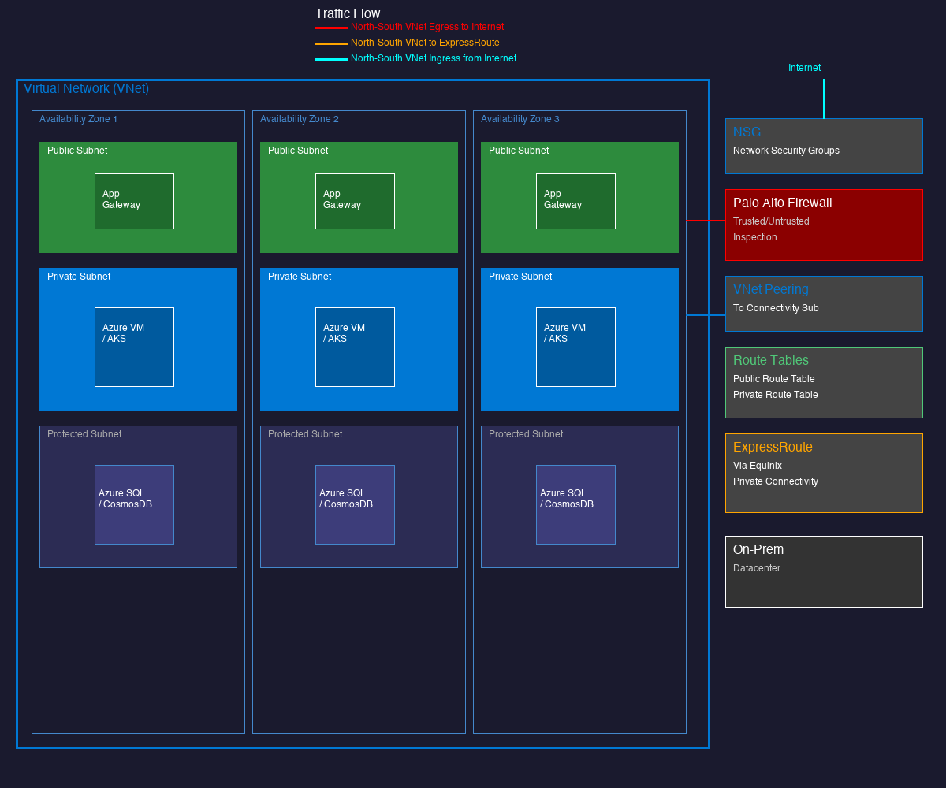
Virtual Network Isolation
Ally builds isolated, controlled networks across 3 Availability Zones for every subscription in the landing zone.
Resources are placed into one of three areas (subnets) within an Azure VNet based on connectivity requirements:
Public Subnet: Internet-facing resources (App Gateway, Azure Front Door) with Untrusted Palo inspection.
Private Subnet: Internal compute (VMs, AKS, Functions) with no direct internet access. Route to on-prem via Trusted Palo.
Protected Subnet: Database resources (Azure SQL, CosmosDB) explicitly denied external access.
NSGs provide subnet-level access control. Route Tables force inspection.
8
Ally Confidential

Slide 9
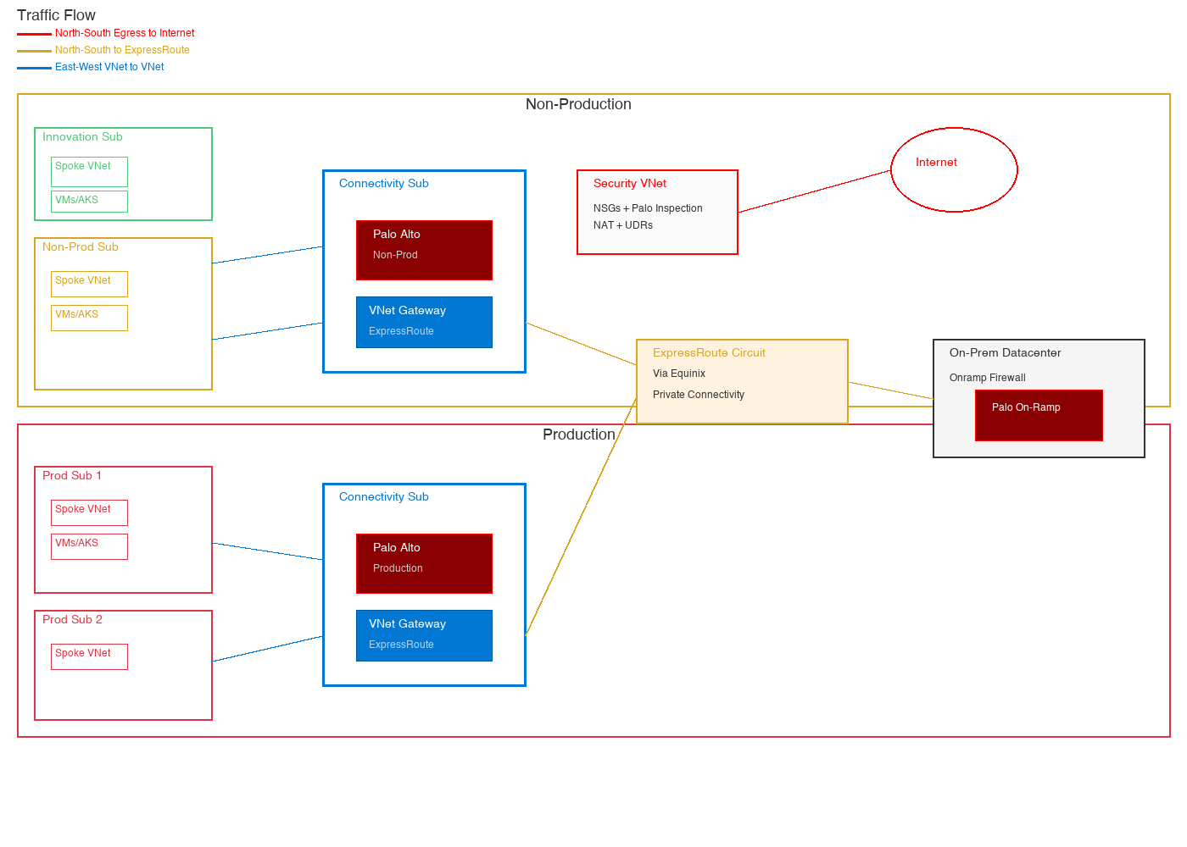
Multi-Subscription Isolation
Ally enables secure multi-subscription isolation with segmented non-prod and prod subscriptions per business unit.
To secure multiple subscriptions on the network, Ally utilizes:
• VNets are peered to the Connectivity subscription VNet for routing
• All traffic leaving or entering a subscription is routed to the Palo Alto firewall in Connectivity
• Firewall Policy inspects all traffic; denied unless explicitly allowed
• If an applicable rule allows connectivity, the connection succeeds
• Separate Palo stacks for Non-Prod vs Production subscriptions
9
Ally Confidential

Slide 10
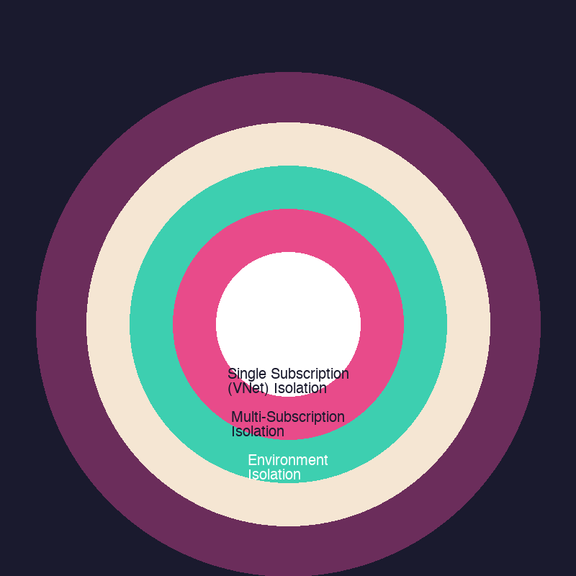
Environmental Segmentation
Ally delivers secure workload isolation with segmented subscriptions per business unit, with increasingly restrictive access.
Application Workload Isolation
Centrally managed policies that define what services are available and allowable configurations per subscription type.
Each subscription is a control boundary with network segmentation and separate RBAC roles.
Each Business Unit has separate subscriptions for Innovation, Non-production, and Production with increasingly restrictive access.
Innovation Subs
• Cost alerting
• Standard Services
• Network access restricted
• Temporary usage
Non-Production Subs
• Persistent Environments
• User access restrictions
• DevSecOps driven releases
Production Subs
• Change Control
• Least-Privileged + PIM
• Fully automated deployments
• Enforced Change Management
10
Ally Confidential

Slide 11
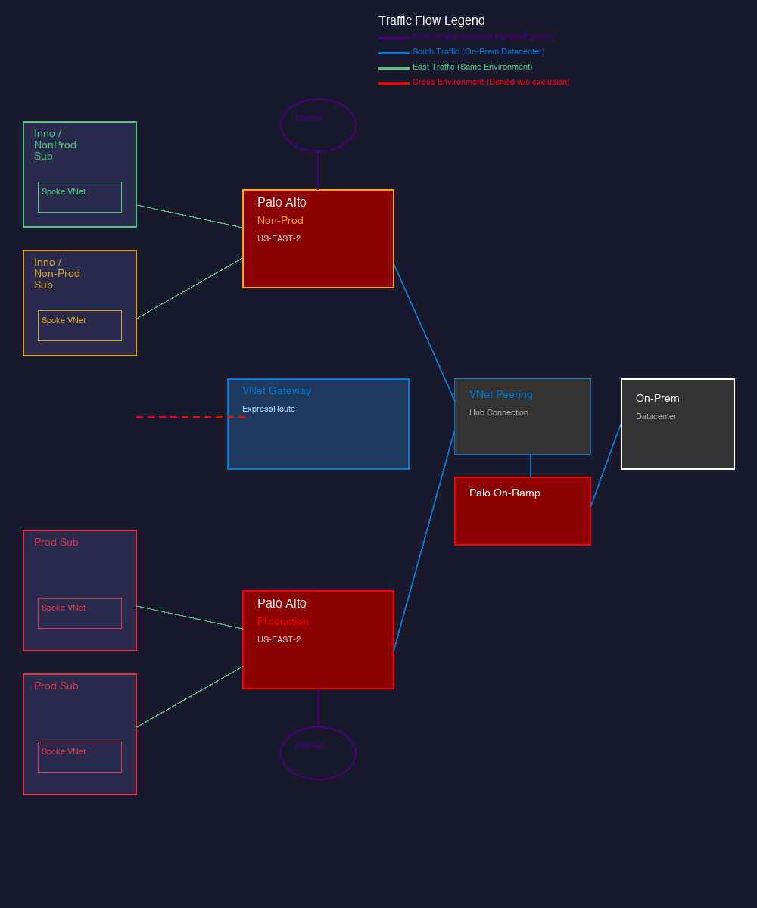
Network Security Design - Same Region
Ally enables comprehensive visibility within regions, subscriptions, and environments through Palo Alto inspection.
Ally utilizes Palo Alto virtual firewalls that can scale to meet traffic volumes on demand.
These firewalls inspect traffic leaving and entering each Azure subscription in a given region:
(North) Traffic coming in or out from the public internet
(South) Traffic coming in or out from on-premises via ExpressRoute
(East) Traffic coming in and out from one VNet to another in the same region
11
Ally Confidential

Slide 12
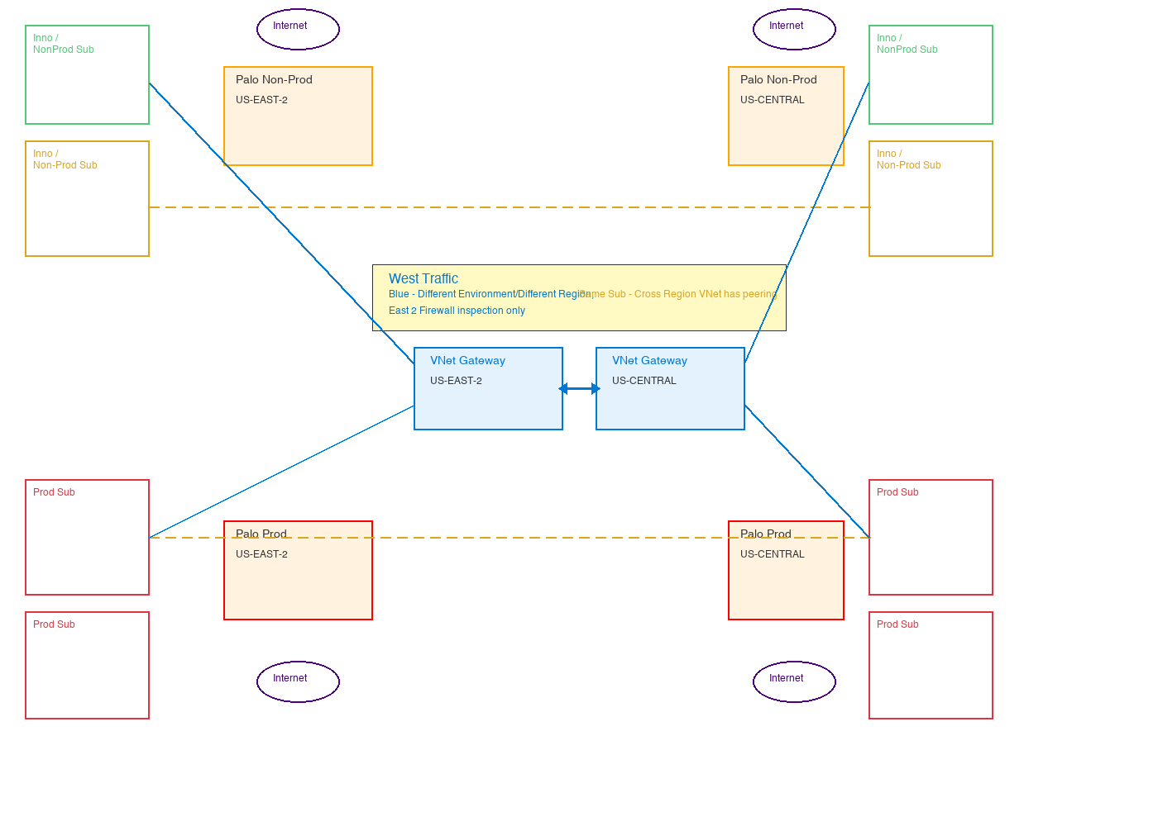
Network Security Design - Cross Region
Ally enables comprehensive visibility across regions, inspecting north, south, east, and west traffic at both regional firewalls.
Palo Alto firewalls in US Central inspect traffic leaving and entering subscriptions in a different region (US East 2):
(West) Traffic coming in and out from one VNet to another in a different region
This design accommodates single firewall inspection at all times & enables growth.
This diagram overlays existing region setup. Cross region VNet peering is set up in the same subscription.
12
Ally Confidential

Slide 13
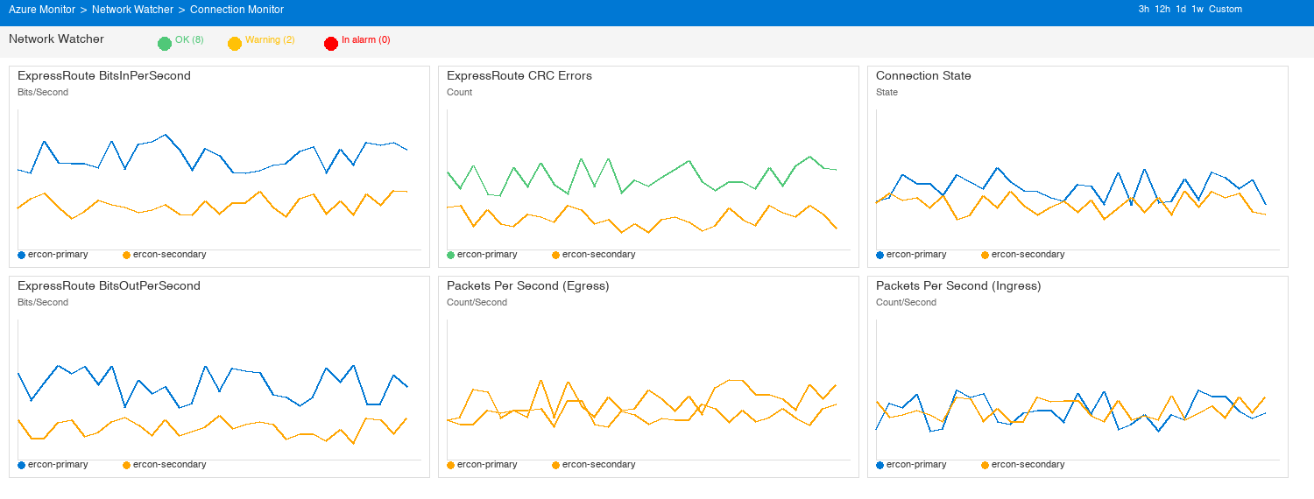
Network Performance Reviews
Ally employs 24/7 real-time monitoring & alerting, quarterly failover validation, and circuit health dashboards via Azure Network Watcher.
We monitor and maintain network availability, alerting, and performance data on all network circuits. Network circuits are proactively analyzed for capacity and actions are taken to ensure ample bandwidth and latency requirements are met.
13
Ally Confidential

Slide 14
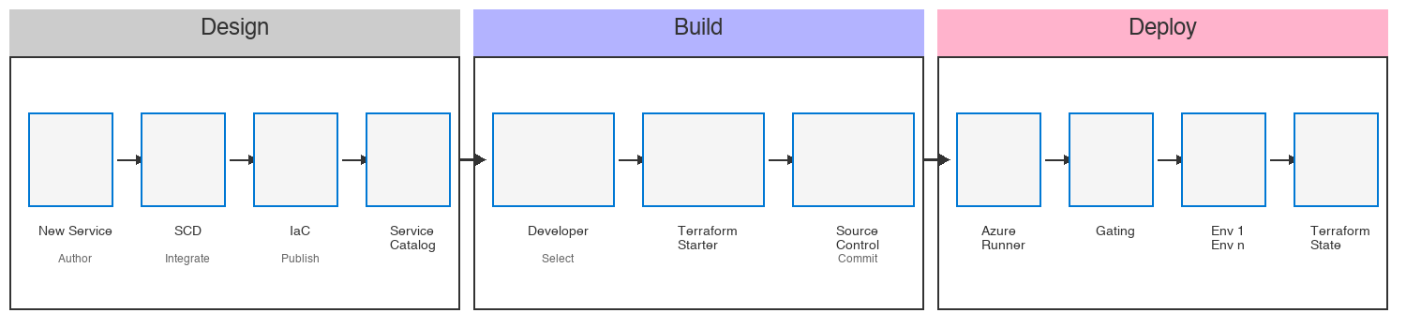
Enabling Application Adoption
Ally leverages the Cloud Services catalog, Terraform Starter, and GitLab to seamlessly deploy cloud applications to Azure.
Design Phase
• New Service request creates SCD
• IaC modules authored & published
• Service Catalog listing created
Build Phase
• Developer selects Terraform Starter
• Customizes for application needs
• Commits to GitLab source control
Deploy Phase
• Azure Runner triggers pipeline
• Gating & approval checks enforced
• Deploys to Env 1..n, stores TF state
14
Ally Confidential

Slide 15
Cloud Resiliency
15
Ally Confidential

Slide 16
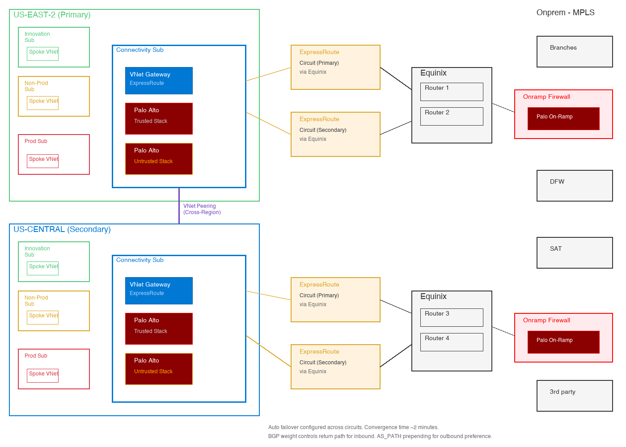
Multi-Region Architecture
Ally enables Resilience by design: multi-region architecture means maximum uptime with auto-failover via ExpressRoute.
Deployment across multi regions for High Availability: US East 2 & US Central
Highly Redundant - ExpressRoute circuits and VNet Gateways in each region. 2 redundant links (Primary/Secondary) in each region.
In the event of a full region failure from connectivity standpoint, traffic is failed over.
Auto failover mechanism is configured across circuits in each region.
Circuit Failover time - approx. 2 minutes for BGP convergence.
BGP weight controls return path for inbound. AS_PATH prepending for outbound preference.
16
Ally Confidential

Slide 17
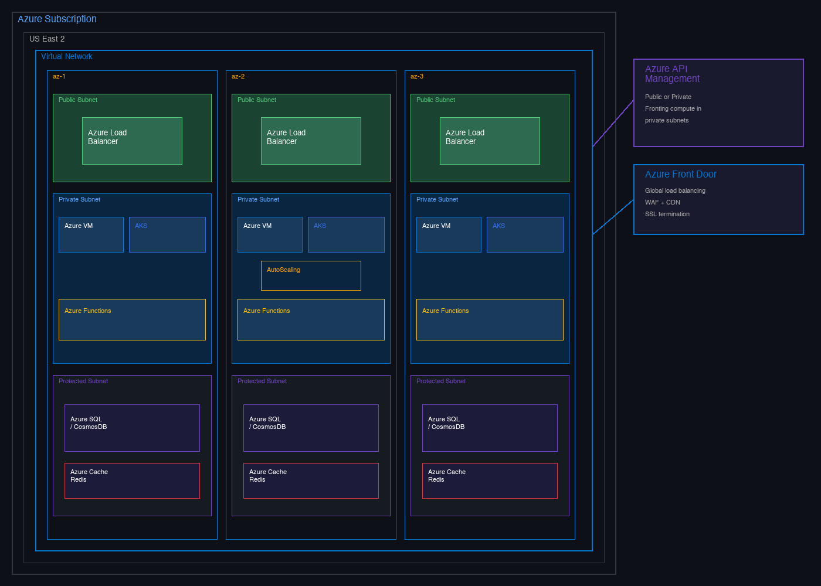
Load Balancing & Elasticity
Resilience assured - Load balancing and auto-scaling across 3 zones by default.
Cloud Foundations offers various patterns for load balancing and compute scaling, all leveraging multi-AZ by default.
Load Balancing
Azure Front Door, App Gateway, Azure LB
Front Door: public, global load balancing + CDN
App Gateway/LB: public or private fronting compute in private subnets
Elasticity
VMs, AKS, Azure Functions, CosmosDB, SQL
3 availability zones enabled
Autoscaling configurable as needed (VMSS)
Serverless scaling where applicable (Functions)
17
Ally Confidential

Slide 18
Identity & Access Management
18
Ally Confidential

Slide 19
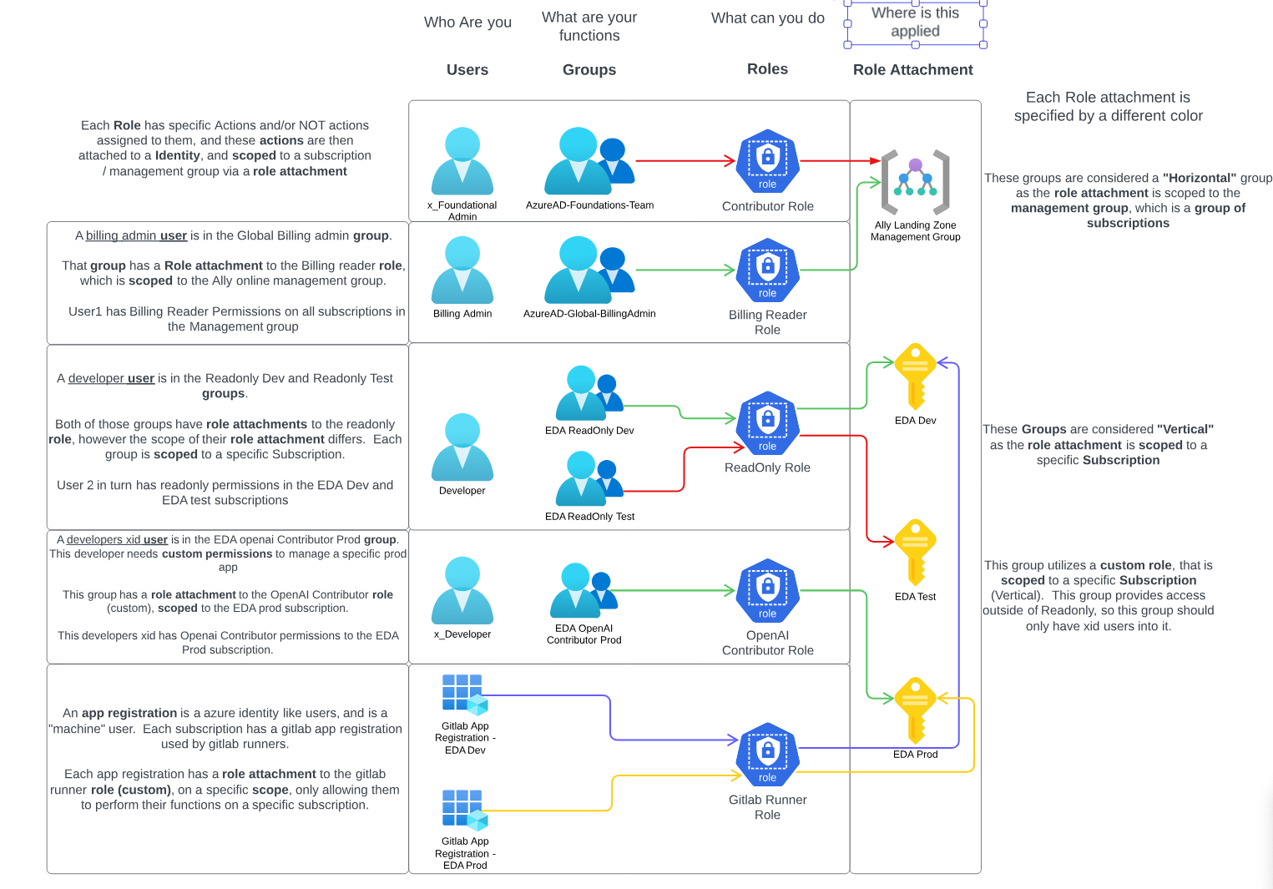
IAM - Role Attachment Model
Ally implements secure role-based access with Entra ID groups mapped to Azure RBAC roles at subscription scope.
• Each Role has specific actions within Entra ID attached to an Identity, and scoped to a subscription or resource group
• A billing admin is in the Online Billing admin group with Billing Reader Permissions on all subscriptions
• A developer is in the Boundary Dev and Boundary Test groups with Contributor role
• A production user is in the ECN Contributor group for Operations read/write access
• An app registration is a service identity with role attachment to a specific Subscription
19
Ally Confidential

Slide 20
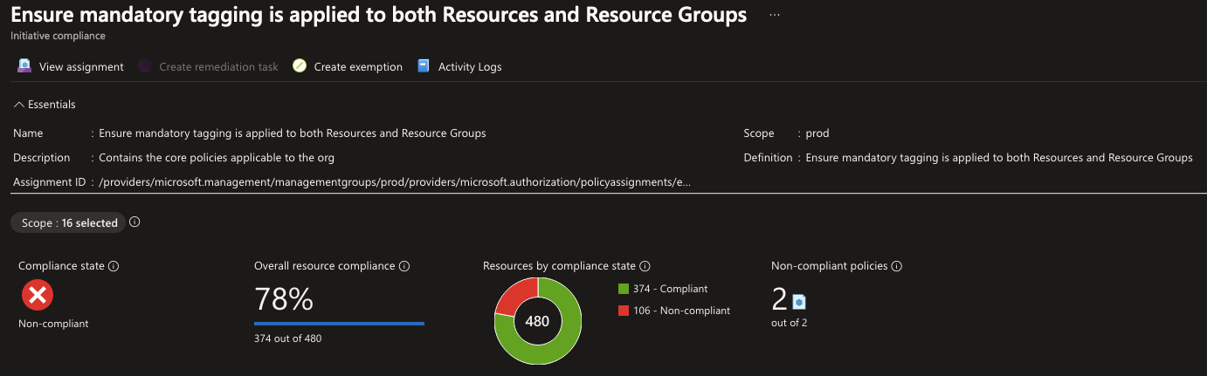
Azure Policy Governance
Ally delivers policy-driven governance: Azure Policy assigned at Management Group level enforces resource compliance across all subscriptions.
• Azure Policy assigned at Management Group level for inheritance across subscriptions
• Policies enforce resource tagging, allowed regions, allowed SKUs, and security baselines
• Deny policies prevent deployment of non-compliant resources at deploy time
• Audit policies report compliance without blocking deployment
• Initiative definitions group related policies for compliance tracking
• Custom policies authored in Terraform and deployed via CI/CD pipeline
• Compliance data surfaced through Azure Policy dashboard (see below)
20
Ally Confidential

Slide 21
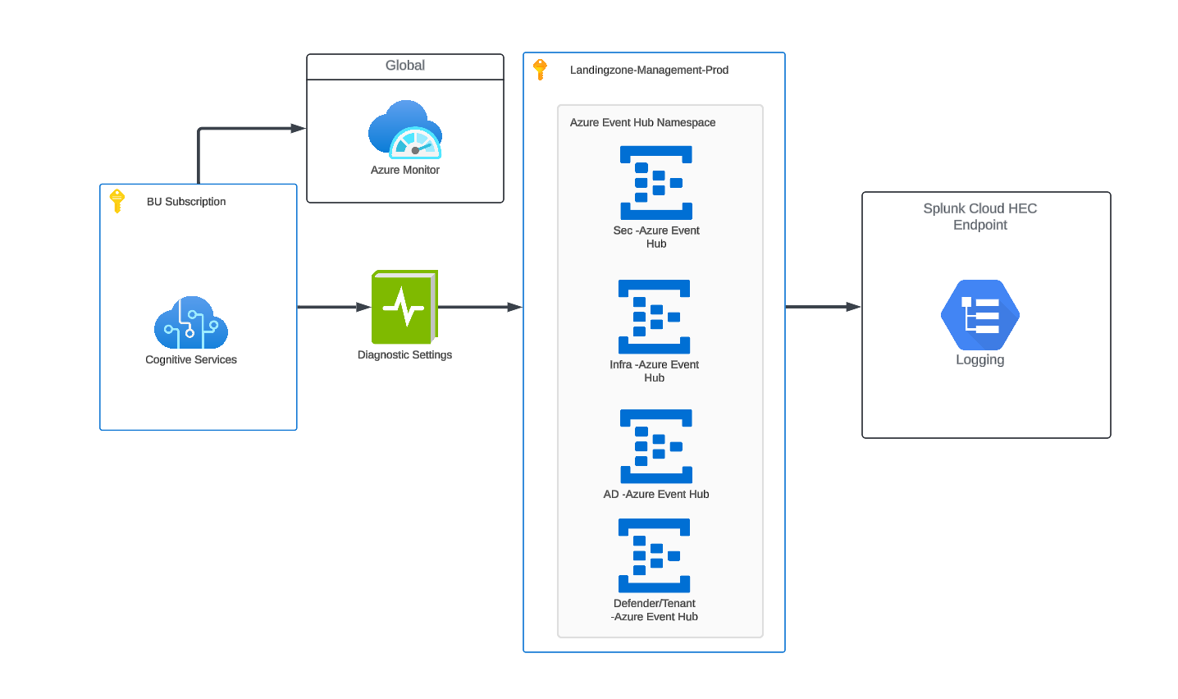
Application Log Flow
Ally employs centralized log aggregation from Azure Monitor through Event Hubs to Splunk Cloud for unified observability.
• BU Subscription resources emit logs to Azure Monitor
• Diagnostic Settings route to Event Hub Namespaces
• Separate Event Hubs per log type:
- Sec-Azure Event Hub (security)
- Infra-Azure Event Hub (infrastructure)
- AD-Azure Event Hub (identity)
- Defender/Tenant-Azure Event Hub
• Splunk Cloud HEC Endpoint receives all aggregated log streams
• Management-Prod subscription hosts shared logging infrastructure
21
Ally Confidential

Slide 22
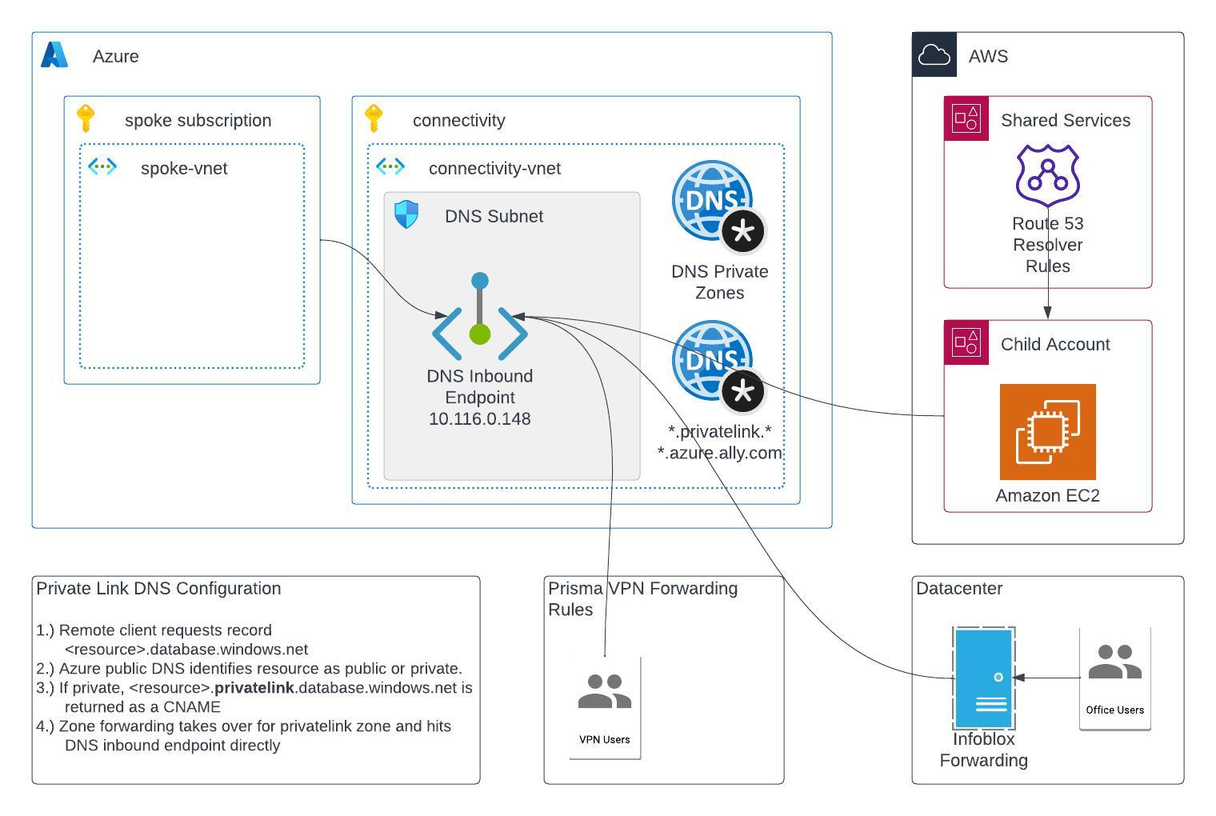
Azure Hybrid DNS
Azure Private DNS Resolvers enable seamless name resolution across Azure, AWS, on-premises, and VPN users.
• Azure Private DNS Resolver in Connectivity VNet (DNS Subnet)
• DNS Inbound Endpoint: 10.116.0.148
• Private DNS Zones for *.privatelink.* and *.azure.ally.com
• On-prem Infoblox forwards Azure queries to DNS Inbound Endpoint
• AWS Route 53 Resolver Rules forward Azure zones to DNS endpoint
• Prisma VPN users route DNS via forwarding rules
• Spoke VNets linked to Private DNS Zones via VNet Links
Private Link DNS Resolution:
1. Client requests <resource>.database.windows.net
2. Azure public DNS identifies resource as private
3. CNAME to <resource>.privatelink.database.windows.net
4. Zone forwarding hits DNS inbound endpoint directly
22
Ally Confidential

Slide 23
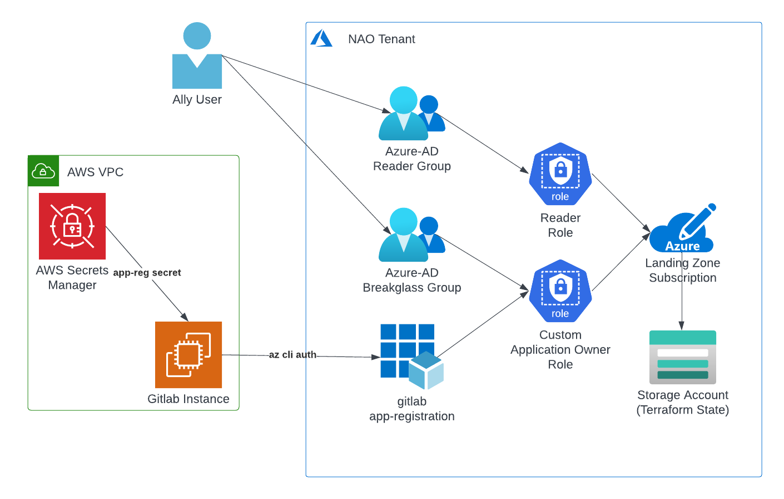
GitLab Integration & CI/CD
Cross-cloud CI/CD: AWS-hosted GitLab deploys to Azure Landing Zone subscriptions via Entra ID federated authentication.
• Ally User accesses Azure via Entra ID Reader Group or Breakglass Group
• GitLab Instance in AWS VPC uses app-reg secret from AWS Secrets Manager
• az cli auth from GitLab authenticates via gitlab app-registration in Entra ID
• Custom Application Owner Role grants deployment access to Landing Zone Subscription
• Terraform State stored in Azure Storage Account
23
Ally Confidential

Slide 24
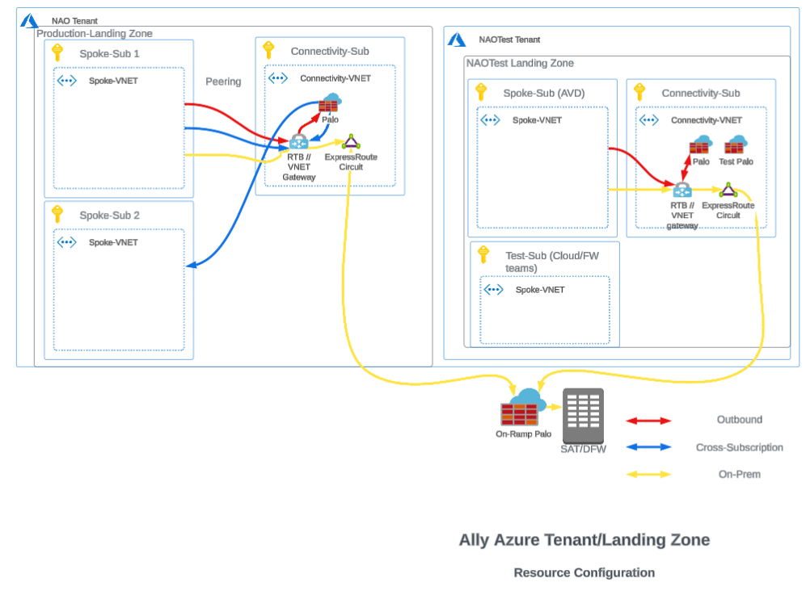
NAOTest Tenant Architecture
Dual-tenant architecture: Production NAO and NAOTest with shared On-Ramp Palo connectivity at SAT/DFW.
NAO Tenant (Production):
• Spoke-Sub 1 & 2 with Spoke-VNETs
• Connectivity-Sub with Connectivity-VNET
• Palo + ExpressRoute Circuit + VNet Gateway
NAOTest Tenant:
• Spoke-Sub (AVD) with Spoke-VNET
• Connectivity-Sub with Palo + Test Palo
• Test-Sub for Cloud/FW teams
Shared:
• On-Ramp Palo at SAT/DFW
• ExpressRoute connectivity to on-prem
24
Ally Confidential

Slide 25
Interoperability
Ally has adopted a multi-cloud strategy to avoid vendor lock-in. Azure serves as the primary alternative to AWS, selected due to existing contractual relationships with Microsoft.
Ally Cloud Engineering has identified corresponding technologies in Azure and on-prem:
• Azure was selected as primary alternative due to existing Microsoft contracts (M365, Entra ID)
• Workloads include containers (AKS), infrastructure (VMs), and data stores (SQL, CosmosDB)
• Enterprise standard tooling including GitLab CI/CD and Terraform enable cloud portability
• Common patterns: VNet isolation, Palo Alto inspection, ExpressRoute, RBAC
• Cross-cloud integration: AWS GitLab -> Azure deployments, AWS Secrets -> Azure auth
• Hybrid DNS: Azure DNS Resolver <-> AWS Route 53 <-> On-prem Infoblox
Azure <-> AWS Equivalents:
AWS VPC = Azure VNet
AWS Account = Azure Subscription
AWS Direct Connect = Azure ExpressRoute
AWS Transit Gateway = Azure VNet Peering/Gateway
AWS IAM Roles = Azure RBAC + Entra ID
AWS CloudWatch = Azure Monitor
AWS S3 = Azure Storage Account
AWS Lambda = Azure Functions
AWS EKS = Azure AKS
AWS CloudTrail = Azure Activity Log
AWS Organizations = Azure Management Groups
25
Ally Confidential

