Slide 1
jQuery Plugins

Slide 2
Outline
WHAT plugins are
WHY create/use a jQuery plugin
HOW to create a (simple) jQuery plugin
APPLICATION:
jQuery plugins in CaleCale

Slide 3
What are Plugins?
A jQuery plugin is simply a new method that is use to extend jQuery's prototype object.
By extending the prototype object, all jQuery objects inherit any methods that you add.

Slide 4
What are Plugins?
Whenever jQuery() is called, a new jQuery object is created and inherits all of jQuery's methods.

Slide 5
What are Plugins?
The idea of a plugin is to do something to a collection of elements.
Each method that comes with jQuery can be considered a plugin, e.g. .fadeOut() and .addClass()

Slide 6
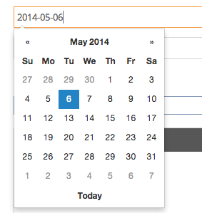
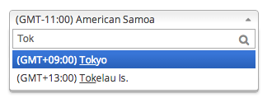
Plugin Examples
Datepicker
Chosen

Slide 7
Why Create a jQuery Plugin?
Portability & Reusability
Packaging a common function within a jQuery plugin will make it more portable – doing so allows you to easily integrate the plugin into different projects within a short amount of time.

Slide 8
Why Create a jQuery Plugin?
Abstraction
Packaging code can help you focus on the other areas of your application without worrying about the details of the implementation of the plugin.

Slide 9
Why Create a jQuery Plugin?
Time
If a functionality that is commonly used is wrapped as a plugin, you can save time since it had already been implemented.

Slide 10
Why Create a jQuery Plugin?
Containment
Namespacing and scoping are two very prevalent issues in JavaScript. Creating a jQuery plugin means functionality will be logically contained and reduce the chance of scope/namespace conflicts.

Slide 11
Why Create a jQuery Plugin?
Community
You can contribute to the jQuery community by making and sharing a robust plugin. Other people can also help in improving the plugin.

Slide 12
Let's Create A Plugin!
(The plugin demo is at http://kjcpaas.github.io/color_clicker)

Slide 13
Creating A Plugin
Color Clicker Goals
1. For each click on each element, the background changes color.
2. Colors may be random or specified.
3. User should be able to get current color and set color.
4. It should have callbacks.

Slide 14
Creating A Plugin
Step 1
Create a closure (for containment) in a separate js file.

Slide 15
Creating A Plugin
Inside the closure, $ is used as an alias for jQuery.
Add a method/plugin to jQuery by:
$.fn.(plugin name) = function() { ... }
This method is exposed and can now be used by jQuery objects.

Slide 16
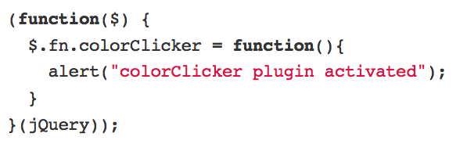
Creating A Plugin

Slide 17
Creating A Plugin
Note:
If possible, only add one method to $.fn for each plugin you make.
This is to avoid conflicts with other plugins and applications.

Slide 18
Creating A Plugin
Step 2
Add the plugin logic.

Slide 19
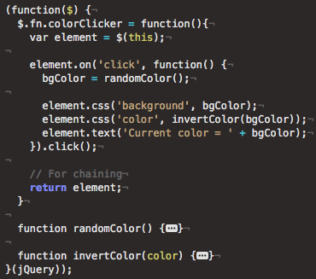
Creating A Plugin
Attach listener
Change background
Change text color (complementary to background)
Trigger listener

Slide 20
Creating A Plugin
Note:
Unlike $(selector).colorClicker(), randomColor() and invertColor() cannot be accessed outside the closure.

Slide 21
Creating A Plugin
Color Clicker Goals
1. For each click on each element, the background changes color. ?
2. Colors may be random or specified.
3. User should be able to get current color and set color.
4. It should have callbacks.

Slide 22
Creating A Plugin
Color Clicker Goals
1. For each click on each element, the background changes color.
2. Colors may be random or specified.
3. User should be able to get current color and set color.
4. It should have callbacks.

Slide 23
Question:
How can the elements be detached from each other?

Slide 24
Creating A Plugin
Step 3
Support multiple elements

Slide 25
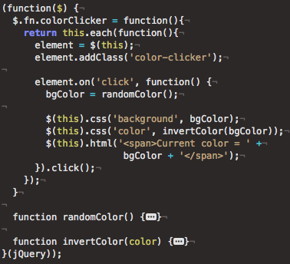
Creating A Plugin
Surround the logic with $.each()

Slide 26
Creating A Plugin
Color Clicker Goals
1. For each click on each element, the background changes color.
2. Colors may be random or specified.
3. User should be able to get current color and set color.
4. It should have callbacks.

Slide 27
Creating A Plugin
Step 4
Add support for options
(Options are important for customization)

Slide 28
Creating A Plugin
So far, we are able to a generate random colors for each click.
For now, we don't have any way of cycling through a specified set of colors.

Slide 29

Creating A Plugin
For this plugin, add an option to specify this set of colors.

Slide 30
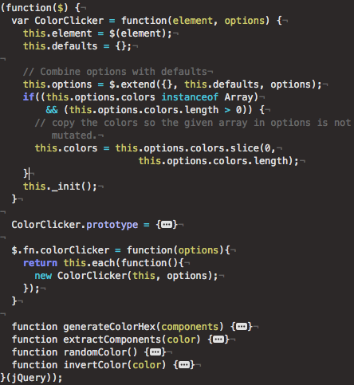
Creating A Plugin
Defaults can be combined with the user specified options using $.extend().
Other options processing can be done within the constructor (more on this later).
What's this?

Slide 31
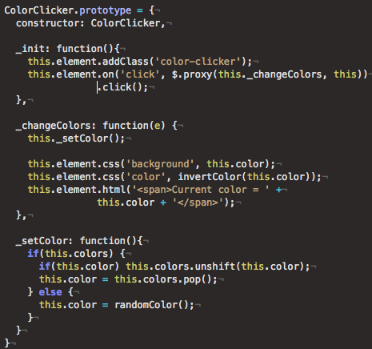

Creating A Plugin
Prototype (similar to Ruby class) can also be used to organize the methods and listeners.
Methods that start with '_' are private.
Sometimes $.proxy() needs to be used so that this inside event listeners still refers to the ColorClicker object, not the event target.

Slide 32
Creating A Plugin
Color Clicker Goals
1. For each click on each element, the background changes color.
2. Colors may be random or specified.
3. User should be able to get current color and set color.
4. It should have callbacks.

Slide 33
Question:
If we want to get the color of the clicker what should we do?

Slide 34
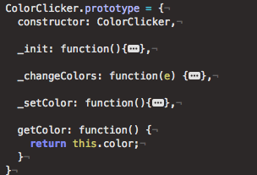
Creating A Plugin
Solution:
Add a getter method. (Make sure it is not private)
Problem:
How can we access this method?

Slide 35
Creating A Plugin
So far, colorClicker() only initializes the plugin for the elements. We have no way to get data about the plugin.

Slide 36
Creating A Plugin
Step 5
Allow access of existing plugin data.

Slide 37
Creating A Plugin
This can be done by changing the plugin function.

Slide 38
Creating A Plugin
Possible ways to call a plugin:
Type 1: Using options
$(selector).colorClicker( {option: value} );
Type 2: Using public method (w/o arguments)
$(selector).colorClicker( 'getColor' );

Slide 39
Creating A Plugin
Possible ways to call a plugin:
Type 3: Using public method (w/ arguments)
$(selector).colorClicker( 'setColor', '#ffffff' );
We must allow the access to plugin elements in all these cases.

Slide 40
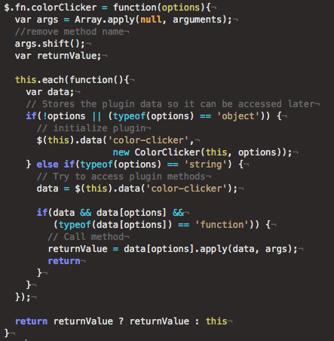
Creating A Plugin
Get arguments.
If Type1, initialize plugin and store data.
If Type2 or 3, try to get existing plugin data.
- If data and method exists, call method with the arguments.

Slide 41
Creating A Plugin
Color Clicker Goals
1. For each click on each element, the background changes color.
2. Colors may be random or specified.
3. User should be able to get current color and set color.
4. It should have callbacks.

Slide 42
Creating A Plugin
Step 6
Add callbacks.

Slide 43
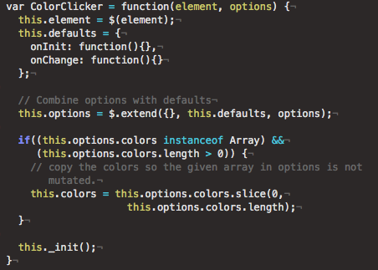
Creating A Plugin
Add default callback functions

Slide 44
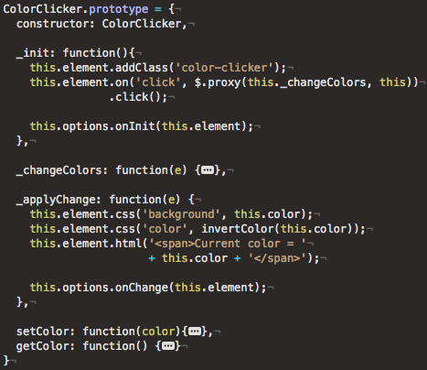
Creating A Plugin
Call the callbacks in their respective methods

Slide 45
Creating A Plugin
Color Clicker Goals
1. For each click on each element, the background changes color.
2. Colors may be random or specified.
3. User should be able to get current color and set color.
4. It should have callbacks.

Slide 46
Creating A Plugin
Step 1: Create a closure
Step 2: Add plugin logic
Step 3: Add support for multiple elements
Step 4: Add options (for customization)
Step 5: Allow access of existing plugin data
Step 6: Callbacks

Slide 47
Creating A Plugin
If the plugin elements need specific styles, it we can also add a .css file for it.

Slide 48
Creating A Plugin
Add a “wrapper” class for the topmost plugin element.
It is best to do this when initializing the plugin.

Slide 49
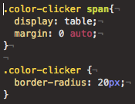
Creating A Plugin
This wrapper class should be used in the css as reference.

Slide 50
Plugins in CaleCale

Slide 51
Creating A Plugin
cale-multiselect
- for user and facility selection
clock-timepicker
- timepicker for forms (analog clock interface)

Slide 52
Creating A Plugin
datetime-interval
- keeps set interval
- validates date and time values
schedule-picker
- interface for selecting values for repeating schedules

Slide 53
References
http://james.padolsey.com/javascript/why-create-a-jquery-plugin/
http://learn.jquery.com/plugins/
...Personal Experience...

