Slide 1
The Spectral Shortcut
why locking part of a model makes it better
Krzysztof Dziuba · lab meeting

Slide 2
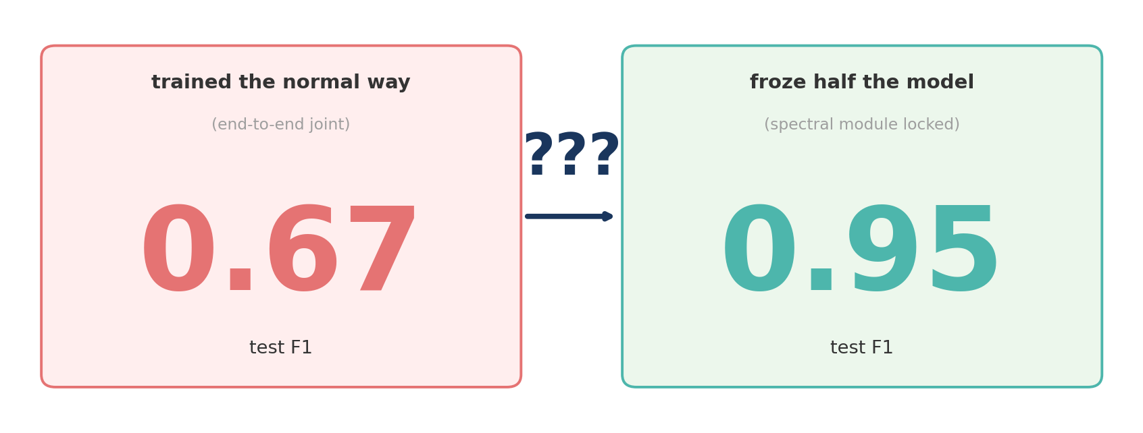
the puzzle
same model — totally different results
2 / 7

Slide 3
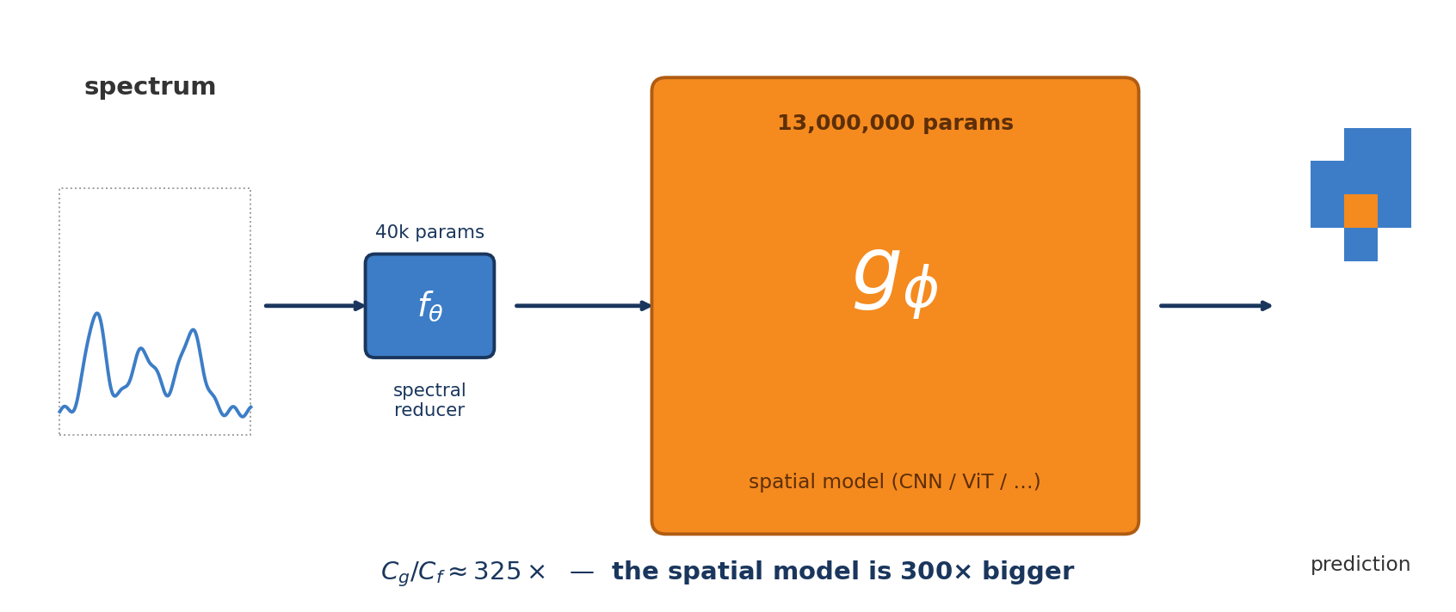
what's inside
a small "squeezer" feeds a huge "brain" — and the size gap is the whole story
3 / 7

Slide 4
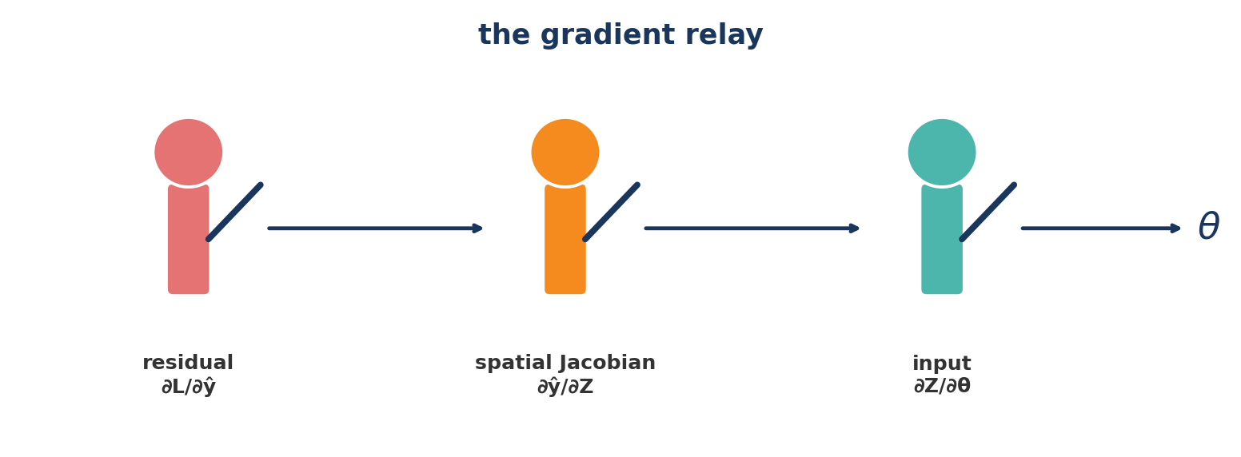
gradients move backward — like a relay
∂L/∂θ = ∂L/∂ŷ · ∂ŷ/∂Z · ∂Z/∂θ
three runners pass the same baton: "residual" → "Jacobian" → "input" → θ
4 / 7

Slide 5
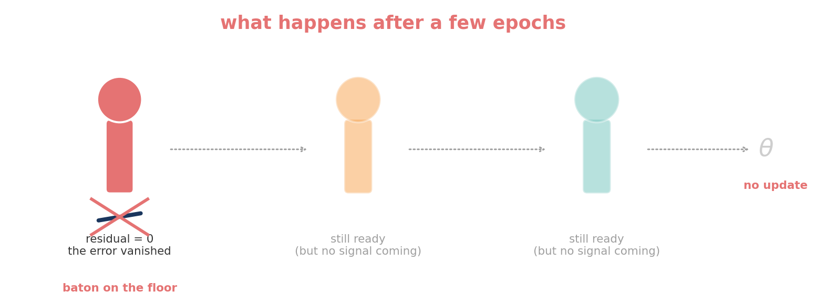
and then the first runner drops it
cross-entropy saturates fast → residual = 0 → no gradient ever reaches θ
5 / 7

Slide 6
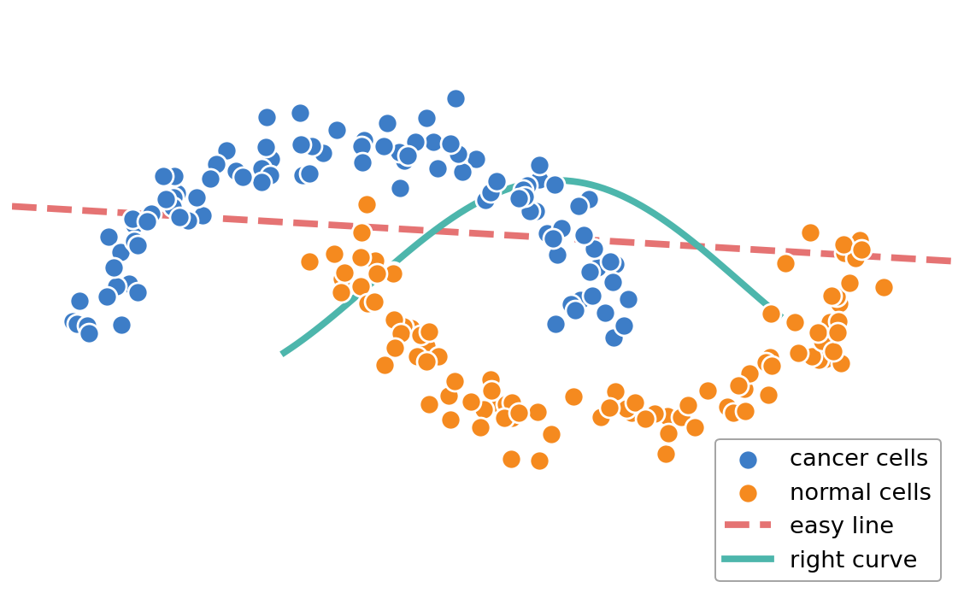
the "easy line" beats the "right curve"
imagine cancer (blue) vs normal (orange) — gradient descent picks the easy line, ignores the curve. In our case the "easy line" is morphology, the "right curve" is chemistry.
6 / 7

Slide 7
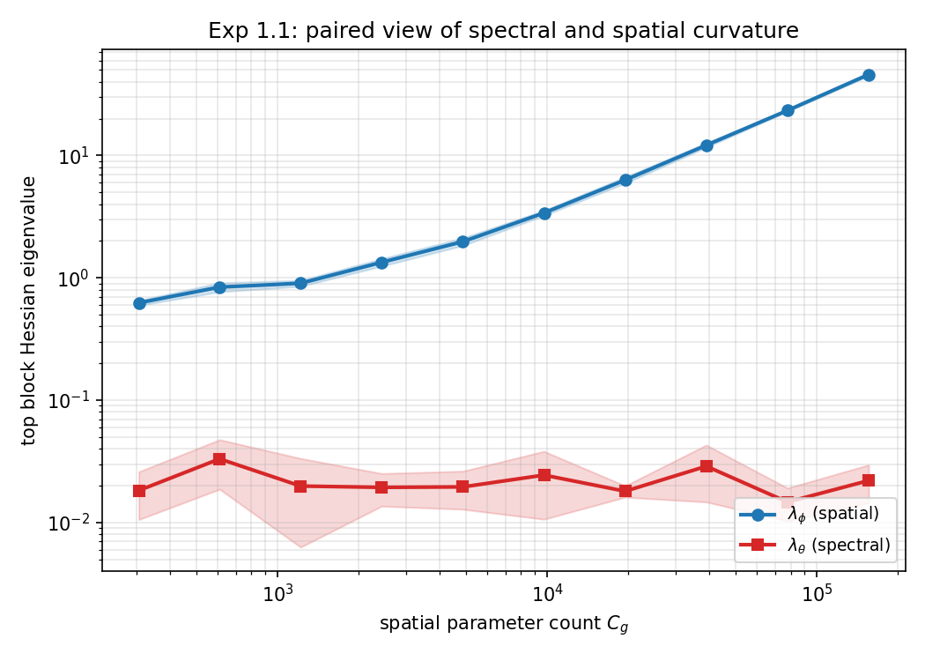

and the data shows it
spatial curvature (blue) grows 75×. spectral curvature (red) stays flat.
freeze. anchor. watch.
don't train everything at once — the math says you can't.
7 / 7

