Slide 1
spectral shortcut theory
Why end-to-end training fails
in spectral-spatial deep learning
A mathematical diagnosis of why the same network does better when we DON'T train part of it — and what this means for FTIR / QCL classification.
lab meeting
Krzysztof Dziuba
(Joint paper #2; companion to the empirical results)

Slide 2
The empirical paradox we keep running into
Same architecture. Same data. Same training budget. Different test F1.
Variant
Test F1
Note
End-to-end learned linear (joint)
0.675
the standard approach
What this is telling us
Frozen random spectral
0.70
even random beats joint
• Joint training underperforms
• Random frozen beats joint by 3 points
• Pretrained frozen wins by 30 points
• Fine-tuning UNDOES the pretraining
• Symptom: training procedure failing
• Not the data, not the architecture
Frozen PCA-128 spectral
0.78
fixed but informative
Frozen pretrained spectral (Peak)
0.84
freeze + chemistry-aware
Frozen pretrained spectral (MLP)
0.90
freeze + learned
Frozen pretrained spectral (Slidewin)
0.95
best result we have
Fine-tuned pretrained
0.79
UNfreezing destroys it
Spectral Shortcut Theory — lab meeting

Slide 3
The setup — a compositional model
Almost every spectral-spatial deep model has this shape:
input
f_θ spectral reduction
g_φ spatial model
ŷ prediction
X ∈ R^(H × W × S) for each pixel: a spectrum
per-pixel R^S → R^K linear, small (C_f params)
CNN / ViT / U-Net big (C_g ≫ C_f)
per-pixel class logits then softmax
The key structural fact: capacity asymmetry
C_f ≈ 40,000 (linear, ~942 → 128) C_g ≈ 13,000,000 (ViT + decoder) ratio C_g / C_f ≈ 325 ×
The question we are answering:
why does training f_θ together with g_φ ("end-to-end") fail in a way that freezing f_θ fixes?
Spectral Shortcut Theory — lab meeting

Slide 4
The math intuition — the chain rule decomposition
Gradient flowing back to the spectral parameters factorizes into three pieces:
∂L / ∂θ = ∂L/∂ŷ · ∂ŷ/∂Z · ∂Z/∂θ
residual
spatial Jacobian
input
1. ∂L/∂ŷ — the error
2. ∂ŷ/∂Z — what g_φ wants
3. ∂Z/∂θ — the input
• how wrong predictions are
• softmax(ŷ) − y
• when predictions get confident, this goes to 0 EXPONENTIALLY
• if this is 0, the whole product is 0
• Jacobian of the spatial model
• tells f_θ "give me features looking like this"
• depends on g_φ's current state
• CHANGES every training step → moving target
• Z = Wᵀ X, so this is just X
• the input spectrum
• doesn't change during training
• delivers signal at full strength
Key insight: the gradient to the spectral module is killed at term 1. Doesn't matter how good the other two are.
Spectral Shortcut Theory — lab meeting

Slide 5
The shortcut — easy answer crowds out the right one
From Pezeshki et al. (NeurIPS 2021): gradient descent picks the EASIEST separating boundary, not the most useful one.
Pezeshki's two-moons
Our spectroscopy setting
• Two curved classes, almost linearly separable
• GD finds the LINEAR boundary
• Never finds the curved one — even though curved is more robust on held-out data
• Mechanism: linear feature has bigger eigenvalue in the NTK; the residual decays along it first
• Weaker (curved) features get NO gradient signal after that — they starve
• "Curved" = chemistry — subtle peak ratios, amide bands, lipid signatures
• "Linear" = morphology — region size, tissue boundaries, density contrast
• Joint training picks MORPHOLOGY because it's the bigger-eigenvalue feature in the high-capacity spatial module
• Chemistry never gets the gradient it needs to specialize → spectral shortcut
• Same mechanism, different domain
This is why end-to-end training underperforms. It's a structural property of compositional models with capacity asymmetry — not a hyperparameter problem.
Spectral Shortcut Theory — lab meeting

Slide 6
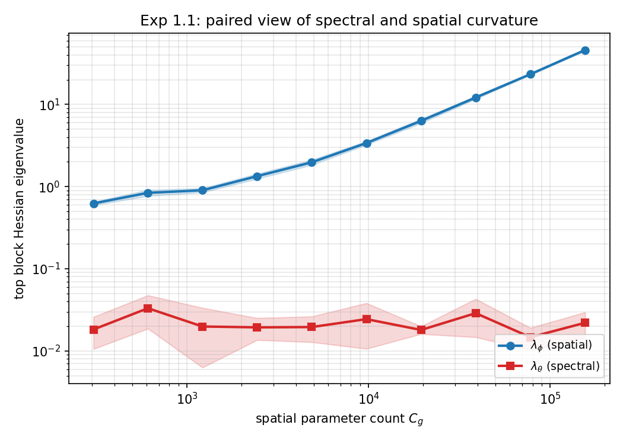
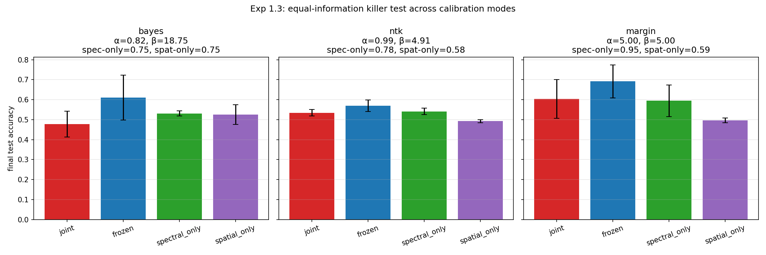
Preliminary results — what we're seeing
1. The loss landscape is GEOMETRICALLY ill-conditioned
2. Joint training collapses BELOW each modality's baseline
Spatial curvature (blue) grows 75× with capacity. Spectral curvature (red) stays flat at ~0.02. Condition number κ from 40 → 2,400.
Left panel = Bayes-calibrated equal info. Joint reaches 0.48 — below frozen (0.61), spectral-only (0.53), spatial-only (0.53).
SYNTHETIC DATA: per-pixel spectrum (R^64) + smooth class patterns; CNN width D varied across 16 → 8192, 5 seeds.
SYNTHETIC DATA: spectral signal in u-direction, spatial signal in orthogonal v-direction; α, β calibrated to give equal per-modality baselines.
Spectral Shortcut Theory — lab meeting

Slide 7
Where this goes — the paper and the prescription
What the paper delivers
The prescription
• Theorem 1: condition number κ(G) ≥ Ω(C_g / C_f) — capacity asymmetry forces ill-conditioning
• Theorem 2: under joint SGD the spectral module is GRADIENT-STARVED before it can specialize
• EGR diagnostic: ‖∇_θ L‖ / ‖∇_φ L‖ during training — a real-time signal of the pathology
• Synthetic verification (Exps 1.1–1.4)
• Real-data link (FTIR / QCL companion paper)
• FREEZE the spectral module — removes the timescale gap by construction
• Or: PCA / fixed baseline injection — spatial sees stable input even if f_θ drifts
• Track EGR during training — when it collapses, training is going wrong
• Stop trying to learn everything at once — the math says you can't, on this architecture
• Why it matters: every FTIR / QCL / Raman / hyperspectral paper using end-to-end joint training is losing performance on test data
One-line takeaway: in spectral-spatial DL the math says don't train everything at once — freeze the spectral encoder and the test F1 goes up.
Spectral Shortcut Theory — lab meeting

