Slide 1
So you want to start a bakery in new york?
Applied Data Science Capstone Project

Slide 2
Data acquisition and cleaning
Data on bakeries in New York obtained from FourSquare
Data included name, likes, rating, tips, location.
FourSquare data included 155 bakeries.
Geodata obtained from dataset:
https://cocl.us/new_york_dataset
Capita data for New York obtained from:
https://en.wikipedia.org/wiki/Boroughs_of_New_York_City

Slide 3
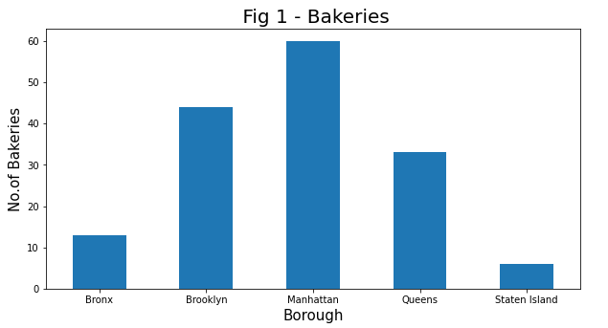
Bakeries per Borough
Manhattan has most Bakeries and Bronx least

Slide 4
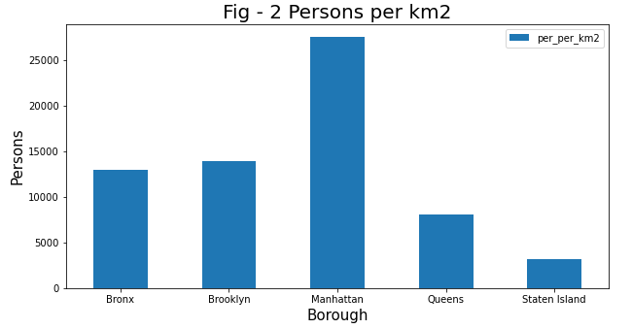
CAPITA DENSITY
Manhattan is the most densely populated Borough

Slide 5
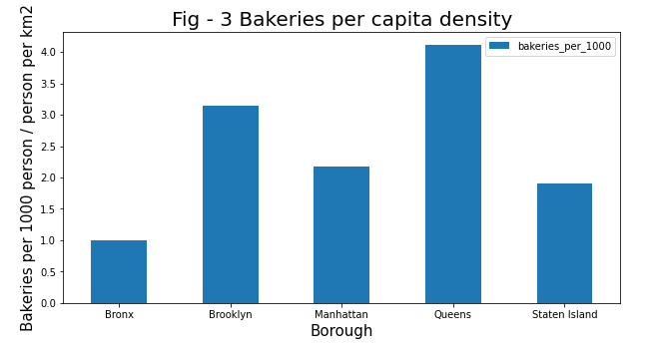
Underserved borough
By combining data on bakeries per borough and capita density we can find the Borough with least bakeries per person

Slide 6
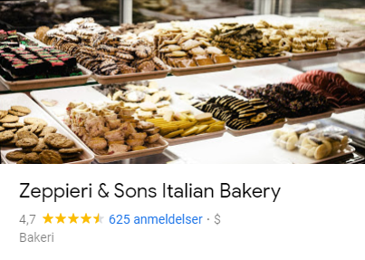
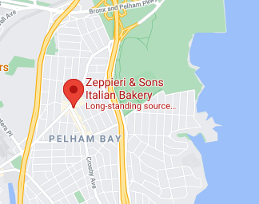
Ratings, likes and max tips
The Bakery with most likes is “Baked” in Brooklyn
The Bakery with most tips is also “Baked” in Brooklyn
The highest rated bakery is however located in Bronx and is “Zeppieri & Sons” in Pelham Bay and as should be considered when choosing a location:

Slide 7
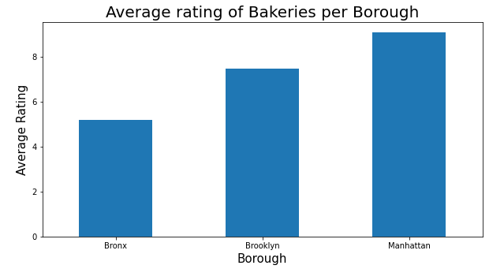
Average ratings of bakeries
Even the highest rated Bakery is in Bronx, the average rating is quite low which reinforces Bronx as a good location.

Slide 8
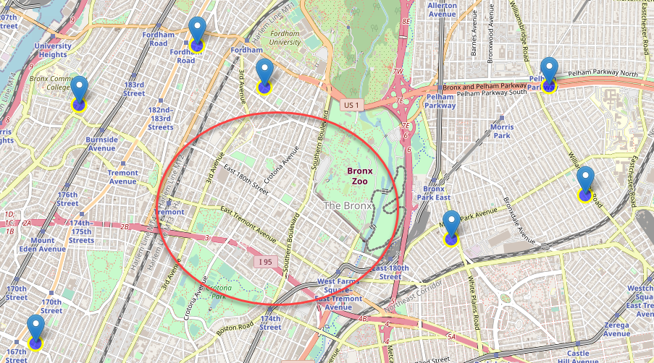
conclusion
I would suggest Bronx as the Borough with highest potential for a new bakery. More specifically in the area around Bronx Zoo and New York Botanical Garden

