Slide 1
Opening new café in Seoul
IBM data science coursera
capstone

Slide 2
Seoul is hot spot for Coffee Shops
Coffee shops in Seoul are more than just COFEE:
Meetings
Work/Study
Social gatherings
More # of Starbucks stores in Seoul than that of in New York city in 2019.
Coffee shops in Seoul close around 12 AM
(vs. ~7 PM in US).

Slide 3
Target Audience
What type of clients or a group of people would be interested in this project?
-Business personnel who wants to invest or open a coffee shop.
-Travelors in Seoul who wants to visit hot Cafes.
-Freelancer who would like to have their own cafes as a side business.

Slide 4
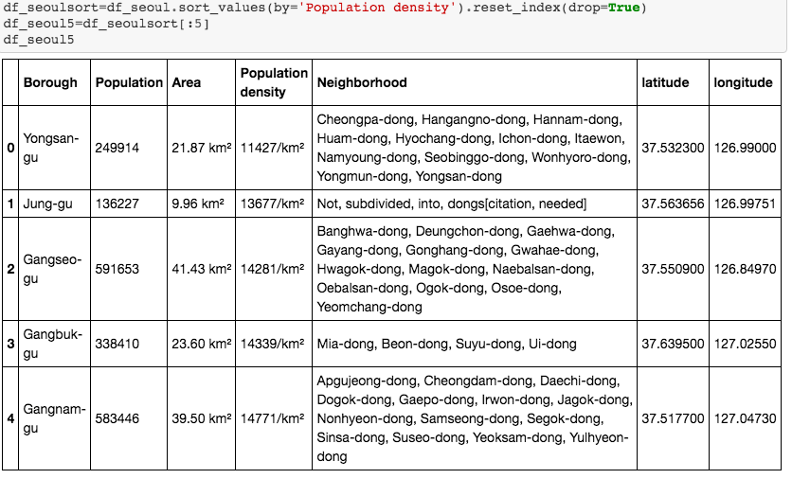
Data acquisition and cleaning
Top 5 boroughs in Seoul with high population density:
- Yongsan-gu
- Jung-gu
- Gangseo-gu
- Gangbuk-gu
- Gangnam-gu

Slide 5
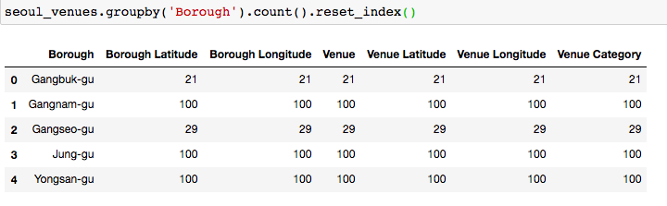
Data acquisition and cleaning
Venues on each district:
Foursquare API, 100 venue limit in 1 km radius.

Slide 6
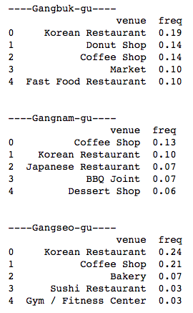
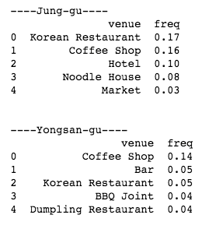
Analyze each borough
Top 5 venues in each borough

Slide 7
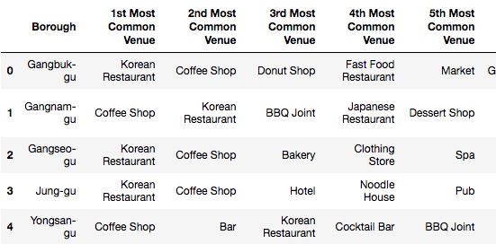
Analyze each borough
Most common venues in dataframe:
the most common venue on Gangnam-gu and Yongsan-gu is 'Coffee Shop’.

Slide 8
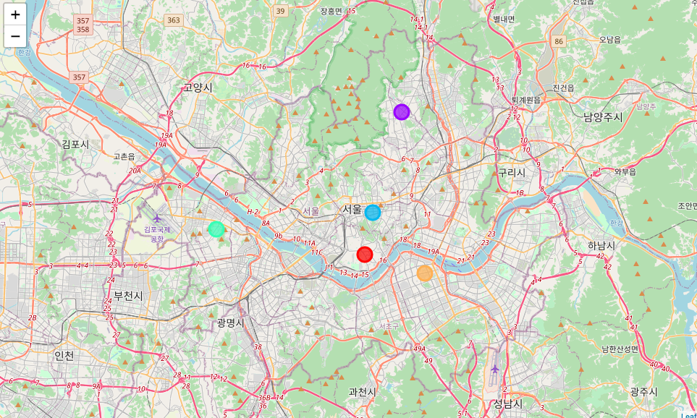
Kmeans clustering in folium map

Slide 9
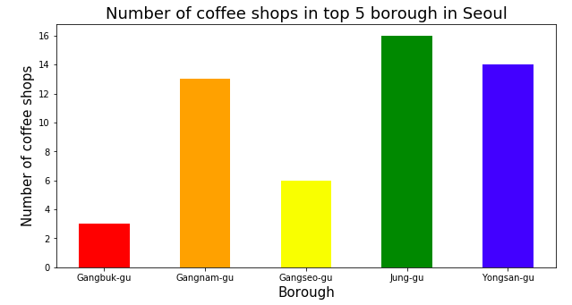
Analyze ‘Coffee shop’ in each borough
Absolute number of coffee shops in each borough

Slide 10
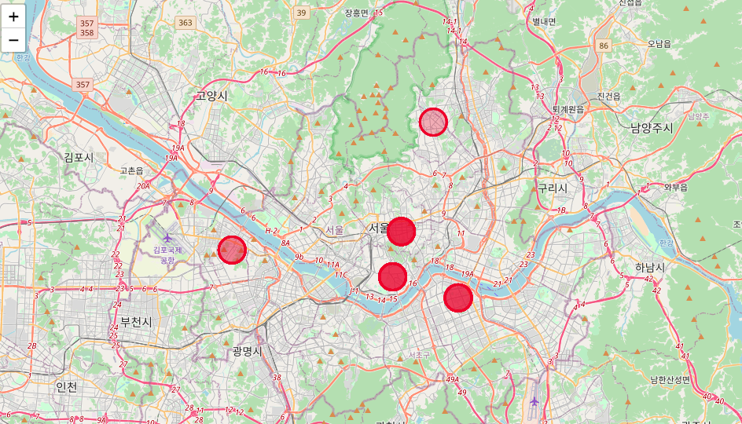
Analyze ‘Coffee shop’ in each borough

Slide 11
Discussions
Interestingly, the top 3 absolute number of coffee shops resulted in Gangnam-gu, Jung-gu and Yongsan-gu. As we have seen from the frequency analysis, Gangnam-gu and Yongsan-gu have the most crowded cafes with high numbers of coffee shops. However, Jung-gu showed cafe as 2nd most common, but still its absolute number is still as high as Yongsan-gu.
From these two analyses, my recommendation to open coffee shop is either at Gangbuk-gu or Gangseo-gu. Both boroughs have high population density in Seoul, which will attract many customers, but at the same time, competition with other coffee shops is still lower than other three boroughs.

Slide 12
Conclusion
I used python libraries, Geopy client and Foursquare API to explore top 5 boroughs in Seoul. It was very interesting to see the difference between the most frequent venue and the absolute number of coffee shops in Jung-gu. Here, my recommendation to open new cafe is either Gangbuk-gu or Gangseo-gu. However, for those who would like to explore many coffee shops during the visit in Seoul, I definitely recommend Yongsan-gu and Gangnam-gu. These two boroughs had the most frequent and high number of coffee shops. It should be very convenient to explore cafes in a short, limited time during the visit.

