Slide 1

BRIGHT TV Viewership ANALYSIS
01

Slide 2
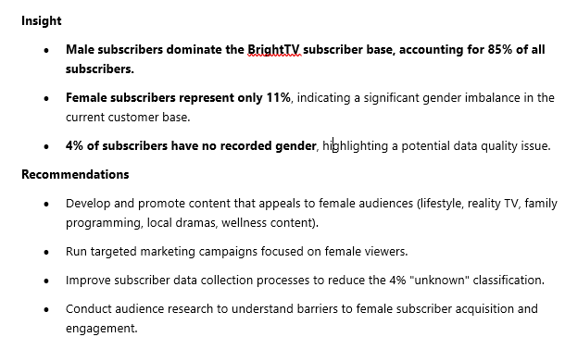
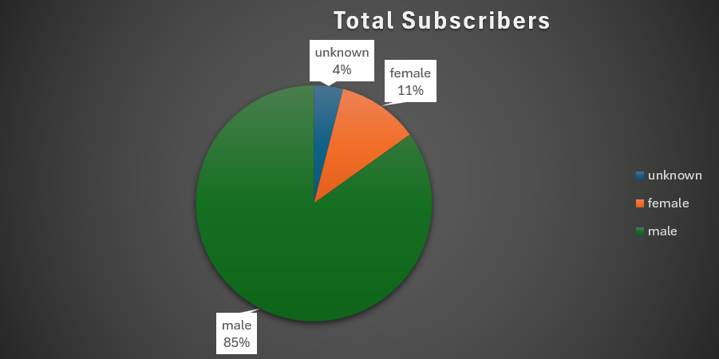
Race Profile of Subscribers
KEY INSIGHT
of subscribers are male
11%
Female
Data quality flag: 4% of subscribers have no recorded gender.
02

Slide 3
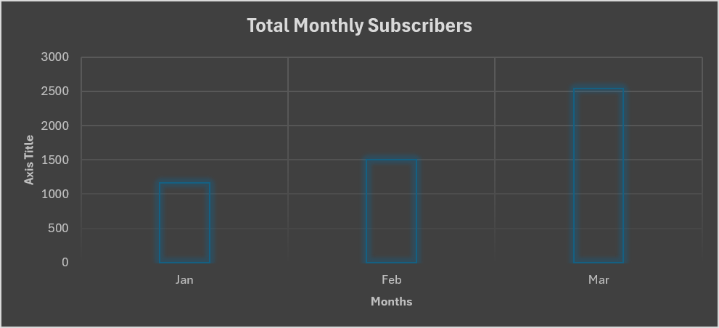
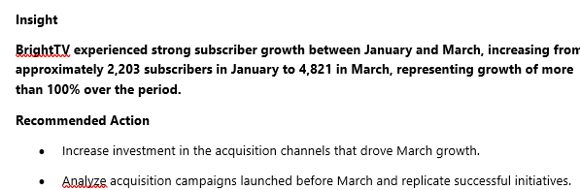
Total Subscribers by Growth
A clear view of the current subscriber Growth
KEY INSIGHT
of subscribers are male
11%
Female
Data quality flag: 4% of subscribers have no recorded gender.
BRIGHTTV • CUSTOMER VALUE MANAGEMENT
02

Slide 4
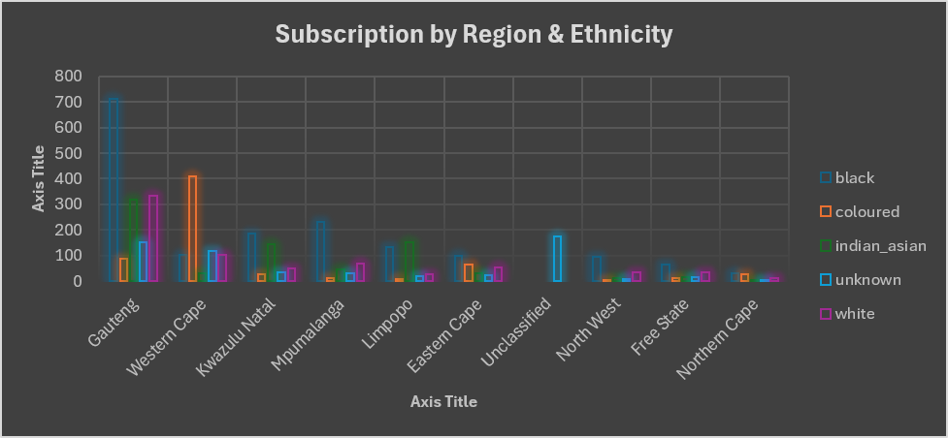
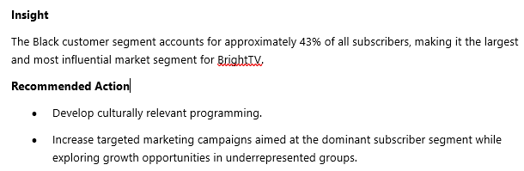
Total Subscribers by Ethnicity
A clear view of the current subscriber Growth
KEY INSIGHT
of subscribers are male
11%
Female
Data quality flag: 4% of subscribers have no recorded gender.
02

Slide 5
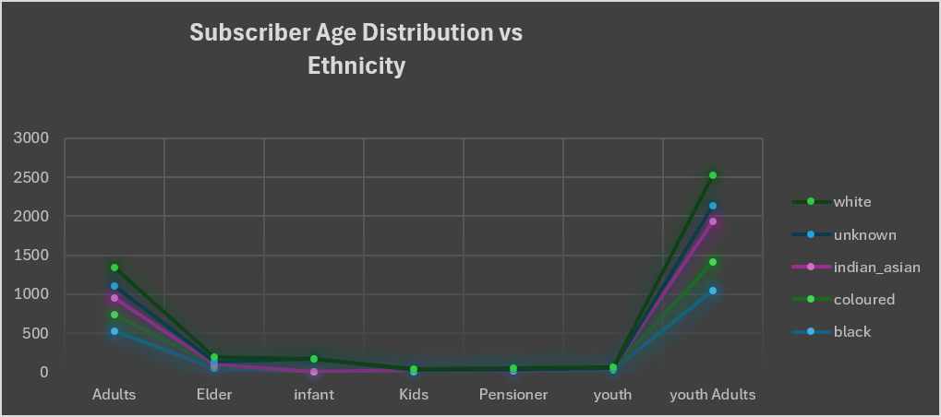
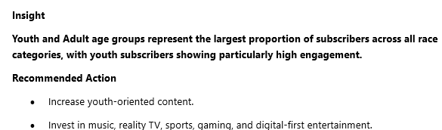
Subscribers by Age distribution
A clear view of the current subscriber Growth
KEY INSIGHT
of subscribers are male
11%
Female
Data quality flag: 4% of subscribers have no recorded gender.
02

Slide 6
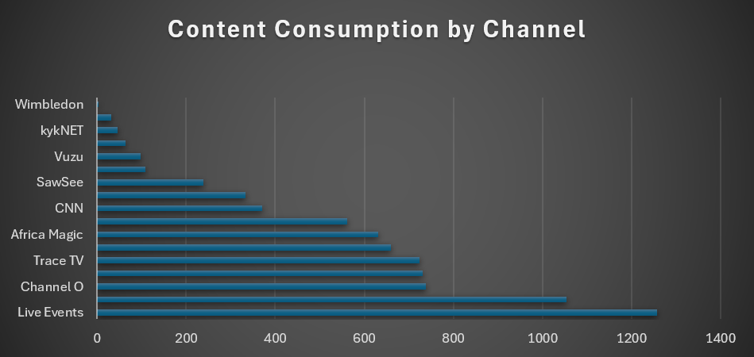
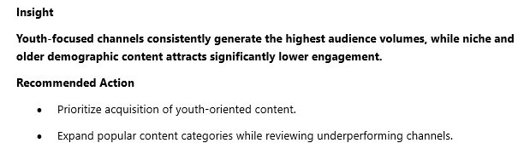
Content Consumption by channel
A clear view of the current subscriber Growth
KEY INSIGHT
of subscribers are male
11%
Female
Data quality flag: 4% of subscribers have no recorded gender.
02

Slide 7
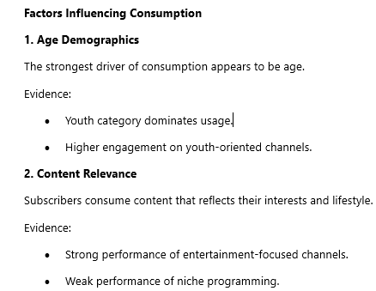
1
2
03

Slide 8
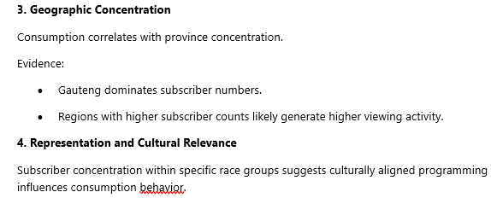
1
2
03

Slide 9
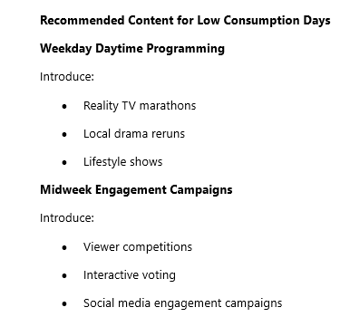
1
2
03

Slide 10
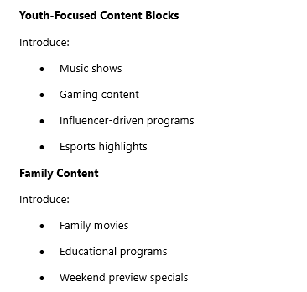
1
2
03

Slide 11
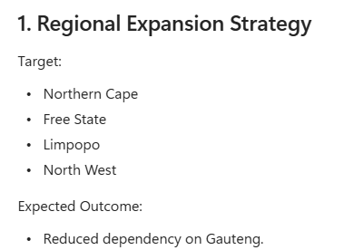
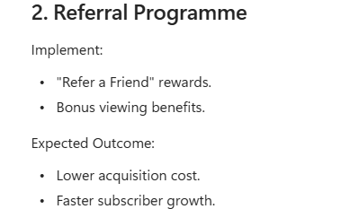
Initiatives to Grow Bright TV user Base
1
2
03

Slide 12
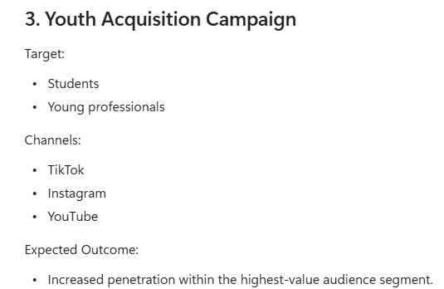
Initiatives to Grow Bright TV user Base
1
2
03

Slide 13
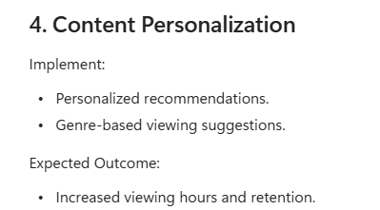
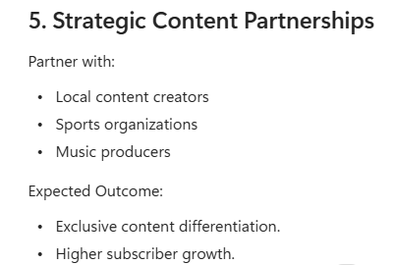
Initiatives to Grow Bright TV user Base
1
2
03

Slide 14
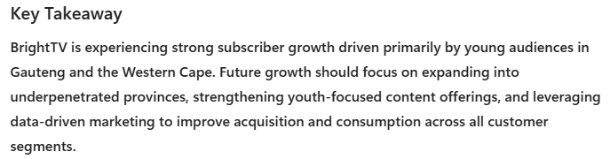
Conclusion
1
2
03

