Slide 1
Predicting Housing Prices
Based on sales data from three separate counties in 2017

Slide 2
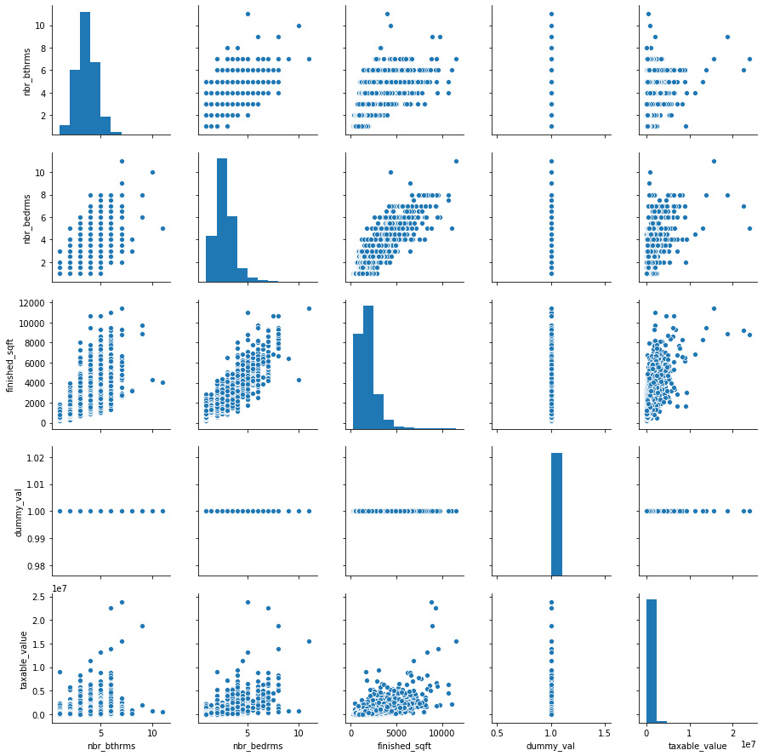
Beds, Baths, and Beyond

Slide 3
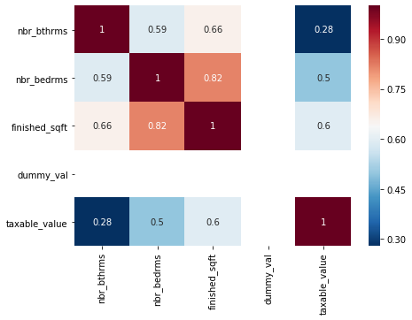
Correlations of significant features

Slide 4
What the data shows
Regardless of stated preferences regarding bedrooms and bathrooms, Americans view square footage as a primary determinate of overall value
Following square footage, additional bedrooms are more strongly correlated with assessed value than additional bathrooms

