Slide 1
Predicting Housing Prices
Based on sales data from three separate counties in 2017

Slide 2
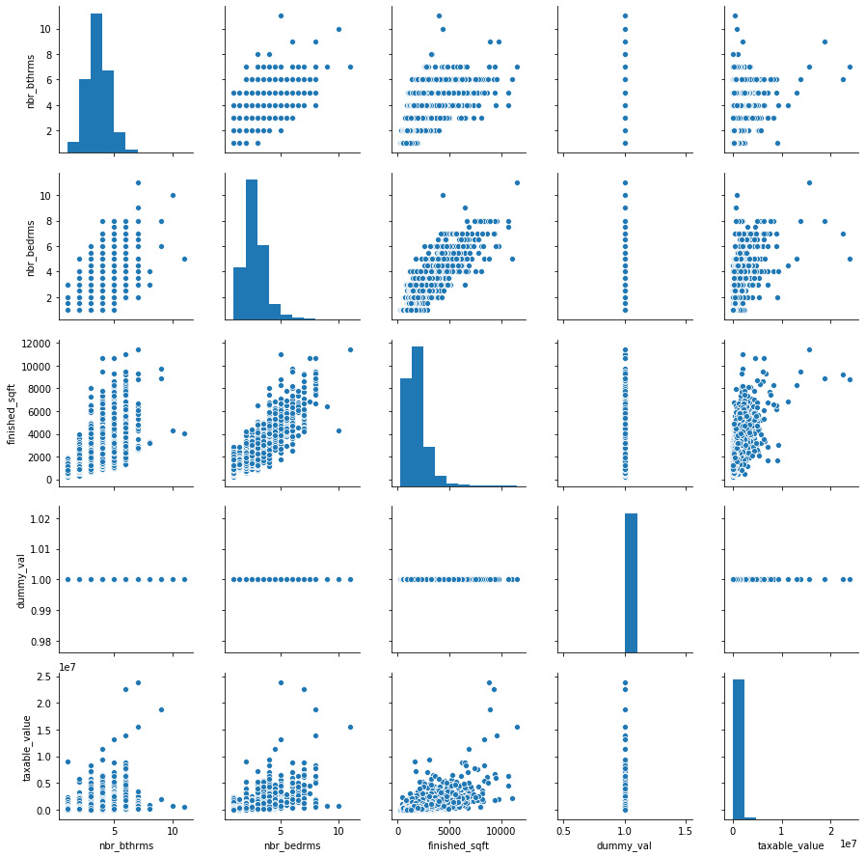
Beds, Baths, and Beyond

Slide 3
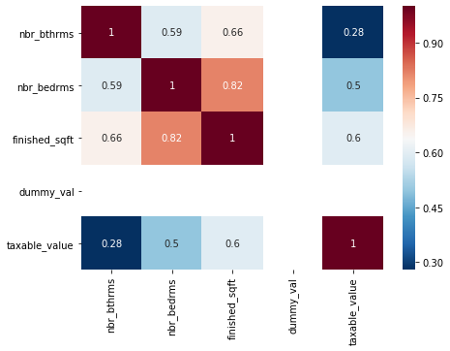
Correlations of significant features

Slide 4
What the data shows
Regardless of stated preferences regarding bedrooms and bathrooms, Americans view square footage as a primary determinate of overall value
Following square footage, additional bedrooms are more strongly correlated with assessed value than additional bathrooms

Slide 5
What the data doesn’t show
Los Angeles County includes 87 different cities plus dozens of other legal entities. These include Beverly Hills, Malibu, Compton, Watts, and Beautiful Downtown Burbank. These all have vastly different factors driving pricing that are more significant that anything captured in the data set. The data should be localized.
Forecasting from this data would be greatly improved by merging in Census and Labor Department data and by using additional data from the database to establish local metrics.

