Slide 1

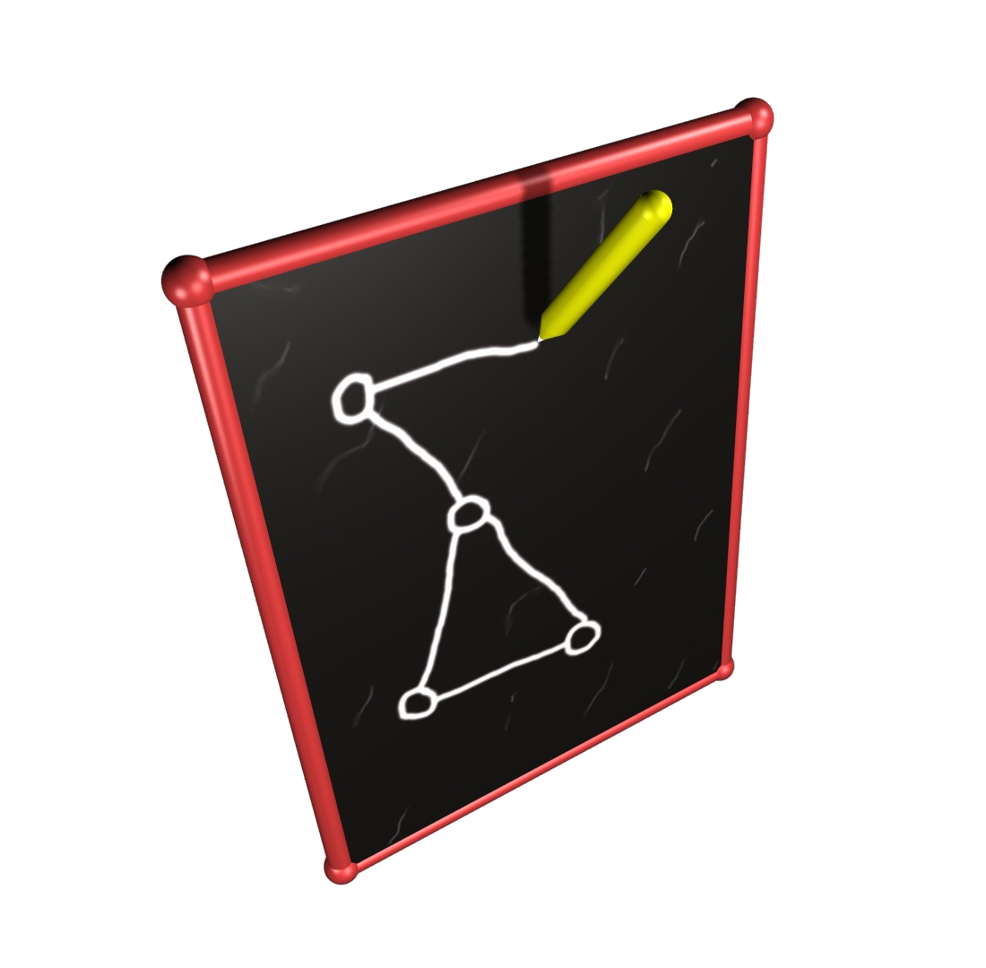
The Stanford Clean Slate Program http://cleanslate.stanford.edu
POMI 2020
Programmable Open Mobile Internet
Dan Boneh, Andrea Goldsmith, Ramsesh Johari, Paul Kim, Scott Klemmer, Christos Kozyrakis, Monica Lam, Phil Levis, David Mazieres, Nick McKeown (PI), John Mitchell, Guru Parulkar, Roy Pea,
Arogyaswami Paulraj, Mendel Rosenblum, Fouad Tobagi

Slide 2
POMI 2020
Outline
Vision
  Revolution in computing and communications
  Three tiers of mobile computing
Industry won’t get us there!
The Big Picture
Expedition Management
Broader Participation
Intellectual Merit
Conclusion

Slide 3
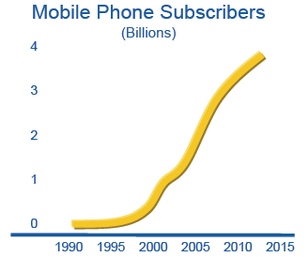

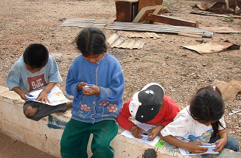
Revolution in Mobile Computing
Millions  Billions
Democratization of computing
Entirely new uses of mobile computing
Power-limitation of handheld  computation will move to the cloud
Need to back up and refresh our lost data  data will move to the cloud

Slide 4
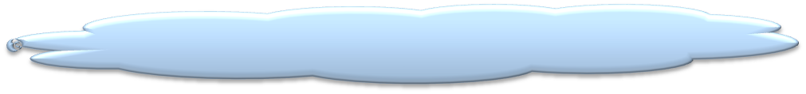
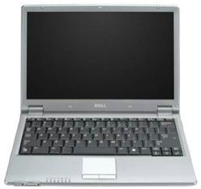

Vision: Three tiers of computing
Shoka
servers
data
Internet
PC,TV
at home, on the road,
in hotels, on the plane
Borrow the display, keyboard, memory, etc
My window into the Internet.
My cache of personal data.
The key to my online data.
Will identify me to others.
Make payments, open physical locks.
Great opportunities
Revolution in Mobile Computing will change our field.
Opportunity to bring change before ossification.

Slide 5
POMI Team: breadth & depth
Education
Applications
Paul Kim
Roy Pea
HCI
Scott Klemmer
Security
Dan Boneh
Languages
John Mitchell
Monica Lam
Distributed Systems
David Mazieres
OS
Phil Levis
Mendel Rosenblum
Architecture
Christos Kozyrakis
Economics
Ramesh Johari
Guru Parulkar
Nick McKeown
Networking
Fouad Tobagi
Andrea Goldsmith
Radio
Arogyaswami Paulraj

Slide 6


Today
Vision
Problem with the network.
3G: Cellular networks  IP
IP: Bad for mobility, security, management
Need a network that continually evolves
When they’ve got our data, they’ve got us!
Surrounded by capacity we can’t use
Inefficient: Costs more, poorer quality
We need an alternative
Big-brother portals luring us to their repository
We have to provide an alternative
Healthcare, Financial: May never take off
Where industry
will go otherwise
Barriers
Big-brother portals will own our data
We will be locked-in to applications
Wireless capacity will stay closed
Network will stay ossified

Slide 7
Choice and innovation
Openness
Innovation
Choice
We will create “platforms for innovation” in
computing, storage and networking

Slide 8
The Big Picture
Allow users to control who can access and mine their data
PRPL protocol allows services to be separated from data
We can choose where our data resides
PRPL
New poplations of users
Need to quickly repurpose and test new Uis
Today’s technology is rudimentary
Decouple UI from application
User Interface
Applications
PocketSchool, Virtual Worlds, Augmented Reality
Large services built from 100s or 1000s of VMs
VMs stay seamlessly connected, tracking users
Made possible by OpenFlow
Build on hugely successful work
Exploit the move from desktop to mobile browsers
VM as granularity of computing
Secure Mobile Browser
Make users aware of how they use energy
Energy management per thread
Integrate with Information Flow Control
“Capacitors”
OS
Data Substrate
PRPL Virtual Data System
Handheld
UI
Continued innovation by users, owners and operators
Easy to experiment with mobility, security and mgmt
Seamless movement between networks,
e.g. WiFi to WiMAX.
OpenFlow
Secure mobile browser
Do I lock-in a profitable, known, homegrown service now,
knowing others can pass me by?
Or do I open up my infrastructure,
and risk being commoditized?
Infrastructure owner's dilemma
Computation Substrate
Network of VMs, Mobile VMs
Economics
Energy efficient
Secure OS
Today: WiMAX gives ~20Mb/s
1Gb/s predicted by 2013
Extrapolating: Set the stage for 10Gb/s
Need cooperation of handhelds: Distributed MIMO,
client relaying, accumulation coding
Faster radios
HW Platform
Network Substrate
OpenFlow
Radio technology
Multi-Gb/s, 99% coverage

Slide 9
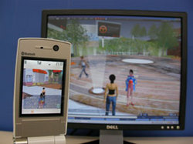
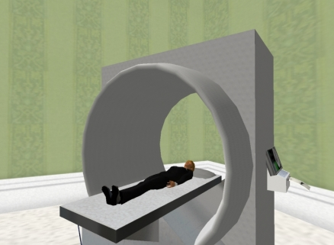

Content
UI
S
S
S
Client
S
S
S
OS
S
S
S

Slide 10
Computation Substrate
Network of VMs, Mobile VMs
Network Substrate
OpenFlow
Content
UI
Radio technology
Multi-Gb/s, 99% coverage
S
S
S
Client
S
S
S
OS
S
S
S

Slide 11


Data Substrate
PRPL Virtual Data System
Private
Data
Computation Substrate
Network of VMs, Mobile VMs
Network Substrate
OpenFlow
Radio technology
Multi-Gb/s, 99% coverage
S
S
S
S
S
S
Energy aware OS
S
S
S
Content
UI
Private
Data
Client
Private
Data
OS

Slide 12
The Big Picture
Applications
PocketSchool, Virtual Worlds, Augmented Reality
Handheld
Data Substrate
PRPL Virtual Data System
UI
Secure mobile browser
Computation Substrate
Network of VMs, Mobile VMs
Economics
Energy efficient
Secure OS
HW Platform
Network Substrate
OpenFlow
Radio technology
Multi-Gb/s, 99% coverage

Slide 13
The Data Substrate
Data/Service Ownership Trends
PRPL (public-private) index:
  Allow users to control who can access their data
  Protocol to separate the data from the service
  Allow location-independence of data
deg. of sharing
Healthcare application
Flickr
Facebook
Financial application
private
public

Slide 14


PRPL: PRivate-PubLic Data Index
Old & New
Data Apps/Services
data
Old & New
Data Repositories
A unified view of data
Separate data ownership, storage, applications
Secure, fine-grain sharing
Device-independence: caching
Interactive data navigation with semantic-web queries

Slide 15
Today
Vision
Where industry
will go otherwise
Barriers
Big-brother portals will own our data
We will be locked-in to applications
Wireless capacity will stay closed
Network will stay ossified

Slide 16
The Big Picture
Applications
PocketSchool, Virtual Worlds, Augmented Reality
Handheld
Data Substrate
PRPL Virtual Data System
UI
Secure mobile browser
Computation Substrate
Network of VMs, Mobile VMs
Economics
Energy efficient
Secure OS
HW Platform
Network Substrate
OpenFlow
Radio technology
Multi-Gb/s, 99% coverage

Slide 17
OpenFlow Model
Allow lots of innovation
Diverse applications
Routing, Mobility,
Naming/Addressing,
Access Control,
Management,
Monitoring…
Diverse transport layers
Ethernet
IP
X
Y
Z
Flow layer
Diverse link layers
Diverse physical layers

Slide 18
OpenFlow Network Substrate
Our goal
  Allow continued evolution of the network
  e.g. new ways to manage and secure
  Allow different mobility, naming, addressing, routing schemes to co-exist
  Yet backwardly compatible with IP and end-hosts.
Our approach
  Smart central controller, dumb flow-based datapath.
  Separate control and routing from the datapath
  OpenFlow Protocol: Control datapath by adding/deleting flow-entries
  Add OpenFlow to existing switches and routers.
  Add new mobility services on top.

Slide 19


OpenFlow Switching
Controller
OpenFlow
Switch
OpenFlow
Protocol (SSL)
PC
Flow
Table
Flow
Table
Flow
Table
Flow
Table
Path to broader impact
  We are getting traction: 8 switch vendors so far.
  We will deploy on our campus: Two buildings at Stanford (HP/Cisco).
  We will deploy “POMI Kits” on other campuses too.

Slide 20
Today
Vision
Where industry
will go otherwise
Barriers
Big-brother portals will own our data
We will be locked-in to applications
Wireless capacity will stay closed
Network will stay ossified

Slide 21
POMI 2020
Outline
Vision
  Revolution in computing and communications
  Three tiers of mobile computing
Industry won’t get us there!
The Big Picture
Expedition Management
Broader Participation
Conclusion

Slide 22
Expedition Management
Faculty Steering Group
External Advisory Group
Industrial Partners
Financial & Event Support
Stanford Computer Forum
Executive Director
Guru Parulkar
Expedition Director
Nick McKeown (PI)
Administrative Support
Computing and Data Substrates
Monica Lam
Security
Dan Boneh & John Mitchell
Open Network Substrate
Nick McKeown
Education Outreach
Paul Kim
Radio Technology
Arogyaswami Paulraj
Weekly
Executive Management Meetings
POMI 2020 Public Seminar
Research meetings
Annual
POMI 2020 Retreat (Fall)
POMI 2020 Workshop (Spring)
CTO Summit & Advisory Board (Fall)

Slide 23
External Advisory Board
Rick Rashid SVP Research, Microsoft
Bob Iannucci SVP, Research, Nokia
Siavash Alamouti CTO Wireless, Intel
Steve Trilling VP Security, Symantec
Andy Rubin Head of Android, Google
Bill Raduchel Former CTO AOL
Larry Peterson Princeton
Scott Shenker Berkeley
Stefan Savage UCSD
Hal Varian Google/Berkeley
Industrial Partners
Cisco, DoCoMo, Deutsche Telekom (T-Mobile), NEC, Xilinx

Slide 24
Industry Partners Endorsements
“The project has the potential to reshape future mobile internet and services and goes well beyond what is going on in industrial research labs.”
“[…] is profoundly interested in the kind of work PIs are proposing.” T-Labs, Deutsche Telekom
“The project strategically aims to create a truly programmable and open mobile internet by breaking the barriers through important technical innovations.”
“As such, we have high expectations of the POMI project, and we strongly support the POMI proposal.” NTT DoCoMo Labs USA.

Slide 25
Industry Partners Endorsements
“POMI 2020 project is very exciting project and has a big potential for a new networking paradigm.”
“NEC expects to provide all the necessary support to make it a success and will consider deploying the solutions in Japan and elsewhere as appropriate.”
NEC Central Research Laboratory
“It [POMI Research] has a unique character that addresses many of the deep challenges involved in moving towards a future Internet founded upon support for mobility and personal customization of services.”
“This whole area is of great strategic importance to Xilinx …” Xilinx Research Labs

Slide 26
Mobile Computing: a new discipline
Co-location is essential
Mobile computing touches everything.
Many hard problems from different areas.
Shaping the research of 15 faculty across fields.
Needs constant interaction.
Already 18 new collaborations taking place across boundaries.

Slide 27
POMI 2020
Outline
Vision
  Revolution in computing and communications
  Three tiers of mobile computing
Industry won’t get us there!
The Big Picture
Expedition Management
Broader Participation
Intellectual Merit
Conclusion

Slide 28
Broader Impact
Societal Benefits
Data, computation, network infrastructure open to competition & innovation
Protection of data privacy, critical for health and financial services
Technology Transfer: Strong Past Record
Publication, graduates, corporate partners, external board, entrepreneurship
Education
Impact on the curriculum of 17 courses at Stanford
Class curriculum available to other universities
New minor in Mobile Computing
Excite and educate the new generation
Broader Participation
Education on mobile devices for under-served children
  Lutheran Burbank School District of San Jose and East Palo Alto school
  Collaboration with CETYS Universidad, Mexico
POMI kits for new research and curriculum; summer camps
  University of Texas in El Paso, University of New Mexico

Slide 29

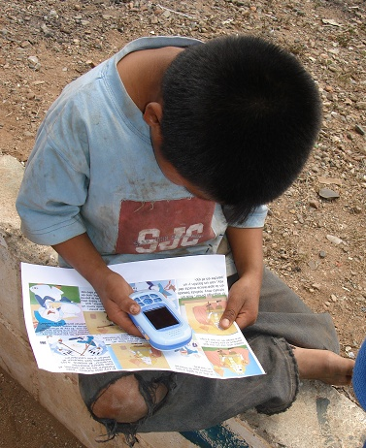
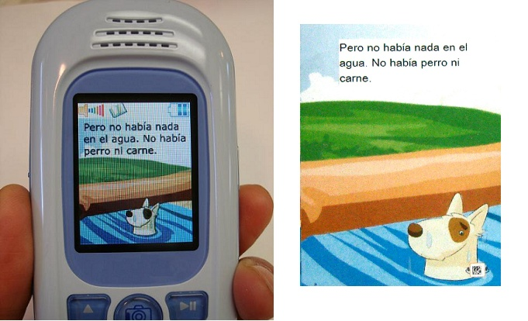
Broader Participation
Bad history of bringing technology to education*
Technologists rarely understand how to benefit education
PocketSchool (Paul Kim)
Works with extremely poor migrant indigenous children (Latin America). No schools or teachers.
Designs and evaluates mobile learning tools.
* “Oversold and Underused” – Larry Cuban (Stanford, 2001)

Slide 30
Broader Participation
Our approach
  Work hand-in-hand with colleagues in our School of Education (Paul Kim, Roy Pea), teachers and students
  Learn how POMI technology can benefit students
  Learning vector goes both ways!
  Leverage huge resources and experience of our School of Education

Slide 31
POMI 2020
Outline
Vision
  Revolution in computing and communications
  Three tiers of mobile computing
Industry won’t get us there!
The Big Picture
Expedition Management
Broader Participation
Intellectual Merit
Conclusion

Slide 32
Intellectual Merit
Shoka
A seamless three-tier architecture
Open platforms for innovations
PRPL virtual data system
VM-based computation system
Openflow programmable networks
Open-source handheld software
Capstone demo on Stanford campus
A complete prototype infrastructure, devices and applications
Technologies
  Education: Mobile empowerment & assessment
  Separation of data ownership, storage, apps
  Collaborative semantic web
  Multi-modal UI prototyping
  Contextual security/privacy policies
  Secure mobile browser
  Information flow control in network, OS, apps
  Energy-efficient OS
  Privacy-preserving marketing
  Economics of programmable open systems
  Mobility across diverse networks with OpenFlow
  Continuously evolvable networks
  Wireless radio: 10 Gbps, 99% coverage

Slide 33
POMI 2020
Outline
Vision
  Revolution in computing and communications
  Three tiers of mobile computing
Industry won’t get us there!
The Big Picture
Expedition Management
Broader Participation
Intellectual Merit
Conclusion

Slide 34
Conclusion
Mobile Computing is the future of computing.
It will change everything.
Great research in mobile computing can
  Break down industry barriers
  Break the 5th barrier: Reinvigorate undergraduates in Computer Science
  Lead the country forward

