Slide 1
The Impact of Training Data Division in Inductive Dependency Parsing
Kjell Winblad
Internal supervisor Olle Gällmo
External supervisor at:
The Department of Linguistics and Philology
Joakim Nivre

Slide 2
Dependency Parsing
The process of parsing sentences to create a graph with words as vertices and edges with labels as representations of dependencies between the words.
Grammars that describe the structure of sentences are called dependency grammars

Slide 3
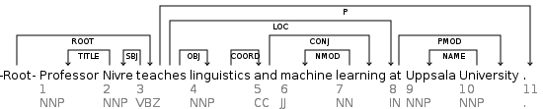
Dependency Grammar
The dependency structure can be used in for example automatic translation systems
Sentence with dependency structure:

Slide 4
Inductive Dependency Parsing
To automatically generate a ”good” dependency structure for a sentance is a hard problem because of the complexity of natural languages and the ambiguity of words.
Promising results have been archived by using machine learning methods

Slide 5
Inductive Dependency Parsing
Transition-based parsing system
A configuration
A set of rules
An oracle function (constructed with machine learning method)
The algorithms apply the rule given by the oracle function at the current configuration until the sentence is parsed

Slide 6
Inductive Dependency Parsing
Training
Extract the necessary rules to construct the correct dependency tree from example sentences.
The result is a set of elements of the form configuration=>rule that can be represented as an vecor of numbers
The converted training data can be used in any standard machine learning system to train an oracle function

Slide 7
Machine Learning Methods
Most accurate result: Nonlinear Support Vector Machines (SVM) with the Kernel Trick
- Slow training
- Require a huge amount of memory
Worse: Linear SVMs
- Fast training and parsing
Better: Divide the training data by a particular feature before training with a Linear SVM
- Still fast training and parsing

Slide 8
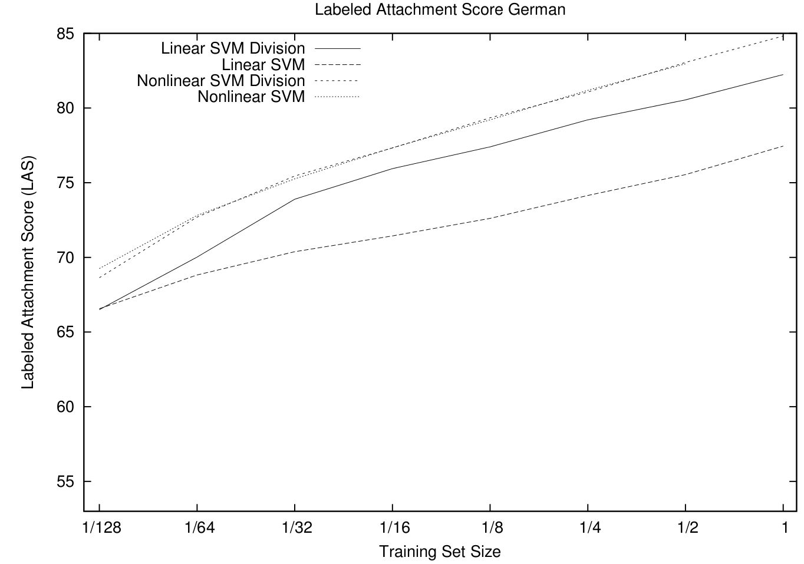
Machine Learning Methods Test

Slide 9
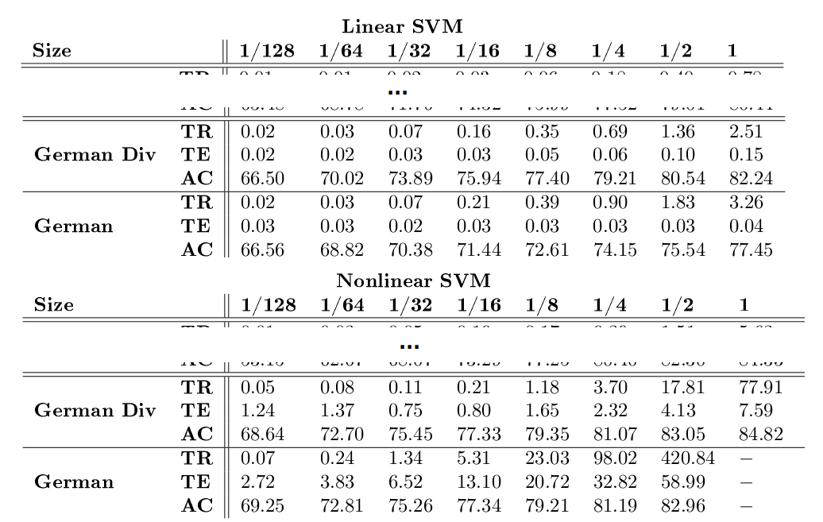
Machine Learning Methods Test

Slide 10
Objectives
Find out why dividing the training set gives better accuracy when a linear SVM is used
Is it possible to improve the accuracy even further while still keeping the fast training and parsing time with a more advanced division strategy?

Slide 11
Goal
Find a division strategy that can divide the training data in an optimal way:
Maximize:
accuracy_improvement - generalisation_error

Slide 12
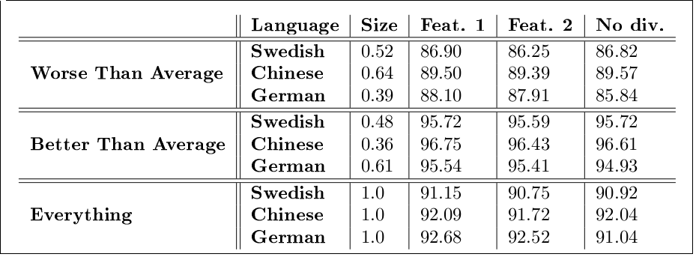
Experiment: Divide worst partions with another feature

Slide 13
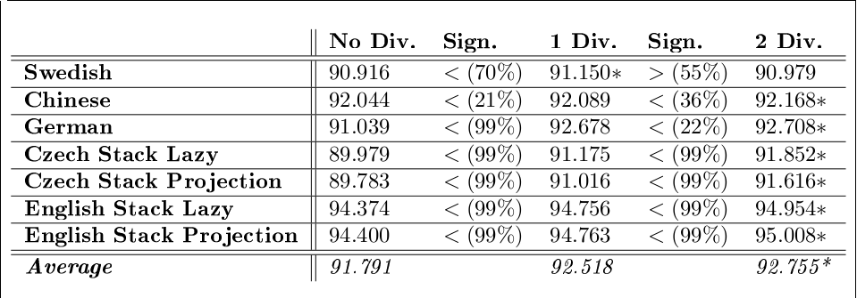
Exepriment: Dividing even more

Slide 14
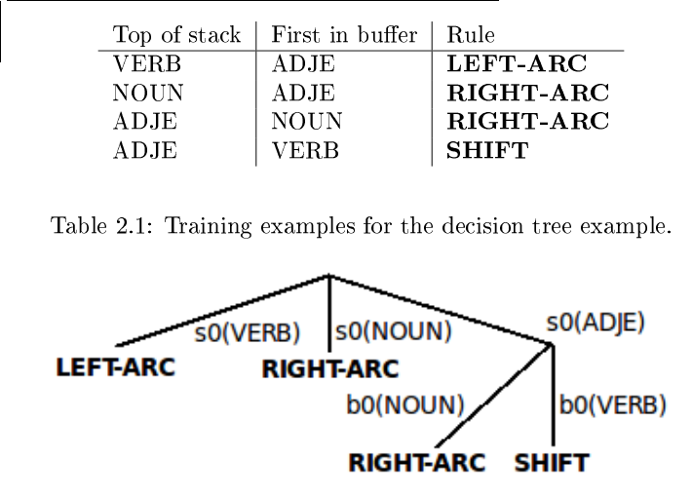
Experiment: Decision Tree

Slide 15
Decision Tree Creation
Divide the training data
If the division impove accuracy then perform the algorithm for all new nodes
The test is done with cross validation

Slide 16
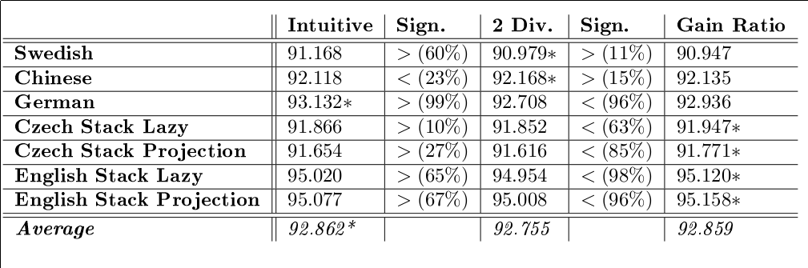
Decision Tree Results

Slide 17
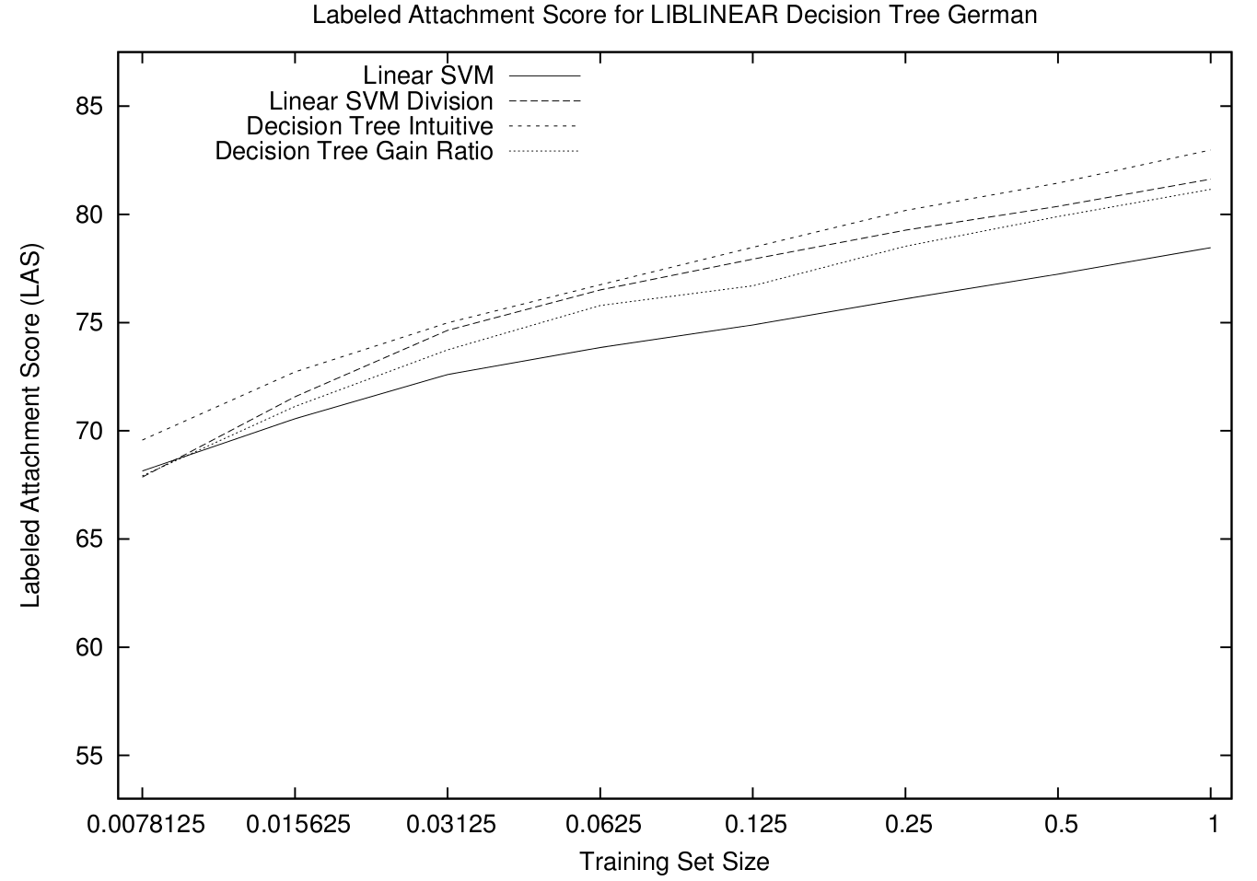
Decision Tree in MaltParser

Slide 18
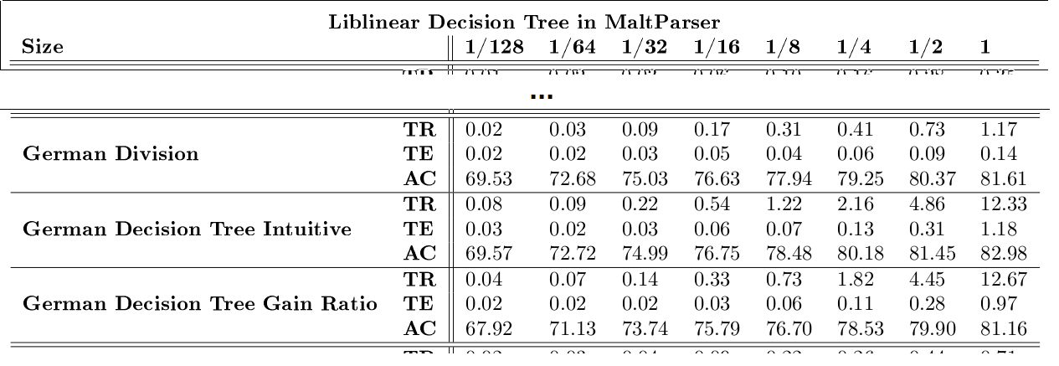
Decision Tree in MaltParser

Slide 19
Conclutions

