Slide 1
Statistical Inference for Nanopore Sequencing
Kevin Emmett, Ken Shephard, Chris Wiggins
Columbia University
Jacob Rosenstein
Brown University
Rabadan Lab Group Meeting
03/26/2013

Slide 2
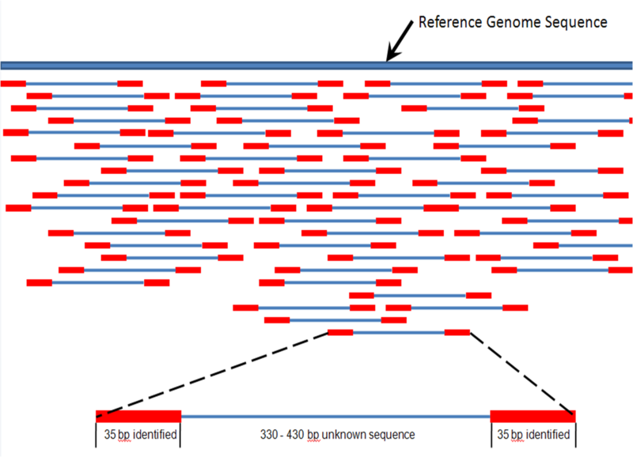
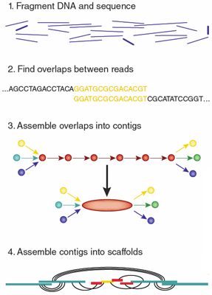
Genome Assembly
NGS – short reads
HiSeq ~ 35-100 bp
Illumina ~ 35-100 bp
Roche 454 ~ 400 bp
PacBio ~1000 bp
De novo assembly is hard
Mapping assembly is hard
Variant calling is hard
Non-model genomes are hard
No phasing information

Slide 3
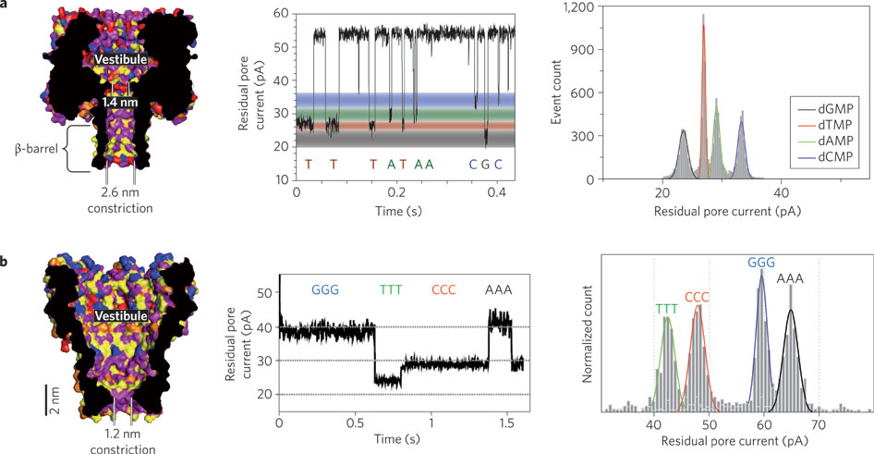
Nanopore Sequencing
Basic idea:
Sequence passes through a pore and fluctuations in ionic current are measured
Advantages:
Long read length
Single molecule sequencing
Real time sequence information
Venkatesan, Bala Murali, and Rashid Bashir. "Nanopore sensors for nucleic acid analysis." Nature nanotechnology 6.10 (2011): 615-624.

Slide 4
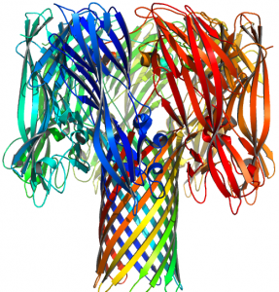
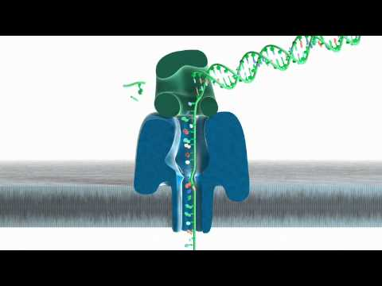
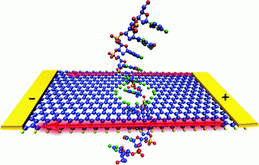
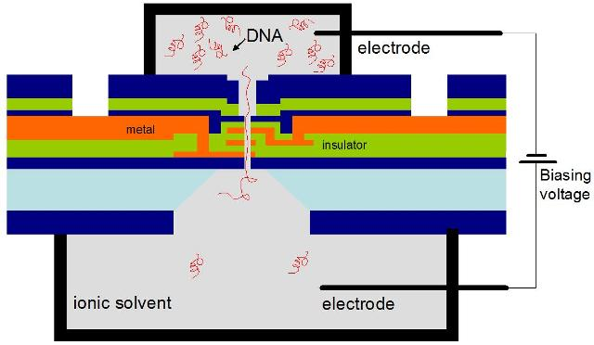
Nanopore Sequencing
Bionanopore
Oxford Nanopore
Kasianowicz, Jingyue Ju (Columbia)
alpha-hemolysin
2. Solid-state (Graphene) Nanopope
3. DNA Transistor
Gustavo Stolovitzky (IBM, Columbia)

Slide 5
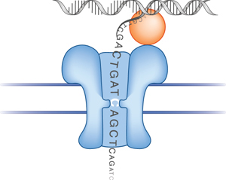
Nanopore Sequencing
Problem: molecule translocation through the pore is diffusive
Model: one-dimensional biased random walk (bias p), unit step
Recorded signal:
Input: CTGCCTGGAC
Observed: CTGCCCGTGTGCCTGGGGGGAC
p
1-p

Slide 6
Model Specification
Input Parameters:
p : forward bias of random walk
e : base-call error rate
L : length of input DNA sequence
N : number of i.i.d. reads of input
DNA sequence S
S = {A-A-A-A-C-T-G-A-T-C-…}
{p, e, N}
Data:
Z = {Z¹ … Z^{N}} : N hidden state sequences
Z^{i}_{1:T} : hidden state sequence i
X = {X¹ … X^{N}} : N observed state sequences
X^{i}_{1:T} : observed state sequence i
Z¹ = {1-2-3-4-3-2-3-2-3-4-…}
X¹ = {A-A-A-A-A-A-A-G-C-G-…}
…
Z^{N} = {1-2-3-4-5-6-5-6-5-6-…}
X^{N} = {A-A-A-G-C-T-A-T-C-T-…}
Goal:
Learn an estimate for S, the true DNA sequence

Slide 7
Statistical Inference
Transition distribution:
Use a Hidden Markov Model to infer the sequence most likely to have generated the observed data
Goal: maximize likelihood of data
p(X|θ)
Emission distribution:
z₁
z₂
z₃
z_{T-1}
z_{T}
x₁
x₂
x₃
x_{T-1}
x_{T}

Slide 8
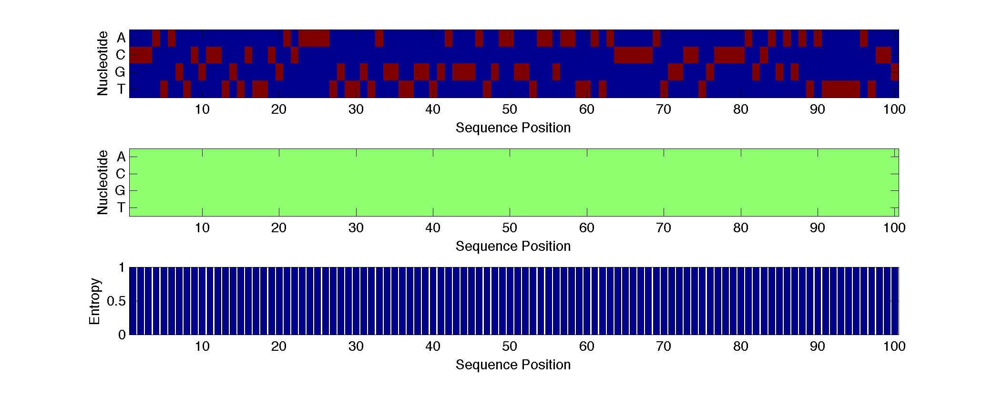
Model Output
p = 0.7, e = 0.05, N = 25
Inference Evaluation = Edit Distance / Length

Slide 9
What is a realistic p?
Lu et al. reported experimental conditions 4k_{B}T/Fa ~ 5 --> p = 0.7
Lu, Bo, et al. "Origins and consequences of velocity fluctuations during DNA passage through a nanopore." Biophysical journal 101.1 (2011): 70-79.

Slide 10
Parameter Sweep: N vs p

Slide 11
Parameter Sweep: N vs e

Slide 12
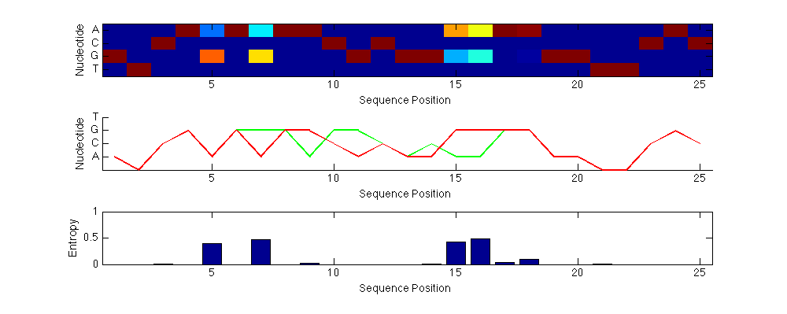
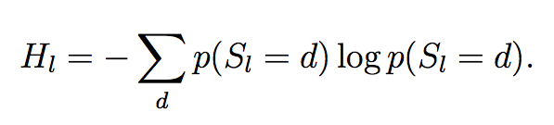
Heuristics
Can we identify statistical signature of insertion/deletion events?
true sequence
inferred sequence
deletion
insertion
Use inference entropy as a heuristic

Slide 13
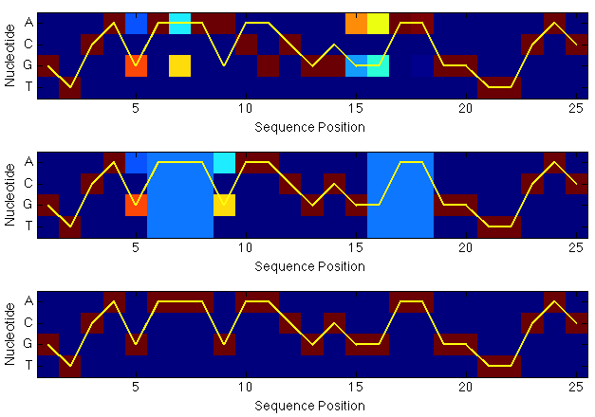
Heuristic: Inference Entropy
Use restarts to search for increases in log likelihood.
ED = 4
ED = 0

Slide 14


Conclusions
Probabilistic models are a natural way of thinking about nanopore translocation
Good accuracy can be achieved even with diffusive motion
Averaging multiple reads has the strongest effect on performance
Inference errors are identifiable and correctable using heuristics such as inference entropy
Future work: (1) Stochastic time steps, (2) n-mer state observations
Thanks to: David Pfau, Sakellarios Zairis, Jan-Willem van de Meent, Frank Wood
Funding: NSF

