Slide 1
Bitcoin Wallet
An Android application for CIS 444
Kelly Fallon kjfallon@syr.edu and Alec Echenique awecheni@syr.edu

Slide 2
Summary
Creates and stores a private keystore (wallet)
submits transactions to the global blockchain transaction ledger
reads transactions from the global blockchain transaction ledger
uses the bitcoinj Java implementation of the Bitcoin protocol

Slide 3
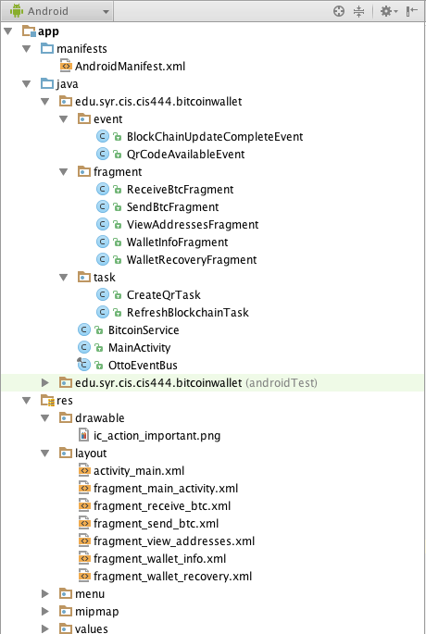
Android Studio Project

Slide 4
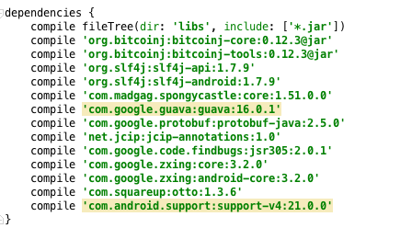
Dependencies

Slide 5
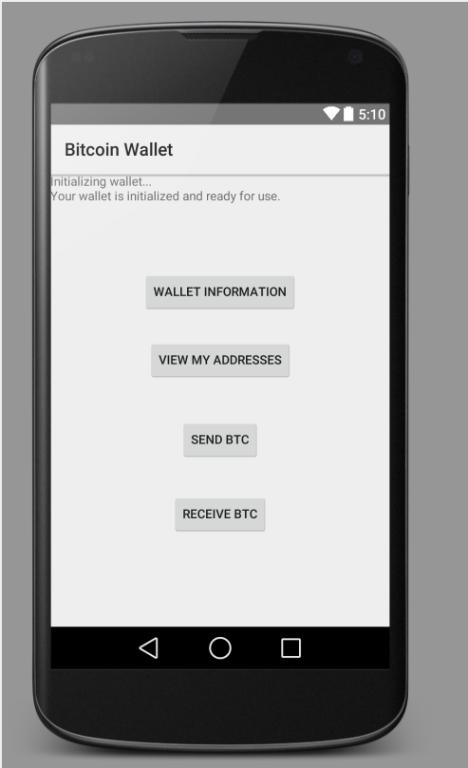
User interface

Slide 6
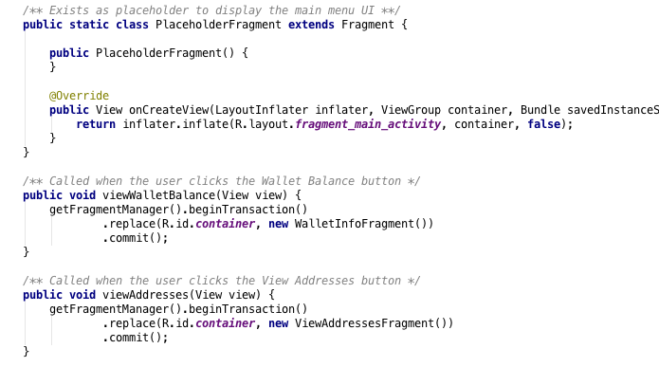
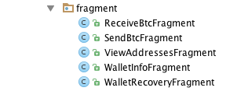
Usage of Fragments

Slide 7
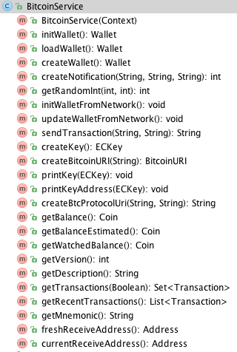
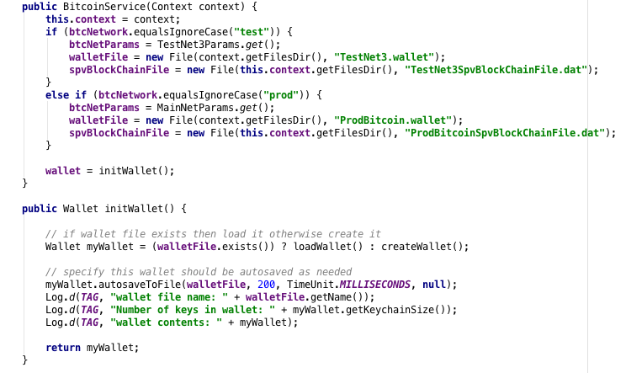
BitcoinService Class

Slide 8
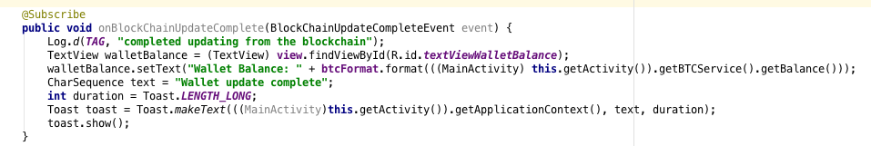
Usage of Android Toast

Slide 9
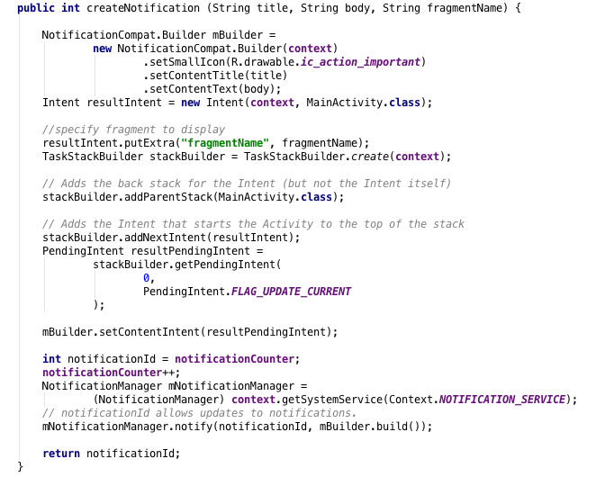
Usage of Android notifications
use specific icon
fragment to launch
on click

Slide 10
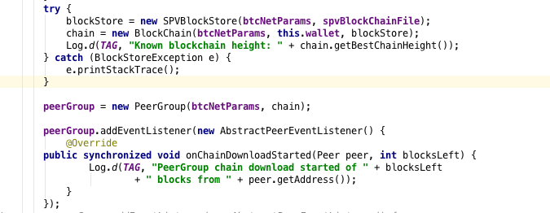
Usage of bitcoinj API

Slide 11
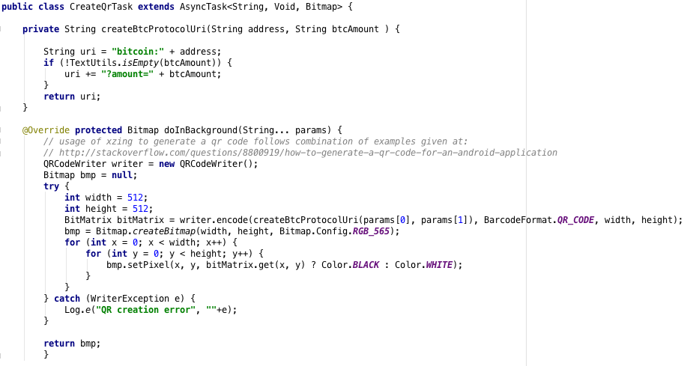
Create QR code of URI

Slide 12
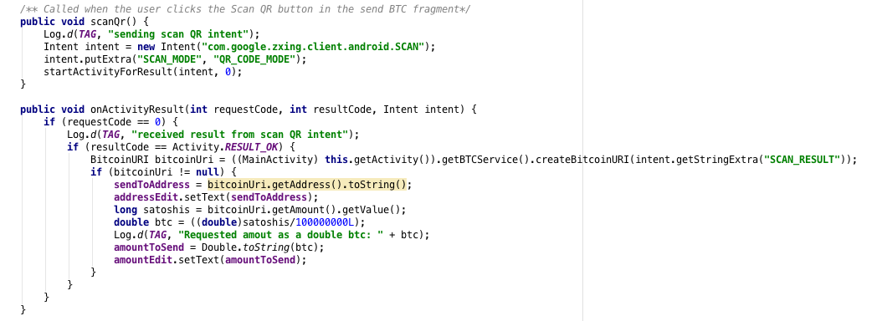
Read QR code

Slide 13
Demo

