Slide 1
임상신경과학 컨퍼런스 MS, NMOSD, MOGAD의 진단과 치료
신경과 유일한

Slide 2
Differential diagnosis of MS, NMOSD, MOGAD
Progressive demyelinating diseases of central nervous system (CNS)
Multiple sclerosis
Neuromyelitis optica spectrum disorder
Myelin oligodendrocyte glycoprotein antibody associated disease
Optic neuritis, myelitis, supra/infra-tentorial lesion

Slide 3
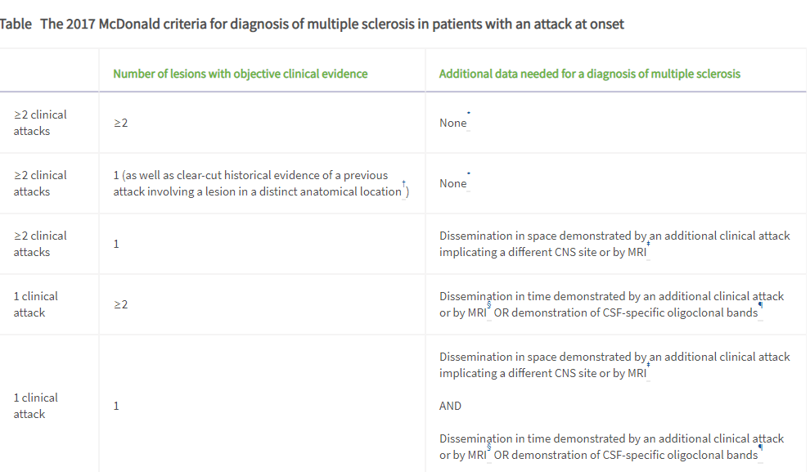
Alan J Thompson et al., Lancet Neurol, 2017
Notes:
If the 2017 McDonald Criteria are fulfilled and there is no better explanation for the clinical presentation, the diagnosis is multiple sclerosis. If multiple sclerosis is suspected by virtue of a clinically isolated syndrome but the 2017 McDonald Criteria are not completely met, the diagnosis is possible multiple sclerosis. If another diagnosis arises during the evaluation that better explains the clinical presentation, the diagnosis is not multiple sclerosis. An attack is defined in panel 1.
* No additional tests are required to demonstrate dissemination in space and time. However, unless MRI is not possible, brain MRI should be obtained in all patients in whom the diagnosis of multiple sclerosis is being considered. In addition, spinal cord MRI or CSF examination should be considered in patients with insufficient clinical and MRI evidence supporting multiple sclerosis, with a presentation other than a typical clinically isolated syndrome, or with atypical features. If imaging or other tests (eg, CSF) are undertaken and are negative, caution needs to be taken before making a diagnosis of multiple sclerosis, and alternative diagnoses should be considered.
† Clinical diagnosis based on objective clinical findings for two attacks is most secure. Reasonable historical evidence for one past attack, in the absence of documented objective neurological findings, can include historical events with symptoms and evolution characteristic for a previous inflammatory demyelinating attack; at least one attack, however, must be supported by objective findings. In the absence of residual objective evidence, caution is needed.
‡ The MRI criteria for dissemination in space are described in panel 5.
§ The MRI criteria for dissemination in time are described in panel 5.
¶ The presence of CSF-specific oligoclonal bands does not demonstrate dissemination in time per se but can substitute for the requirement for demonstration of this measure.

Slide 4
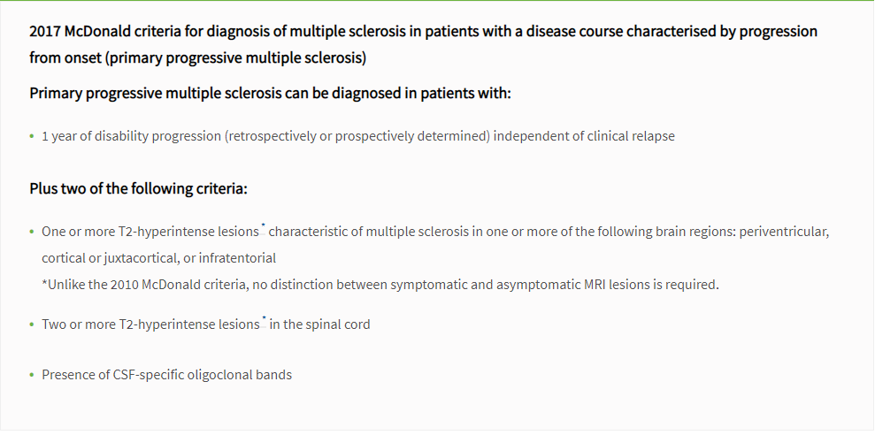
Alan J Thompson et al., Lancet Neurol, 2017

