Slide 1
Executive Summary (MSDS 422 Kwame Fordwor)
• Objective: Harvest mean-reversion in the U.S. 2–10 spread for tradable signals
• Approach: FRED data → feature engineering → z-score rule backtest
• Preliminary Findings: +1σ flatten signal → Sharpe ≈ 0.8 (2010–2020)

Slide 2
Problem Statement / Research Objectives
• Business Question: Can we systematically time a 2–10 curve steepener/flattener ?
• H₁: Spread > μ₆₀ + 1σ → flatten over next month
• H₂: Incorporating carry and volatility features improves predictability
• Unit of Analysis: Daily spread observations → monthly labels (~5,000 points)

Slide 3
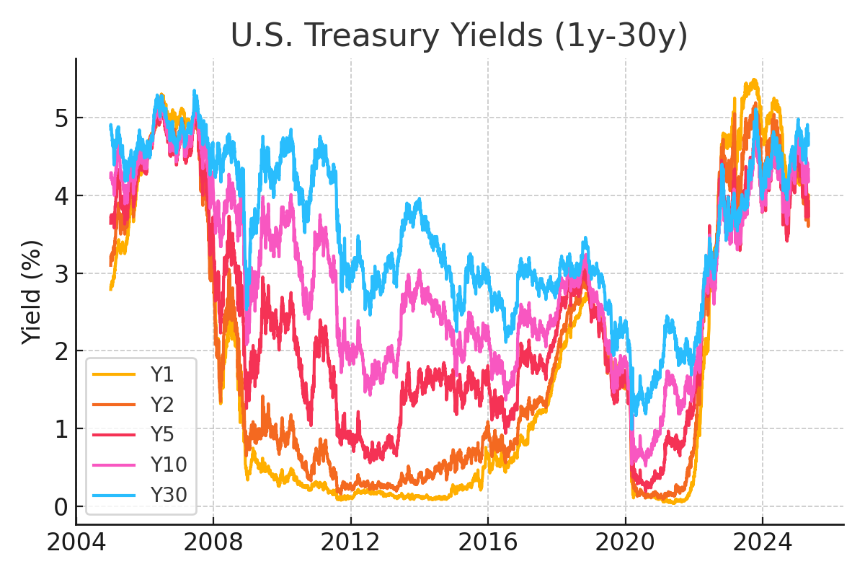
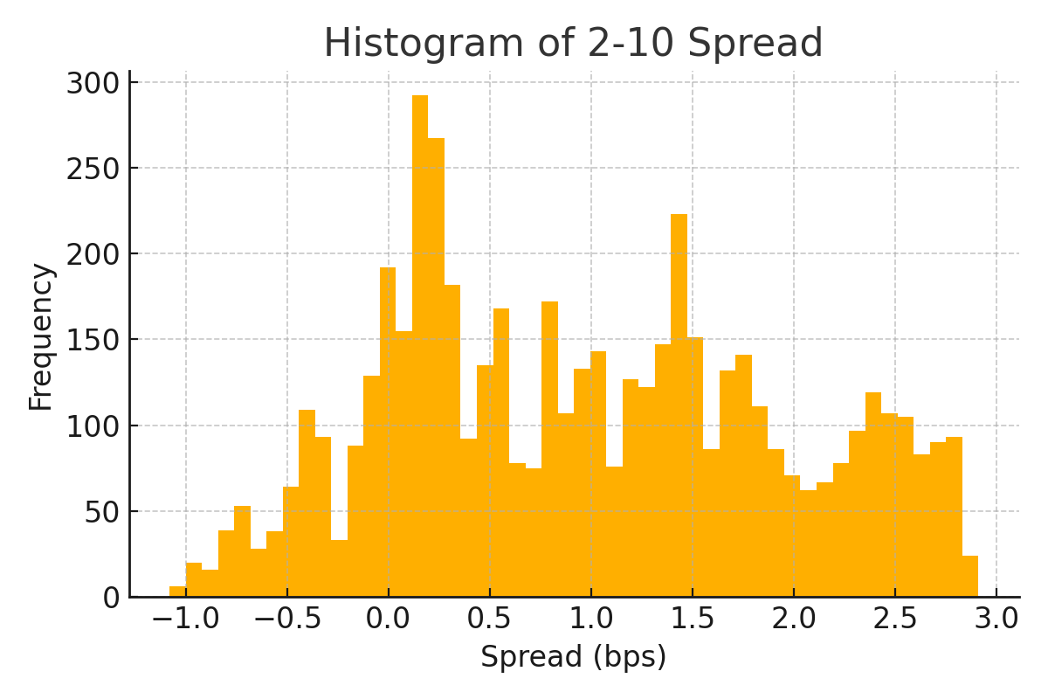
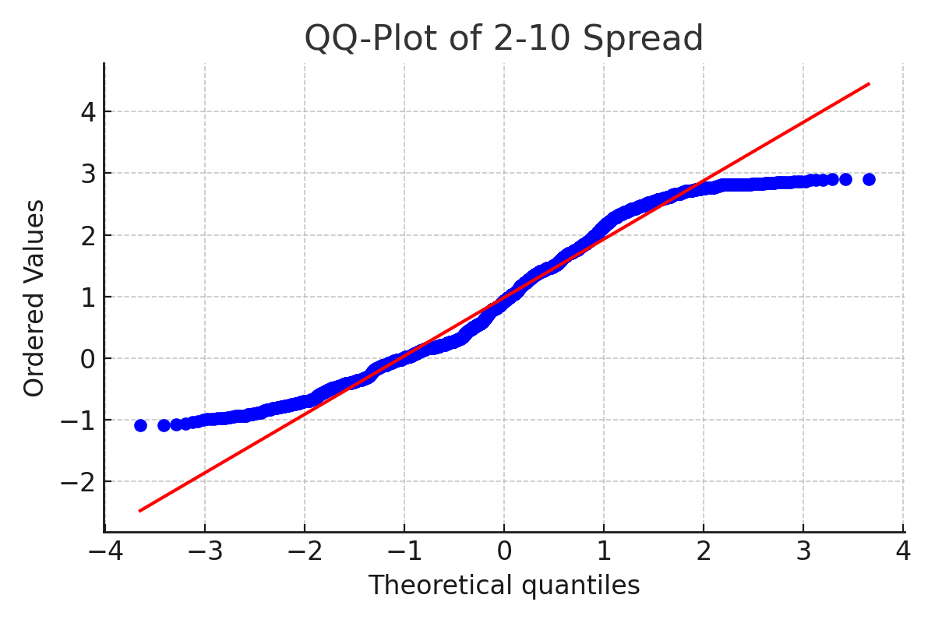
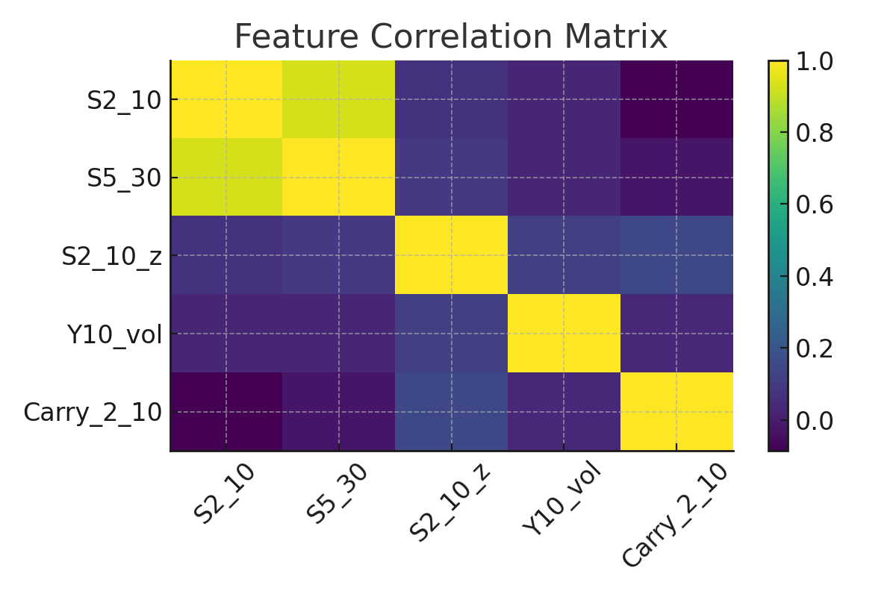
Exploratory Data Analysis

Slide 4
Exploratory Data Analysis Pt1
CHARTS (a) Yield Curves(Overlay of 1y,2y,5y,10y,30y yields)
(b) Histogram of S₂₋₁₀
(c) QQ-Plot of S₂₋₁₀
(d) Rolling mean ± 1σ on S₂₋₁₀
(e) ACF / PACF of S₂₋₁₀
(f) Feature Correlation Matrix
Notes
Long-term yields have trended lower post-2008; curve twist around 2015.
Right-skewed: mean ≈ 8.35 bps, tails extend beyond ±200 bps.
Heavy upper tail vs. normal distribution—extreme steepening events.
Shows frequent ±1σ excursions; 3σ spikes around Fed easing periods.
Significant autocorrelation at lags 1–5 days—mean-reversion horizon.

Slide 5
Exploratory Data Analysis Pt2
Feature | Mean | Std | Skew | Kurtosis
S₂₋₁₀ | 8.35 | 28.47 | 1.22 | 4.18
S₅₋₃₀ | 25.12 | 15.34 | 0.35 | 2.90
S₂₋₁₀_z | 0.02 | 0.99 | 0.10 | 3.00
Y₁₀_vol | 1.15 | 0.75 | 0.85 | 3.45
Carry₂₋₁₀ | –0.10 | 5.20 | –0.45 | 3.10

Slide 6
Data Preparation & Feature Engineering
Step | Transformation | Rationale
1. Ingestion | FRED API pull of DGS1–DGS30; forward-fill weekends/holidays | Continuous daily series for time-series modeling
2. Spreads | S₂₋₁₀ = Y₁₀ – Y₂; S₅₋₃₀ = Y₃₀ – Y₅ | Core indicators of curve steepener/flattening
3. Rolling Stats | μ₆₀, σ₆₀, z = (S₂₋₁₀ – μ₆₀)/σ₆₀ | Normalized deviation from recent history
4. Volatility | Y₁₀_vol = EWMA std of Y₁₀ (half-life = 21 days) | Captures recent yield variability
5. Carry Proxy | Carry₂₋₁₀ = S₂₋₁₀(t+21) – S₂₋₁₀(t) | Approximation of 1-month roll-down profit
6. Label Creation | Label_flatten = 1 if S₂₋₁₀(t+21) < S₂₋₁₀(t), else 0 | Binary target for mean-reversion direction ML model

