Slide 1
An Analysis on the Competitive Capabilities of Stereo Vision Cameras:
Stereo Vision for 3D Object Localization
Kristian Gonzalez
Masters Mechatronics Thesis Presentation
12 September 2019
Notes:
Name
-
Project: Analysis on the Competitive Capability of Stereo Vision for 3D Object Localization

Slide 2

Introduction: Context (1/2)
SMART3D origin
Related Work:
  Pyramid Stereo Matching Network [1]
  iResNet [2]
  Semi-Global Block Matching [3]
  Frustum Pointnet [4]
  Sparse-to-Dense net [5]
  Real-Time 3D net [6]
  Stereo R-CNN [7]
  Pseudo-Pointcloud net [8]
  (among others)
Notes:
SMART3D: investigate lidar alternatives
-
PSMnet: state of the art NN disparity estimation
-
iResNet: 2nd place state of the art, also functions with hourglass networks in 2D, no skip layers or SPP module
-
SGBM: non NN approach, runs real time without GPU
-
Sparse2Dense: best-performing lidar-based network on KITTI Dataset
-
RT3D: real-time capable network, ~10Hz, adapted to stereo
-
-
Project has local origins, but is widely being investigated

Slide 3
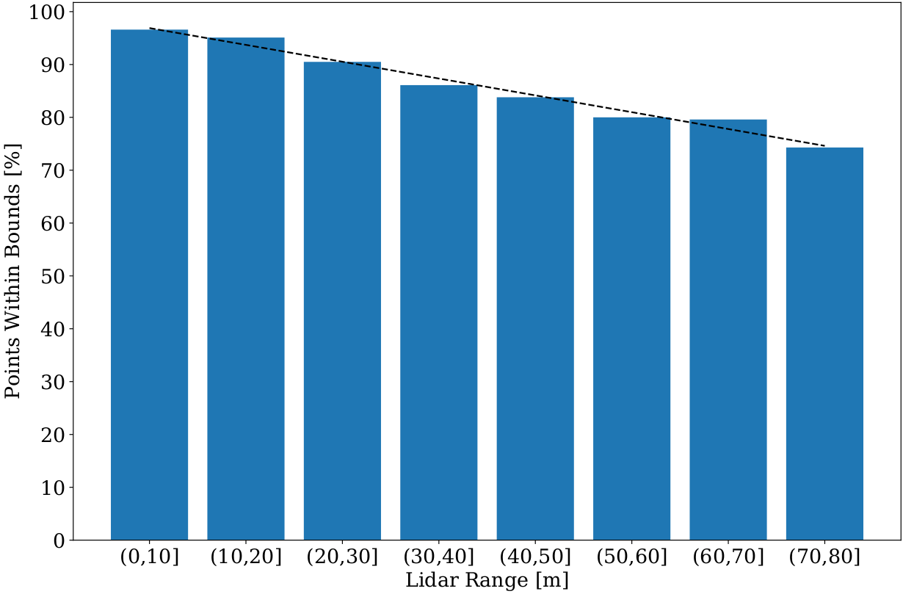
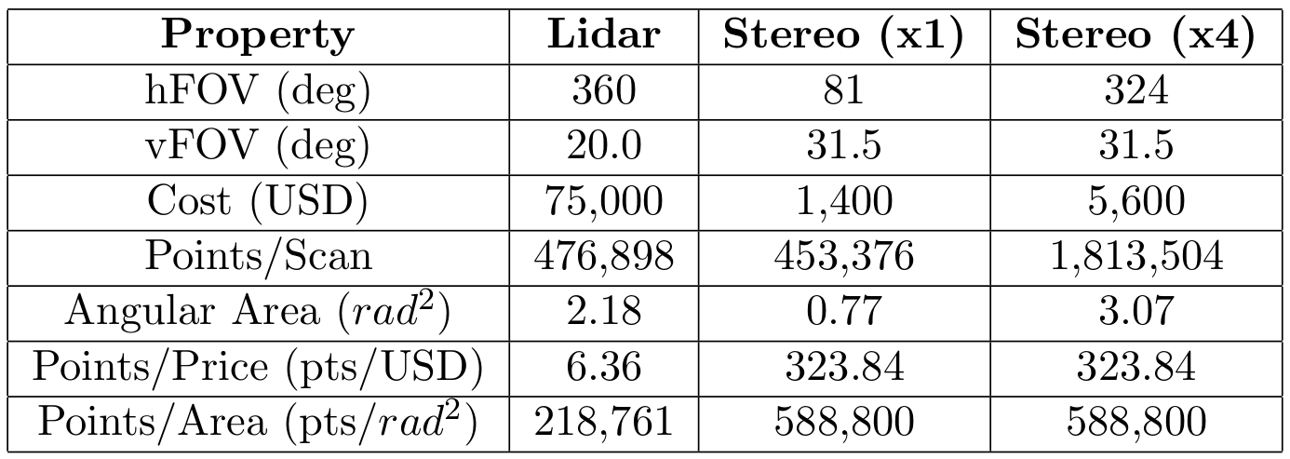
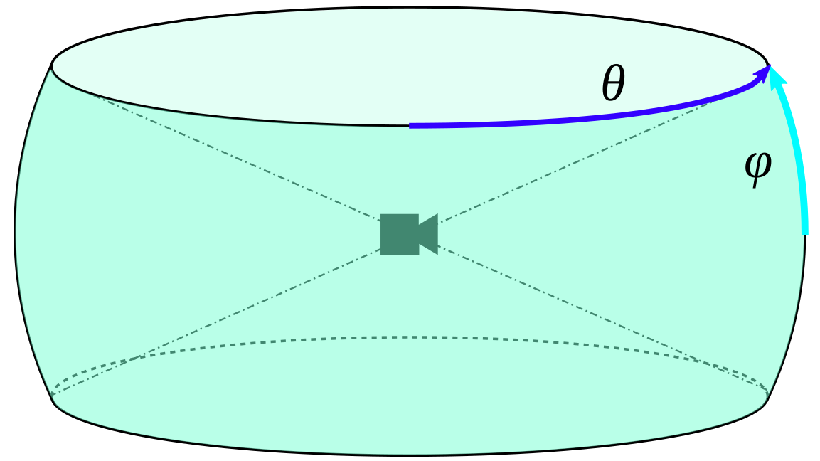
Introduction: Motivation (2/2)
75,000+ pts
Lidar:
  Constant error
  360 degree vision
Stereo cameras:
  Affordable
  High refresh rate
  Passive sensor
* Prices / Specs taken from KITTI sensor setup [10]
Notes:
Main motivation of this project: economic benefit of cheaper sensors
-
Positives of lidar:
small & constant error
360 degree vision
D
Positives of stereo cameras:
Affordable
High refresh rate
Passive sensor
-
Stereo cameras provide more points per price and per area, but have an increasing error
-
-
There’s a clear economic incentive to investigate

Slide 4
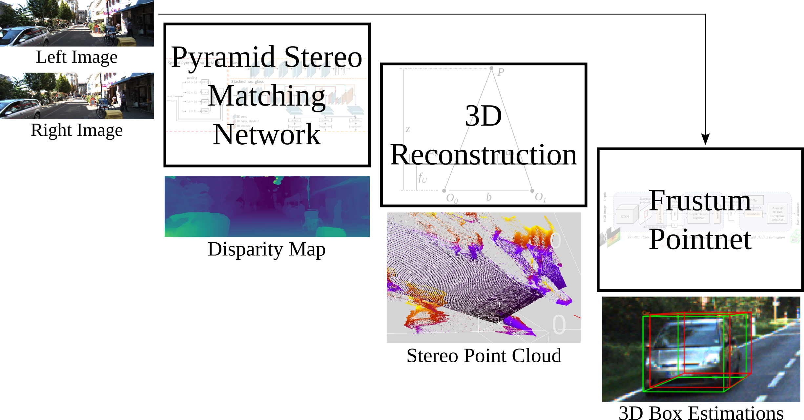
Network Architecture
*
* different image shown for convenience
Notes:
Overall architecture used in this project, inspired by combining both the best disparity networks and 3D detection networks
-
Network comprised of three parts, each to be explained:
-
PSMnet: takes in images, outputs disp map
-
3D Reconstruction: outputs point cloud
-
Fpnet: outputs final 3D box estimations
-
-
Each part will be explained individually next

Slide 5
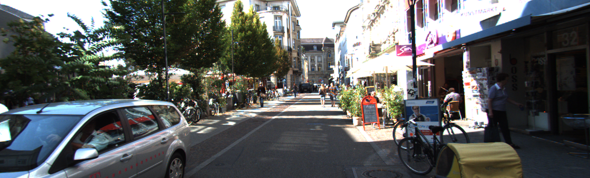
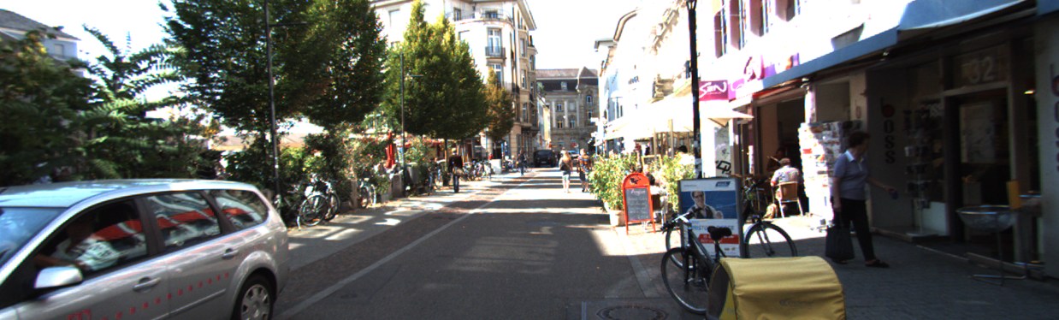
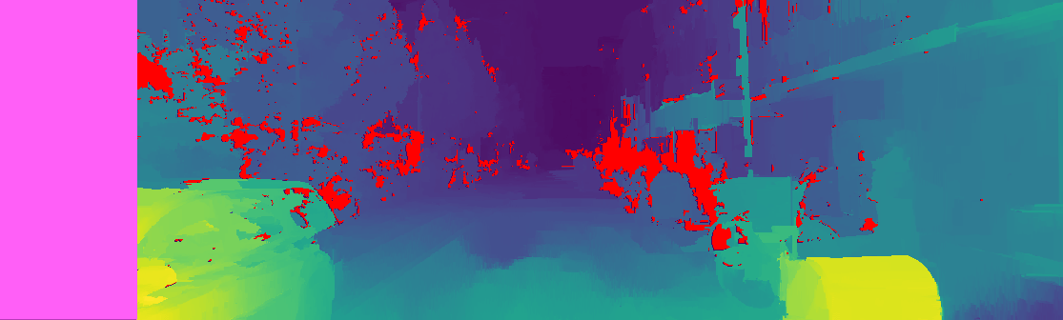

About:
Disparity Maps
Left
Disparity: pixel difference between
matching items [11]
Right
SGBM disparity map
PSMnet disparity map
Notes:
Quick note about disparity maps
-
Goal: match regions in a L/R image pair, find pixel distance between
-
SGBM, a well-known non-NN method, performs well, but has shortcomings
-
PSMnet, a state-of-the-art NN method, is needed to generate high-quality maps
-
-
Although slower, PSMnet outputs accurate maps, implying there is a middle ground for future, real-time applications.

Slide 6
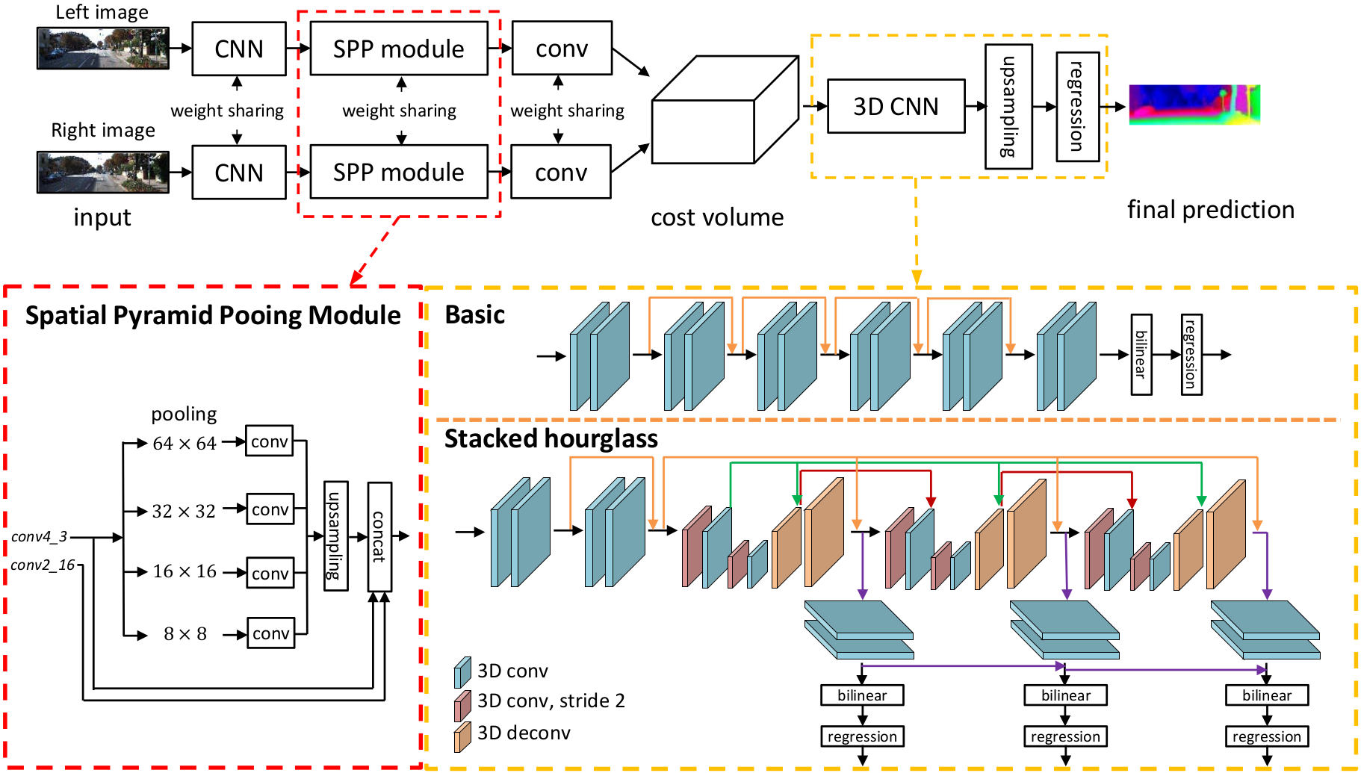
PSMnet: Stereo Vision (1/2)
Training: Pretrained on Freiburg SceneFlow, finetuned on KITTI [10]
Notes:
The necessary disaprity map is generated by PSMnet, trained on KITTI stereo images
-
Main features:
SPP module to concatenate several “magnifications” of the L/R pair
Cost-volume to aggregate all information
3D CNN comprised of hourglass networks
-
SPP module: takes L/R feature maps, pools at various levels, concatenates
-
Cost volume: 4D matrix with dimensions (Height, Width, Disparity, Features)
-
3D CNN: comprised of conv-deconv modules, each individually supervised during training.
-
-
PSMnet provides a robust, powerful method to generate high-quality disparity maps

Slide 7

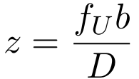
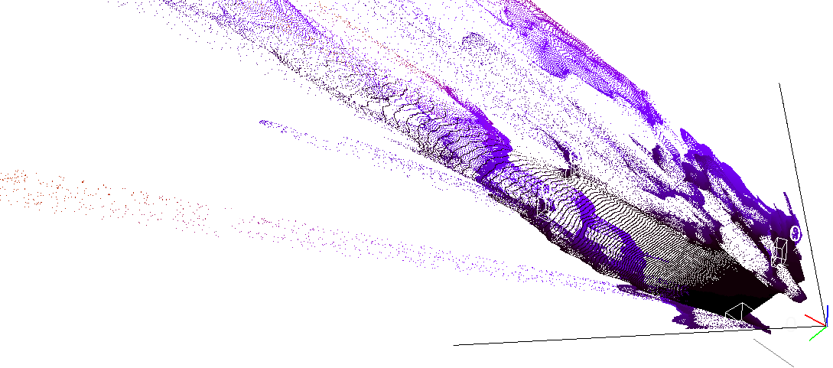
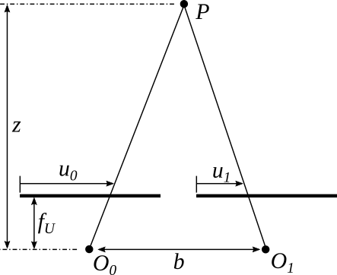
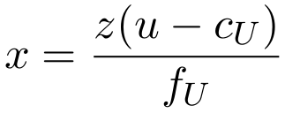
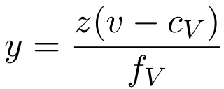
3D Reconstruction
Disparity Map
Assumptions [11]:
Two cameras, identical in performance
Aligned camera centers
Images are rectified
Horizontal baseline between camera centers
Depth Map
Point Cloud
Notes:
Reconstruction is an in-between step: disp to PCL
-
Using the known camera geometry and several assumptions, disparity can be transformed to depth
-
After creating a depth map, horizontal and vertical distance can be derived by further manipulating camera geometry
-
The end result is a rich, detailed point cloud with as many points as the resolution of the camera that is used
-
-
With 3D reconstruction, high quality point clouds can be derived from disparity maps.

Slide 8
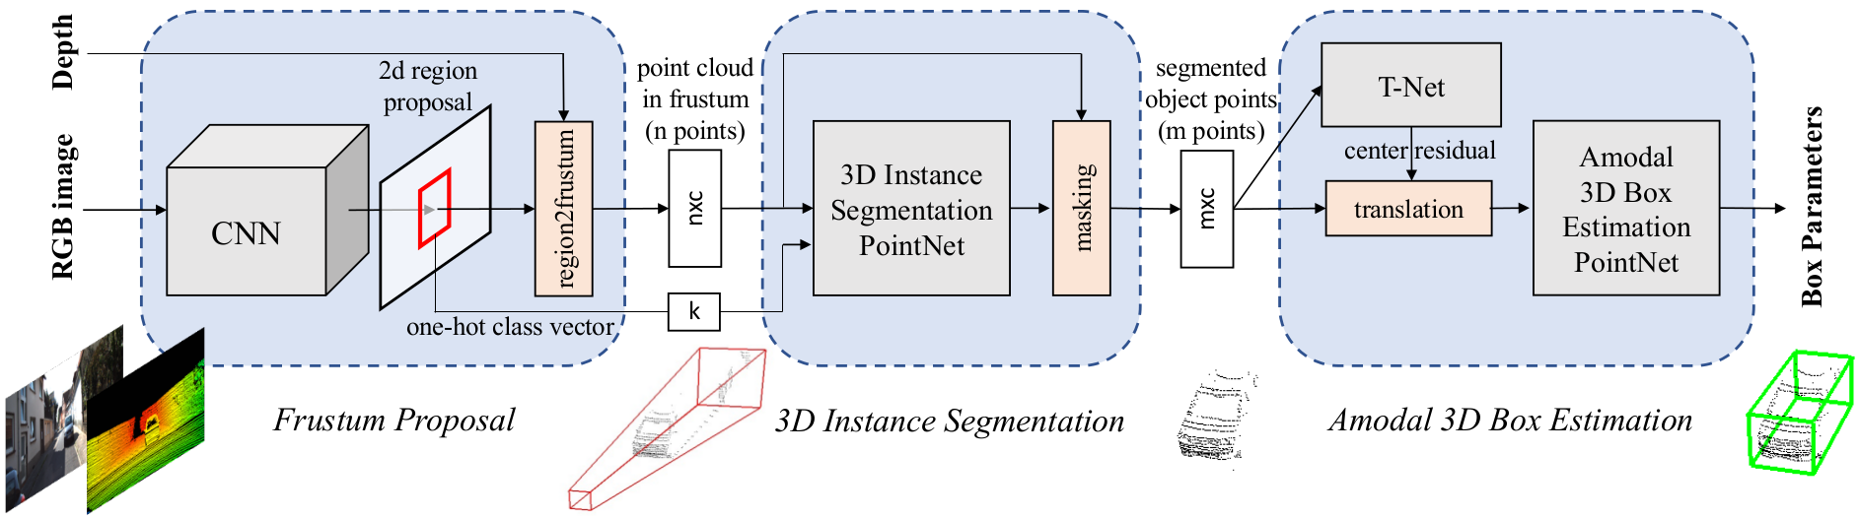
Frustum Pointnet: 3D Bboxes
Stereo training: preprocess both train and validation with PSMnet
Notes:
Frustm Pointnet is 3rd, final step in obtaining 3D bounding boxes
-
Fpnet works by:
taking a point cloud and left-image
creating regions of interest via 2D object detection
removing the background / foreground noise from these regions
estimating the 3D bounding box of the segmented points
-
Frustum proposal: use mature 2D object detector to find regions of interest, reconstructed into 3D frustums (cones) to filter raw point cloud (Feature Pyramid Network is default)
-
Instance Segmentation: individually supervised pointnet learns to classify relevant regions, given sub-cloud and class info
-
Amodal Estimation: two individually supervised nets estimate the true-center and the final bbox dimensions/orientation, using a residual sum to return the bbox in camera coordinates.
-
-
General functionality is to take a point cloud and output a Bbox prediction, modified by taking in a non-lidar pointcloud

Slide 9
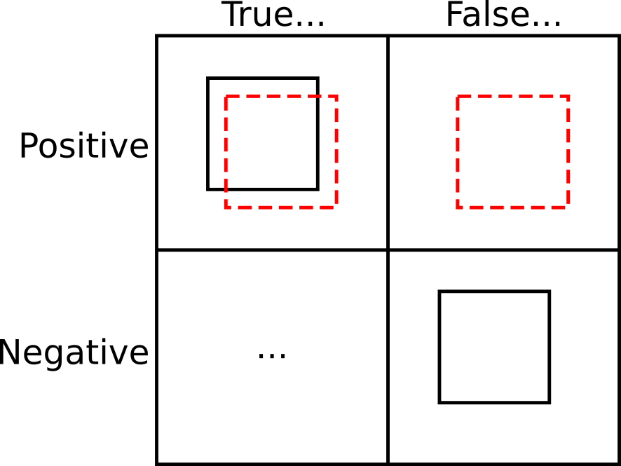
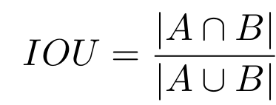
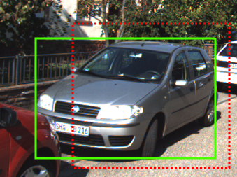
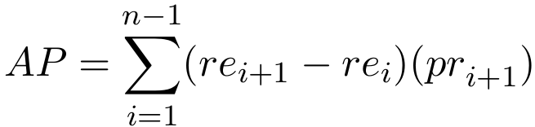
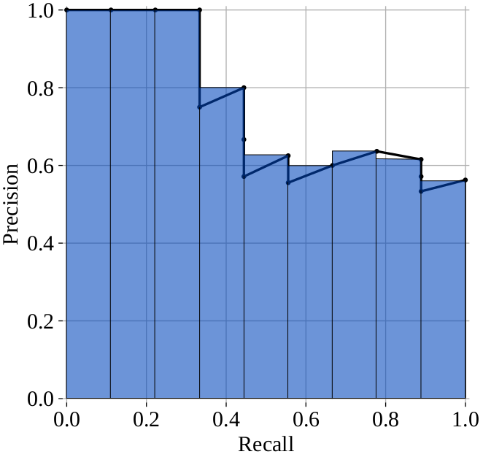
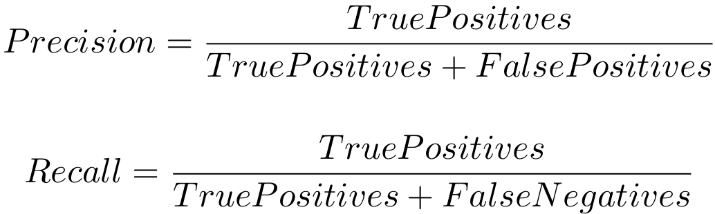
Performance Metrics
Typical Average Precision
Notes:
To establish a successful detection and good performance, several definitions are needed.
-
True & False Positives & Negatives defined by sufficient overlap of ground truth and prediction
-
This overlap is called Intersection over Union
-
The number of TP, FP, and FN obtained given a certani threshold enable calculation of precision / recall
-
Precision: “the number of documents retrieved that are relevant”. Ex: 5 presents, 7 remembered, 5/7 precision
-
Recall: “the number of relevant documents that are retrieved”. Ex: 5 presents, 7 remembered, incl. 5 correct, 5/5
-
Finding P & R at various thresholds leads to a PR curve
-
Finding approximate area under curve gives Average Precision score
-
-
We want highest AP score possible. Will exclusively examine cars, typically at Easy difficulty.

Slide 10
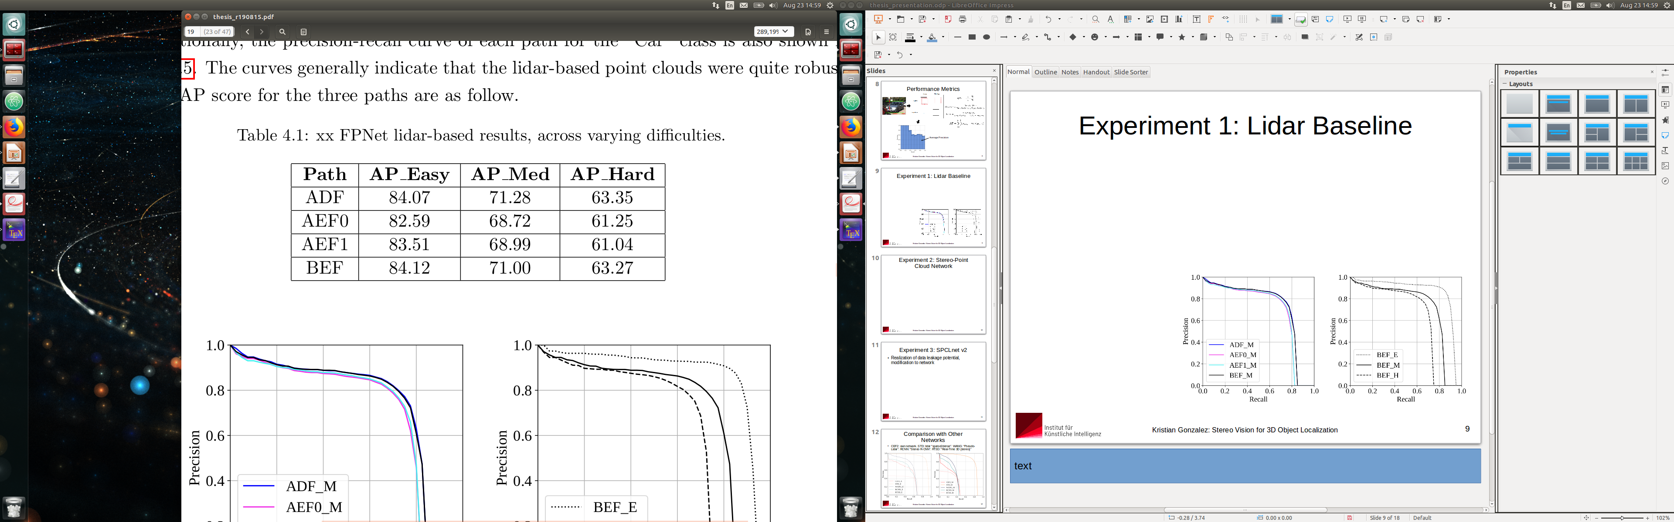
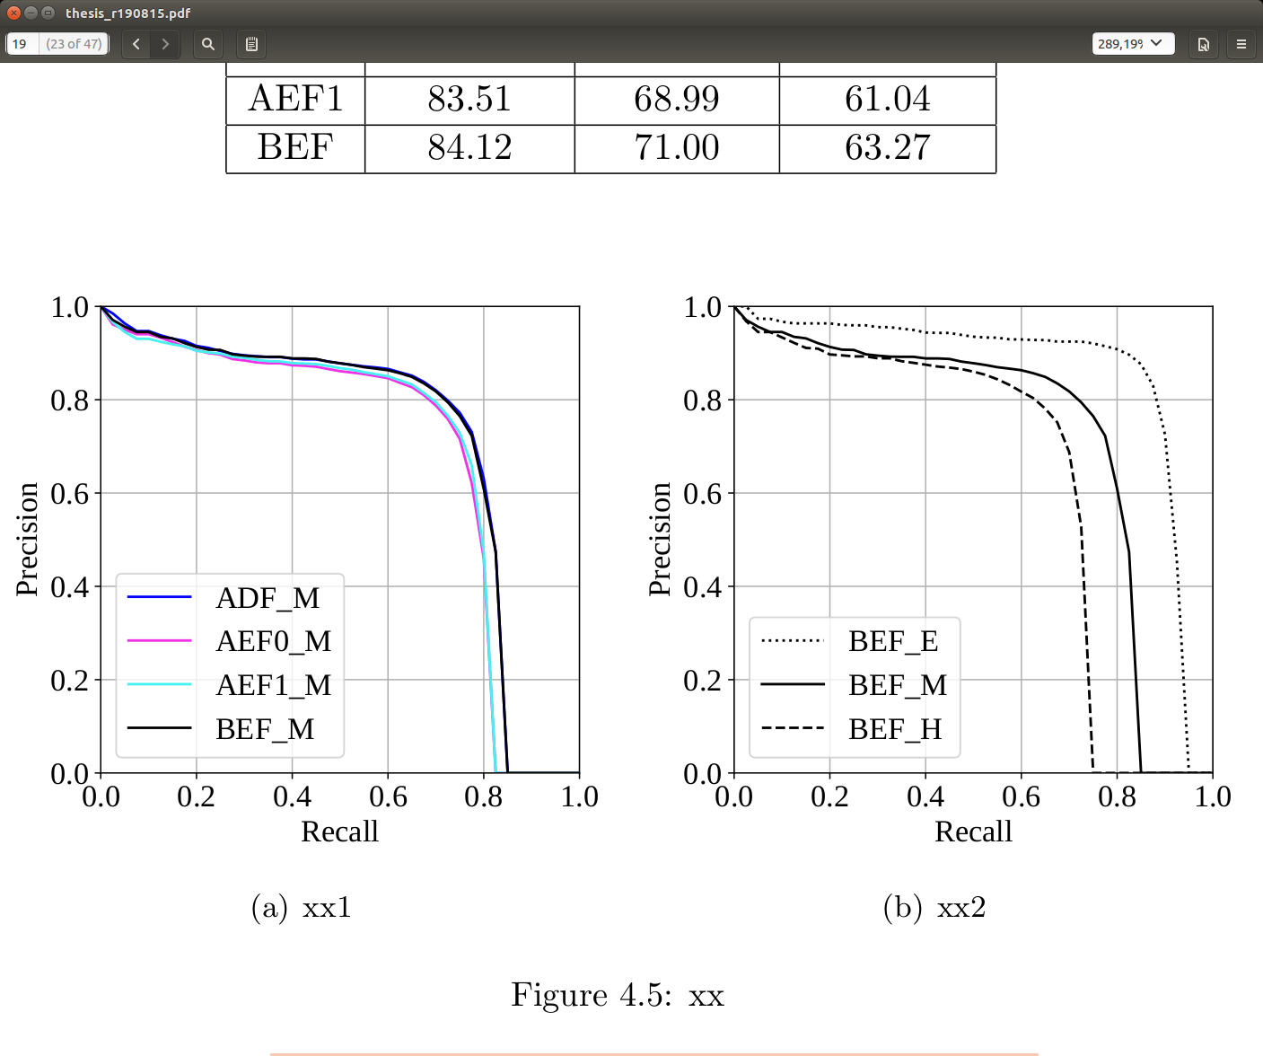
Experiment 1: Lidar Control Variable
A: Download preprocessed data
D: Download pre-trained model
B: Prep own preprocessed data
F: Test / evaluate network
E: Train own network model
C: Prep own stereo preprocessed data
“Paths” for
experimentation
Notes:
Experiment 1: control group, ensuring that lidar does indeed perform well
-
Various paths devised for transition from lidar point clouds to stereo point clouds
-
Out of various paths, self-preprocessed, self-trained network performed nominally better
-
KITTI dataset uses Easy / Medium / Hard criteria, where Easy refers to cars generally within 30 meters of cameras.
-
-
Path BEF is used as lidar reference performance, similar to other lidar-based networks

Slide 11
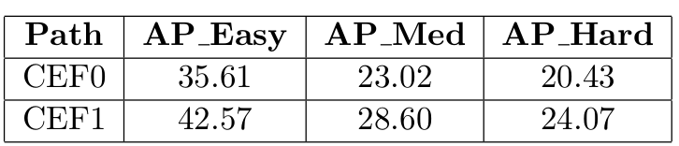
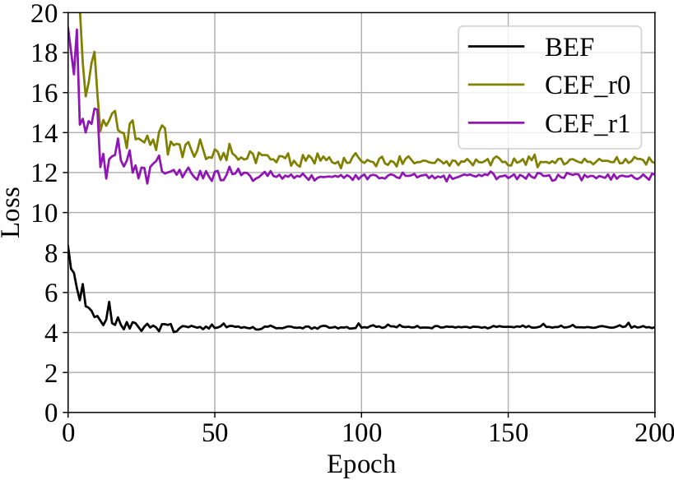
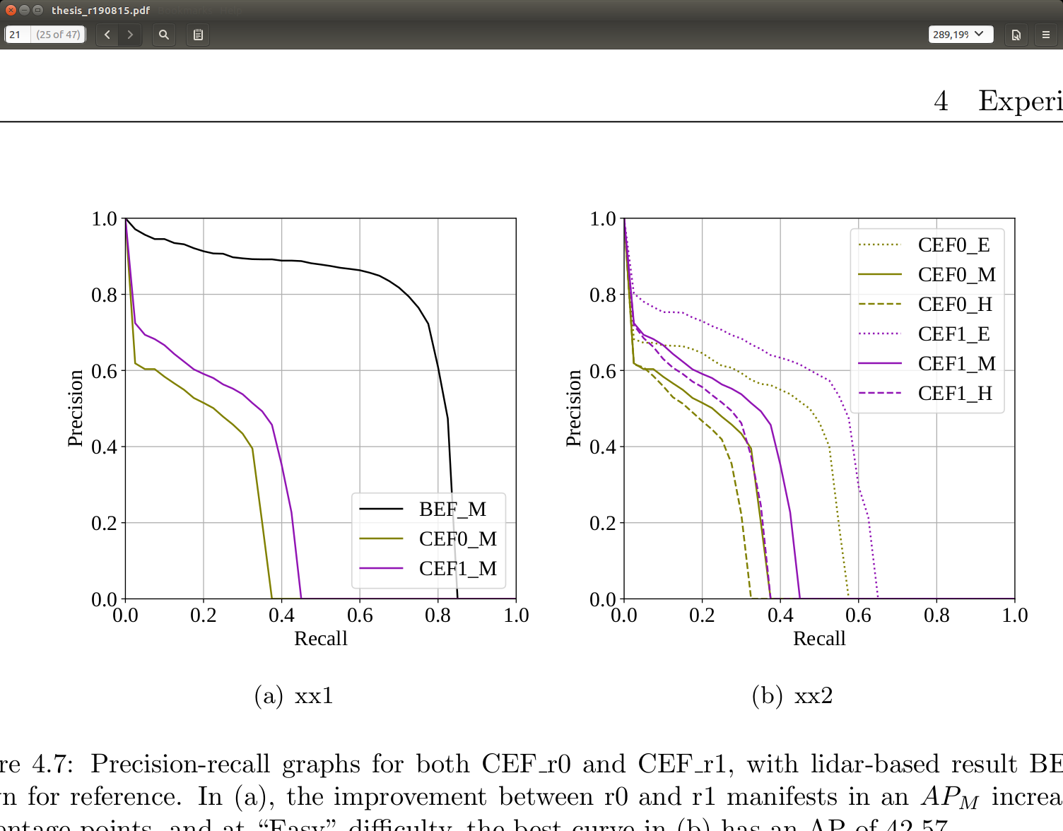
Experiment 2: Stereo-Point Cloud Network
CEF0: Initial attempt at stereo network
CEF1: improvement on stereo alignment & reconstruction
Notes:
Experiment 2: initial performance check after developing full pipeline
-
First iteration, revision 0, performed poorly but indicated that the network was fully functional.
AP_e 35.6, AP_m 23.0
-
Revision 1 demonstrated that with improvement on alignment & reconstruction, significant gains could be achieved
AP_e 42.6 (+7), AP_m 28.6 (+2)
-
-
Initial attempts succesful, but can be improved upon

Slide 12
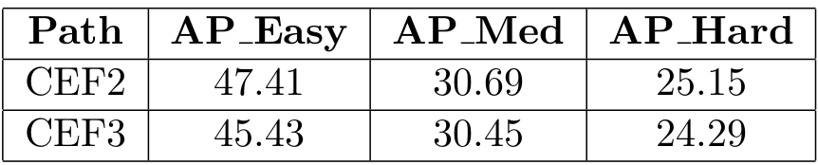
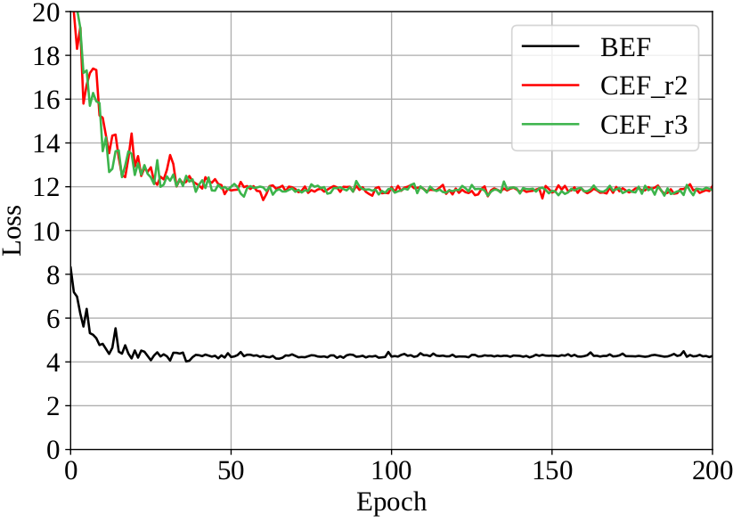
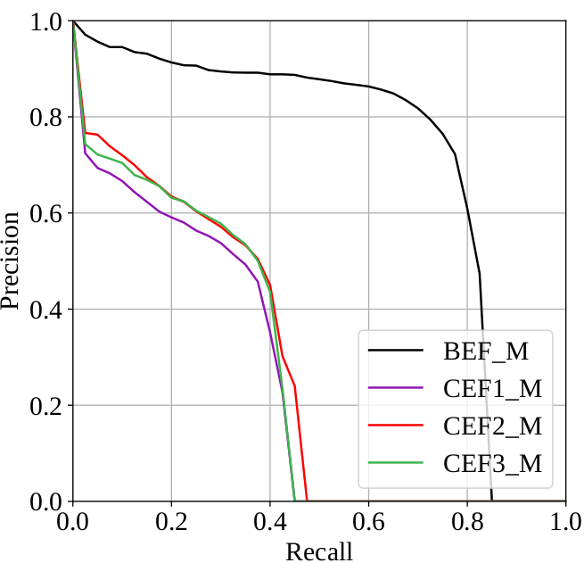
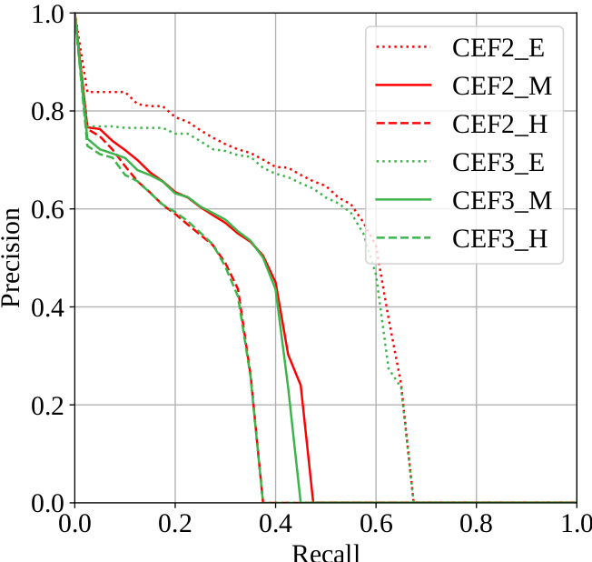
Experiment 3: SPCLnet v2
CEF2: improvement after PSMnet retraining
CEF3: reducing data (remove 1m above origin) not helpful
Notes:
Experiment 3: refinement of disparity map generation
-
During the time working on this project, a similar work produced by Wang, Chao, et al was published
-
Main two suggestions: retrain PSMnet, remove points that may not be generated by lidar
-
Revision 2, after revising PSMnet, showed steady improvement. AP_e 47.4(+5), AP_m 30.7 (+2)
-
Revision 3, removing points over 1m, did not help, nominally hurt results. AP_e 45.4 (-2), AP_m 30.5 (-0.2)
-
-
Further improvements could be possible, will leave for future work

Slide 13
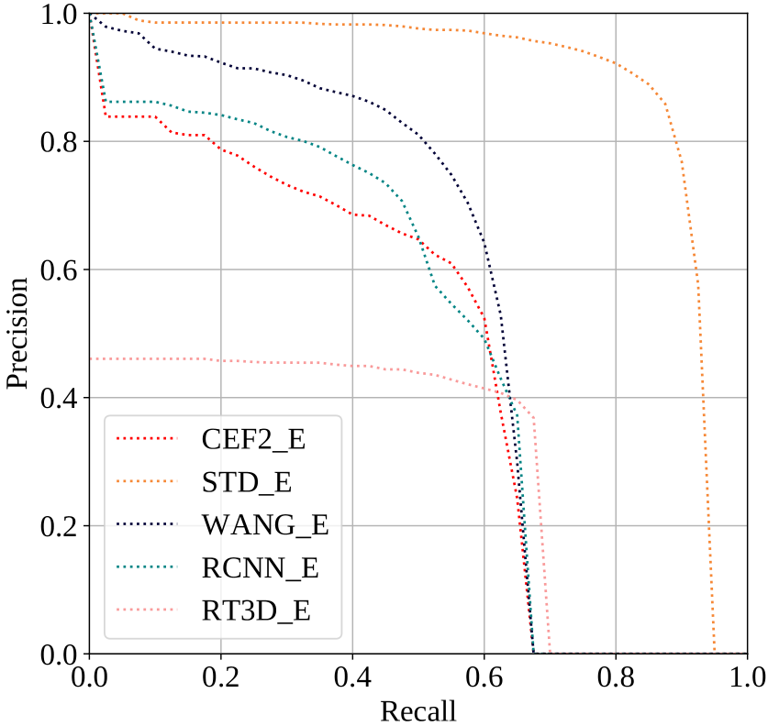
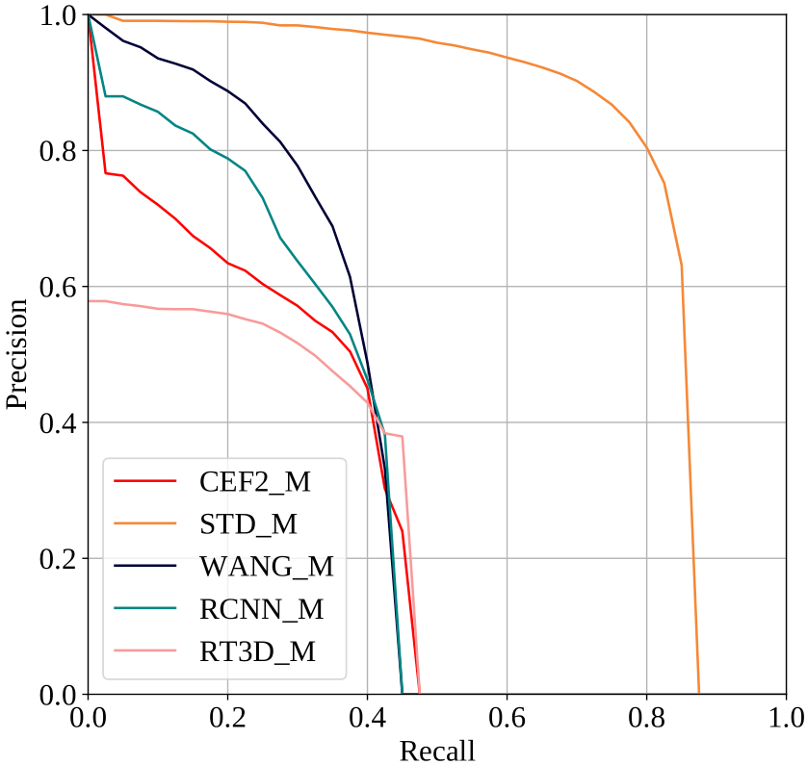
Comparison with Other Networks
CEF2: own network. STD: lidar “sparse2dense” []. WANG: “Pseudo-Lidar” [8]. RCNN: “Stereo R-CNN” [7]. RT3D: “Real-Time 3D (stereo)” [6]
Notes:
Once network performance was generally stable, SPCLnet compared to other works:
-
STD: best-performing, lidar-based network on KITTI
-
Wang: best-performing, stereo-based network on KITTI
-
Stereo RCNN: disparity map directly to 3D predictions
-
RT3D: real-time predictions via BEV feature extraction
-
-
Multiple observations:
Own network performs somewhat on-par with other networks
Improvements to own network are possible
Stereo networks all seem to converge on certain behaviors

Slide 14
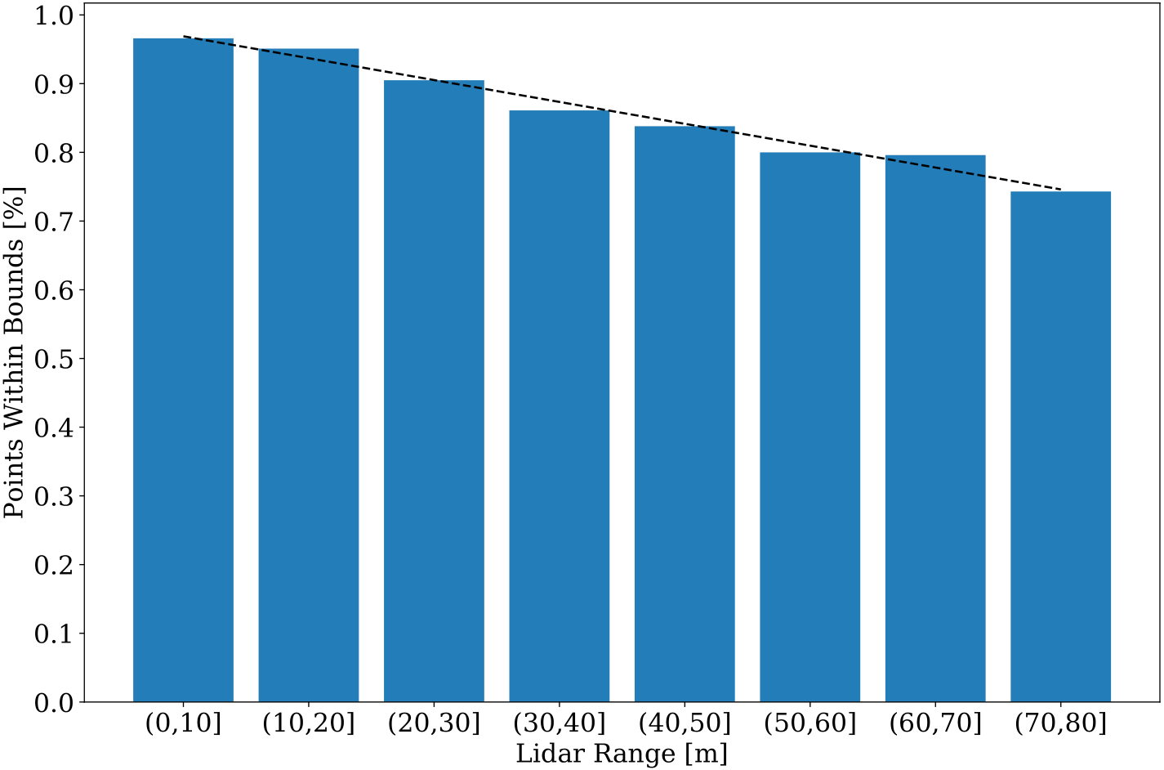
Conclusions
Stereo vision can potentially compete, at near range.
Disparity map quality is key, and this is affected by
the input data. The KITTI dataset may not always
be the best choice.
Real-time stereo is approaching
reality, but not
without
simplification.
51x19 px, 24 meters away
Notes:
Conclusions, based on results
-
Stereo vision performs better at closer range, and can be sensitive to small changes in configuration
-
Disparity map quality strongly affects final bounding box predictions, and map quality is strongly affected by input data.
-
KITTI dataset not built for stereo. Needs to be enhanced or replaced with new dataset meant for stereo
-
Real-time stereo is possible, but the right components need to be put together (real-time disparity map, unified detection pipeline)

Slide 15
Thank you!
Notes:
Thank you!

Slide 16
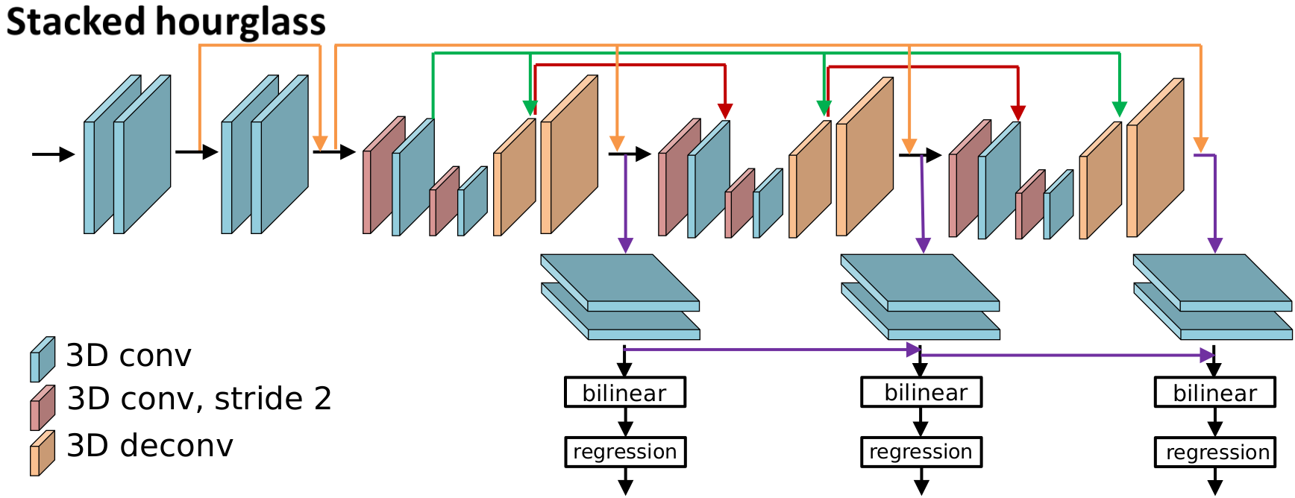
PSMnet: Stacked Hourglass
Hourglass network: conv. + transposed conv. (deconv.)
Skip layers: preserve info
Supervision at three layers
<

Slide 17
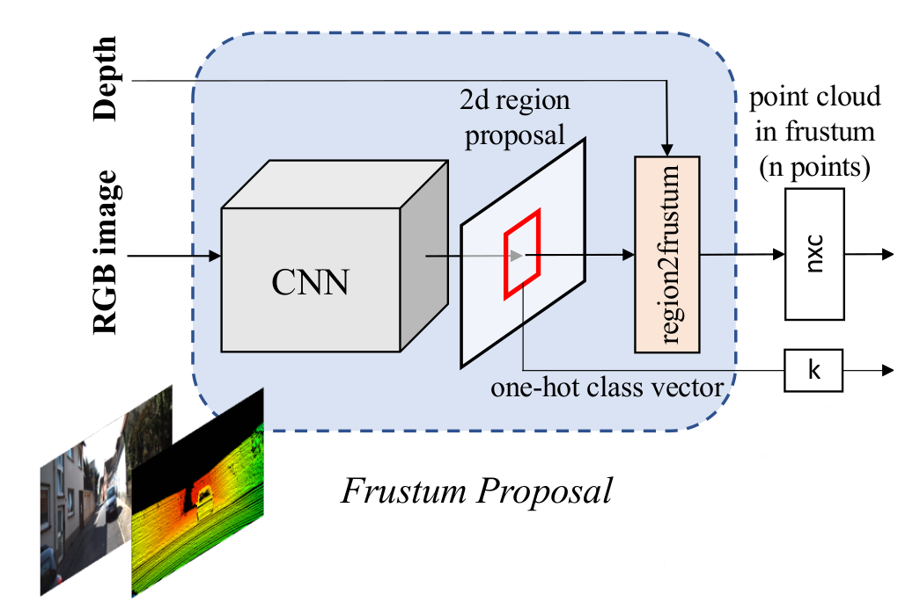
Backup: FPnet Proposal (1/3)
Any 2D detector possible, default Feature Pyramid Network [12] used

Slide 18
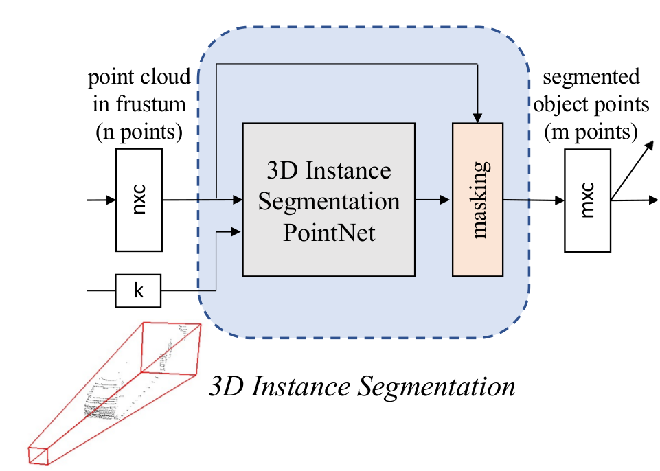
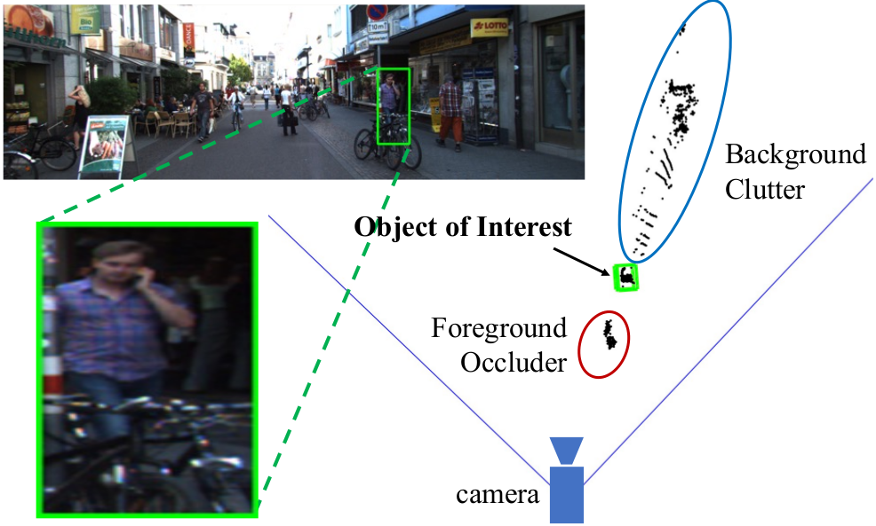
Backup: FPnet Segmentation (2/3)
Pointnet: learn to segment the point cloud (supervised)

Slide 19
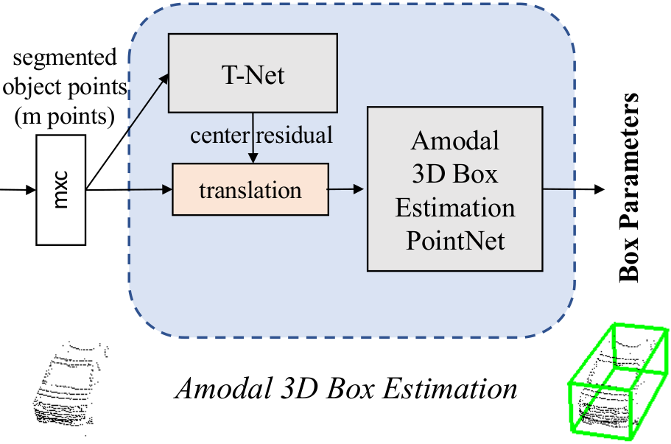
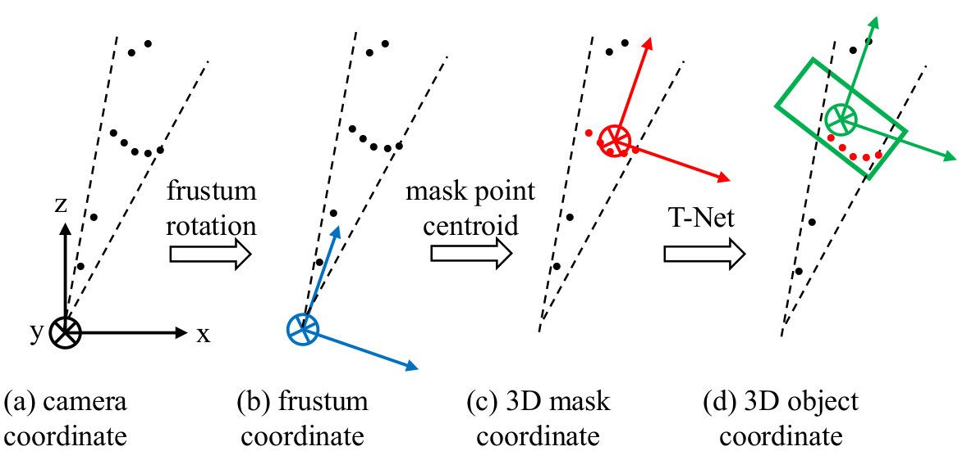
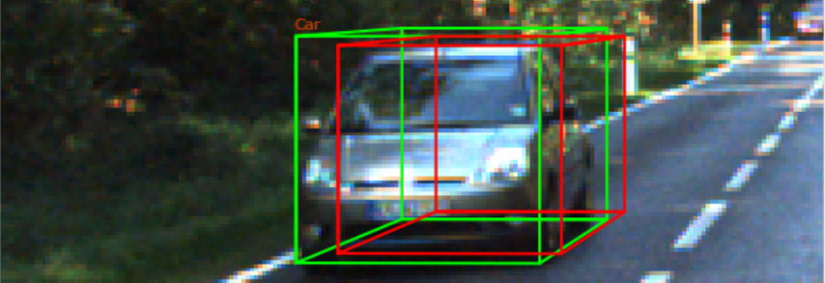
Backup: FPnet Estimation (3/3)
T-Net: estimate “true center” (supervised)
2nd Pointnet: Estimate orientation (supervised)

Slide 20
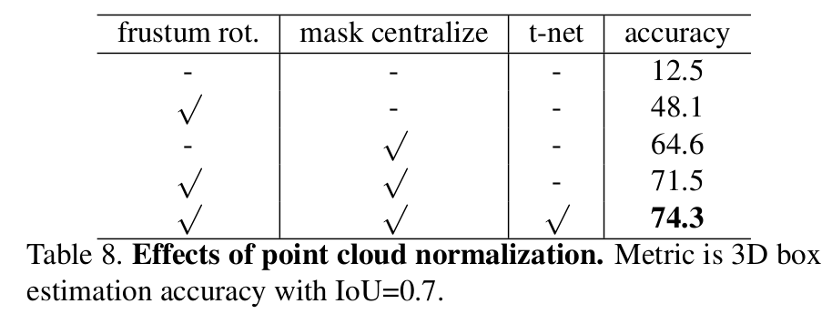
Backup: Why re-center point cloud?
Each network performs better when coordinate system origin lies among points, not far away

Slide 21
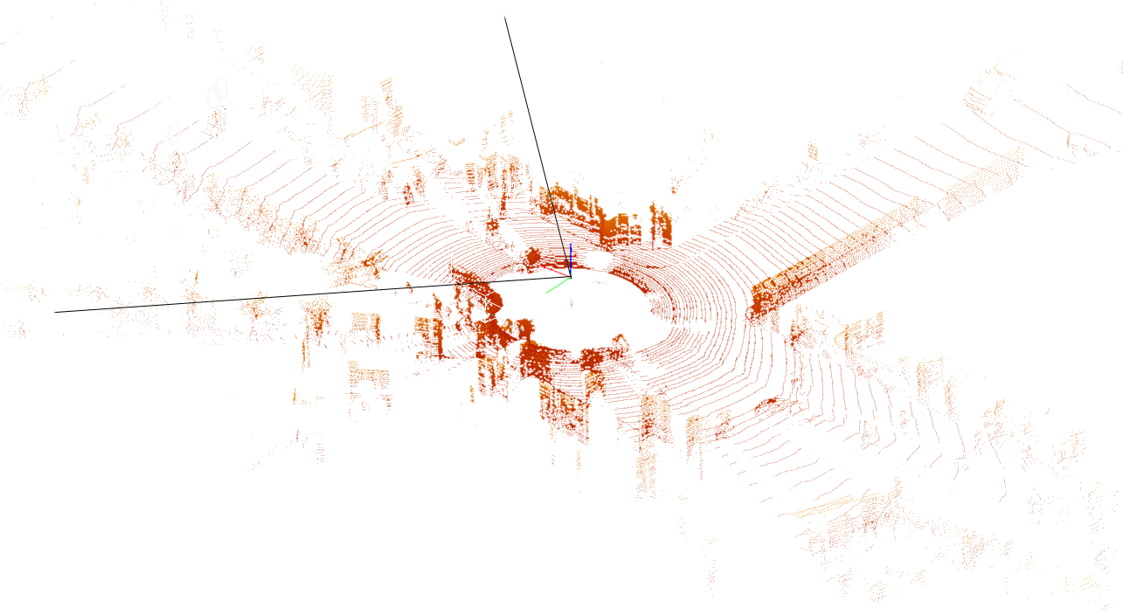
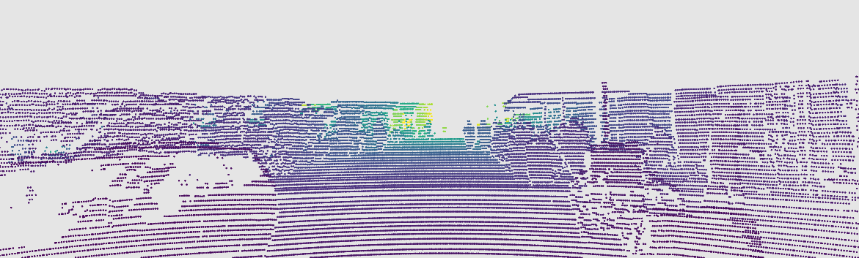
Backup: Creating ObjDet Stereo Ground Truths
Simply the reverse of 3D reconstruction: image projection
Detailed by development kit, explained in code repository
Self-made stereo ground truths used in training PSMnetv2

Slide 22
Backup: Why point cloud representation?
Natural question: why not use a depth map?
Wang et al, “Pseudo-Lidar” [8]:
… The central assumption [of 2D convolutions] is two fold: (a) local neighborhoods in the image have meaning … and (b) all neighborhoods can be operated upon in an identical manner…
… two pixels can be co-located next to each other in the depth map, yet can be very far away in 3D space. Second, objects that occur at multiple depths project to different scales in the depth map.
Qi et al, “Frustum Pointnets” [4]:
One straightforward solution is to directly regress 3D object locations from a depth map using 2D CNN’s. However, … occluding objects and background clutter is common in natural scenes, which might severely distract the 3D localization task…
[segmentation is easier in 3D than] in images where pixels from distant objects can be near-by to each other.

Slide 23
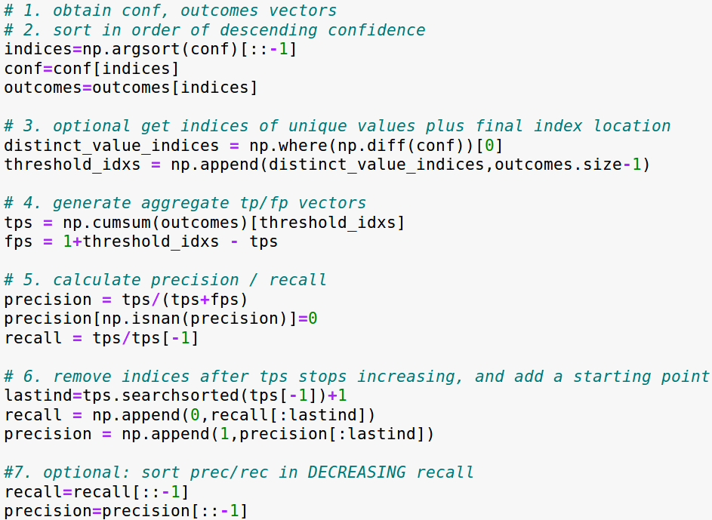
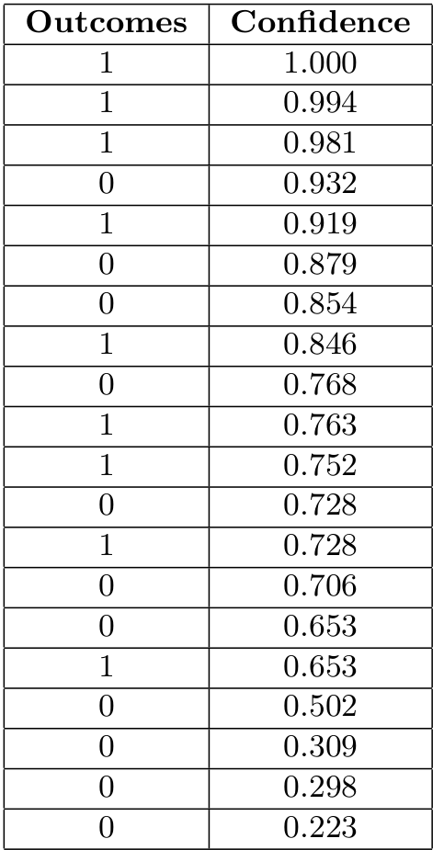
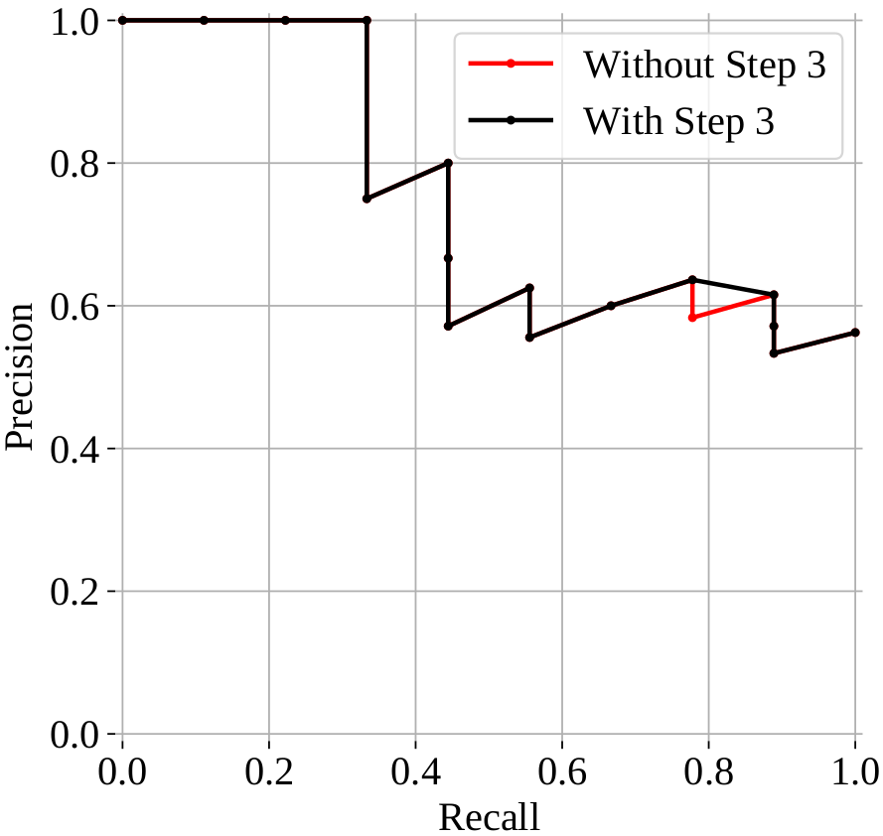
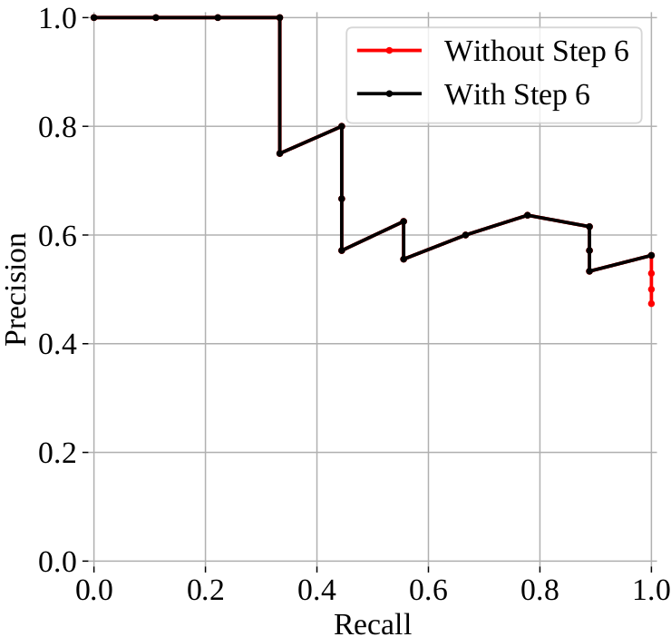
Backup: Precision-Recall Curve
Notes:
Steps:
1. obtain confidence scores & outcomes
2. sort by confidence
3. use only unique confidence values
4. generate cumsum TP/FP
5. calculate raw precision & recall
6. remove indices, add starting point

Slide 24
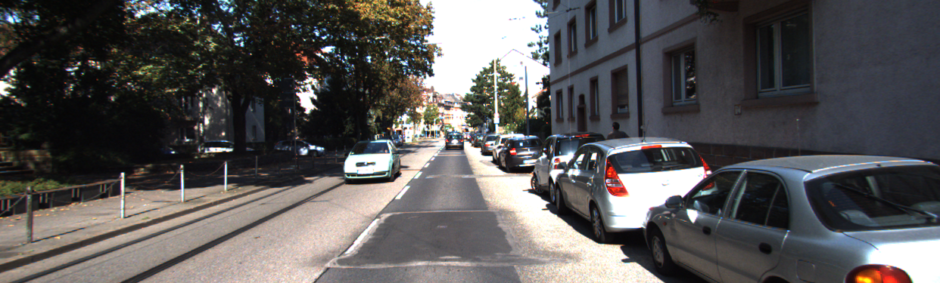
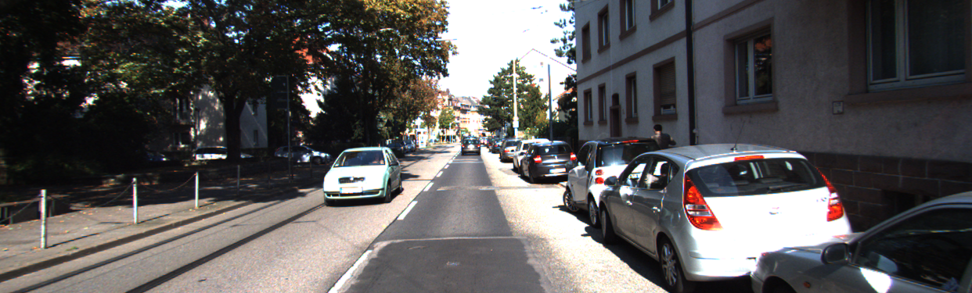
Backup: Stereo & ObjDet Similarity
Stereo (above) and Object Detection (below) dataset sample images.

Slide 25
Backup: Other Datasets
Difficult to find other datasets with both stereo and lidar
Others examined:
  Apolloscape [9]: growing, based off KITTI dataset
  Cityscapes [13]: oriented towards segmentation, but high quality images
  Berkeley DeepDrive [14]: oriented towards lidar usage, but also has high quality images

Slide 26
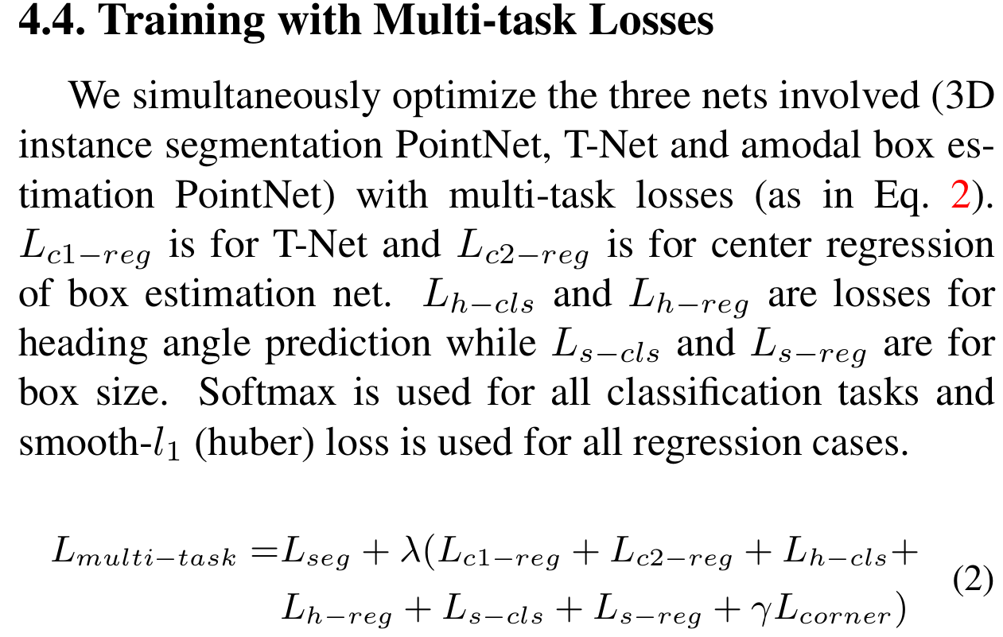
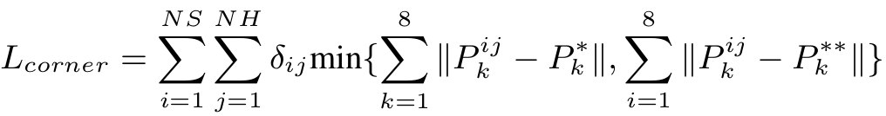
Backup: FPnet loss

Slide 27

Backup: Stereo R-CNN
Objects are detected in each image
Dense 3D box aligment using known regions
Stereo RPN >> Stereo RCNN >> Keypoint prediction >> box estimation and alignment >> output

Slide 28

Backup: Real-Time 3D
Two stage detector with 2D information
Project point cloud to BEV with height info at each point >> 2-stage detector uses RPN >> classify / regress ROI’s
Typical performance speed: ~11 Hz

Slide 29
References
Jia-Ren Chang and Yong-Sheng Chen. Pyramid Stereo Matching Network. In Proceedings of the IEEE Conference on Computer Vision and Pattern Recognition, pages 5410–5418, 2018.
Zhengfa Liang, Yiliu Feng, Yulan Guo, Hengzhu Liu, Wei Chen, Linbo Qiao, Li Zhou, and Jianfeng Zhang. Learning for Disparity Estimation through Feature Constancy. Computer Vision and Pattern Recognition, 2018.
Heiko Hirschmuller. Stereo processing by semiglobal matching and mutual information. IEEE Transactions on pattern analysis and machine intelligence, 30(2):328–341, 2007.
Charles Ruizhongtai Qi, Wei Liu, Chenxia Wu, Hao Su, and Leonidas J. Guibas. Frustum PointNets for 3d Object Detection from RGB-D Data. CoRR, abs/1711.08488, 2017.
Zetong Yang, Yanan Sun, Shu Liu, Xiaoyong Shen, and Jiaya Jia. Std: Sparse-to-dense 3d object detector for point cloud. arXiv preprint arXiv:1907.10471, 2019.
Yiming Zeng, Yu Hu, Shice Liu, Jing Ye, Yinhe Han, Xiaowei Li, and Ninghui Sun. Rt3d: Real-time 3-d vehicle detection in lidar point cloud for autonomous driving. IEEE Robotics and Automation Letters, 3(4):3434–3440, 2018.
Peiliang Li, Xiaozhi Chen, and Shaojie Shen. Stereo R-CNN based 3d Object Detection for Autonomous Driving. arXiv preprint arXiv:1902.09738, 2019.
Yan Wang, Wei-Lun Chao, Divyansh Garg, Bharath Hariharan, Mark Campbell, and Kilian Weinberger. Pseudo-LiDAR from Visual Depth Estimation: Bridging the Gap in 3d Object Detection for Autonomous Driving. In CVPR, 2019
Xinyu Huang, Xinjing Cheng, Qichuan Geng, Binbin Cao, Dingfu Zhou, Peng Wang, Yuanqing Lin, and Ruigang Yang. The ApolloScape Dataset for Autonomous Driving. ArXiv: 1803.06184, 2018.
Andreas Geiger, Philip Lenz, and Raquel Urtasun. Are we ready for Autonomous Driving? The KITTI Vision Benchmark Suite. In Conference on Computer Vision and Pattern Recognition (CVPR), 2012.
Richard Szeliski. Computer Vision: Algorithms and Applications. Springer-Verlag, Berlin, Heidelberg, 1st edition, 2010.
Tsung-Yi Lin, Piotr Dollár, Ross Girshick, Kaiming He, Bharath Hariharan, and Serge Belongie. Feature pyramid networks for object detection. In Proceedings of the IEEE conference on computer vision and pattern recognition, pages 2117–2125, 2017.
Cordts, Marius, Mohamed Omran, Sebastian Ramos, Timo Rehfeld, Markus Enzweiler, Rodrigo Benenson, Uwe Franke, Stefan Roth, and Bernt Schiele. “The Cityscapes Dataset for Semantic Urban Scene Understanding.” CoRR abs/1604.01685 (2016). http://arxiv.org/abs/1604.01685.
Yu, Fisher, Wenqi Xian, Yingying Chen, Fangchen Liu, Mike Liao, Vashisht Madhavan, and Trevor Darrell. “BDD100K: A Diverse Driving Video Database with Scalable Annotation Tooling.” CoRR abs/1805.04687 (2018). http://arxiv.org/abs/1805.04687.
Kristian Gonzalez, Markus Schneider, Christoph Wiedemann. SMART3D Project. https://fbe-gitlab.hs-weingarten.de/prj-iki/smart3d

