Slide 1
컬러 가이드
주색상
보조색상
보조색상
보조색상
보조색상
보조색상
보조색상
* 이 외에도 무채색은 다양한 농도로 사용 가능
제목 색상
내용 색상
불릿 포인트 사용방법
AAAA
BBBB
CCCC
DDDD
EEEE
shift+alt+→(좌우방향키)
예시)

Slide 2

cbNIPT Analysis Report
Chromosome 13 Trisomy Detection, Sample NIPT-2026-0143
지훈 ｜ Clinical Bioinformatics Team ｜ 2026-07-08

Slide 3
CHAPTER 1
Summary
CHAPTER 2
Introduction
CHAPTER 3
Results
CHAPTER 4
Conclusion

Slide 4
01
CHAPTER
Introduction

Slide 5
Summary
01
Purpose
Non-invasive detection of fetal chromosomal aneuploidy from maternal plasma cfDNA
02
Chromosome 13 Z-score = 3.8 (positive for trisomy 13)
Results
03
Result is consistent with Trisomy 13; confirmatory testing recommended
Conclusion
04
Karyotype or CMA confirmation via amniocentesis recommended
Further Study

Slide 6
Introduction

Slide 7
Workflow

Slide 8
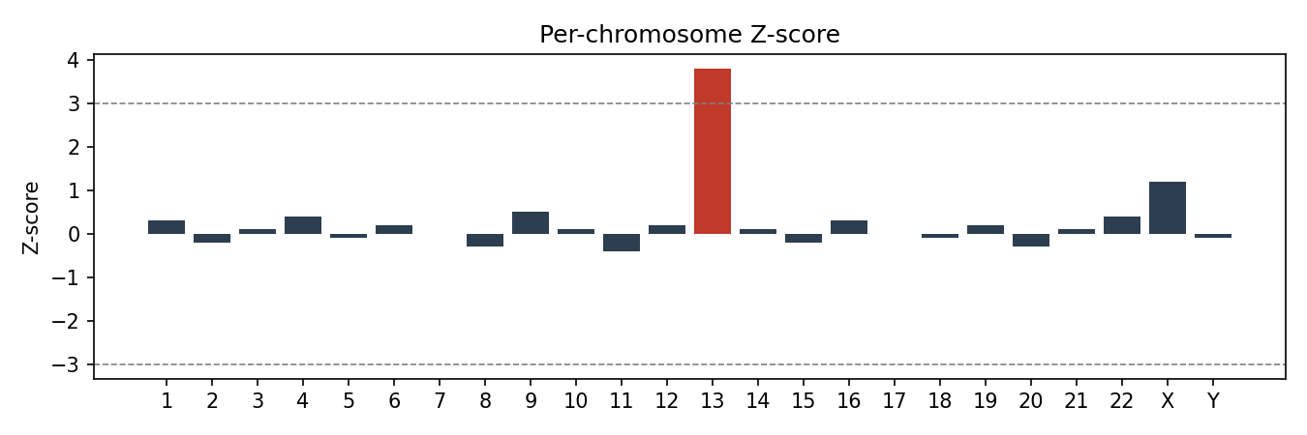
Workflow

Slide 9
Sample Information
Sample ID | Gestational Age | Fetal Fraction | Total Reads
NIPT-2026-0143 | 12w3d | 11.2% | 6,842,110

Slide 10
02
CHAPTER
Results

Slide 11
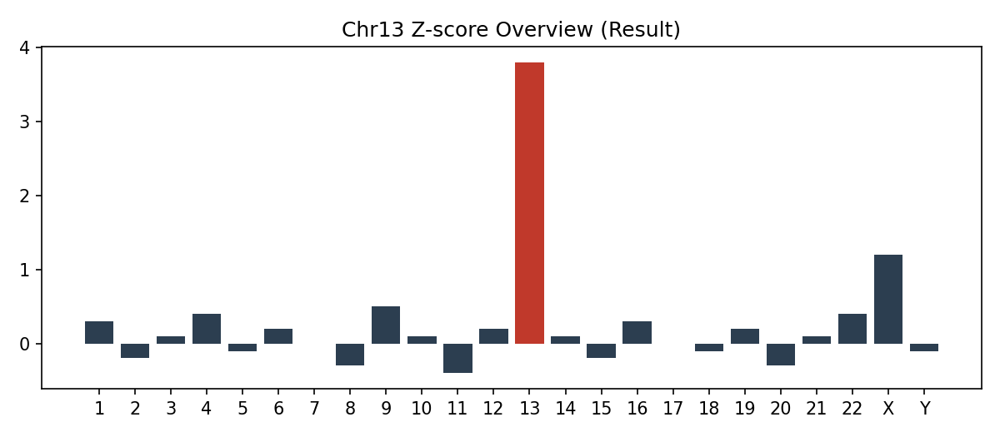
Results : Chromosome 13 Z-score Overview
Chromosome 13 Z-score Overview

Slide 12
Results : Chromosomal Aneuploidy Call Summary
Chromosomal Aneuploidy Call Summary
Chromosome | Z-score | Call
13 | 3.8 | Positive (Trisomy 13)
18 | 0.1 | Normal
21 | -0.3 | Normal
X | 0.2 | Normal (Female)

Slide 13
03
CHAPTER
Conclusion

Slide 14
Conclusion
Chromosome 13 Trisomy Detected
Z-score of 3.8 on chromosome 13 exceeds the +3.0 clinical threshold
Fetal fraction (11.2%) is within the validated range for reliable calling
Recommend confirmatory diagnostic testing (amniocentesis / CVS)
Genetic counseling referral advised prior to further testing

