Slide 1
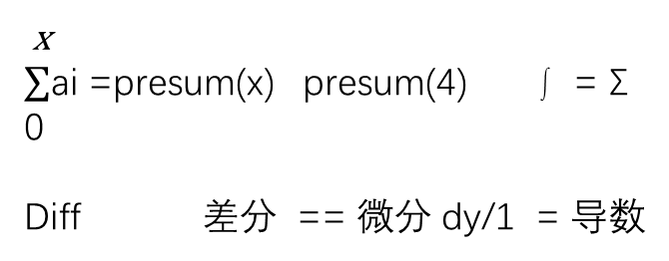
1, 4 , 5 , 3 , 1 , 3 , 4 , 5 , 6
Presum[0], Presum[1],Presum[2],…Presum[8],
0, 1, 2 , 3 , 4 , 5 , 6 , 7 , 8
x
$∑$ai =presum(x) presum(4) ∫ = Σ
0
Diff 差分 == 微分 dy/1 = 导数

Slide 2
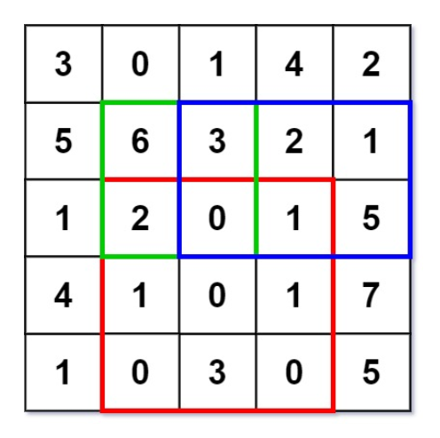
resmatrix[i][j] = resmatrix[i-1][j] 绿+ resmatrix[i][j-1] 红- resmatrix[i-1][j-1] 蓝+ matrix[i-1][j-1] 原始矩阵
[0, 0, 0, 0, 0, 0 ],
[0, 3, 3, 4, 8, 10],
[0, 8, 14, 18, 24, 27],
[0, 9, 17, 21, 28, 36],
[0,13, 22,26, 34, 49],
[0,14, 23,30, 38, 58]
resmatrix[row2+1][col2+1] 38
resmatrix[row1][col2+1] 24
resmatrix[row2+1][col1] 14
+ resmatrix[row1][col1] 8

Slide 3
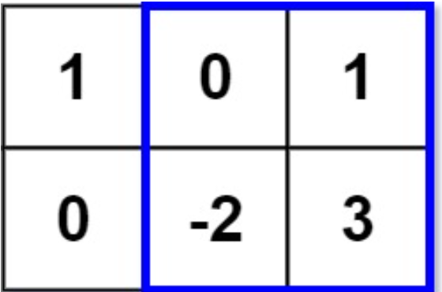
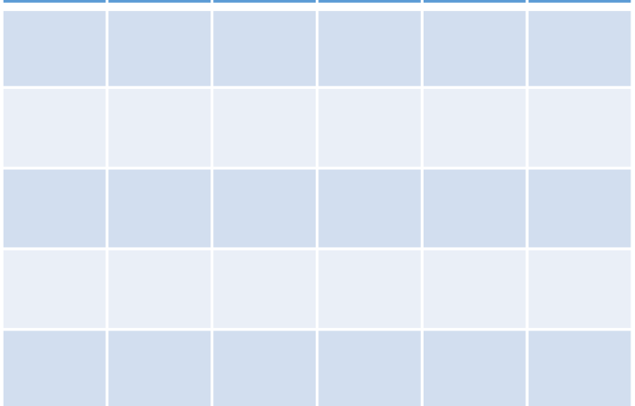
[0, 0, 0, 0]
[0, 1, 1, 2]
[0, 1, -1, 3]
# k >= r - l
L >= r -k
需要寻找最小的满足 l >= r – k
sortset
l
r
for
r
k’
for
l
for
r
l
k’
k
k’<=k,要找最大的k’，但又不能大于k
for

Slide 4
