Slide 1
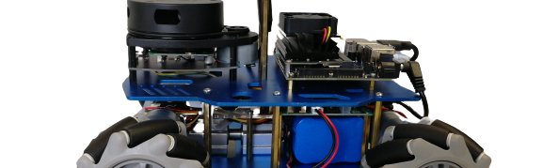
Robot Project
Kaihang Jiang

Slide 2
Agenda
Introduction
Robot system
Functions
Video data flow

Slide 3
Introduction

Slide 4
introduction
Create a map for the field
Use lidar to scan for a 2d map at target area. Simultaneous localization and mapping：The robot starts from unknown location at unknown environment, it constructs map by repeatedly observe environment features and locate its position and orientation while moving.
Navigation with the map
Plan the path and move to goal position. The robot is able to avoid obstacles during the process.
Set way points for navigation
Sequential move between recorded locations with recorded orientation and stay for configured time
Upload video stream to server
Push the Camera video stream to the server. Then process it the object detection and Optical character recognition.

Slide 5
The robot

Slide 6

Usb Camera
Jetson Nano
Lidar:
rplidar
STM32

Slide 7

ROS is an open-source, meta-operating system. It provides hardware abstraction, low-level device control, implementation of commonly-used functionality, message-passing between processes, and package management.
It also provides tools and libraries for obtaining, building, writing, and running code across multiple computers. ROS is similar in some respects to 'robot frameworks’
The mobile robot and virtual machine on PC both use linux operating system with ROS installed.

Slide 8
Server
computer
Netgear router
Bridge mode
Tplink router
connect
connect
Jetson
SSH remote
PC

Slide 9
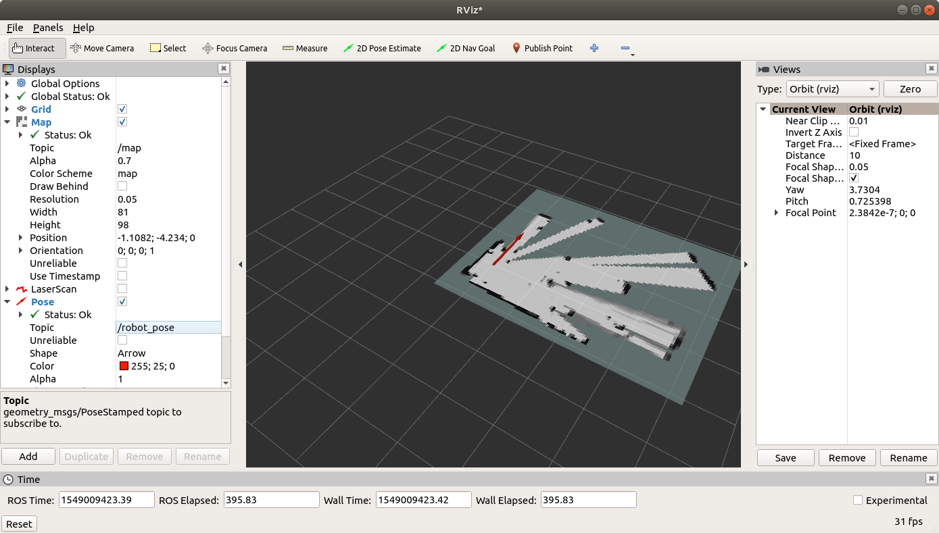
RVIZ
IDE
Pycharm
VScode

Slide 10
Functions

Slide 11
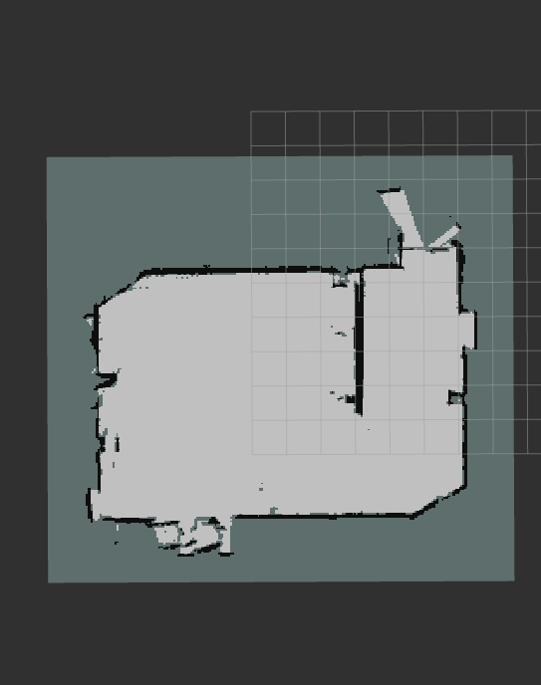
Cartographer is used for this project
Gmapping
Karto
Cartographer
Hector
Since:
Have loop closure, prevent the map from drifting for large area mapping
Storage consumption is small compared to gmapping
Create best map for the target area

Slide 12
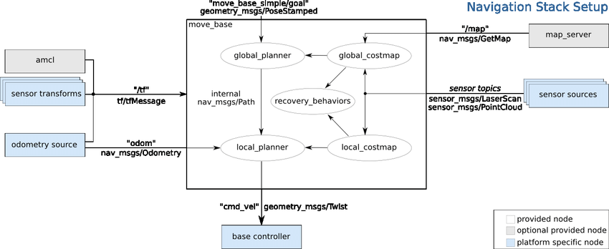

Slide 13
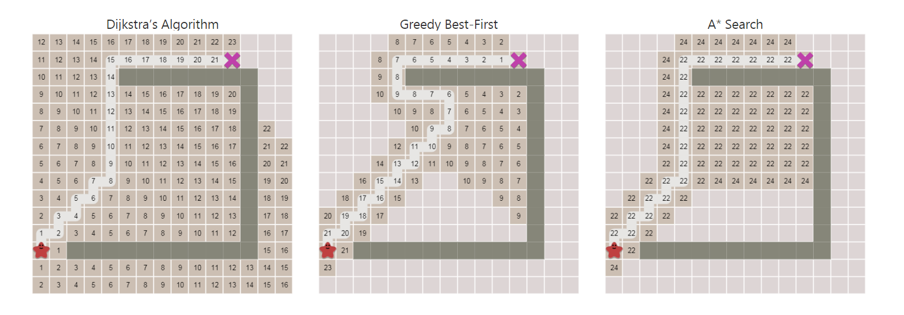

Slide 14
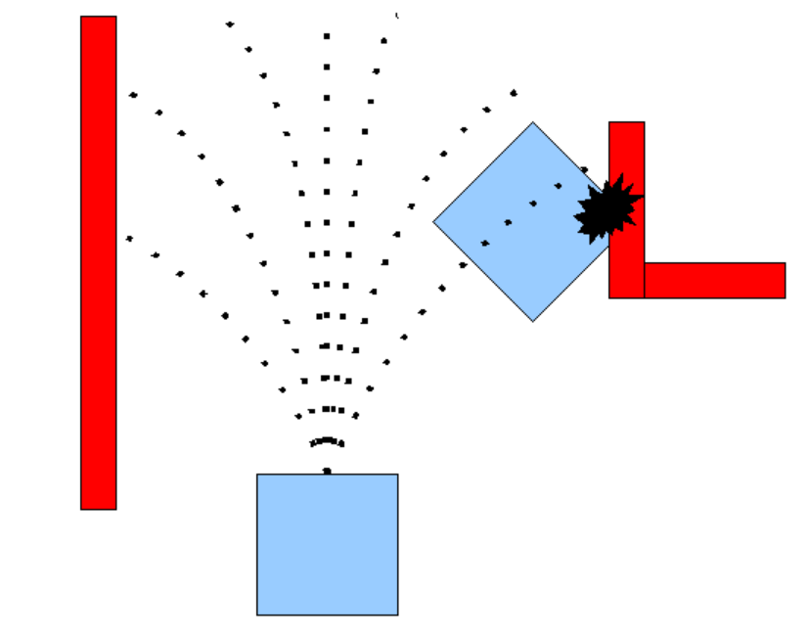
teb
dwa
Dynamic Window Approach
But in ROS ，it only uses velocity，and if there is any obstacle on the trajectory, abandon the trajectory.

Slide 15
Use controller to move the robot to target position and orientation. Record the data and time for stop. Save into txt file for next time use.
When the all positions needed are recorded, the robot will move between points with the same order
Stop or continue
Arbotix_gui
Or controller
Move robot
Record locationd
run

Slide 16
Video flow

Slide 17
Robot
ffmpeg
Cec server
Niginx
Yolo
Find object
OCR
Sql server

Slide 18
Thank you

