Slide 1
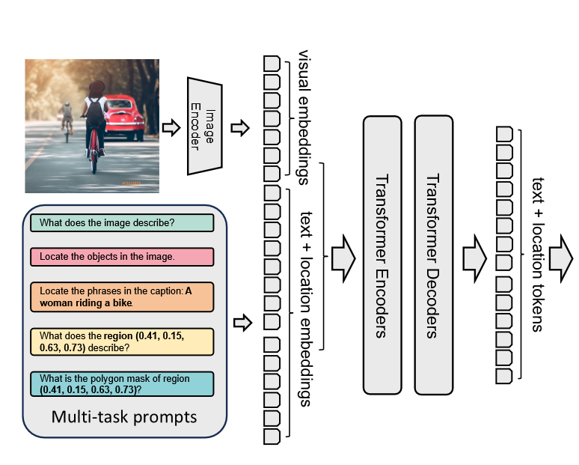
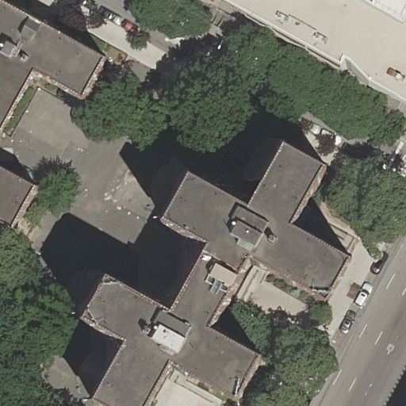
no
yes
Is there a commercial building?
no
Is a road present?
yes
Is a water area present?
Is there a residential building?

