Slide 1



When FTM Discovered MUSIC: Accurate WiFi-based Ranging in the Presence of Multipath
Kevin Jiokeng¹, Gentian Jakllari¹, Alain Tchana², André-Luc Beylot¹
¹IRIT-INPT/ENSEEIHT, University of Toulouse, France – Email: {kevin.jiokeng, jakllari, beylot}@enseeiht.fr
²ENS Lyon, France - Email: alain.tchana@ens-lyon.fr
IEEE INFOCOM’20 - July 2020

Slide 2
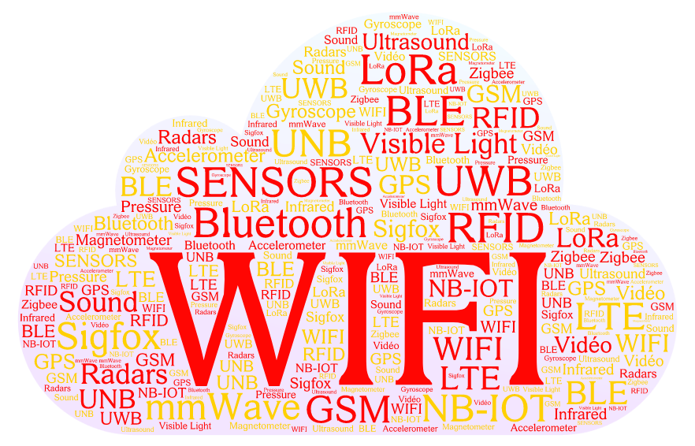
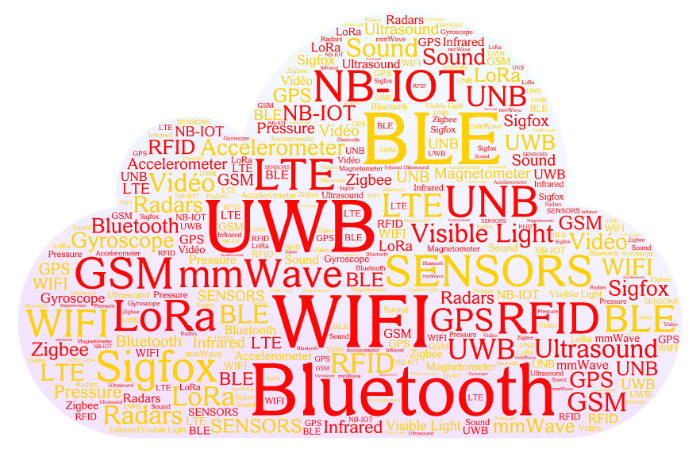
Indoor Localization: a long pathway
Two decades of work !
Multiple technologies have been used
It however remains an unsolved problem
Company
A great majority of works around WiFi because it is ubiquitous
The core problem in these works is accurate Ranging (to enable Multi-lateration)

Slide 3
WiFi-based Ranging: Key approaches
Received Signal Strength Indicator (RSSI) based
  Uses the signal strength and a propagation model to estimate the traveled distance
Time-Of-Flight (ToF) based
  Computes the ToF using timestamps on packets or other low-level information: Channel State Information (CSI) for example
Both approaches can be very accurate (decimeter-level in some recent works)
But are currently difficult to adopt in real-life usage: would need to upgrade all existing WiFi infrastructures
Company

Slide 4
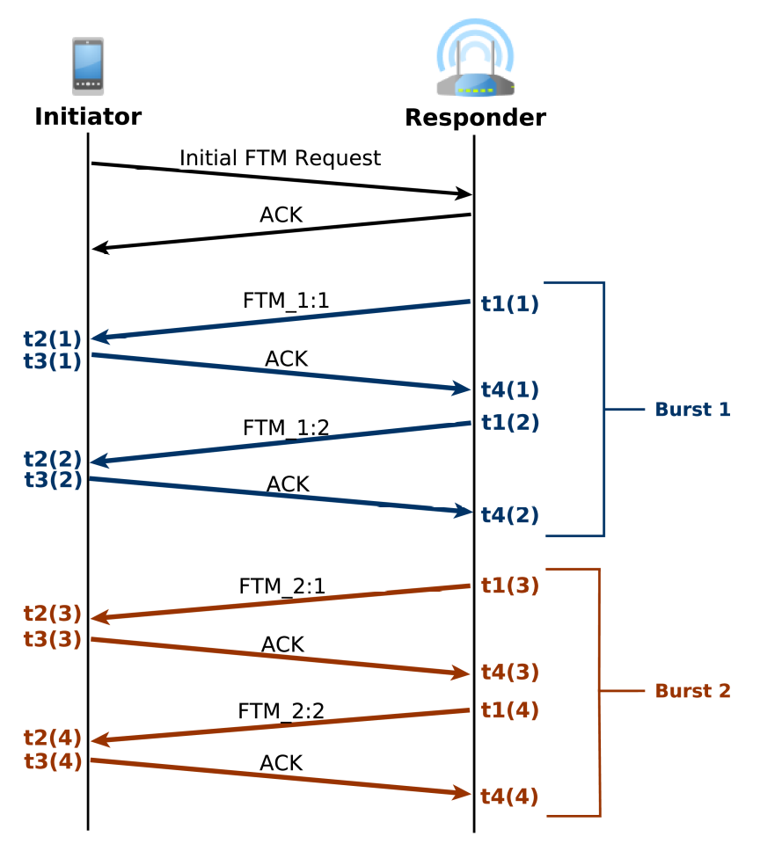
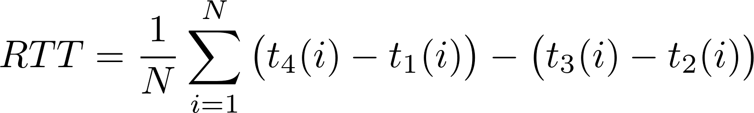
Fine Timing Measurement (FTM) protocol: The IEEE Solution
IEEE 802.11-2016 (802.11mc amendment)
Well defined exchange of packets (Two Way Ranging)
  Implemented in the firmware
  High precision clocks
Promises a precision of ~1-2m
Already supported by major WiFi equipments manufacturers and Android OS
  Google Pixel 2+ phones for example
Has a great potential !
Company

Slide 5
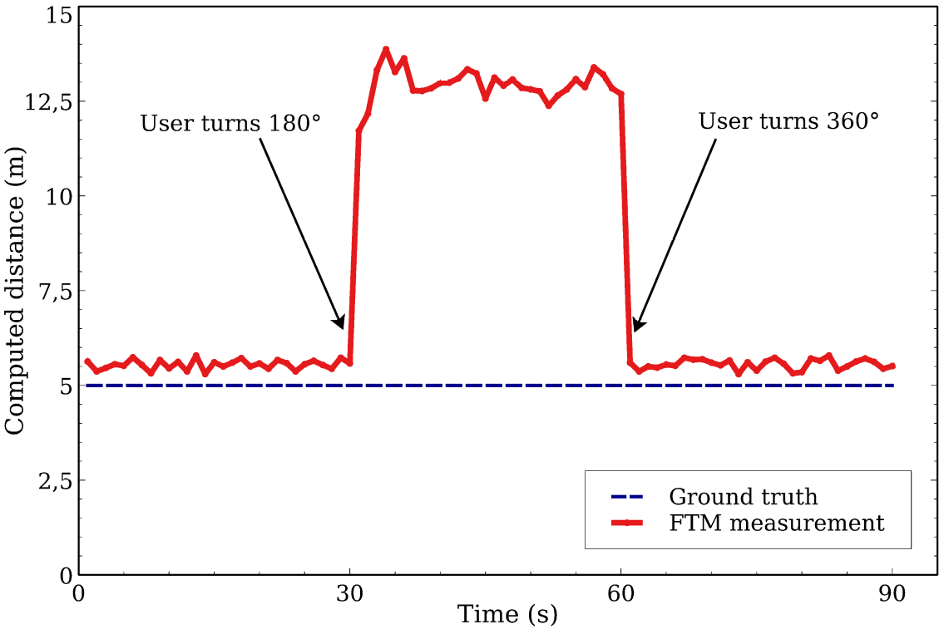
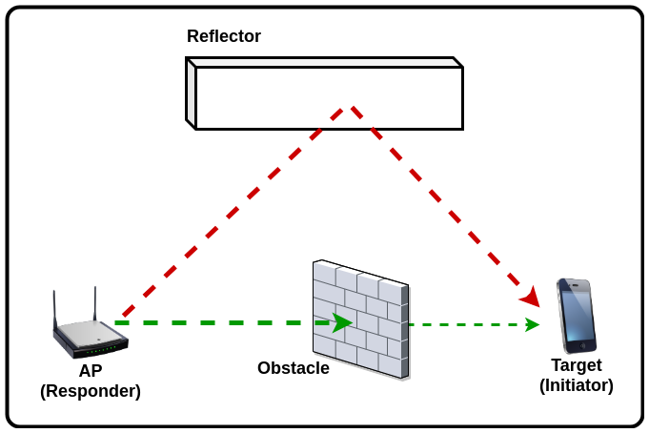
FTM: The Obstructed LOS Problem
Accuracy collapses when the user is between the Initiator and the Responder: error of up 9m
Experimental setup:
  Presence of a wall at 8m
  From t=30s to t=60s, the user stands between the two equipments
FTM seems to be measuring distance based on a (longer) reflected path
Company
There are questions left unanswered:
  The origin of the issue: Multipath or relative permittivity ?
  How to solve the issue ?

Slide 6
Outline
Indoor Localization and WiFi-based Ranging: Key approaches
FTM: First Experiments
Problem Assessment
FUSIC: Our solution
Performance Evaluation
Conclusion
Company

Slide 7
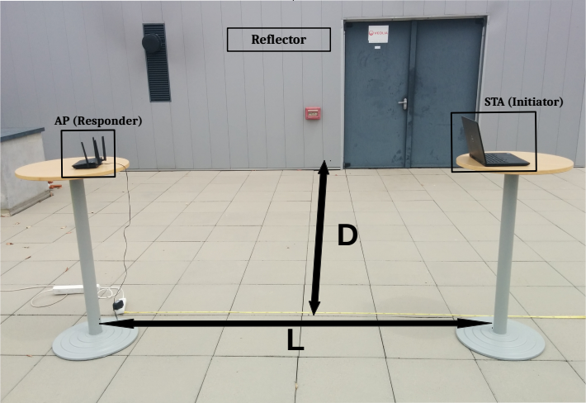
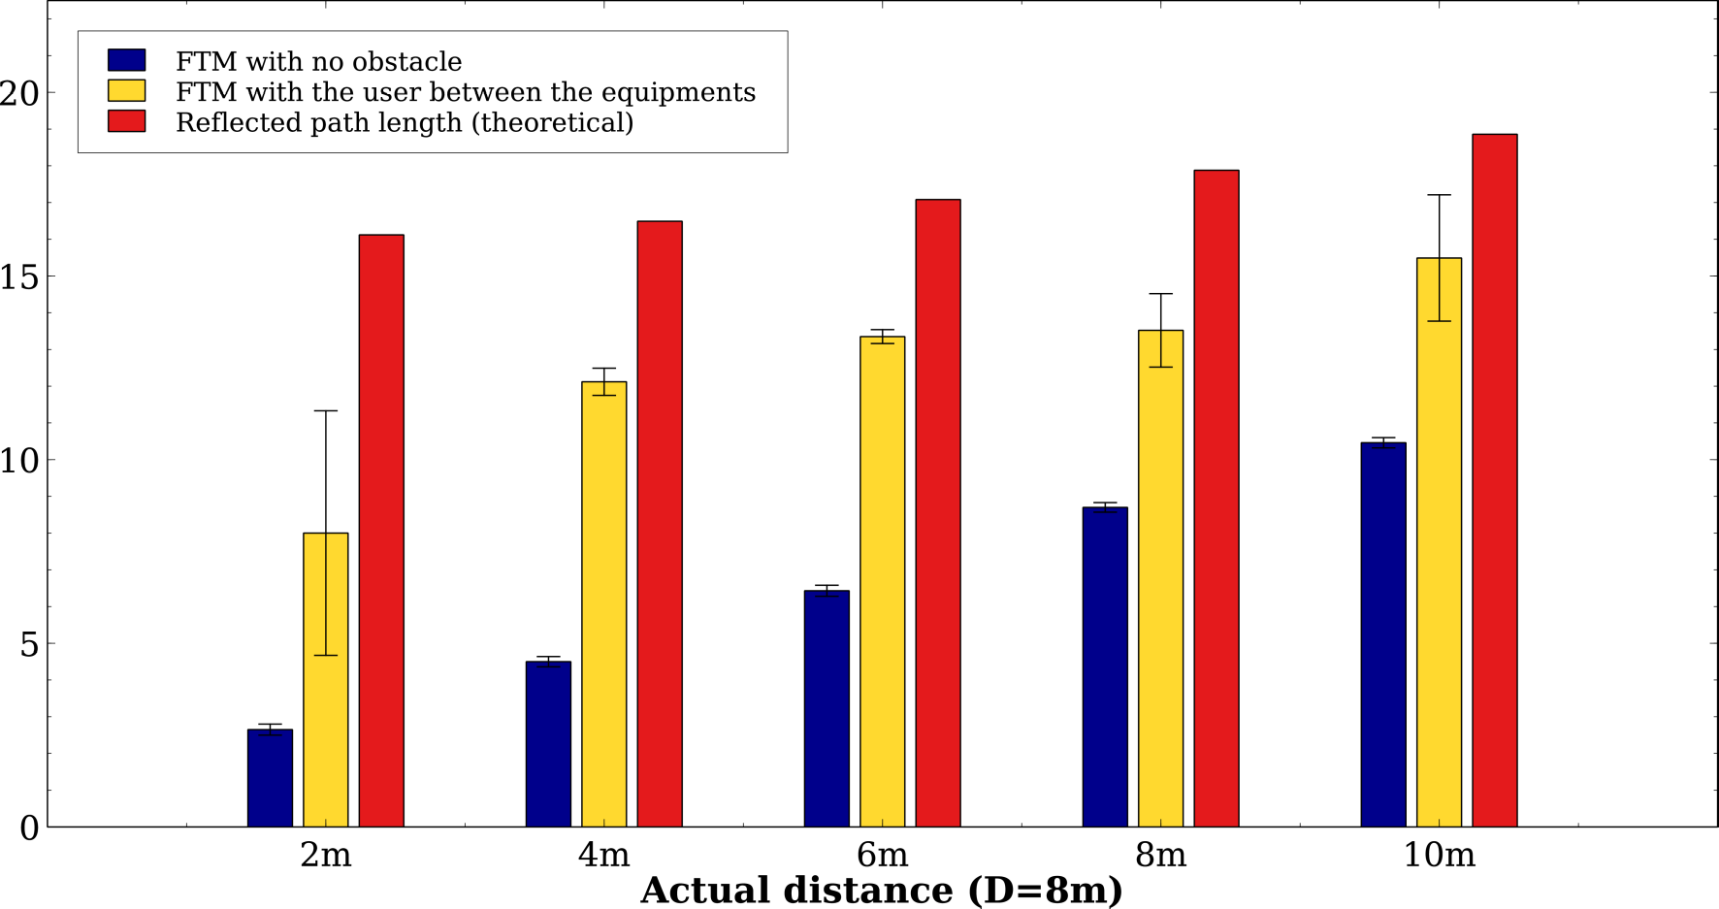
Obstructed LOS in the presence of Multipath
Company
FTM is inaccurate when the LOS is obstructed
FTM output is between direct and reflected paths lengths

Slide 8
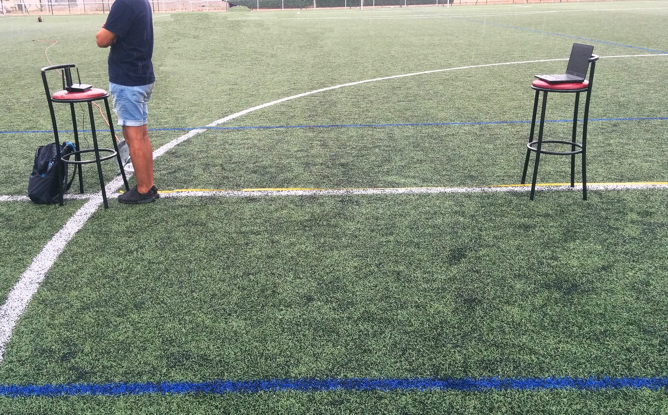
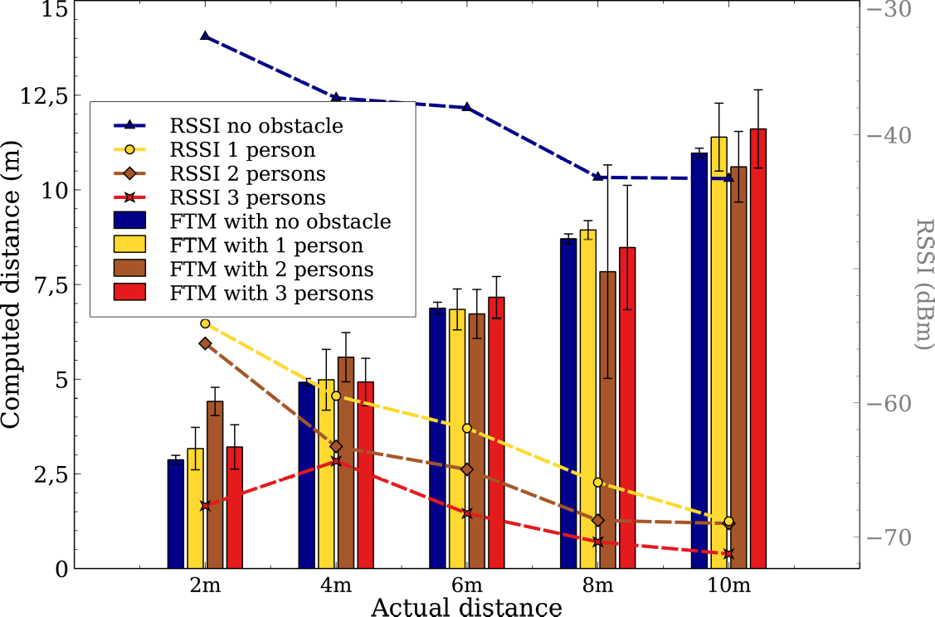
Obstructed LOS with no Multipath
Company
RSSI decreases with the number of persons
But FTM result is almost not affected
Effect of Relative permittivity is negligible
The greatest problem is Multipath

Slide 9
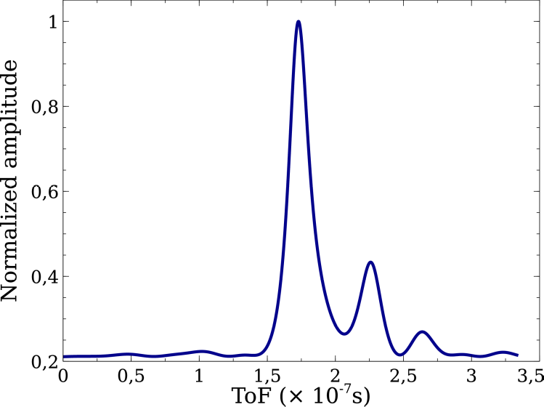
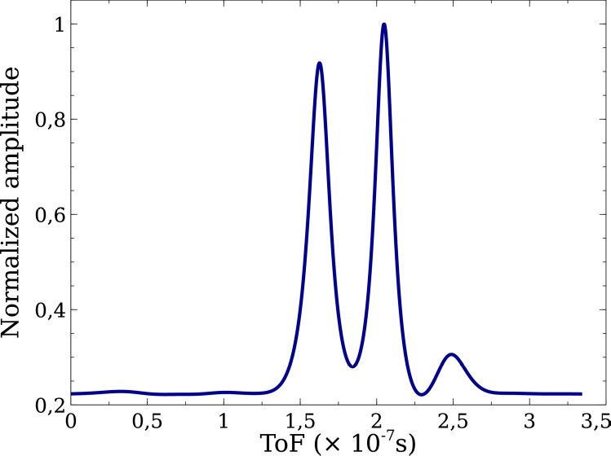
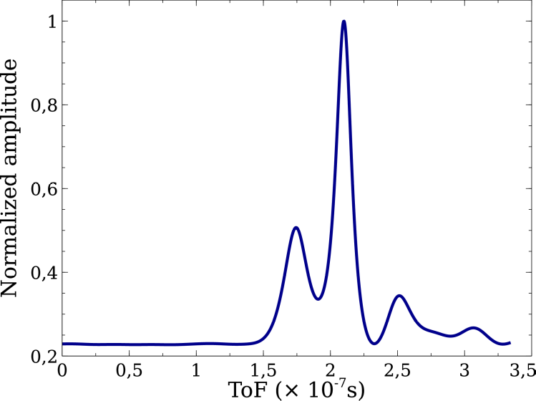
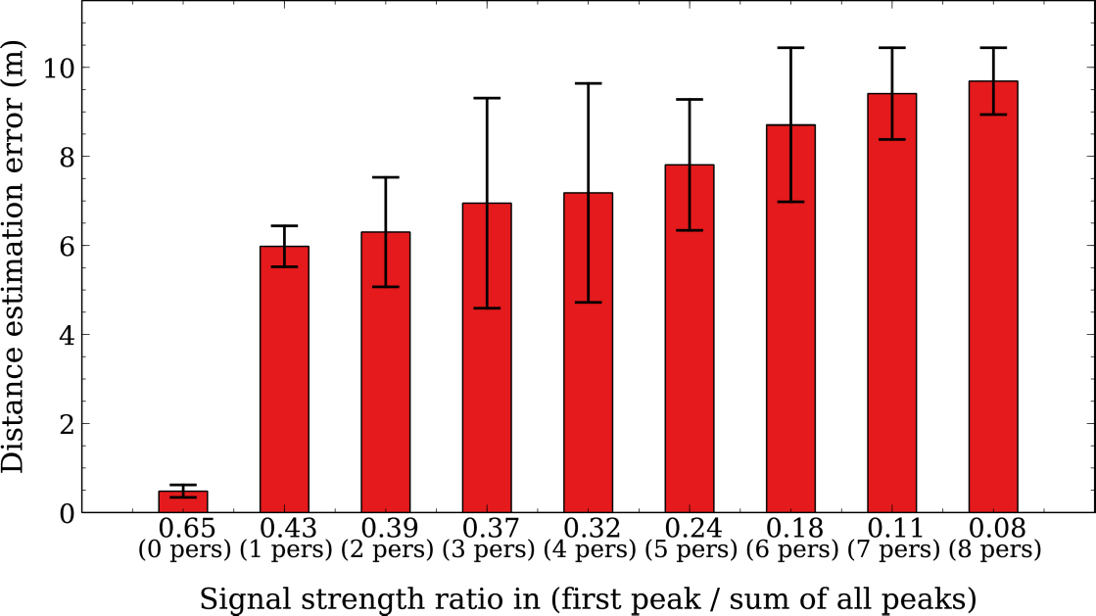
Varying the number of human obstacles in the presence of Multipath
Company
Same semi-controlled experimental setup as before
We collect CSI (Channel State Information) with a computer placed near the responder
CSI are fed to MUSIC algorithm to obtain a PDP (Power Delay Profile)
The error depends on the relative strengths of the direct and reflected paths
Almost no error Low error High error

Slide 10
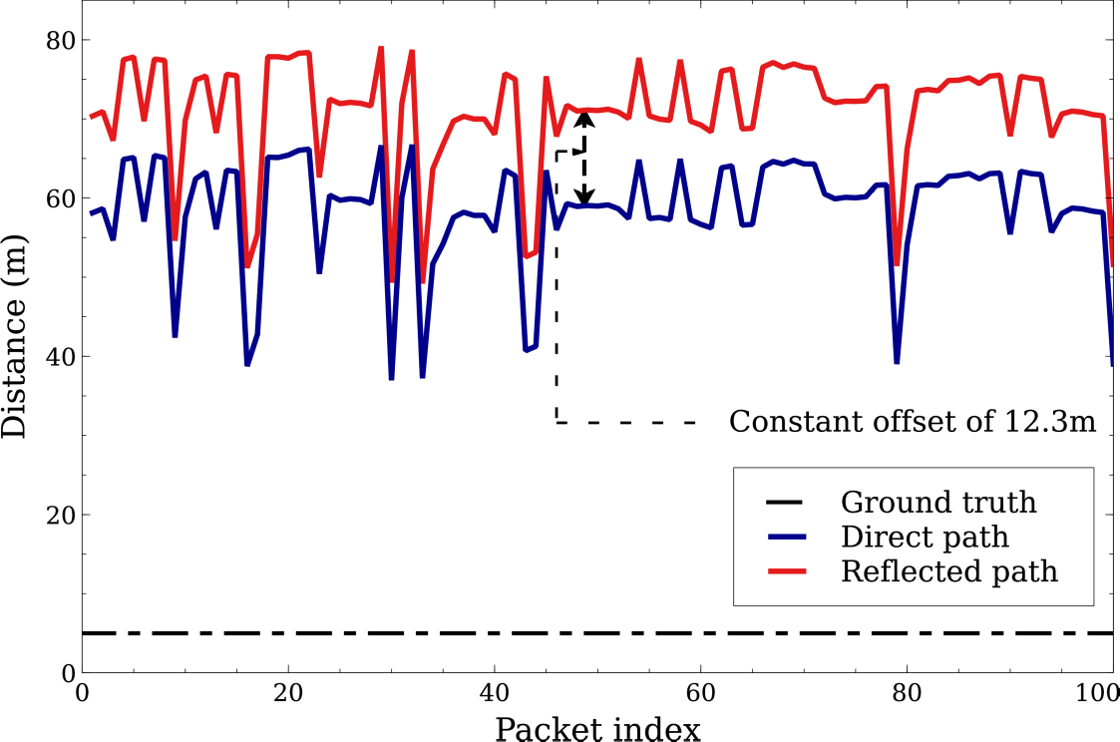
MUSIC and the inaccuracy problem
Experimental setup:
  Two equipments separated by 5m
  A reflector (wall) at 8m
  We send a series of 100 packets
MUSIC estimation of distance is inaccurate (~12 times the actual value on average)
The error is highly variable from one packet to another ==> Static calibration not possible
But, the difference between the two paths is constant and correct across all the packets
Company

Slide 11
Outline
Indoor Localization and WiFi-based Ranging: Key approaches
FTM: First Experiments
Problem Assessment
FUSIC: Our solution
Performance Evaluation
Conclusion
Company

Slide 12
FUSIC: Our Solution
An algorithm Fusing FTM and MUSIC, both erroneous, to provide accurate Ranging even in the presence of multipath
  Requires no changes to the standard
  Requires no changes to the access points
  Can be implemented as an application on the user’s device
Takes as inputs the FTM output and the CSI matrix and outputs a corrected distance estimation
Faces two important challenges:
  Detecting when FTM is mislead
  Actually correcting it and returning the length of the direct path

Slide 13
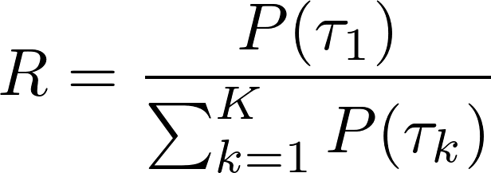
FUSIC: Detecting when FTM is mislead
Data shows that FTM is mislead when the direct path is not the most dominant one
Existence of non trivial cases
Company
We introduce a new metric, R, which quantifies the contribution of the direct path
Trigger the correction algorithm only when R is below a threshold
Selecting a value for the threshold: interesting trade-off

Slide 14
FUSIC: Correcting the FTM Output
Let’s consider a special case
Company
Assume we have only 2 propagation paths, with the LOS being strongly obstructed
  FTM will output the length of the reflected path
Our goal is to compute the error dreflected - ddirect
MUSIC is inaccurate, but gives us the correct value ∆ToF
FUSIC outputs dfusic = dftm - ∆ToF x c

Slide 15
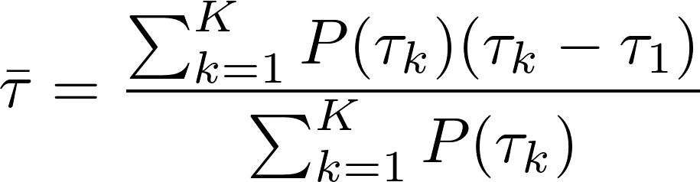

FUSIC: Correcting the FTM Output
General purpose algorithm
Company
In practice, there may be several propagation paths
FTM measurements does not necessarily reflect the length of any particular path
We compute the error as function of all the paths: the mean excess delay
FUSIC outputs

Slide 16
Outline
Indoor Localization and WiFi-based Ranging: Key approaches
FTM: First Experiments
Problem Assessment
FUSIC: Our solution
Performance Evaluation
Conclusion
Company

Slide 17
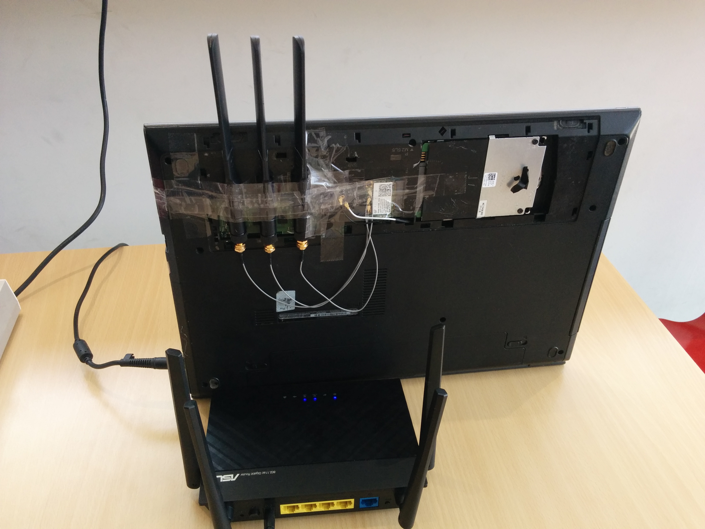
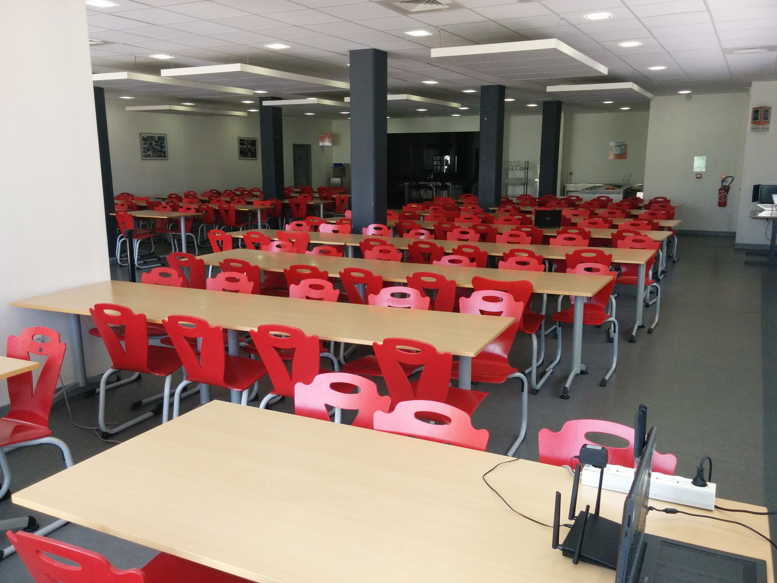
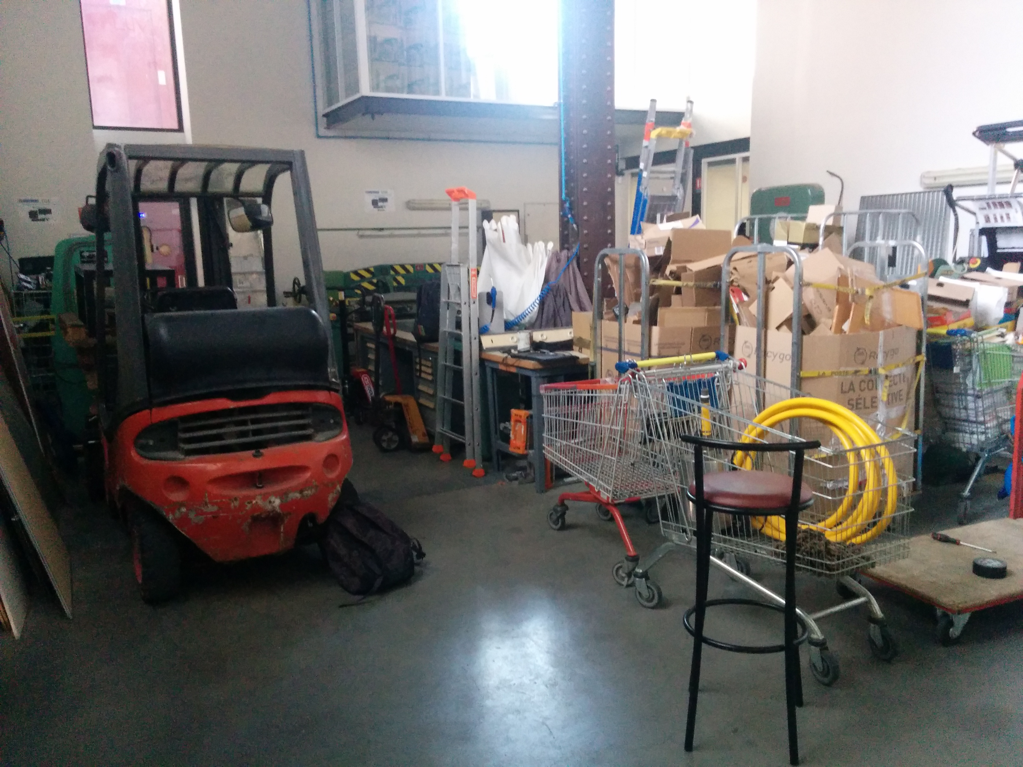
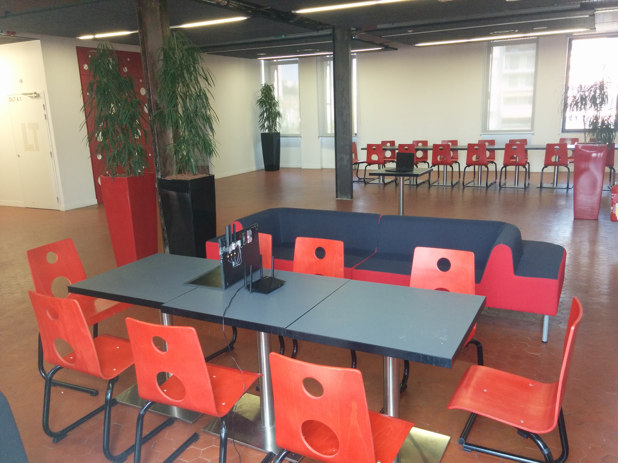
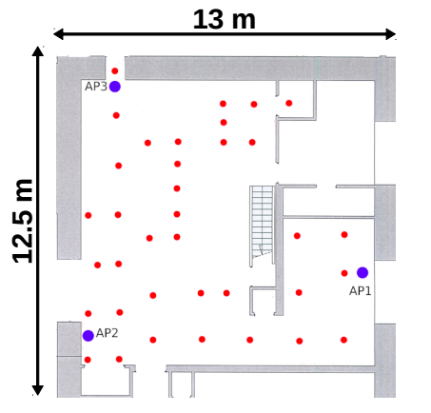
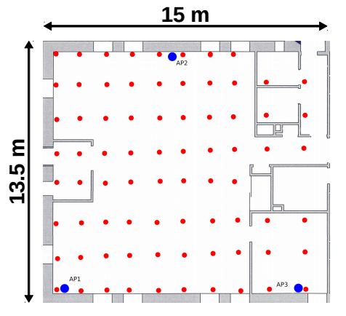
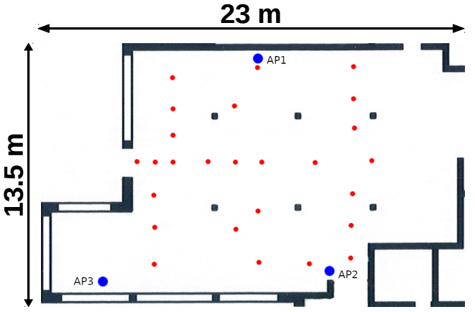
Experimental Setup
We use 3 FTM-capable routers and add each of them a computer which reports CSI
Evaluation in 4 environments: the same semi-controlled one and 3 real indoor buildings
A total of 122 tested target locations in indoor buildings
Evaluation of accuracy in distance estimation and indoor localization
Company
University restaurant Warehouse Lounge

Slide 18
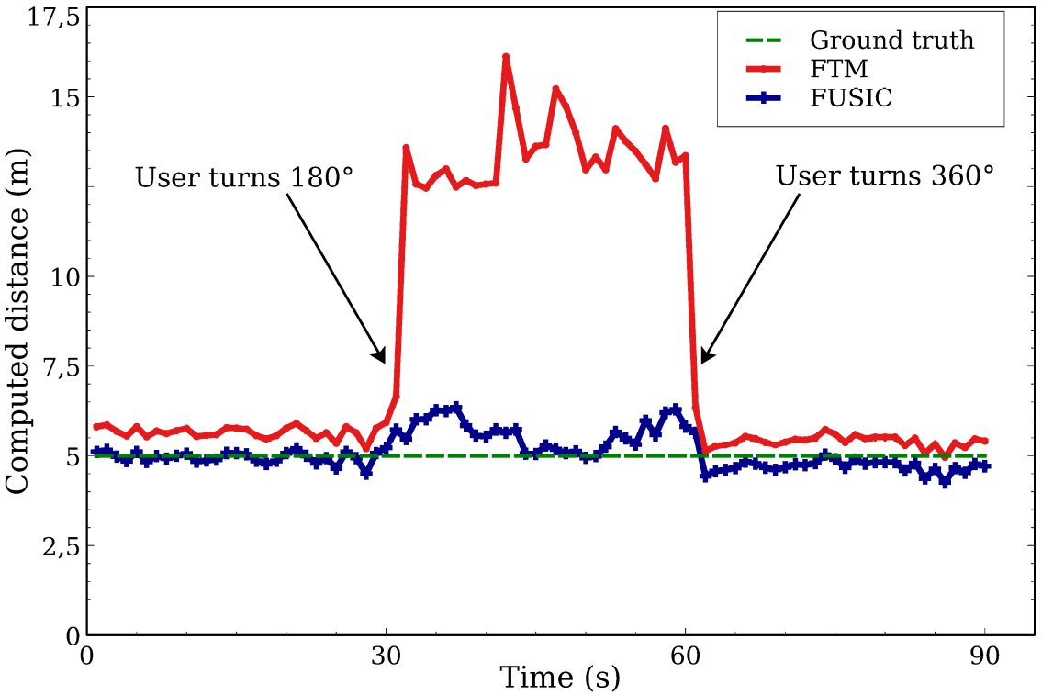
Let’s come back to the beginning
Same time-variant experiment as before:
  Presence of a wall at 8m
  From t=30s to t=60s, the user stands between the two equipments
FUSIC is able to accurately estimate the distance during all the experiment
This is not the case for vanilla FTM
Company

Slide 19
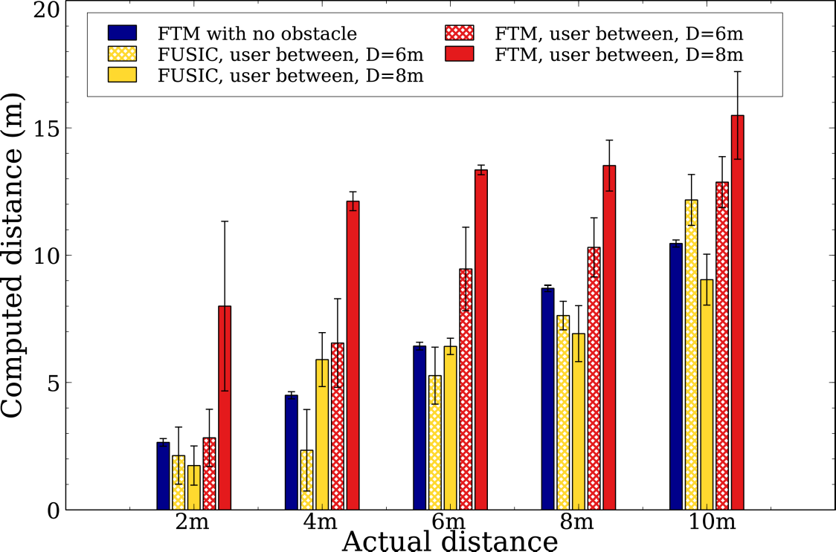
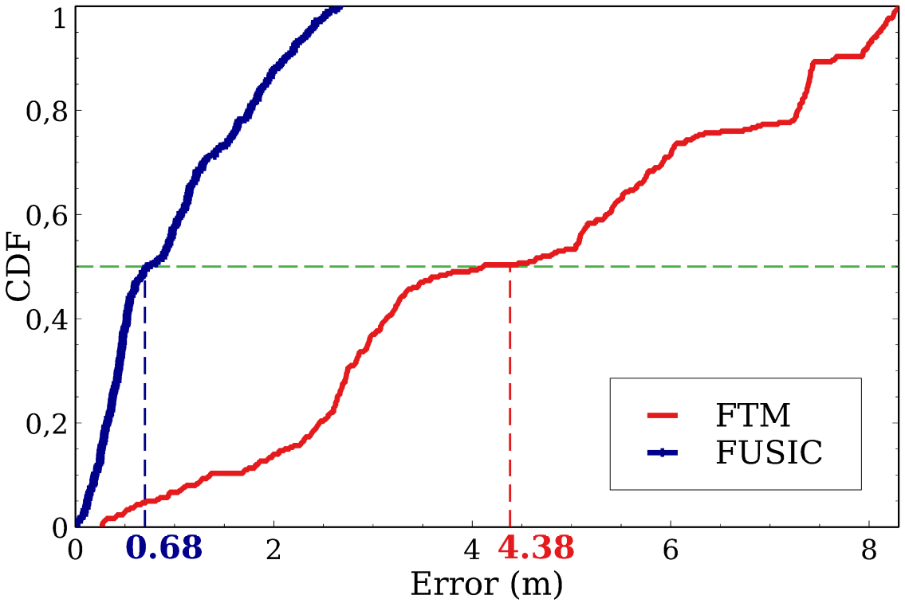
Varying distance between the equipments and to the wall
Company
FUSIC significantly outperforms vanilla FTM
  Median error: 0.68m vs 4.38m
  90-percentile: 2.12m vs 7.8m

Slide 20
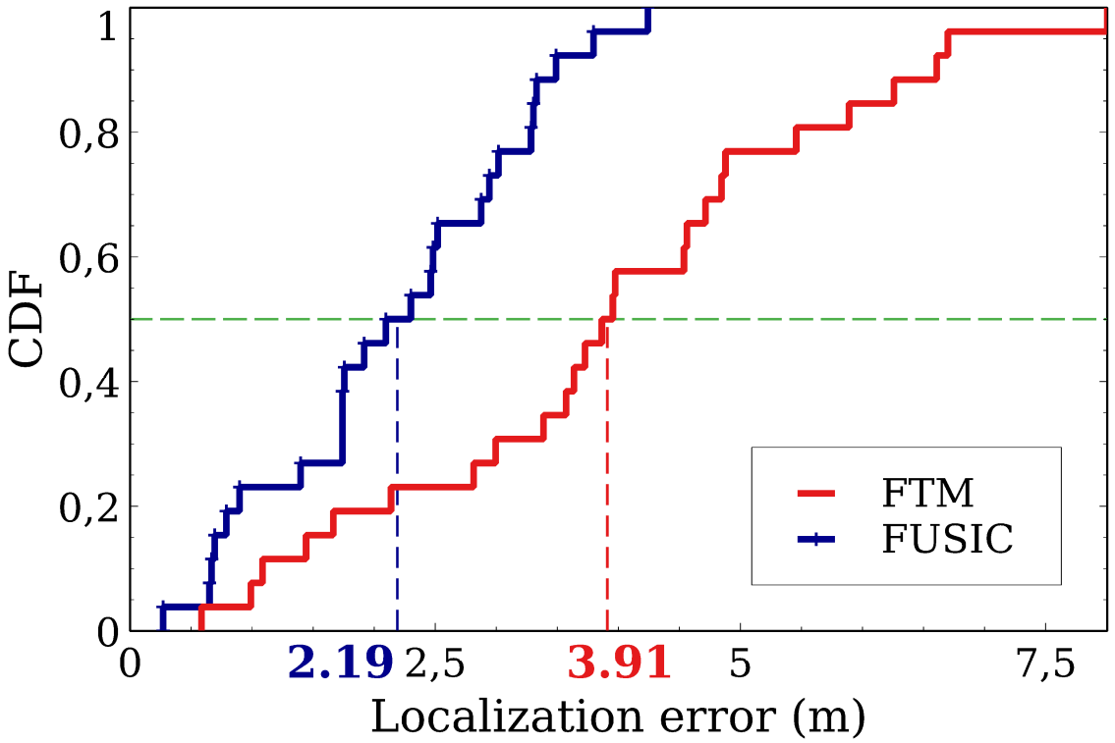
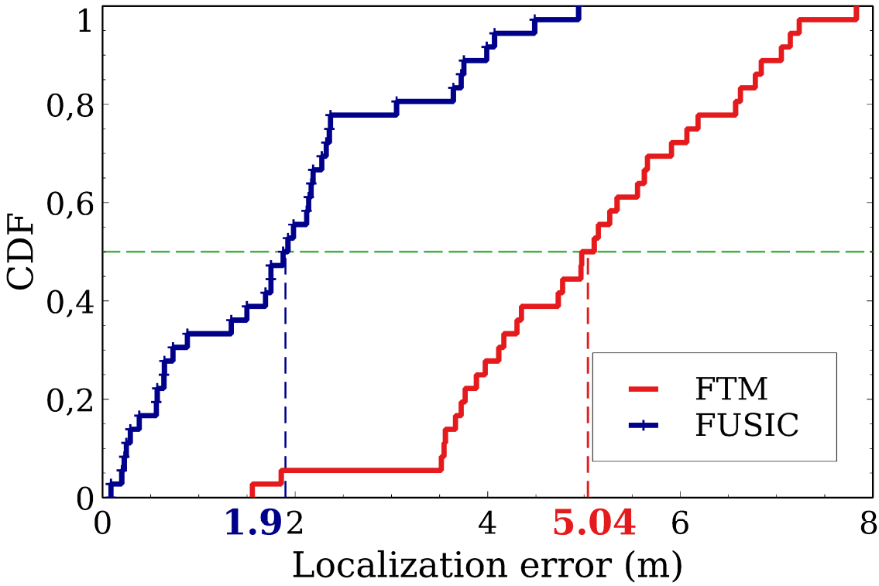
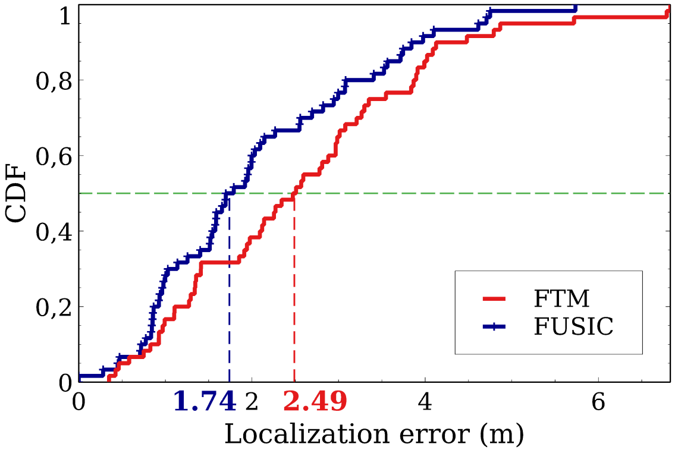
Localization in Indoor Environments
Company
University restaurant Warehouse Lounge
Accuracy in distance estimation ==> Accuracy in localization
  Median error: 1.94m vs 3.64m
  90-percentile: 3.77m vs 5.79m
Very important difference in the warehouse (most challenging multipath environment)
Least difference in the lounge

Slide 21
Outline
Indoor Localization and WiFi-based Ranging: Key approaches
FTM: First Experiments
Problem Assessment
FUSIC: Our solution
Performance Evaluation
Conclusion
Company

Slide 22
Conclusion & Future Work
Assessed the root causes of FTM inaccuracy in Non Line-Of-Sight settings
Introduced FUSIC, an algorithm which extends FTM’s Line-Of-Sight accuracy to Non Line-Of-Sight settings
Implemented FUSIC on off-the-shelf hardware and evaluated its performance
Evaluation shows that FUSIC achieves its goal
Future work: Evaluation of FTM/FUSIC based localization in a real and large scale deployment
Company

Slide 23
Thanks for your kind attention.
Any question ?

