Slide 1

What factors are most associated with physical activity levels across citizens in Maryland Counties?
Data Science Capstone
Research Question:

Slide 2
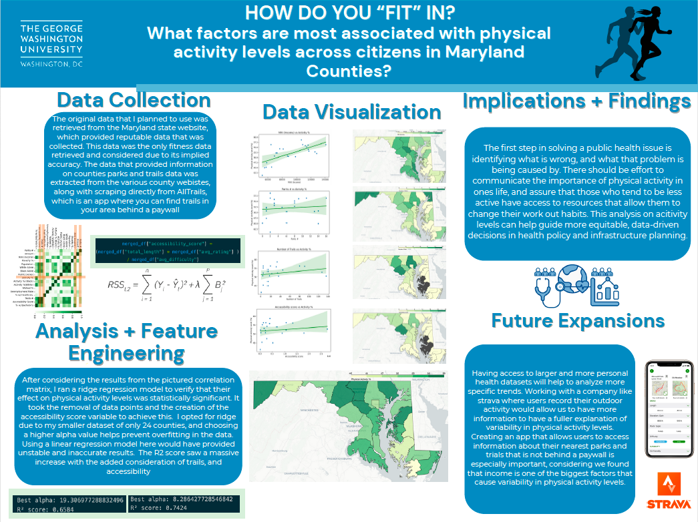
Poster Presentation Visual

Slide 3
Why is this worth researching?
The epidemic of obesity has been a rising concern in recent years.
As of 2023 EVERY U.S. state had an overweight and obesity rate of over 20%, and in recent years we are continuing to see these rates rise
It has been scientifically proven that increasing physical activity (along with diet and nutrition) is the main way to combat this disease.

Slide 4




Data Collection Process
Original Data retrieved from Maryland.gov
Included variables like Income, Physical Activity %, Health Insurance coverage, etc.
Merged with park data that I scraped from various Maryland counties official websites
Addition of more data later in the process, Trails – including length, elevation and other factors

Slide 5
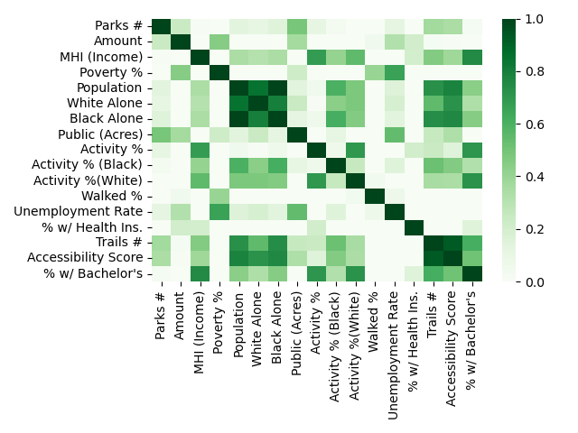
Determining Variables – Feature Importance + Engineering
Plotted a correlation matrix to have a general idea of which variables were most associated with physical activity level
Most important factors are later confirmed by assessing coefficients in the regression model

Slide 6
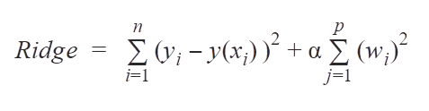
Ridge regression model
The ridge regression model was chosen to prevent overfitting, as I only had 24 observations in my dataset this was the proper choice
The r^2 score translates to explaining 74.24% of the variation of the physical activity levels among counties
Although negative coefficients are still useful to prove trends, from a public health perspective focusing on positive ones are crucial to identify what we should encourage and improve.
Best alpha: 8.2864
R² score: 0.7424
MHI (Income): 0.5486
Public (Acres): 0.4456
Parks #: 0.1498
Number of Trails: 0.1858

Slide 7
Determining Variables – Feature Importance + Engineering
The newly added trail dataset included a lot of information about them including length, user rating, and difficulty. To make use of all of these insights, I created an “accessibility score” which multiplied the length by the rating, then divided that number by the difficulty.
The R2 score saw a massive increase with the added consideration of trails, and accessibility
Based on the coefficients given through the regression model, along with insights from the correlation matrix, I landed on determining Income, Number of Parks, Number of Trails, and Accessibility score as factors with major impacts on activity level.

Slide 8
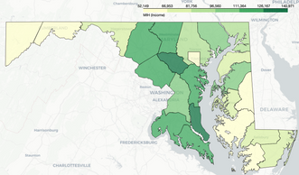
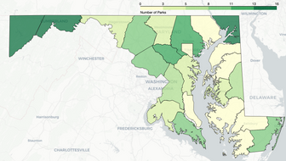
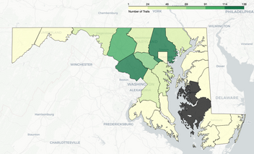
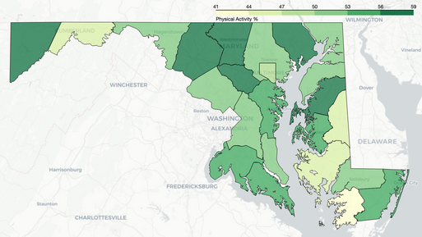
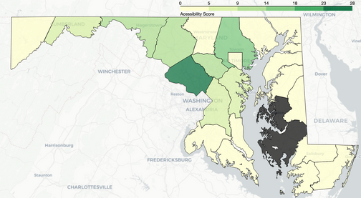
Data Visualization - Maps
Visualizations of the chosen four focus variables – Map of counties and physical activity level provided for comparison
z

Slide 9
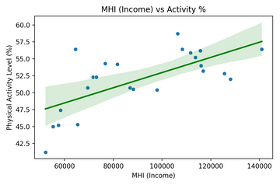
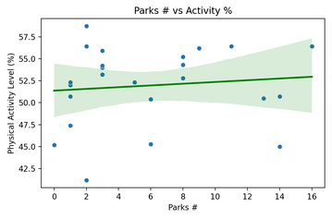
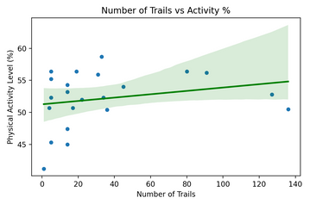
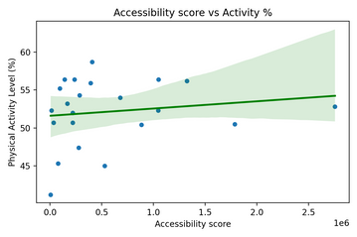
Data Visualization- Regression
Scatterplots – Visual representation of the linear relationship between the chosen 4 focus variables and physical activity
z

Slide 10

Implications + Findings
The first step in solving a public health issue is identifying what is wrong, and what that problem is being caused by.
Based on some of our most influential variables being concerned with the amount of outdoor areas (number of parks and trails), it creates drive for city planning to prioritize walkable areas
Policies surrounding land expansion + parks can take into consideration the economic barriers that cause the variation in these physical activity levels
The main goal here was to pinpoint places where we can start tackling lowering physical activity rates – and in the bigger picture this is linked to the epidemic of obesity.

Slide 11
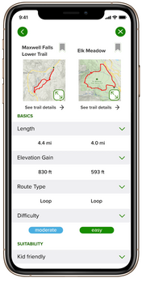
Having access to larger and more personal health datasets will help to analyze more specific trends. Working with a company like Strava, Garmin, or Apple Health where users record their outdoor activity would allow us to have more information to further explore the explanation of variability in physical activity levels.
Future Expansions
Creating an app that allows users to access information about their nearest parks and trials that is not behind a paywall is especially important, considering we found that income is one of the biggest factors that cause variability in physical activity levels.
Public health is centered around ensuring the public has access to information that can impact their health in a variety of ways, including nutrition or as we have discussed here – fitness.

Slide 12
Questions? Suggestions?

