Slide 1
VIRTUAL MEMORY MANAGEMENT

Slide 2

o virtual memory
CONTENTS
Needs of virtual mRlTlOJ
Importance of virtual memory
Advantage of virtual memory
Disadvantage of virtual memory
Addressspace & memory space
Page replacement algorithms
FIFO
LRU
OPT

Slide 3
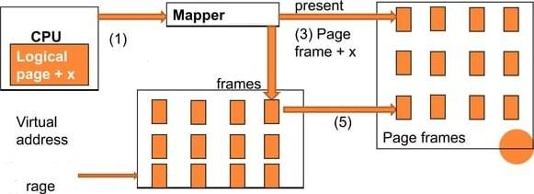

N IRTUAL MEMORY
Virtual memory is a common pan of operaiiog system on desktop
computers.
The term virtual memory refers to something which appears to be present
but actuallyit is not.
The virtual memory technique allows users to use more memory fot a program than the real memory of a computer.
Not preserp_{a}qg
Secondary
sto

Slide 4
NEED OF VI RTUAL MEMORY
o Virtual memory is a imaginary memory which we are assuming. If we have a material that exceed your memory at that time we need to use the concept of virtual
o virtual memory is temporary memory which is used along with the ram of the system.

Slide 5
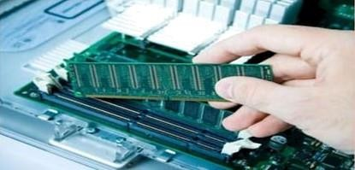
IMPORTANCE OF VIRTUAL MEMOITY
When yourcomputer urns out of physical memory it writes what it needs to remember to the harddisc in a swap file as virtual memory.
If a computer running Windows requires more memory/RAM then there is installed in the system to run a program, etc, it uses a small section of the hard drive for this purpose

Slide 6
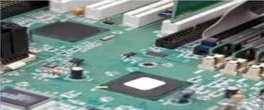
o Virtual memory is the address used by the programmer
and the set of such addresses is called address space.
An address in main memory is called a physical address.
Theset of such locations in main memory is called the
memory space.
Thus the memory space consist of the actual main
memory locations directly addressable for processing.

Slide 7
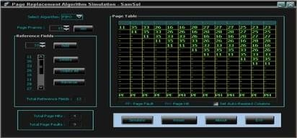
PAGE REPCAC EMENT ARGORITI IMS
o In a computer operating system that uses paging for virtual memory management, page replacement algorithm decide which memory pages to page out. When a page of memory need to be allocated.
FIFO (first in first out)
LRU (Least Recently used)
OPT (Optimal)

Slide 8


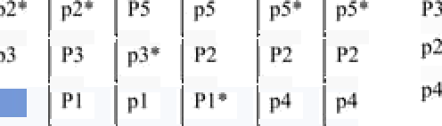


I II”(J
First in first out is very easy to implement.
The fifo algorithm select the page for replacement
that has been in memory the longest time.
time 1
P^{d}9e P2
2 3 4 5 6 7 8 9 10 11 12
p3 p2 p1 p5 p2 p4 p5 p3 p2 p5 p2
hit
hit
hil

Slide 9






LRU
o The leastrecently used page replacement algorithm
keeps track page uses over a short period of time.
o The LRU algorithm can be implemented by associating a
counter with every page that is n main memory.
time 1 | 2 | 3 | 4 | 5 | 6 | 7 | 8 | 9 | 10 | 11 | 12
•g Ph | p3 | p2 | p1 | p5 | p2 | p4 | p5 | p3 | p2 | p5 | p2
 |  | P2 |  |  |  | P2 |  | P3
hit
hit hit

Slide 10






o Theoptimal policy selects that page for replacement for
OPT
which the time to the next reference is longest.
o This algorithm result is fewest number of page faults.
time
_{P}d₉e
1 2 3 4 5 6 7 8 9 10 11 12
P2 p3 p2 p1 p5 p2 p4 p5 p3 p2 p5 p2
hit
hit
hit hit
hit hit

Slide 11
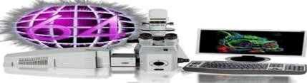
ADVANTAGES OF VI RTUAL MEMORY
Allows processes whoseaggregate memory requirement is greater than the amount of physical memory, as infrequently used pages can reside on the disk.
Virtual memory allows speed gain when only a particular segment of the program is requiredfor the execution of the program.
o This concept is very helpful in implementing multiprogramming environment.

Slide 12
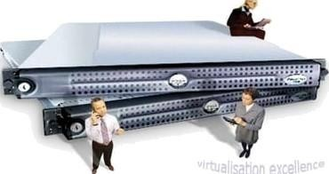
o Applications rim slower if the system is using virtual
D ISADVANTAG US OF VIRTU AL MEMORY
It Takes more time to switch between applications.
Less hard drive space for your use.
It reduces system stability.

Slide 13


