Slide 1

React Native Animation

Slide 2
Animation APIs
LayoutAnimation
Lack of control
Animated library
Control and animate specific views
The most flexibility in crafting animations

Slide 3
Animated. Value
The basic value unit of Animated.
The value can bind to style properties or other props,
and can be interpolated.

Slide 4
Configuring animations
decay
starts with an initial velocity and gradually slows to a stop.
timing
animates a value over time using easing functions.
spring
provides a simple spring physics model.
etc.

Slide 5
Easing
This module is used by Animated.timing
to convey physically believable motion in animations.
Bounce, back, elastic, etc.

Slide 6
Animated. ValueXY
a combination of two Animated.Values, x and y.
provides helper methods for things like translate transforms
or absolute position animations

Slide 7
Composing animations
parallel
starts a number of animations at the same time.
sequence
starts the animations in order, waiting for each to complete before starting the next.
delay
starts an animation after a given delay.
stagger
starts animations in order and in parallel, but with successive delays.

Slide 8
Interpolation
The interpolate function allows input ranges to map
to different output ranges.
Number, degree, rgb, etc.

Slide 9
Extrapolation
The default value is extend but you can use clamp to
prevent the output value from exceeding outputRange.
Extend, clamp, identity

Slide 10
Exercise

Slide 11
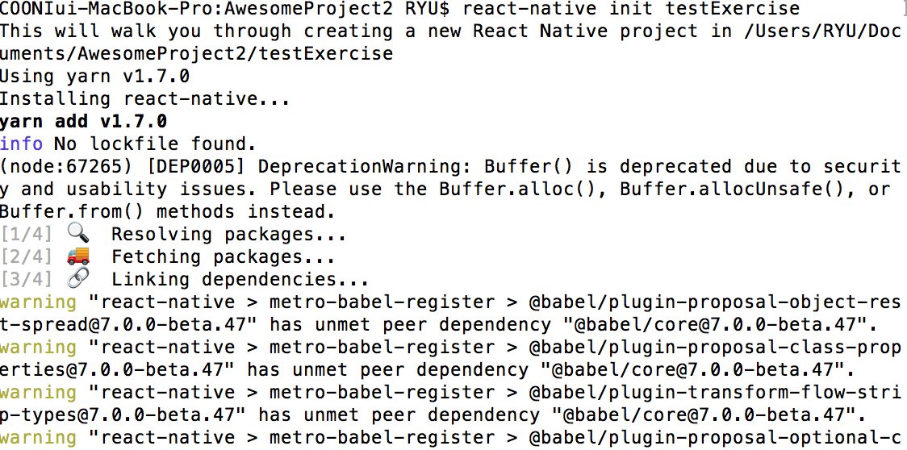
Init project
react-native init “project name”
react-native run-ios --simulator='iPhone X’
react-native run-android

Slide 12

Background image
<ImageBackground style=‘ ’ source=‘ ’>

Slide 13

Login view

Slide 14

Cover and sliding animation

Slide 15

Login view animation

Slide 16

Stagger items animation

Slide 17

Complete!

