Slide 1

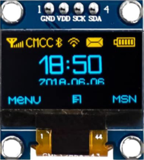
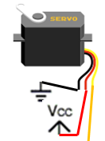
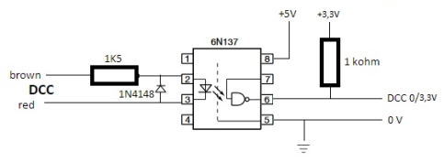
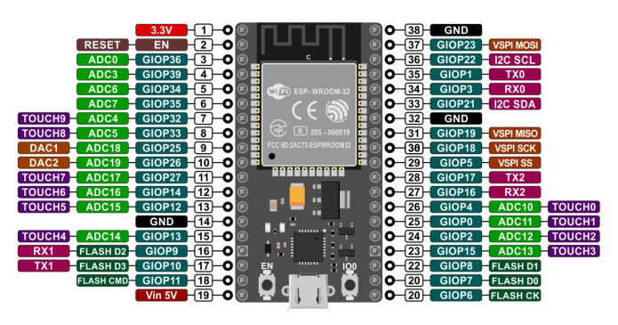
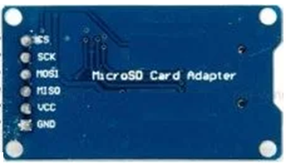
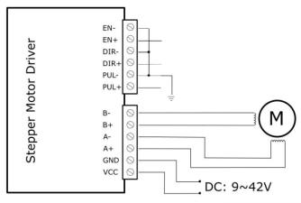
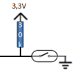

Slide 2
+3,3V
+5V

Slide 3

+3,3V
IR sensors
+5V

Slide 4
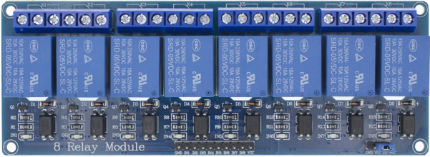
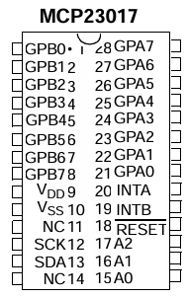


+5V
+3,3V
+3,3V
4K7
+3,3V
end-stop
IR sensors
IR LEDs

Slide 5


+5V
+3,3V
+3,3V
4K7
IR sensors
+3,3V
end-stop

