Slide 1
2段構成TIAの検討
2024年5月24日 和田研M1 小島 光

Slide 2
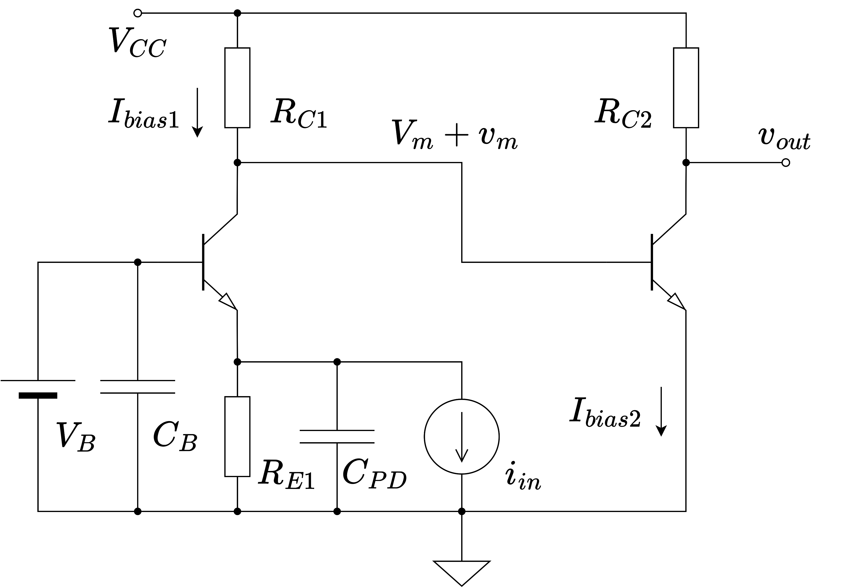
回路構成

Slide 3
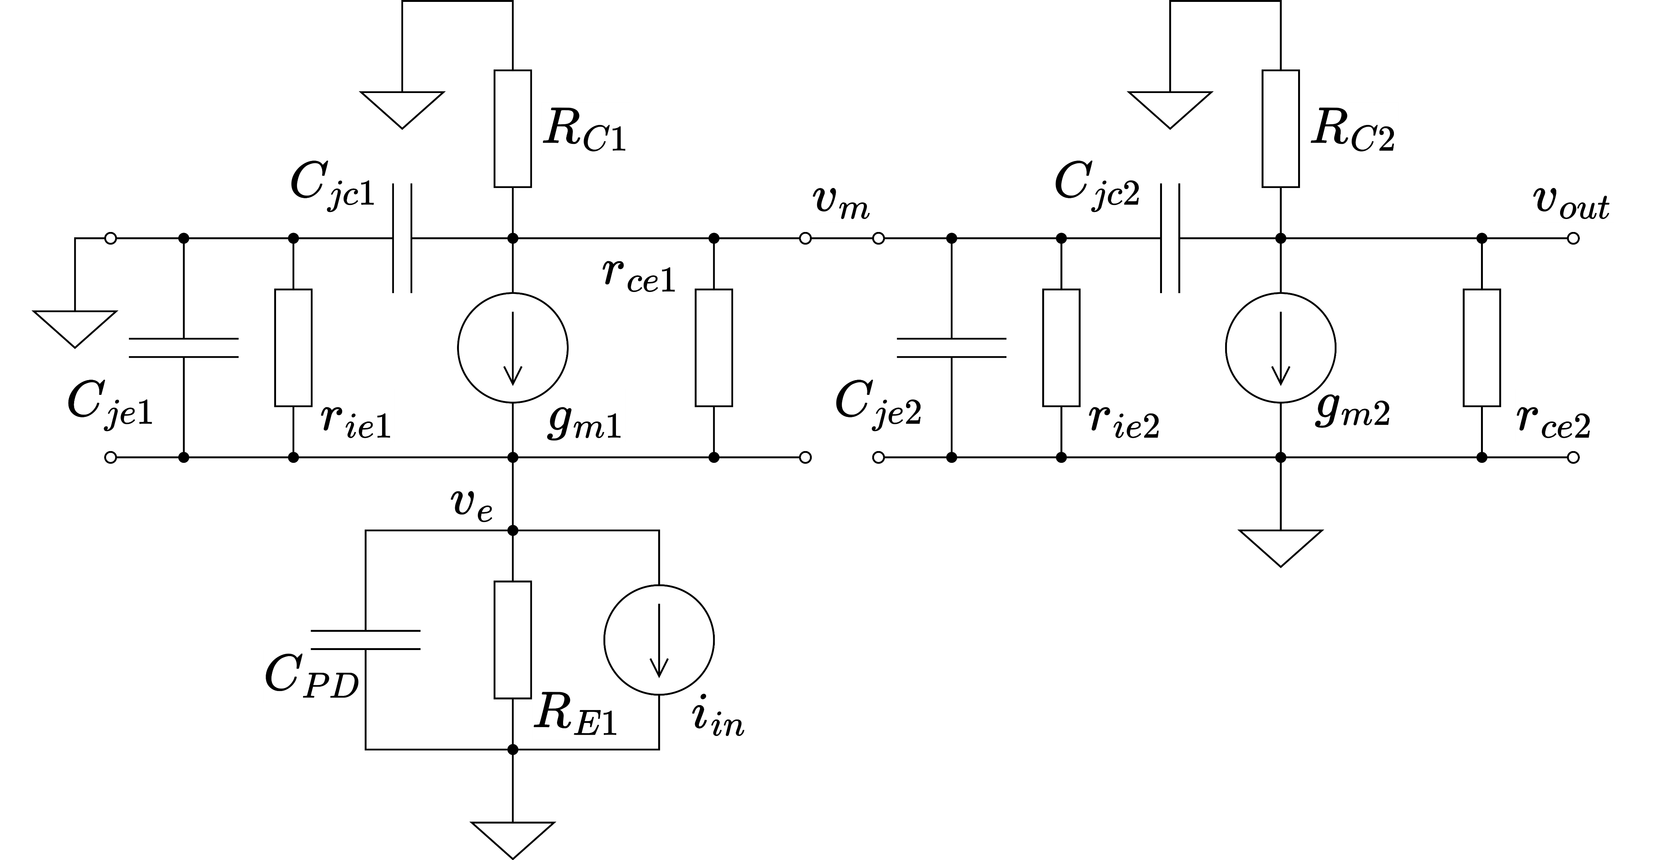
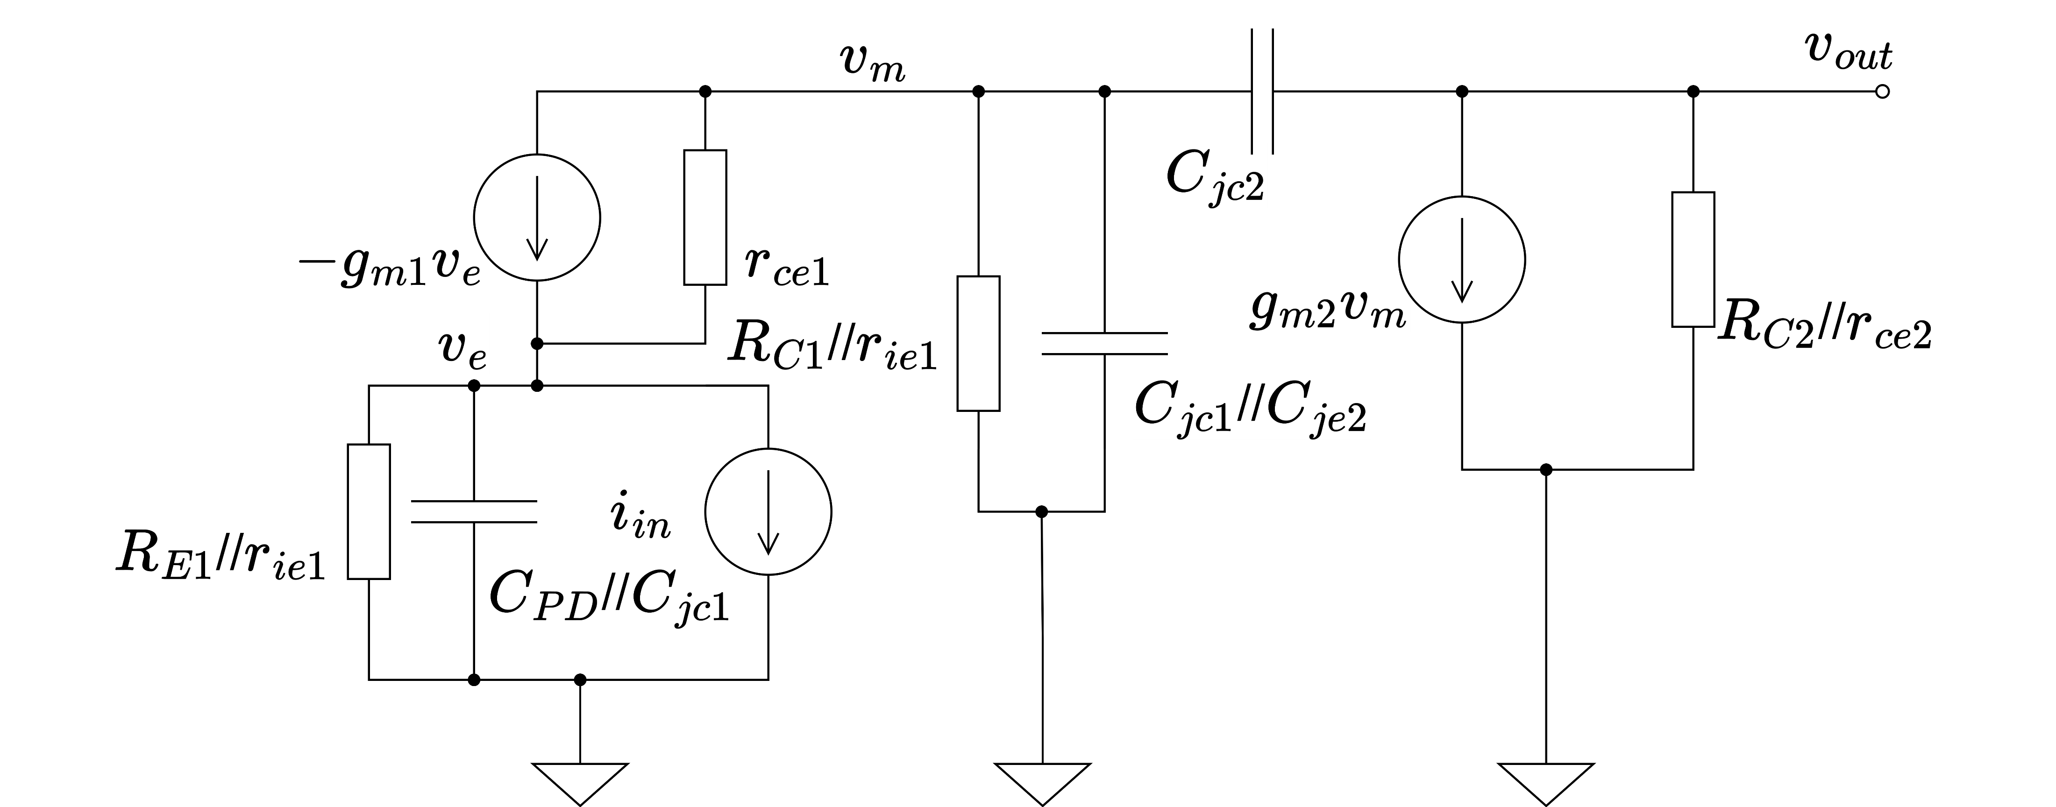
小信号等価回路

Slide 4
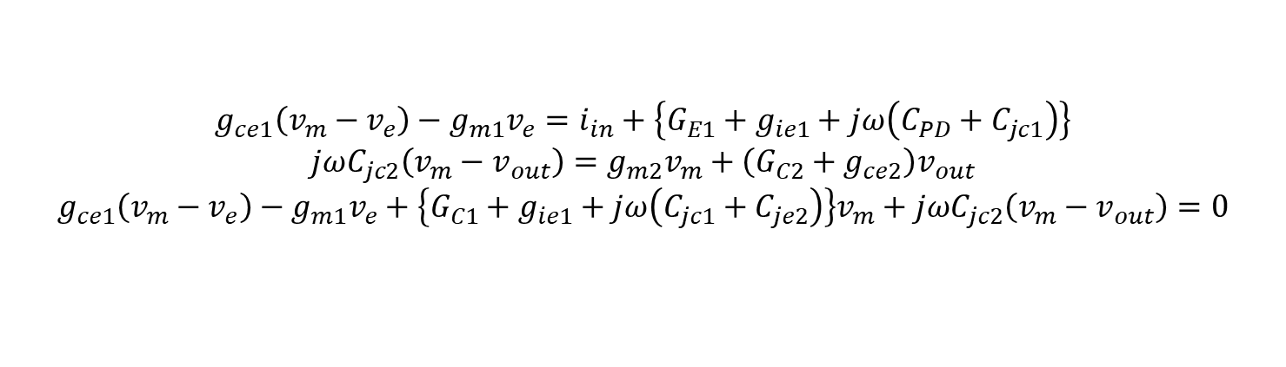
小信号解析
$${g_{ce1}\left(v_{m}−v_{e}\right)−g_{m1}v_{e}=i}_{in}+\left.\left\{G_{E1}+g_{ie1}+jω\left(C_{PD}+C_{jc1}\right)\right.\right\}$$
$$jωC_{jc2}\left(v_{m}−v_{out}\right)=g_{m2}v_{m}+\left(G_{C2}+g_{ce2}\right)v_{out}$$
$$g_{ce1}\left(v_{m}−v_{e}\right)−g_{m1}v_{e}+\left.\left\{G_{C1}+g_{ie1}+jω\left(C_{jc1}+C_{je2}\right)\right.\right\}v_{m}+jωC_{jc2}\left(v_{m}−v_{out}\right)=0$$
KCLより

Slide 5
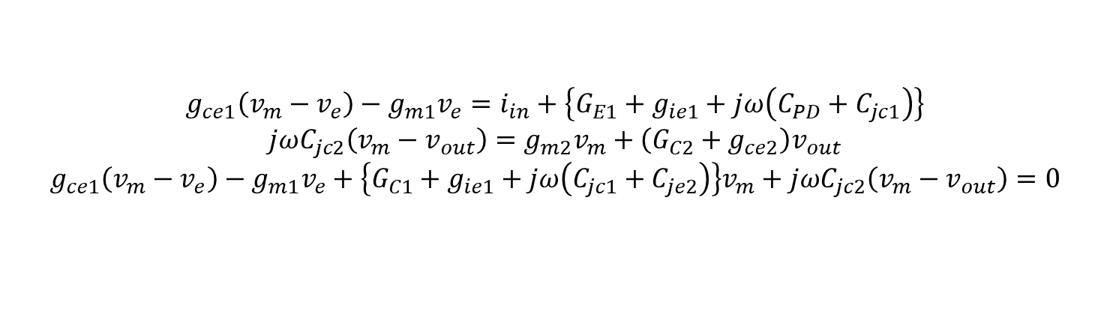

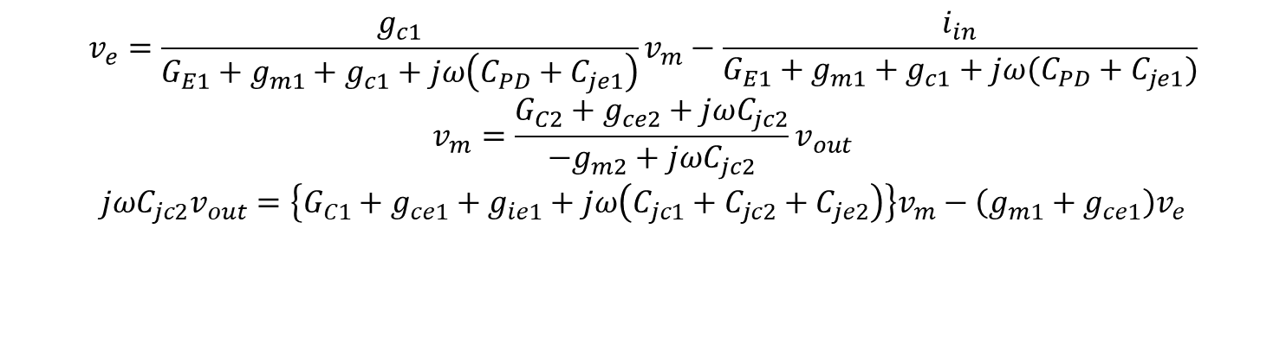
小信号解析
$($・$ω・)$ <暇
$${g_{ce1}\left(v_{m}−v_{e}\right)−g_{m1}v_{e}=i}_{in}+\left.\left\{G_{E1}+g_{ie1}+jω\left(C_{PD}+C_{jc1}\right)\right.\right\}$$
$$jωC_{jc2}\left(v_{m}−v_{out}\right)=g_{m2}v_{m}+\left(G_{C2}+g_{ce2}\right)v_{out}$$
$$g_{ce1}\left(v_{m}−v_{e}\right)−g_{m1}v_{e}+\left.\left\{G_{C1}+g_{ie1}+jω\left(C_{jc1}+C_{je2}\right)\right.\right\}v_{m}+jωC_{jc2}\left(v_{m}−v_{out}\right)=0$$
$$v_{e}=\frac{g_{c1}}{G_{E1}+g_{m1}+g_{c1}+jω\left(C_{PD}+C_{je1}\right)}v_{m}−\frac{i_{in}}{G_{E1}+g_{m1}+g_{c1}+jω(C_{PD}+C_{je1})}$$
$$v_{m}=\frac{G_{C2}+g_{ce2}+jωC_{jc2}}{−g_{m2}+jωC_{jc2}}v_{out}$$
$$jωC_{jc2}v_{out}=\left.\left\{G_{C1}+g_{ce1}+g_{ie1}+jω\left(C_{jc1}+C_{jc2}+C_{je2}\right)\right.\right\}v_{m}−\left(g_{m1}+g_{ce1}\right)v_{e}$$
$$jωC_{jc2}v_{out}=\left.\left\{G_{C1}+g_{ce1}+g_{ie1}+jω\left(C_{jc1}+C_{jc2}+C_{je2}\right)\right.\right\}v_{m}−\frac{g_{c1}\left(g_{m1}+g_{ce1}\right)v_{m}}{G_{E1}+g_{m1}+g_{c1}+jω\left(C_{PD}+C_{je1}\right)}−\frac{\left(g_{m1}+g_{ce1}\right)i_{in}}{G_{E1}+g_{m1}+g_{c1}+jω(C_{PD}+C_{je1})}$$

