Slide 1
2段構成TIAの検討
2024年5月24日 和田研M1 小島 光

Slide 2
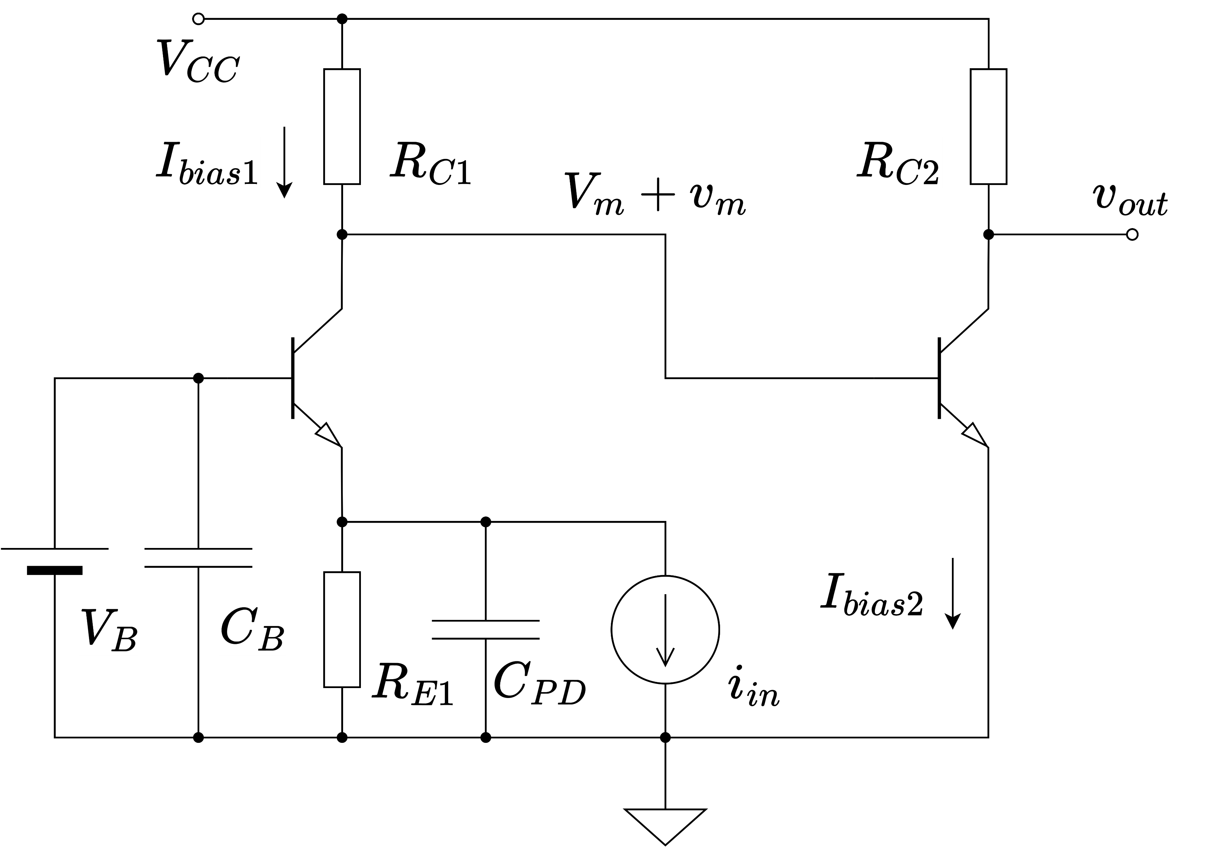
回路構成

Slide 3
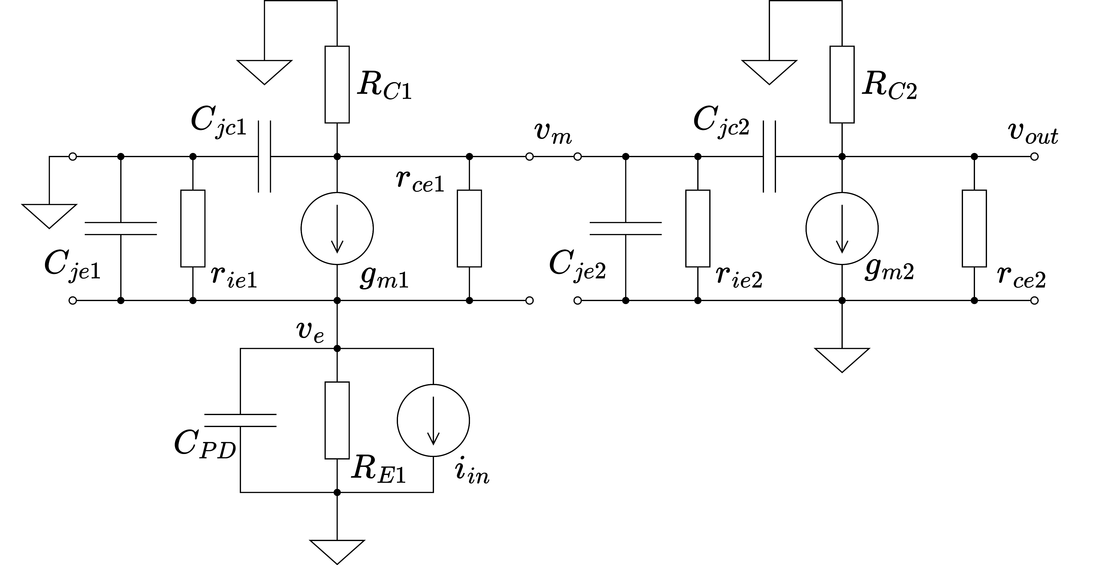
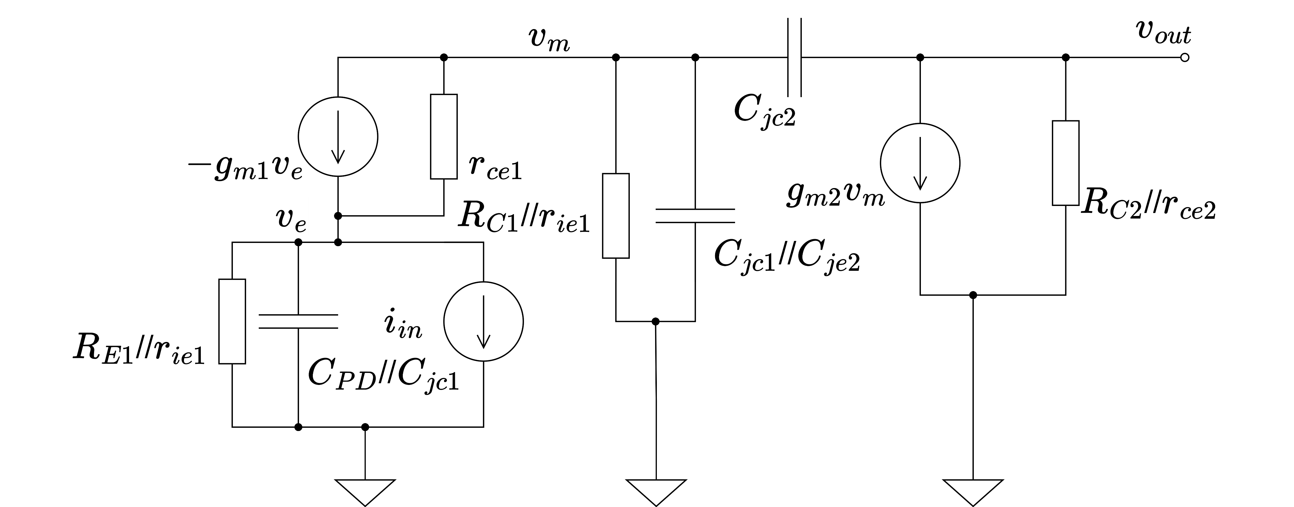
小信号等価回路

Slide 4
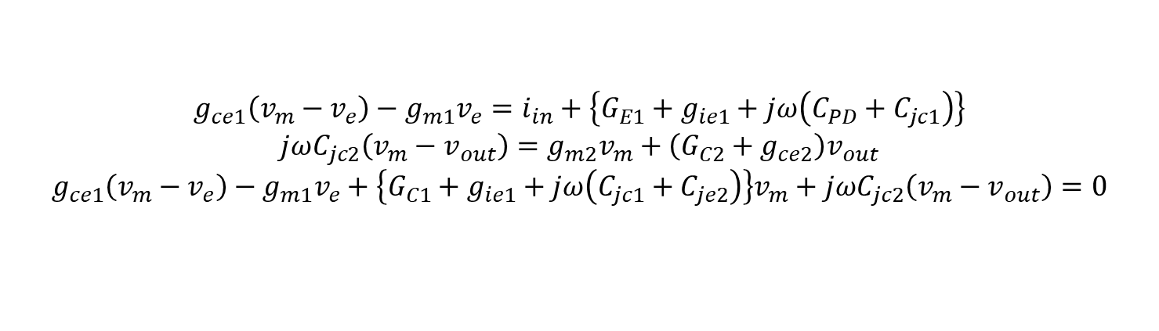
小信号解析
$${g_{ce1}\left(v_{m}−v_{e}\right)−g_{m1}v_{e}=i}_{in}+\left.\left\{G_{E1}+g_{ie1}+jω\left(C_{PD}+C_{jc1}\right)\right.\right\}$$
$$jωC_{jc2}\left(v_{m}−v_{out}\right)=g_{m2}v_{m}+\left(G_{C2}+g_{ce2}\right)v_{out}$$
$$g_{ce1}\left(v_{m}−v_{e}\right)−g_{m1}v_{e}+\left.\left\{G_{C1}+g_{ie1}+jω\left(C_{jc1}+C_{je2}\right)\right.\right\}v_{m}+jωC_{jc2}\left(v_{m}−v_{out}\right)=0$$
KCLより

Slide 5
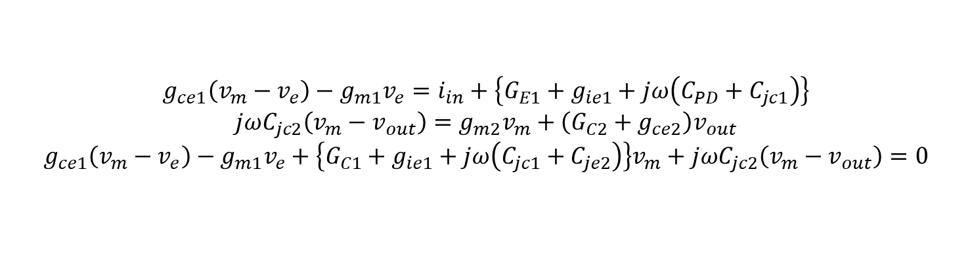
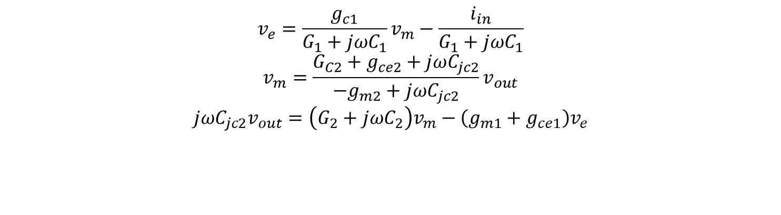
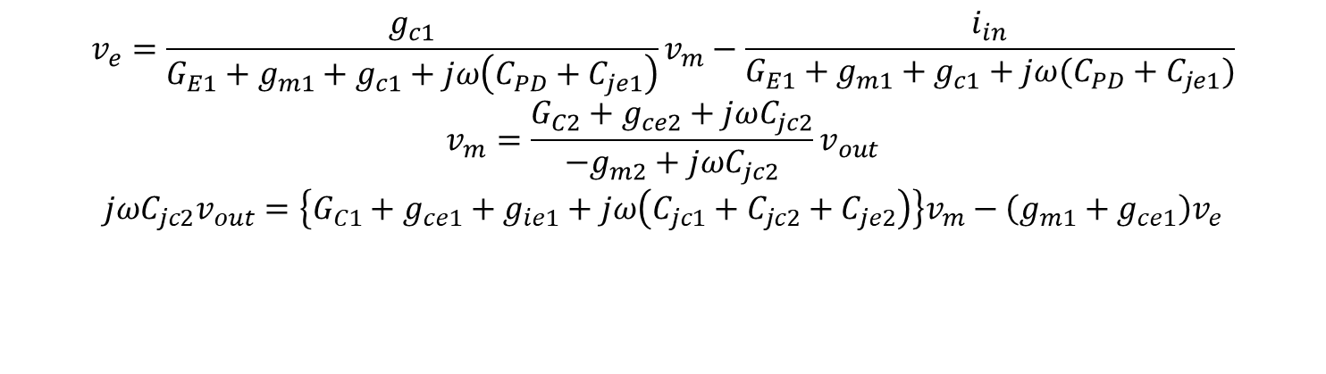
小信号解析
$${g_{ce1}\left(v_{m}−v_{e}\right)−g_{m1}v_{e}=i}_{in}+\left.\left\{G_{E1}+g_{ie1}+jω\left(C_{PD}+C_{jc1}\right)\right.\right\}$$
$$jωC_{jc2}\left(v_{m}−v_{out}\right)=g_{m2}v_{m}+\left(G_{C2}+g_{ce2}\right)v_{out}$$
$$g_{ce1}\left(v_{m}−v_{e}\right)−g_{m1}v_{e}+\left.\left\{G_{C1}+g_{ie1}+jω\left(C_{jc1}+C_{je2}\right)\right.\right\}v_{m}+jωC_{jc2}\left(v_{m}−v_{out}\right)=0$$
$$v_{e}=\frac{g_{c1}}{G_{E1}+g_{m1}+g_{c1}+jω\left(C_{PD}+C_{je1}\right)}v_{m}−\frac{i_{in}}{G_{E1}+g_{m1}+g_{c1}+jω(C_{PD}+C_{je1})}$$
$$v_{m}=\frac{G_{C2}+g_{ce2}+jωC_{jc2}}{−g_{m2}+jωC_{jc2}}v_{out}$$
$$jωC_{jc2}v_{out}=\left.\left\{G_{C1}+g_{ce1}+g_{ie1}+jω\left(C_{jc1}+C_{jc2}+C_{je2}\right)\right.\right\}v_{m}−\left(g_{m1}+g_{ce1}\right)v_{e}$$
$G_{1}≔G_{E1}+g_{m1}+g_{c1}$ $G_{2}≔G_{C1}+g_{ce1}+g_{ie1}$ $C_{1}≔C_{PD}+C_{je1}$ $C_{2}≔C_{jc1}+C_{jc2}+C_{je2}$
と置くと
$$v_{e}=\frac{g_{c1}}{G_{1}+jωC_{1}}v_{m}−\frac{i_{in}}{G_{1}+jωC_{1}}$$
$$v_{m}=\frac{G_{C2}+g_{ce2}+jωC_{jc2}}{−g_{m2}+jωC_{jc2}}v_{out}$$
$$jωC_{jc2}v_{out}=\left.\left(G_{2}+jωC_{2}\right.\right)v_{m}−\left(g_{m1}+g_{ce1}\right)v_{e}$$

Slide 6
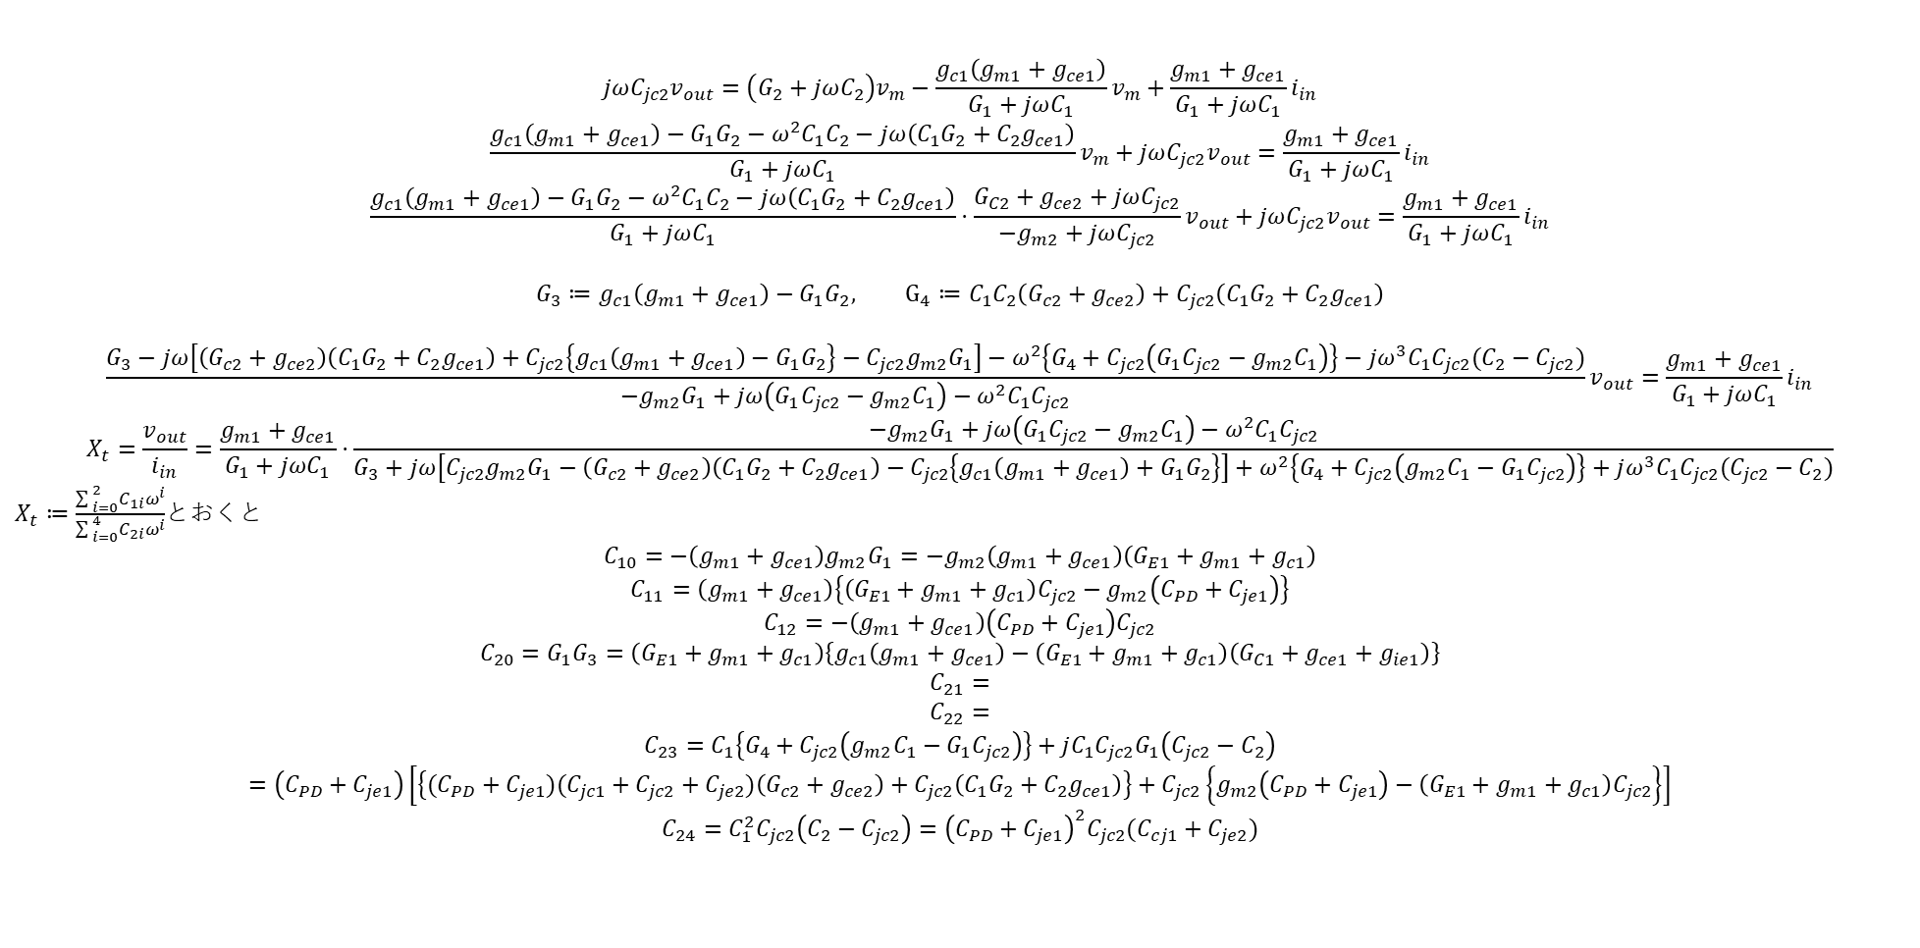
小信号解析
$G_{1}≔G_{E1}+g_{m1}+g_{c1}$ $G_{2}≔G_{C1}+g_{ce1}+g_{ie1}$ $C_{1}≔C_{PD}+C_{je1}$ $C_{2}≔C_{jc1}+C_{jc2}+C_{je2}$
$$jωC_{jc2}v_{out}=\left.\left(G_{2}+jωC_{2}\right.\right)v_{m}−\frac{g_{c1}\left(g_{m1}+g_{ce1}\right)}{G_{1}+jωC_{1}}v_{m}+\frac{g_{m1}+g_{ce1}}{G_{1}+jωC_{1}}i_{in}$$
$$\frac{g_{c1}\left(g_{m1}+g_{ce1}\right)−G_{1}G_{2}−ω^{2}C_{1}C_{2}−jω\left(C_{1}G_{2}+C_{2}g_{ce1}\right)}{G_{1}+jωC_{1}}v_{m}+jωC_{jc2}v_{out}=\frac{g_{m1}+g_{ce1}}{G_{1}+jωC_{1}}i_{in}$$
$$\frac{g_{c1}\left(g_{m1}+g_{ce1}\right)−G_{1}G_{2}−ω^{2}C_{1}C_{2}−jω\left(C_{1}G_{2}+C_{2}g_{ce1}\right)}{G_{1}+jωC_{1}}⋅\frac{G_{C2}+g_{ce2}+jωC_{jc2}}{−g_{m2}+jωC_{jc2}}v_{out}+jωC_{jc2}v_{out}=\frac{g_{m1}+g_{ce1}}{G_{1}+jωC_{1}}i_{in}$$
$$G_{3}≔g_{c1}\left(g_{m1}+g_{ce1}\right)−G_{1}G_{2}, G_{4}≔C_{1}C_{2}\left(G_{c2}+g_{ce2}\right)+C_{jc2}\left(C_{1}G_{2}+C_{2}g_{ce1}\right)$$
$$\frac{G_{3}−jω\left.\left[\left(G_{c2}+g_{ce2}\right)\left(C_{1}G_{2}+C_{2}g_{ce1}\right)+C_{jc2}\left.\left\{g_{c1}\left(g_{m1}+g_{ce1}\right)−G_{1}G_{2}\right.\right\}\right.−C_{jc2}g_{m2}G_{1}\right]−ω^{2}\left.\left\{G_{4}+C_{jc2}\left(G_{1}C_{jc2}−g_{m2}C_{1}\right)\right.\right\}−jω^{3}C_{1}C_{jc2}(C_{2}−C_{jc2})}{−g_{m2}G_{1}+jω\left(G_{1}C_{jc2}−g_{m2}C_{1}\right)−ω^{2}C_{1}C_{jc2}}v_{out}=\frac{g_{m1}+g_{ce1}}{G_{1}+jωC_{1}}i_{in}$$
$$X_{t}=\frac{v_{out}}{i_{in}}=\frac{g_{m1}+g_{ce1}}{G_{1}+jωC_{1}}⋅\frac{−g_{m2}G_{1}+jω\left(G_{1}C_{jc2}−g_{m2}C_{1}\right)−ω^{2}C_{1}C_{jc2}}{G_{3}+jω\left.\left[C_{jc2}g_{m2}G_{1}−\left(G_{c2}+g_{ce2}\right)\left(C_{1}G_{2}+C_{2}g_{ce1}\right)−C_{jc2}\left.\left\{g_{c1}\left(g_{m1}+g_{ce1}\right)+G_{1}G_{2}\right.\right\}\right.\right]+ω^{2}\left.\left\{G_{4}+C_{jc2}\left(g_{m2}C_{1}−G_{1}C_{jc2}\right)\right.\right\}+jω^{3}C_{1}C_{jc2}(C_{jc2}−C_{2})}$$
$X_{t}≔\frac{{\sum{ }}_{i=0}^{2}C_{1i}ω^{i}}{{\sum{ }}_{i=0}^{4}C_{2i}ω^{i}}$とおくと
$$C_{10}=−\left(g_{m1}+g_{ce1}\right)g_{m2}G_{1}=−g_{m2}\left(g_{m1}+g_{ce1}\right)\left(G_{E1}+g_{m1}+g_{c1}\right)$$
$$C_{11}=\left(g_{m1}+g_{ce1}\right)\left.\left\{\left(G_{E1}+g_{m1}+g_{c1}\right)C_{jc2}−g_{m2}\left(C_{PD}+C_{je1}\right)\right.\right\}$$
$$C_{12}=−\left(g_{m1}+g_{ce1}\right)\left(C_{PD}+C_{je1}\right)C_{jc2}$$
$$C_{20}=G_{1}G_{3}=\left(G_{E1}+g_{m1}+g_{c1}\right)\left.\left\{g_{c1}\left(g_{m1}+g_{ce1}\right)−\left(G_{E1}+g_{m1}+g_{c1}\right)\left(G_{C1}+g_{ce1}+g_{ie1}\right)\right.\right\}$$
$$C_{21}=$$
$$C_{22}=$$
$$C_{23}=C_{1}\left.\left\{G_{4}+C_{jc2}\left(g_{m2}C_{1}−G_{1}C_{jc2}\right)\right.\right\}+jC_{1}C_{jc2}G_{1}\left(C_{jc2}−C_{2}\right)$$
$$=\left(C_{PD}+C_{je1}\right)\left.\left[\left.\left\{(C_{PD}+C_{je1})(C_{jc1}+C_{jc2}+C_{je2})\left(G_{c2}+g_{ce2}\right)+C_{jc2}\left(C_{1}G_{2}+C_{2}g_{ce1}\right)\right.\right\}+C_{jc2}\left.\left\{g_{m2}\left(C_{PD}+C_{je1}\right)−\left(G_{E1}+g_{m1}+g_{c1}\right)C_{jc2}\right.\right\}\right.\right]$$
$$C_{24}=C_{1}^{2}C_{jc2}\left(C_{2}−C_{jc2}\right)={\left(C_{PD}+C_{je1}\right)}^{2}C_{jc2}(C_{cj1}+C_{je2})$$

