Slide 1
Double stage TIA
2024/06/03 Kojima Hikaru

Slide 2
Index
Background
Purpose
Topology
Small-signal analysis
Conclusion

Slide 3
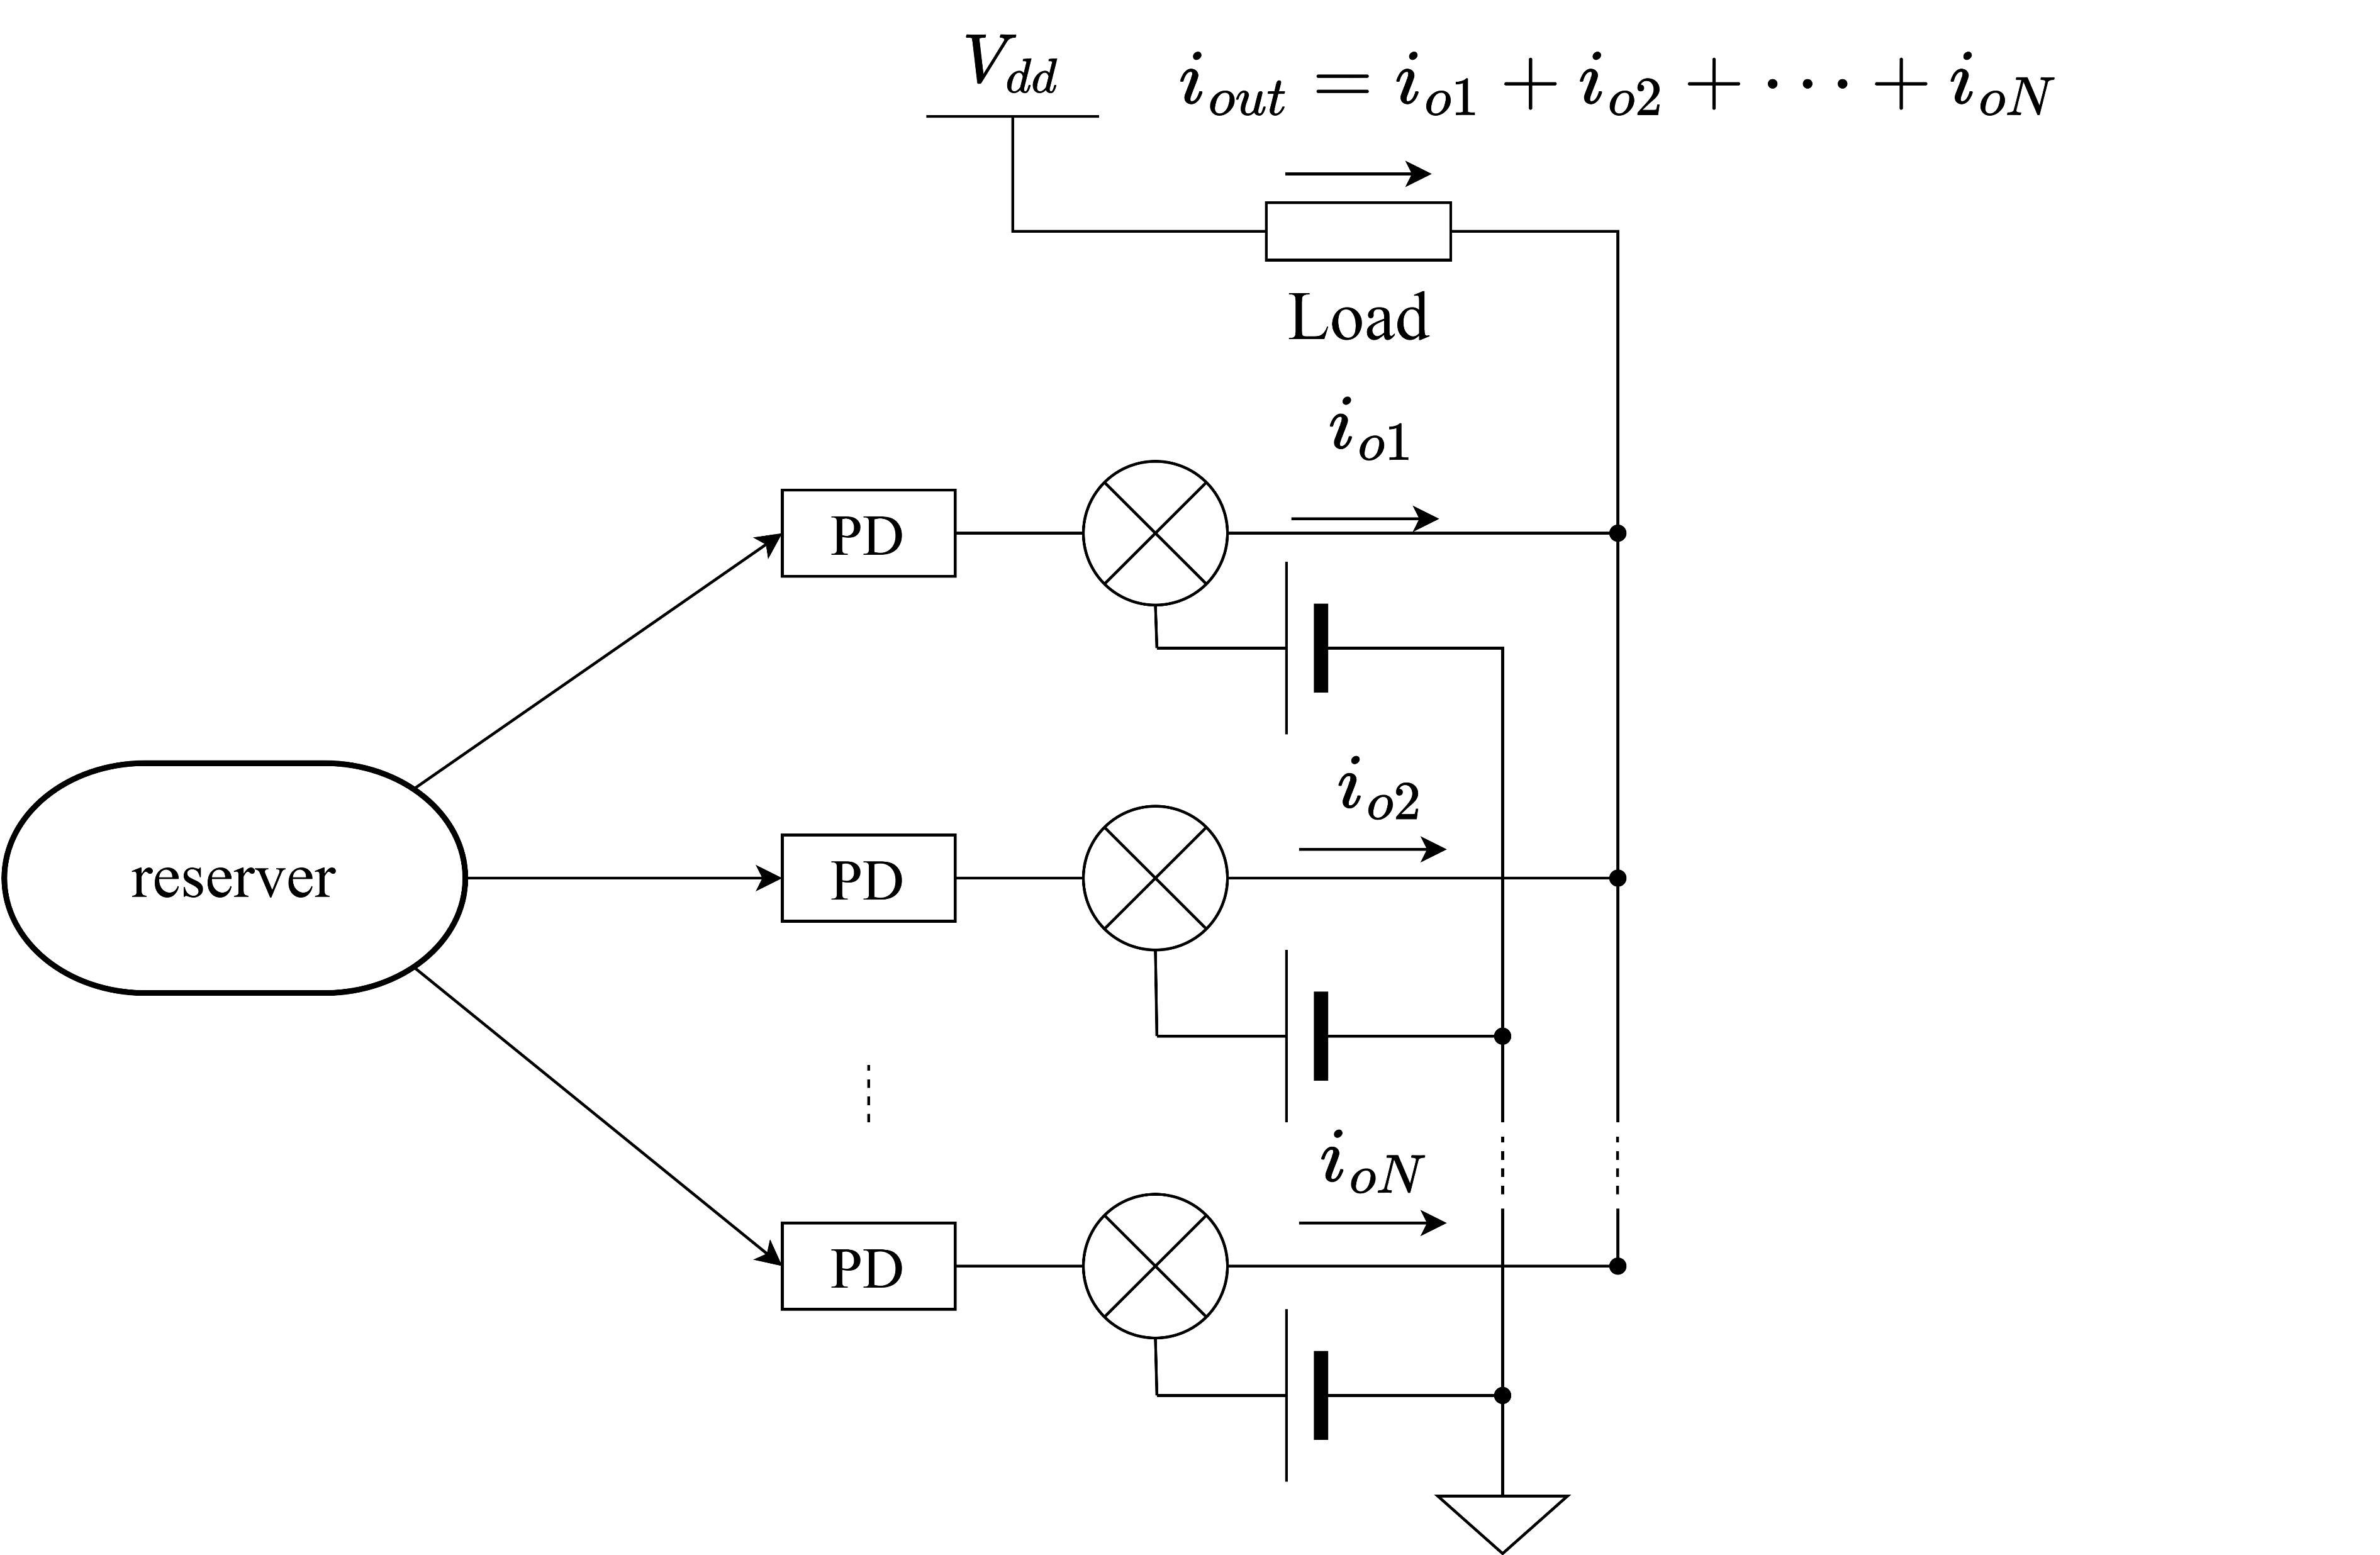
Background
input
output
Reserver is a device that work as a neural network by physical phenomenon.
Reflecting and interfering input light in the photonic reserver made that it store the state of a short time ago.
It seems that photonic reserver can predict chaotic-signal
and real-time graphic processing.

Slide 4
Background
Reserver’s output is sum-of-product.
Reserver’s learning is only learning of weight of sum-of-product.
So reserver’s learning cost is fewer than machine learning.
However, it is difficult for light to calculate sum-of-product.
⇒only this part, calculate in electronic circuits.

Slide 5
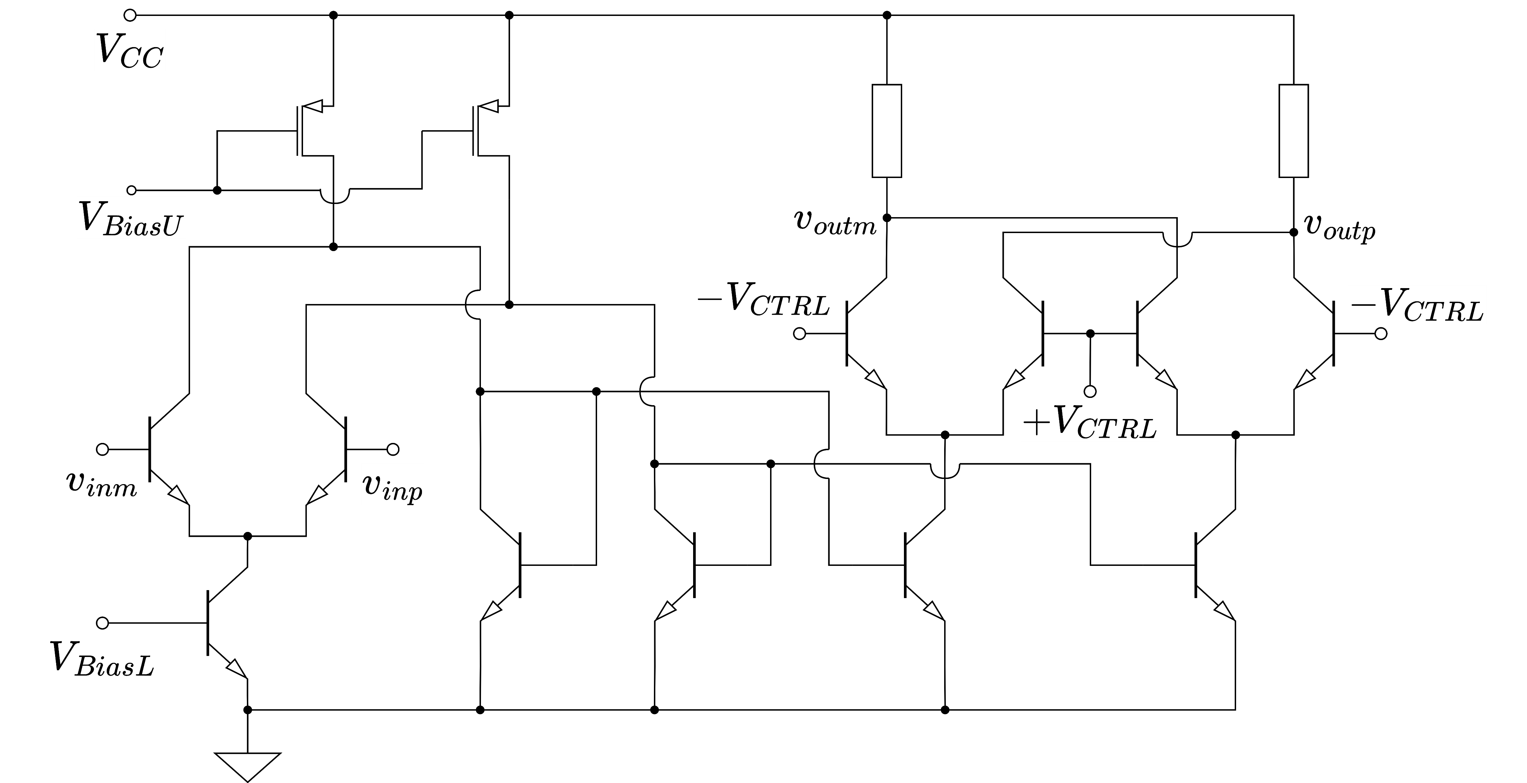
Background
This is a proposing analog multiplying circuit.
It modified gilbert multiplier for expand output amplitude.

Slide 6
Purpose
Photonic reserver output by light and multiplier’s input is voltage.
So, we need photo-diode. But the output amplitude is smaller than multiplier’s input.
⇒It is necessary to photonic-electronic translator and amplifier that have dimension of resister.
This name is TIA(Trans-Impedance Amplifier)

Slide 7
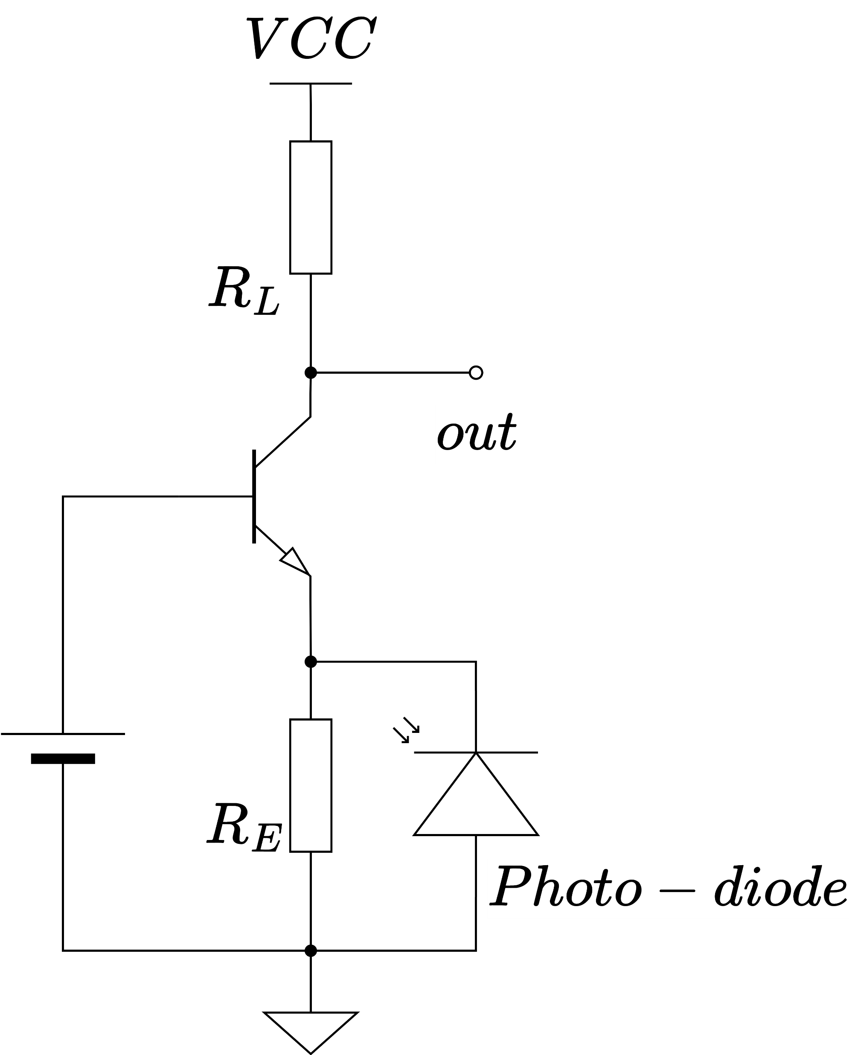
Single stage TIA
Photo-diode is a device of current output and multiplier’s input is voltage, so TIA needs current input and voltage output.
That is a reason why common-base amplifier is used for TIA.
But this topology is trade-off between trance-impedance and bandwidth.

Slide 8
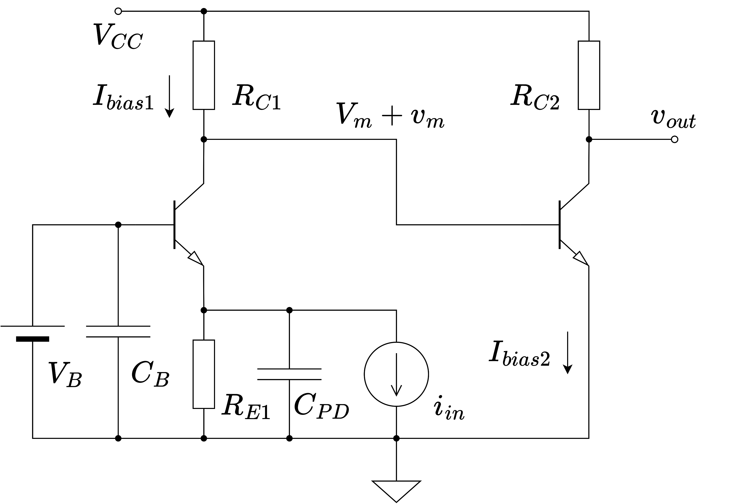







Double Stage TIA
$$870 Ω$$
$$540 Ω$$
To avoid the tread-off, I examining double stage TIA.
This topology dividing gain between two stage, I attempt high trans-impedance and large bandwidth.
$$0.9 V$$
$$1.2 V$$
$$1.5 V$$
$$0.6 V$$
$$650 Ω$$

Slide 9
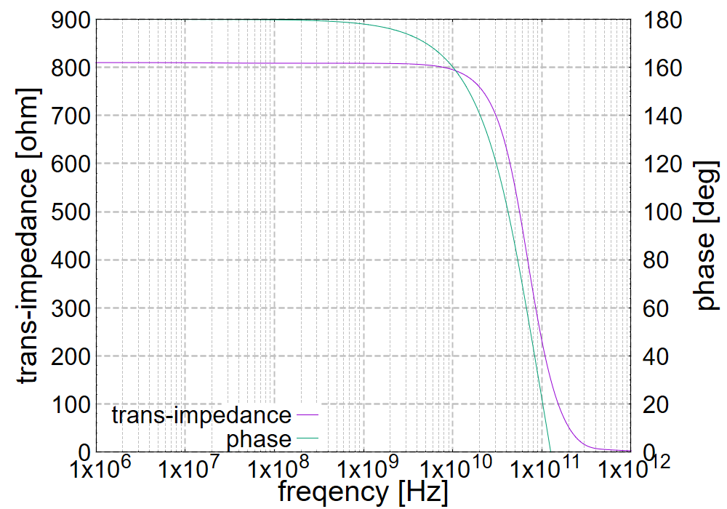
Double Stage TIA
$$870 Ω$$
$$540 Ω$$
$$0.9 V$$
$$1.2 V$$
$$1.5 V$$
$$0.6 V$$
$$650 Ω$$
First stage of frequency characteristic.
This cutoff frequency is 10 GHz ordered.

Slide 10
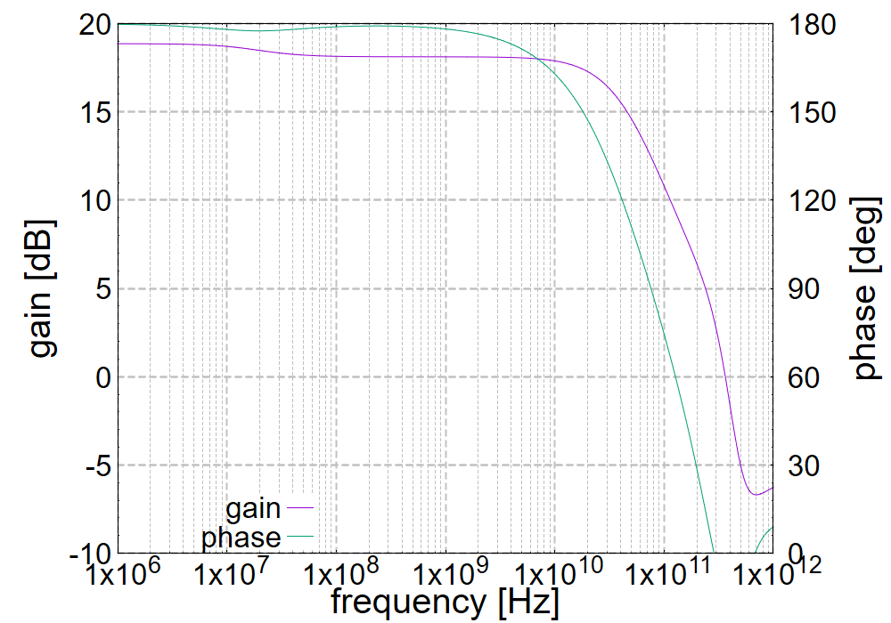







Double Stage TIA
VCC
$$870 Ω$$
$$540 Ω$$
$$0.9 V$$
$$1.2 V$$
$$1.5 V$$
input
$$0.6 V$$
$$650 Ω$$
GND
Second stage of frequency characteristic.
This cutoff frequency is 10 GHz ordered.

Slide 11
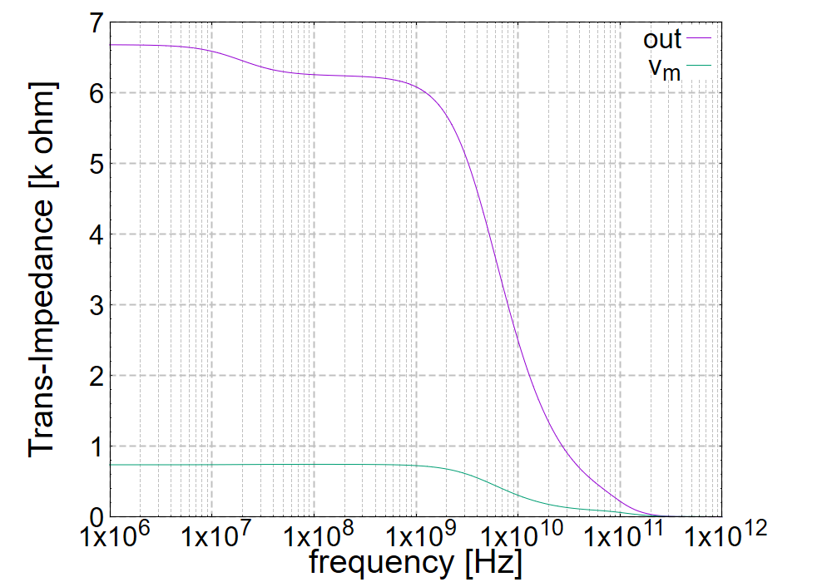
Double Stage TIA
$$870 Ω$$
$$540 Ω$$
$$0.9 V$$
$$1.2 V$$
$$1.5 V$$
$$0.6 V$$
$$650 Ω$$
Connected two stage of frequency characteristic.
This cutoff frequency is limited to a GHz ordered.

Slide 12
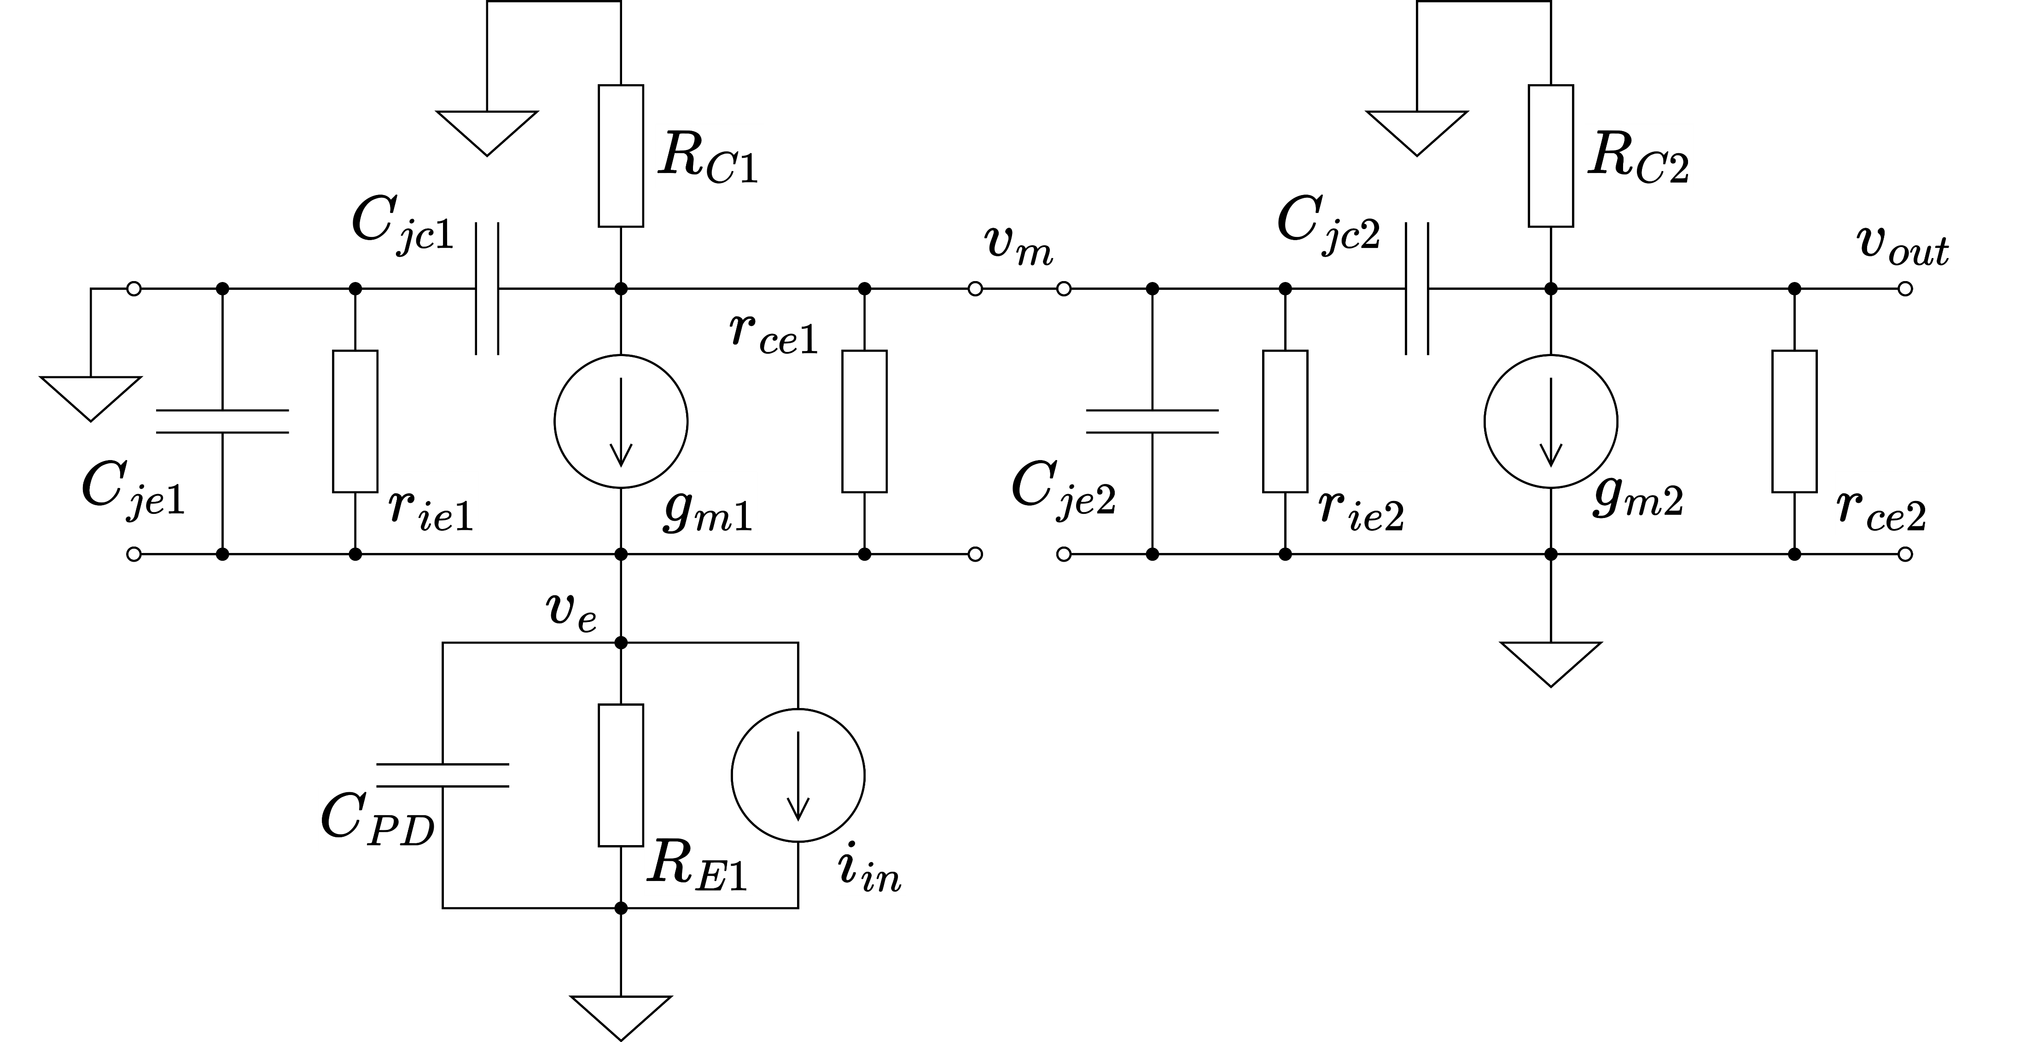
Small-signal analysis
This small-signal equivalent circuit is containing base-emitter and base-collector junction capacitance for high frequency response.

Slide 13
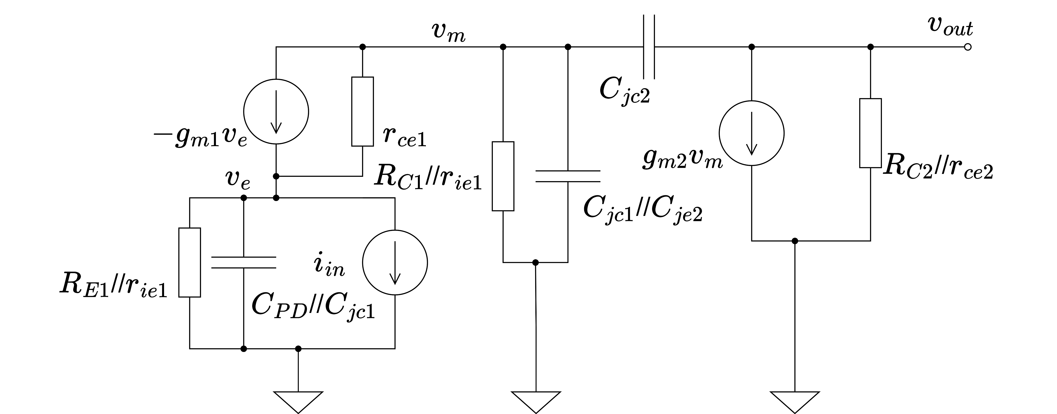
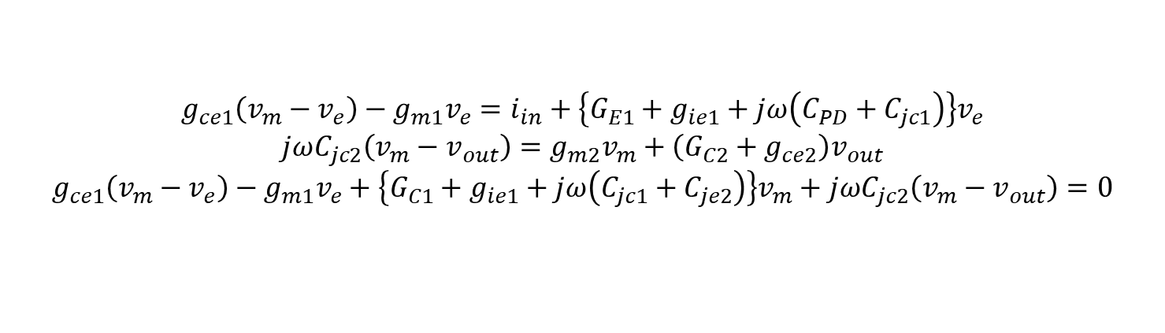
Small-signal analysis
$${g_{ce1}\left(v_{m}−v_{e}\right)−g_{m1}v_{e}=i}_{in}+\left.\left\{G_{E1}+g_{ie1}+jω\left(C_{PD}+C_{jc1}\right)\right.\right\}v_{e}$$
$$jωC_{jc2}\left(v_{m}−v_{out}\right)=g_{m2}v_{m}+\left(G_{C2}+g_{ce2}\right)v_{out}$$
$$g_{ce1}\left(v_{m}−v_{e}\right)−g_{m1}v_{e}+\left.\left\{G_{C1}+g_{ie1}+jω\left(C_{jc1}+C_{je2}\right)\right.\right\}v_{m}+jωC_{jc2}\left(v_{m}−v_{out}\right)=0$$
Given by KCL

Slide 14
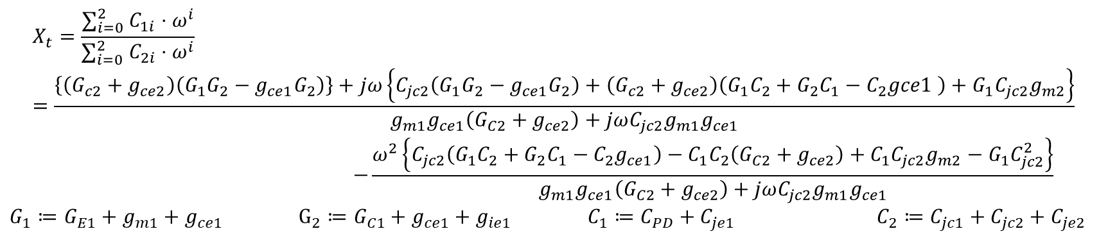
Small-signal analysis
Low degree of omega is higher effect to trans-impedance.
So that, disregard arguments that have 3 or higher degree of omega.
$$X_{t}=\frac{∑_{i=0}^{2} C_{1i}⋅ω^{i}}{∑_{i=0}^{2} C_{2i}⋅ω^{i}}=\frac{\left.\left\{\left(G_{c2}+g_{ce2}\right)\left(G_{1}G_{2}−g_{ce1}G_{2}\right)\right.\right\}+jω\left.\left\{C_{jc2}\left(G_{1}G_{2}−g_{ce1}G_{2}\right)+\left(G_{c2}+g_{ce2}\right)\left(G_{1}C_{2}+G_{2}C_{1}−C_{2}gce1 \right)+G_{1}C_{jc2}g_{m2}\right.\right\}}{g_{m1}g_{ce1}\left(G_{C2}+g_{ce2}\right)+jωC_{jc2}g_{m1}g_{ce1}}$$
$$−\frac{ω^{2}\left.\left\{C_{jc2}\left(G_{1}C_{2}+G_{2}C_{1}−C_{2}g_{ce1}\right)−C_{1}C_{2}\left(G_{C2}+g_{ce2}\right)+C_{1}C_{jc2}g_{m2}−G_{1}C_{jc2}^{2}\right.\right\}}{g_{m1}g_{ce1}\left(G_{C2}+g_{ce2}\right)+jωC_{jc2}g_{m1}g_{ce1}}$$
$G_{1}≔G_{E1}+g_{m1}+g_{ce1}$ $G_{2}≔G_{C1}+g_{ce1}+g_{ie1}$ $C_{1}≔C_{PD}+C_{je1}$ $C_{2}≔C_{jc1}+C_{jc2}+C_{je2}$

Slide 15
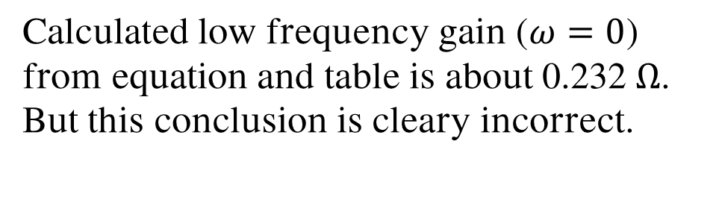
Small-signal analysis
Calculated low frequency gain ($ω=0$) from equation and table is about 0.232 $Ω$.
But this conclusion is cleary incorrect.

Slide 16
Conclusion
In the end, I couldn’t find limit of frequency response.
I will continue to find the part of limitation.

