Slide 1
Simulation of TIA and buffer circuit
2024年7月2日 小島 光

Slide 2
Index
Background
TIA
Output buffer
System simulation
Conclusion

Slide 3
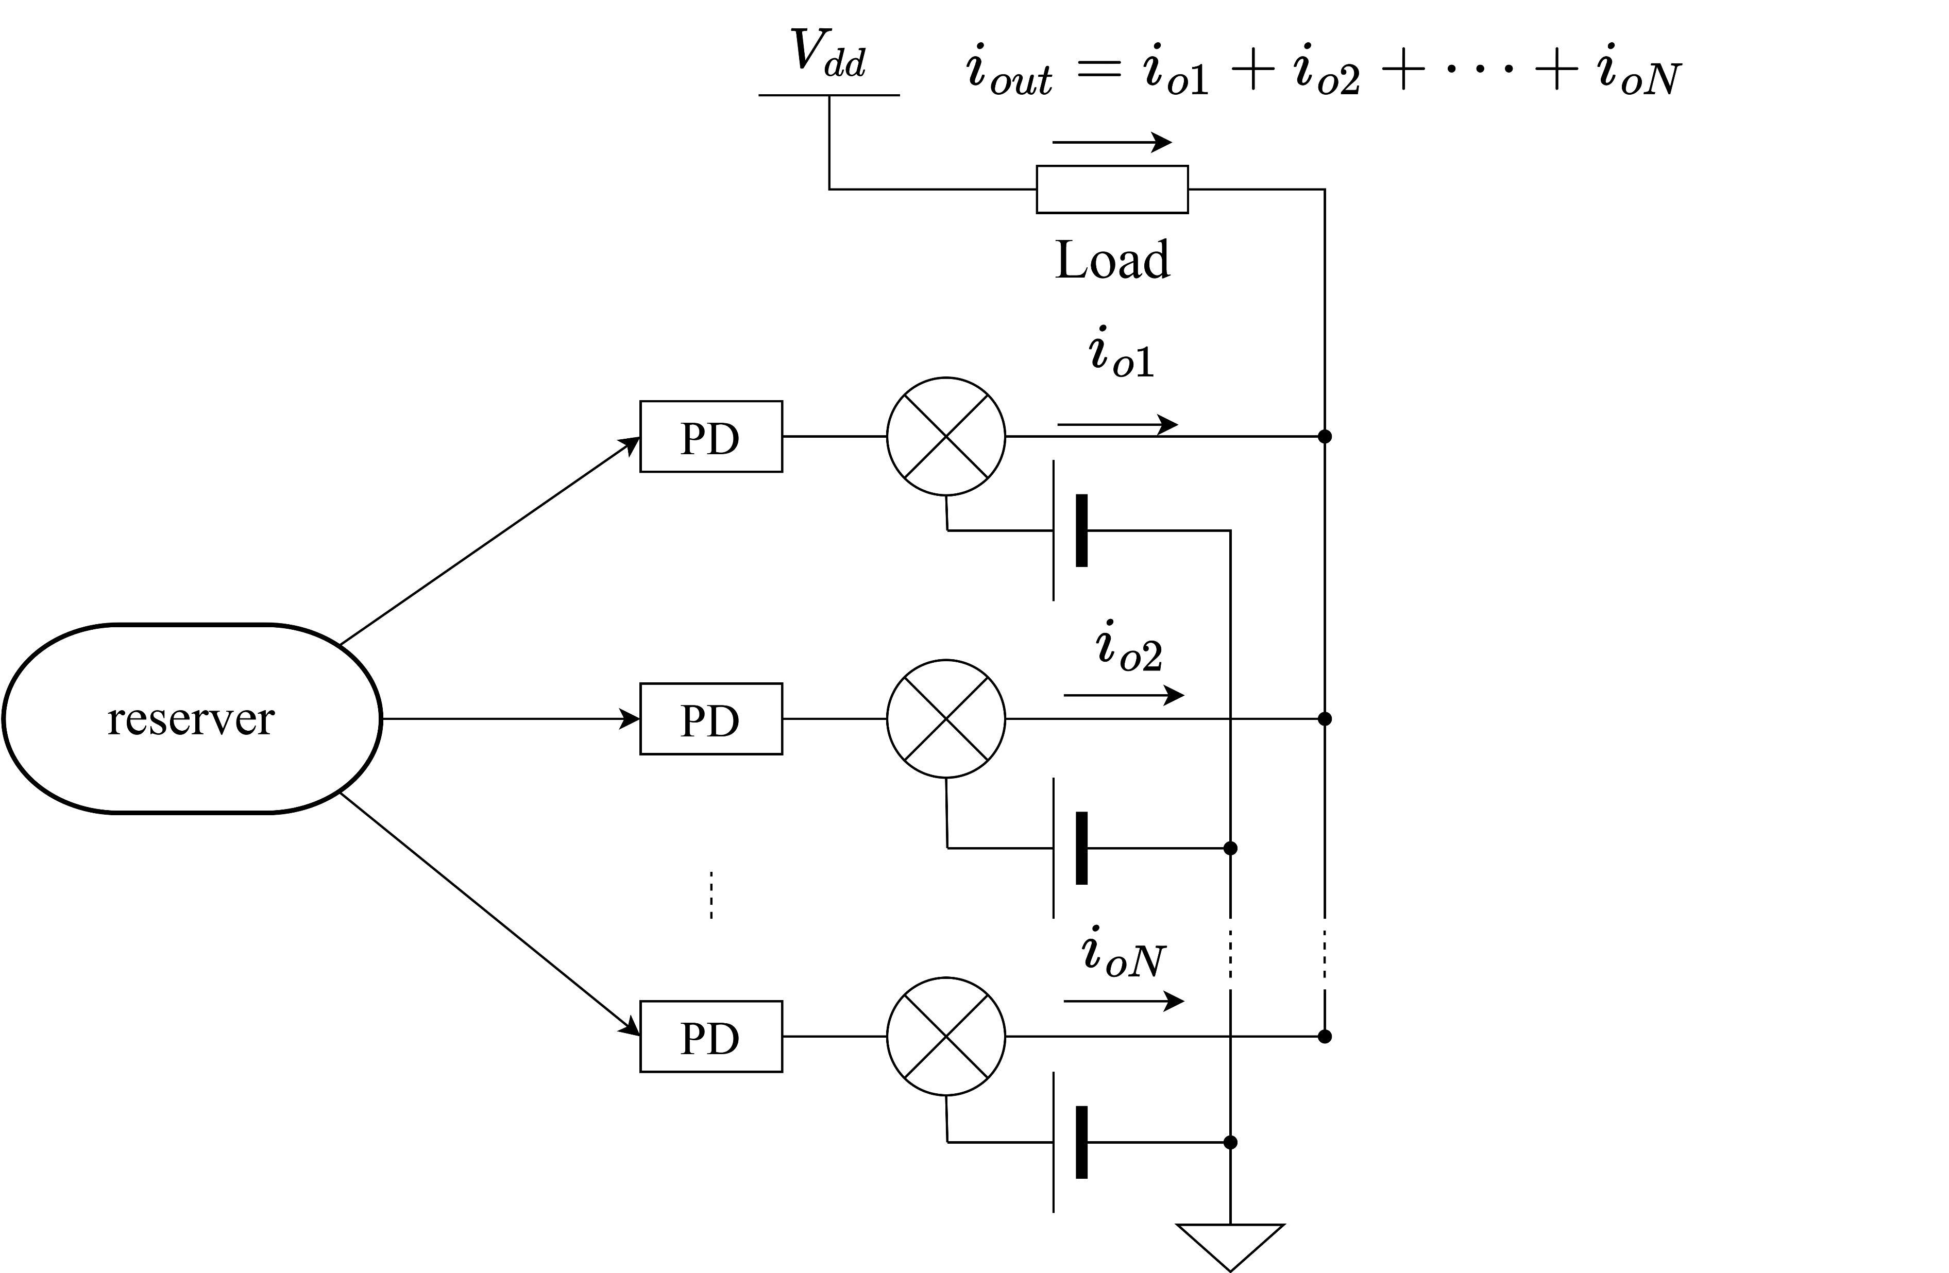
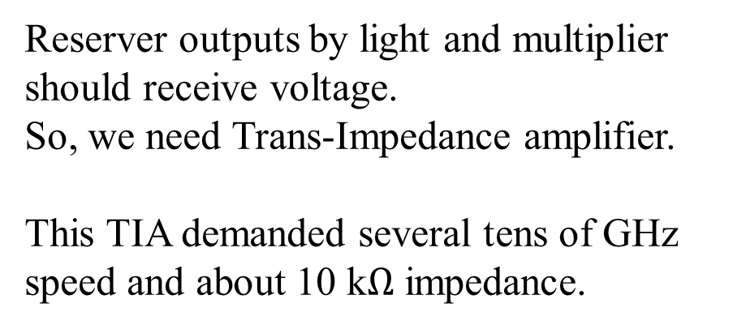
Background – TIA
Reserver outputs by light and multiplier should receive voltage.
So, we need Trans-Impedance amplifier.
This TIA demanded several tens of GHz speed and about 10 k$Ω$ impedance.

Slide 4
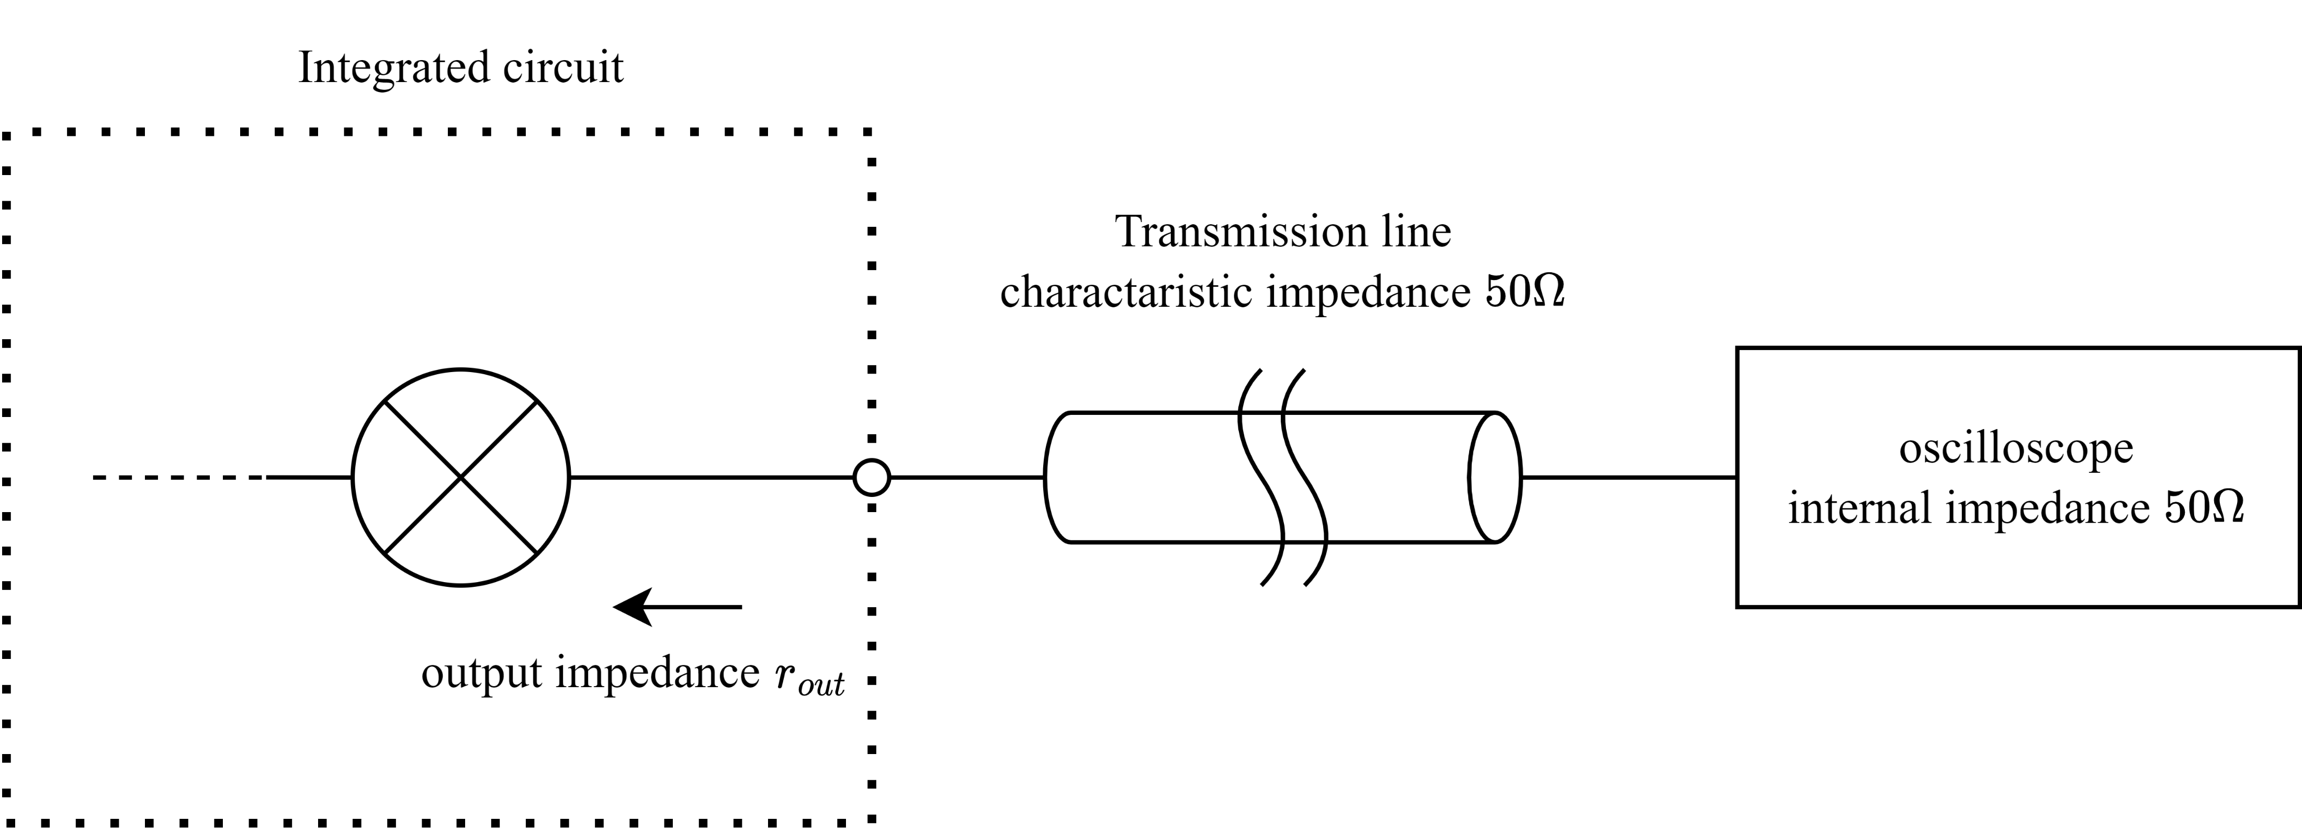
Background – buffer circuit
In high frequency circuit, output impedance should be matched to
characteristic impedance for avoiding signal reflection and reduction.
So that, matching circuit is needed between multiplier and Transmission line.

Slide 5
Purpose
To finish designing circuit and simulation whole system.

Slide 6
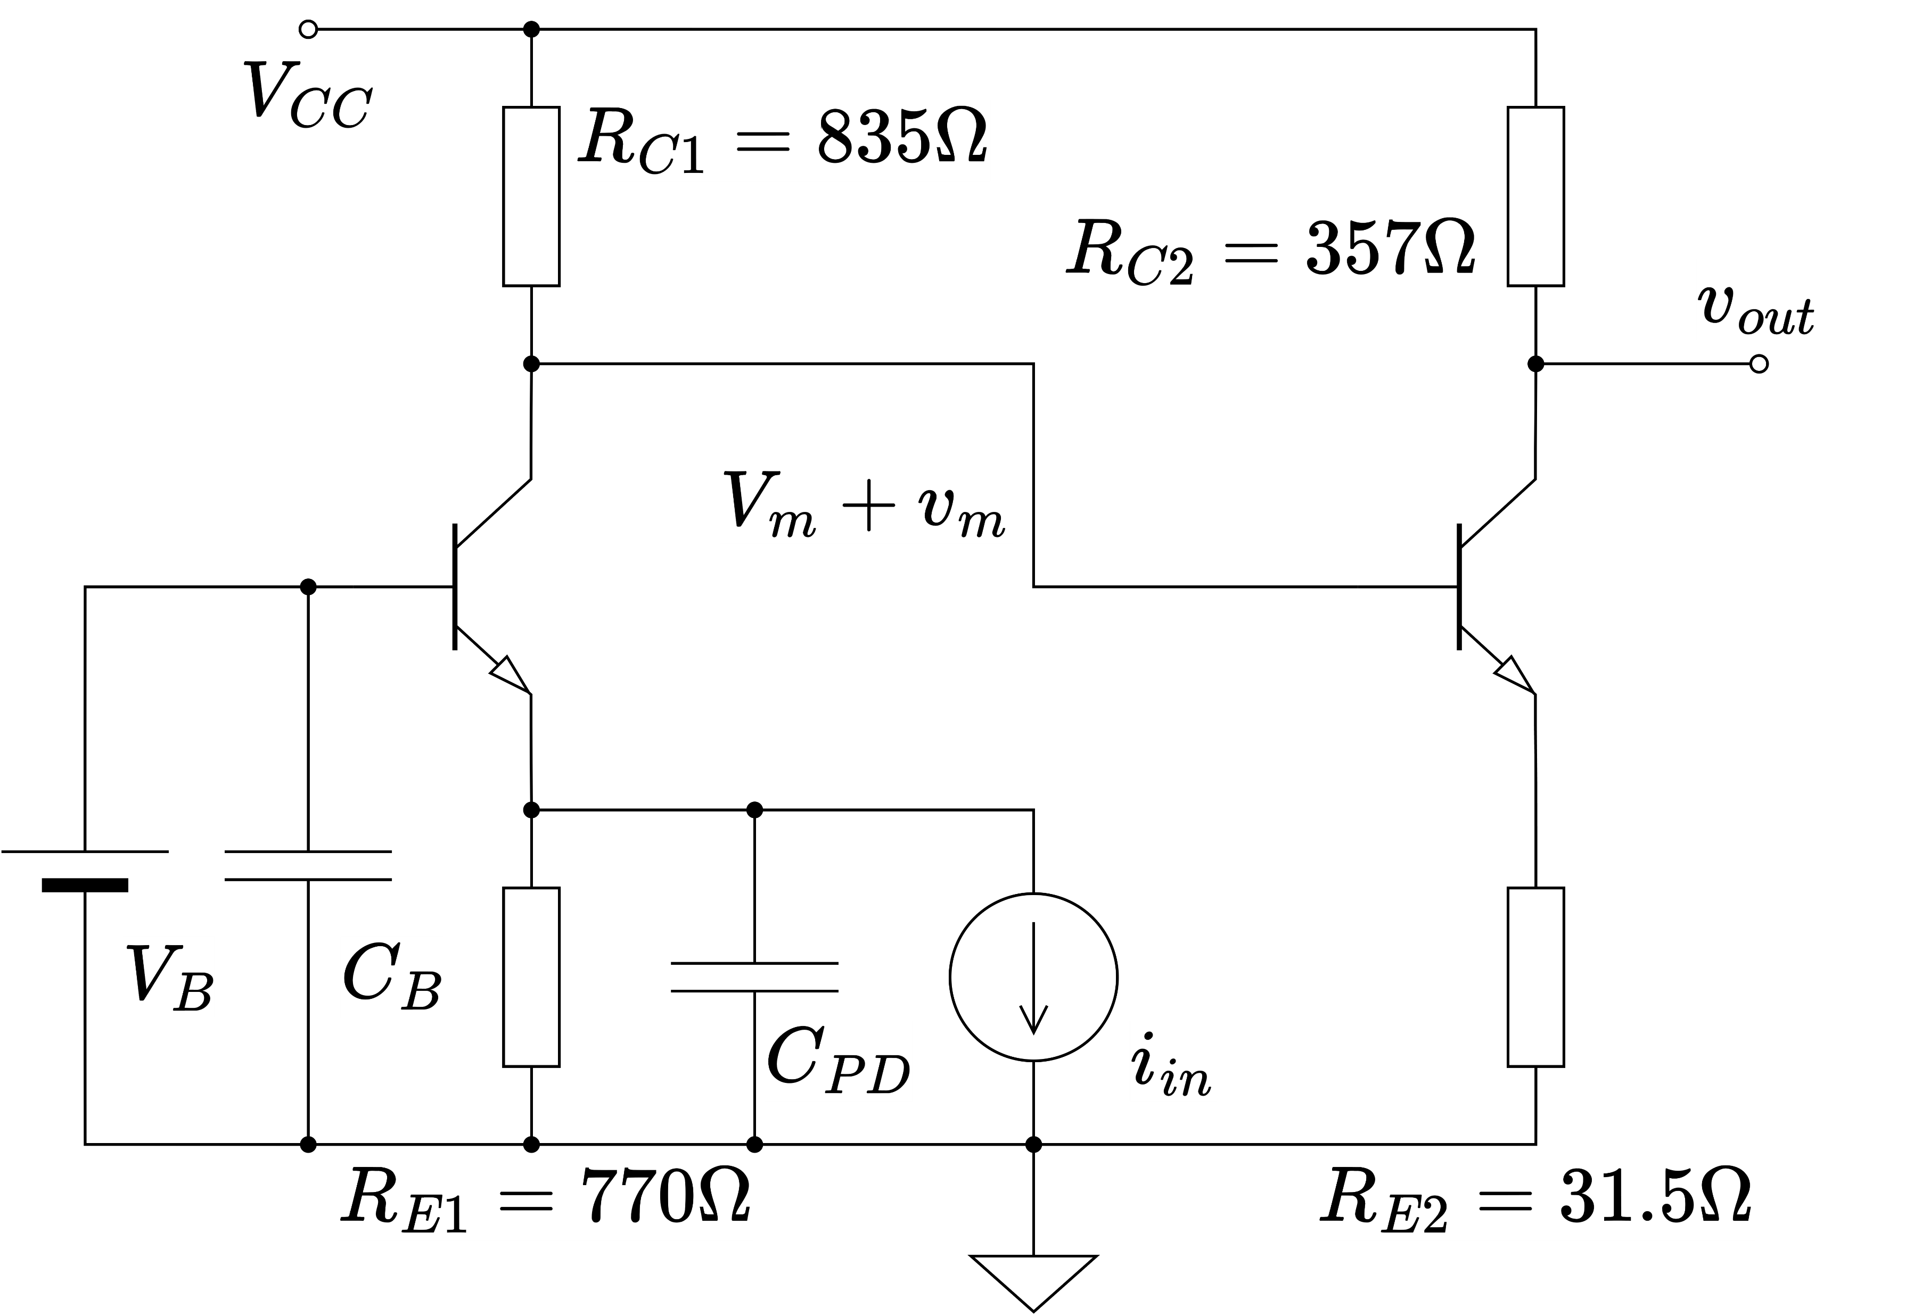
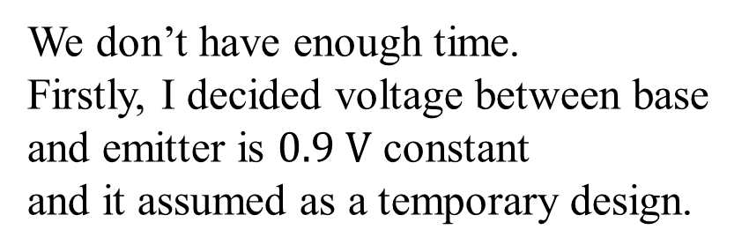
TIA design
We don’t have enough time.
Firstly, I decided voltage between base and emitter is $0.9 V$ constant
and it assumed as a temporary design.

Slide 7
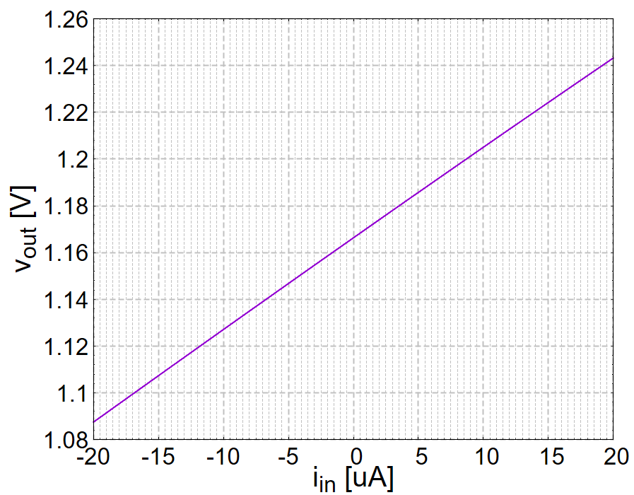
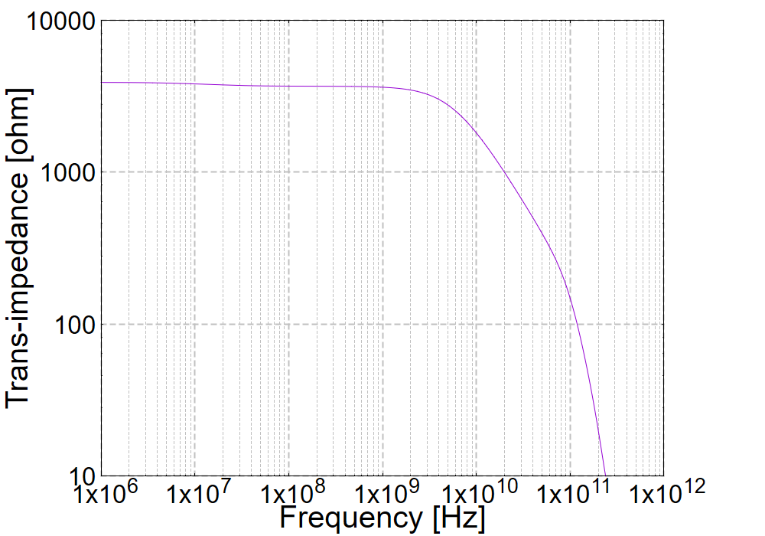
TIA simulation
TIA obtained about $3.9 kΩ$ of trans-impedance and $5 GHz$ of cutoff frequency.

Slide 8
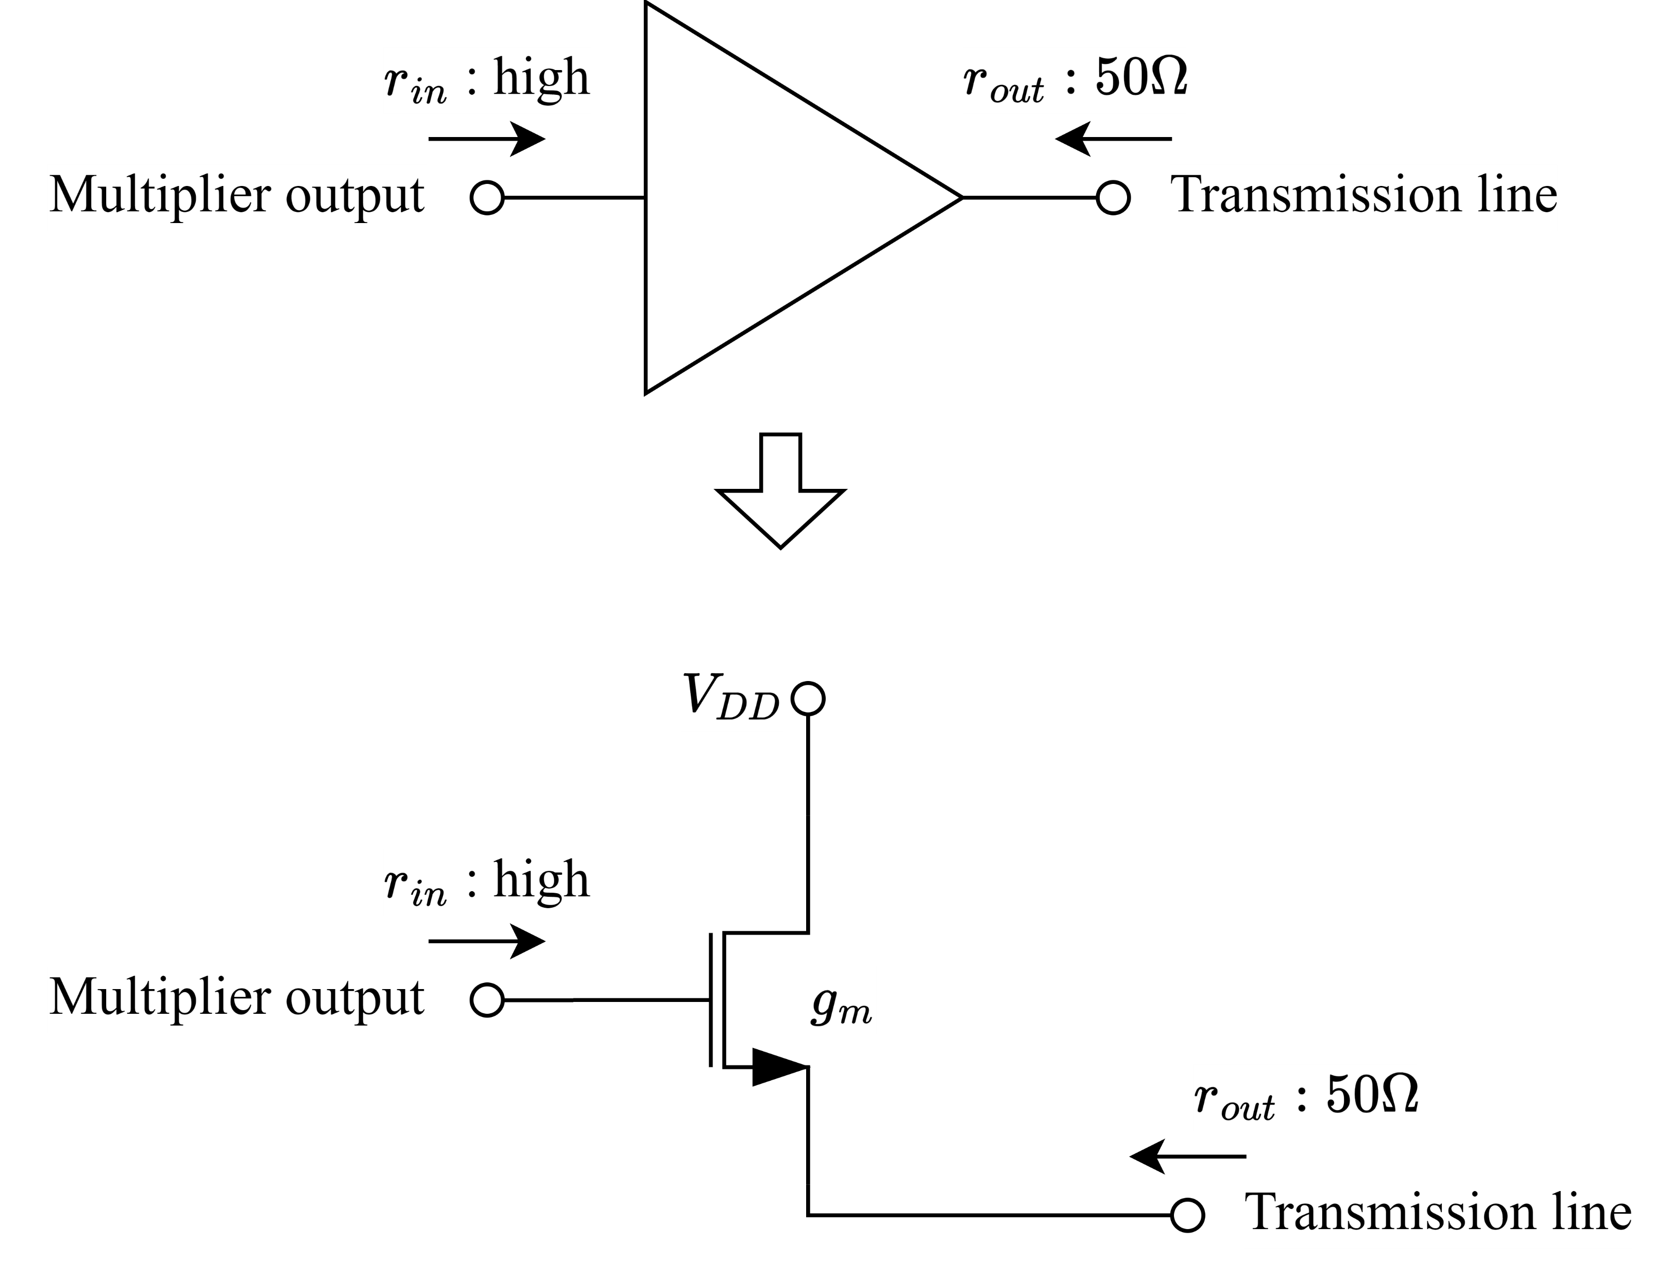
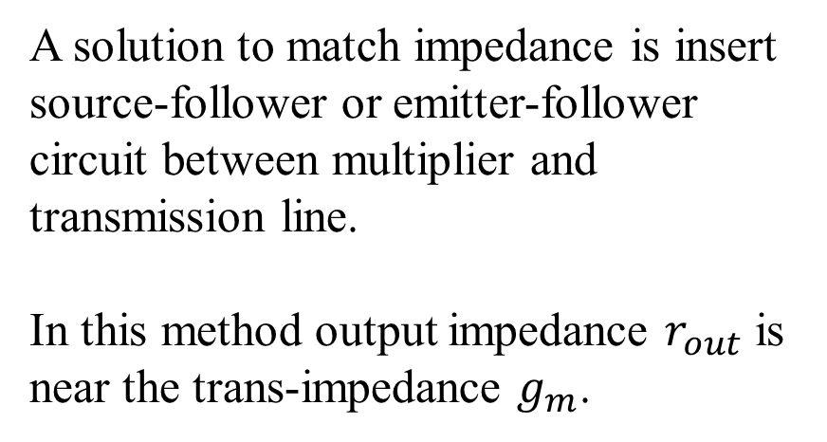
Output buffer
A solution to match impedance is insert source-follower or emitter-follower circuit between multiplier and transmission line.
In this method output impedance $r_{out}$ is near the trans-impedance $g_{m}$.

Slide 9

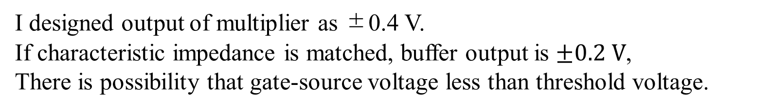
Output buffer
$$1.15 V$$
I designed output of multiplier as ±0.4 V.
If characteristic impedance is matched, buffer output is $±0.2 V$,
There is possibility that gate-source voltage less than threshold voltage.

Slide 10
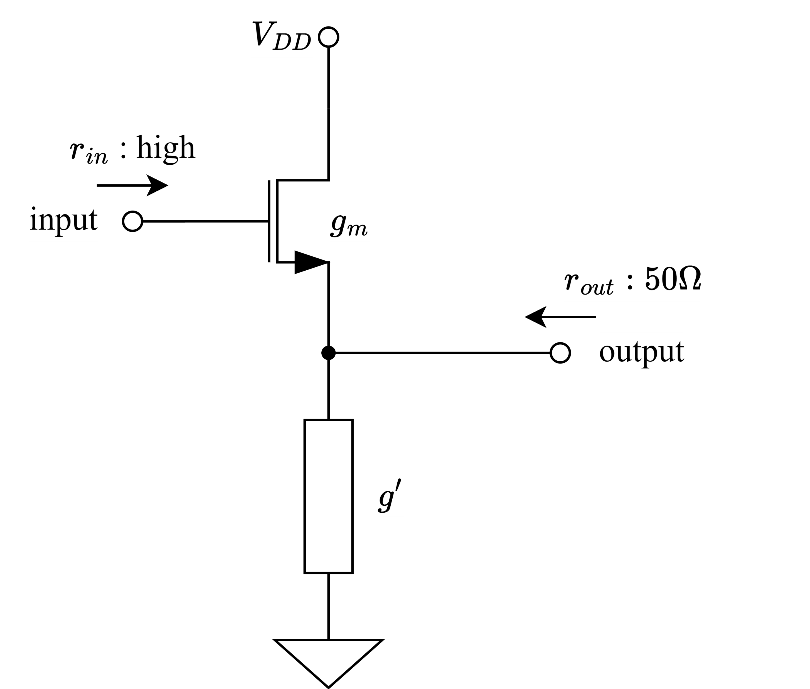
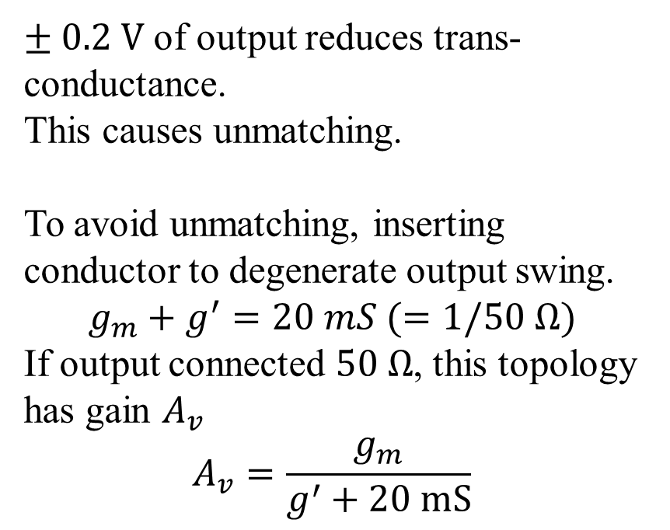
Output buffer
$± 0.2 V$ of output reduces trans-conductance.
This causes unmatching.
To avoid unmatching, inserting conductor to degenerate output swing.
$$g_{m}+g^{′}=20 mS (=1/50 Ω)$$
If output connected $50 Ω$, this topology has gain $A_{v}$
$$A_{v}=\frac{g_{m}}{g^{′}+20 mS}$$

Slide 11

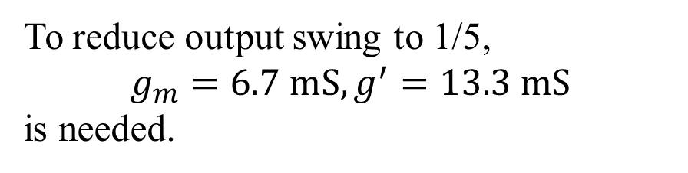
Output buffer
To reduce output swing to 1/5,
$$g_{m}=6.7 mS, g^{′}=13.3 mS$$
is needed.

Slide 12
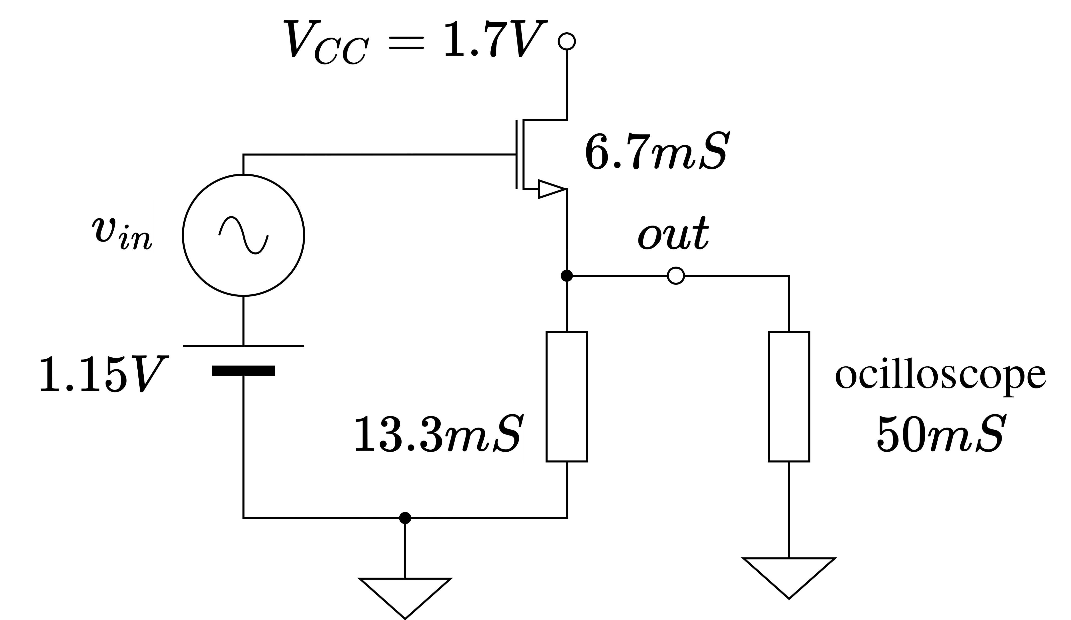
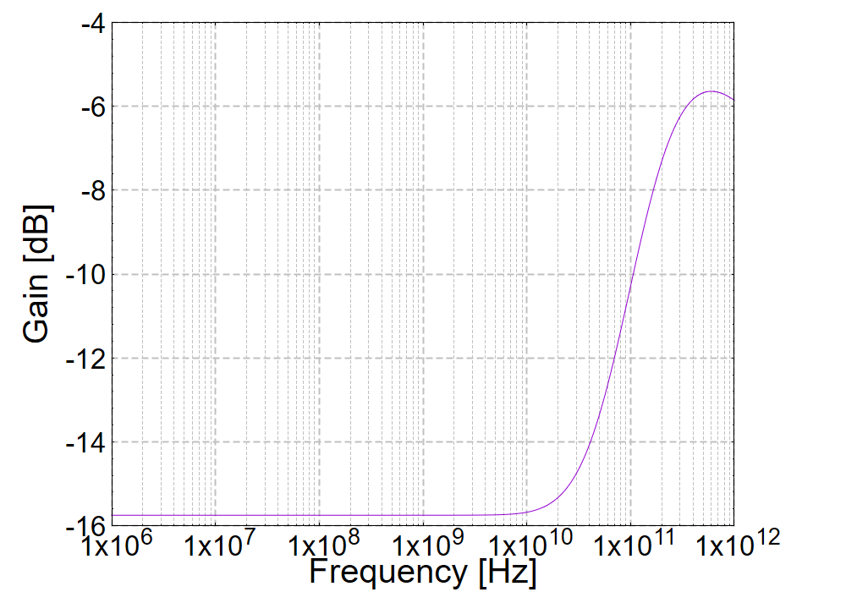
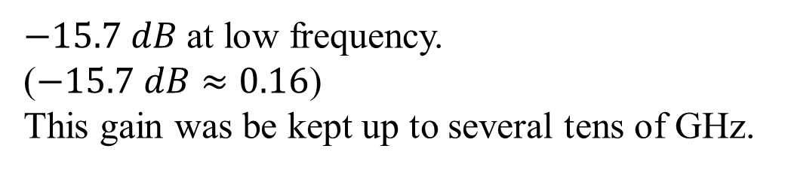
Output buffer – AC simulation
$−15.7 dB$ at low frequency.
($−15.7 dB≈0.16$)
This gain was be kept up to several tens of GHz.

Slide 13
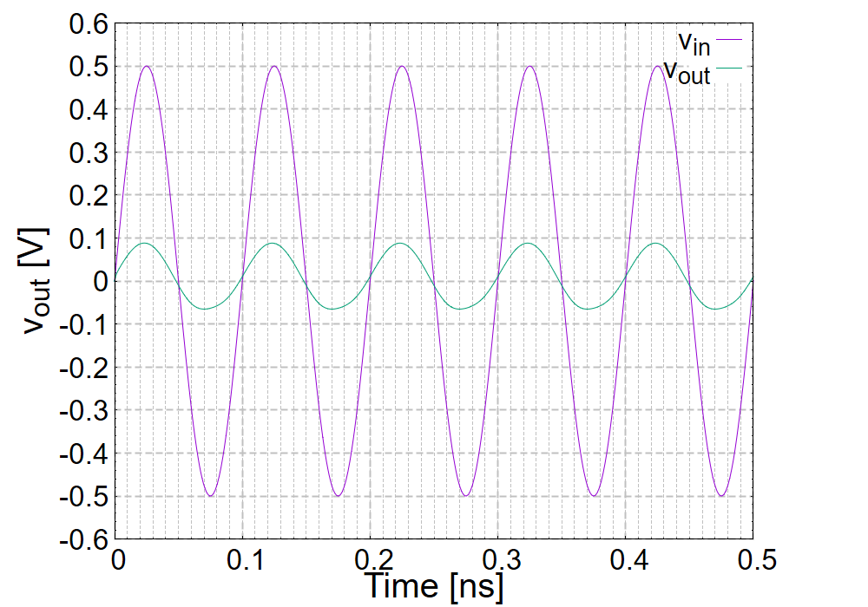
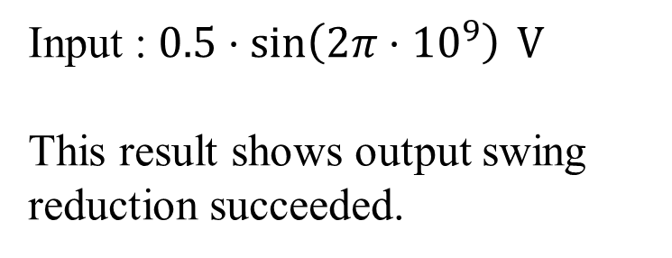
Output buffer – transient simulation
Input : $0.5⋅\sin\left(2π⋅{10}^{9}\right) V$
This result shows output swing reduction succeeded.

Slide 14
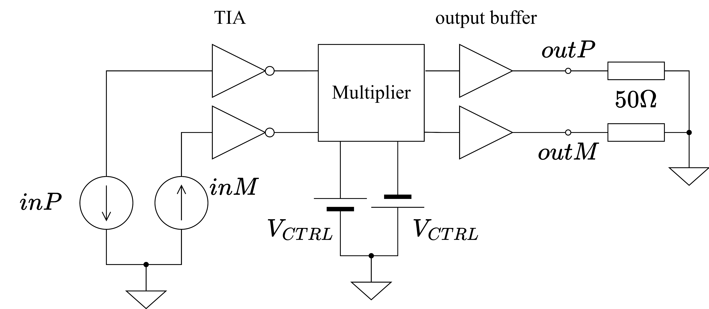
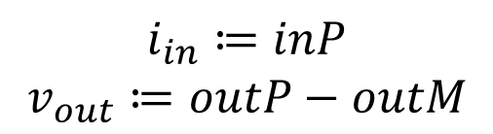
System simulation circuit
$$i_{in}≔inP$$
$$v_{out}≔outP−outM$$

Slide 15
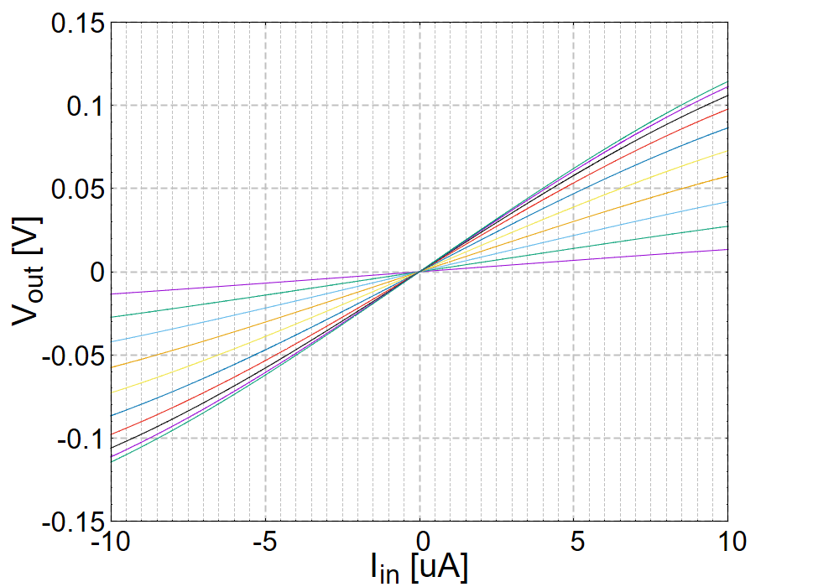
System simulation DC
Nonlinearity to input current didn't be appeared clearly.
Output was directly proportionally to input current and control voltage.

Slide 16
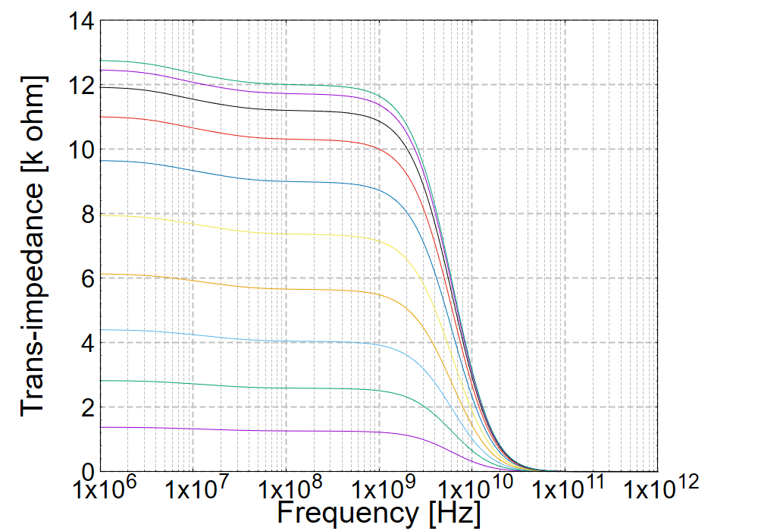
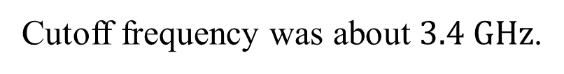
System simulation AC
Cutoff frequency was about $3.4 GHz$.

Slide 17
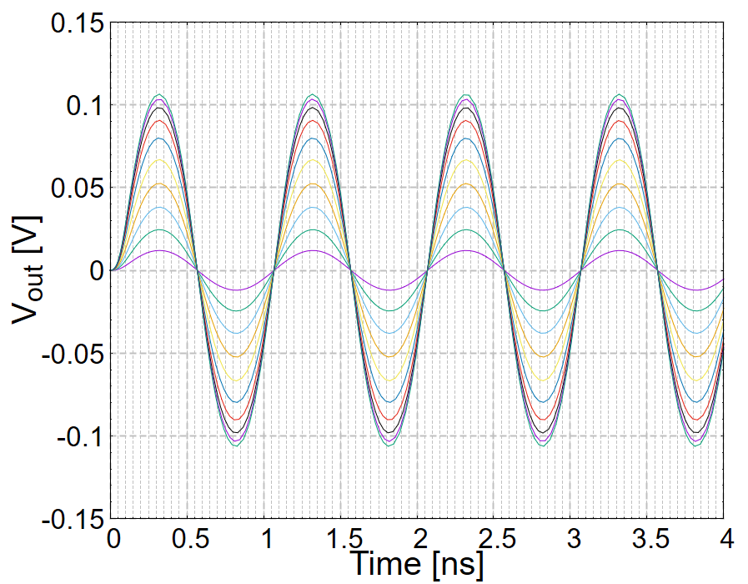
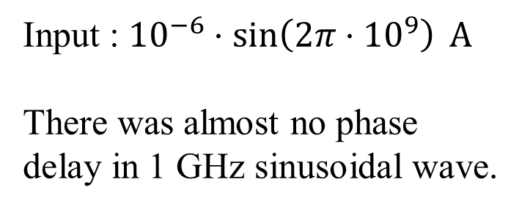
System simulation transient
Input : ${10}^{−6}⋅\sin\left(2π⋅{10}^{9}\right) A$
There was almost no phase delay in 1 GHz sinusoidal wave.

Slide 18
Conclusion
The entire system works a speed of several GHz.
I will begin layout and improve TIA at the same time.

