Slide 1
2024/06/03 Kojima Hikaru

Slide 2
Index

Slide 3
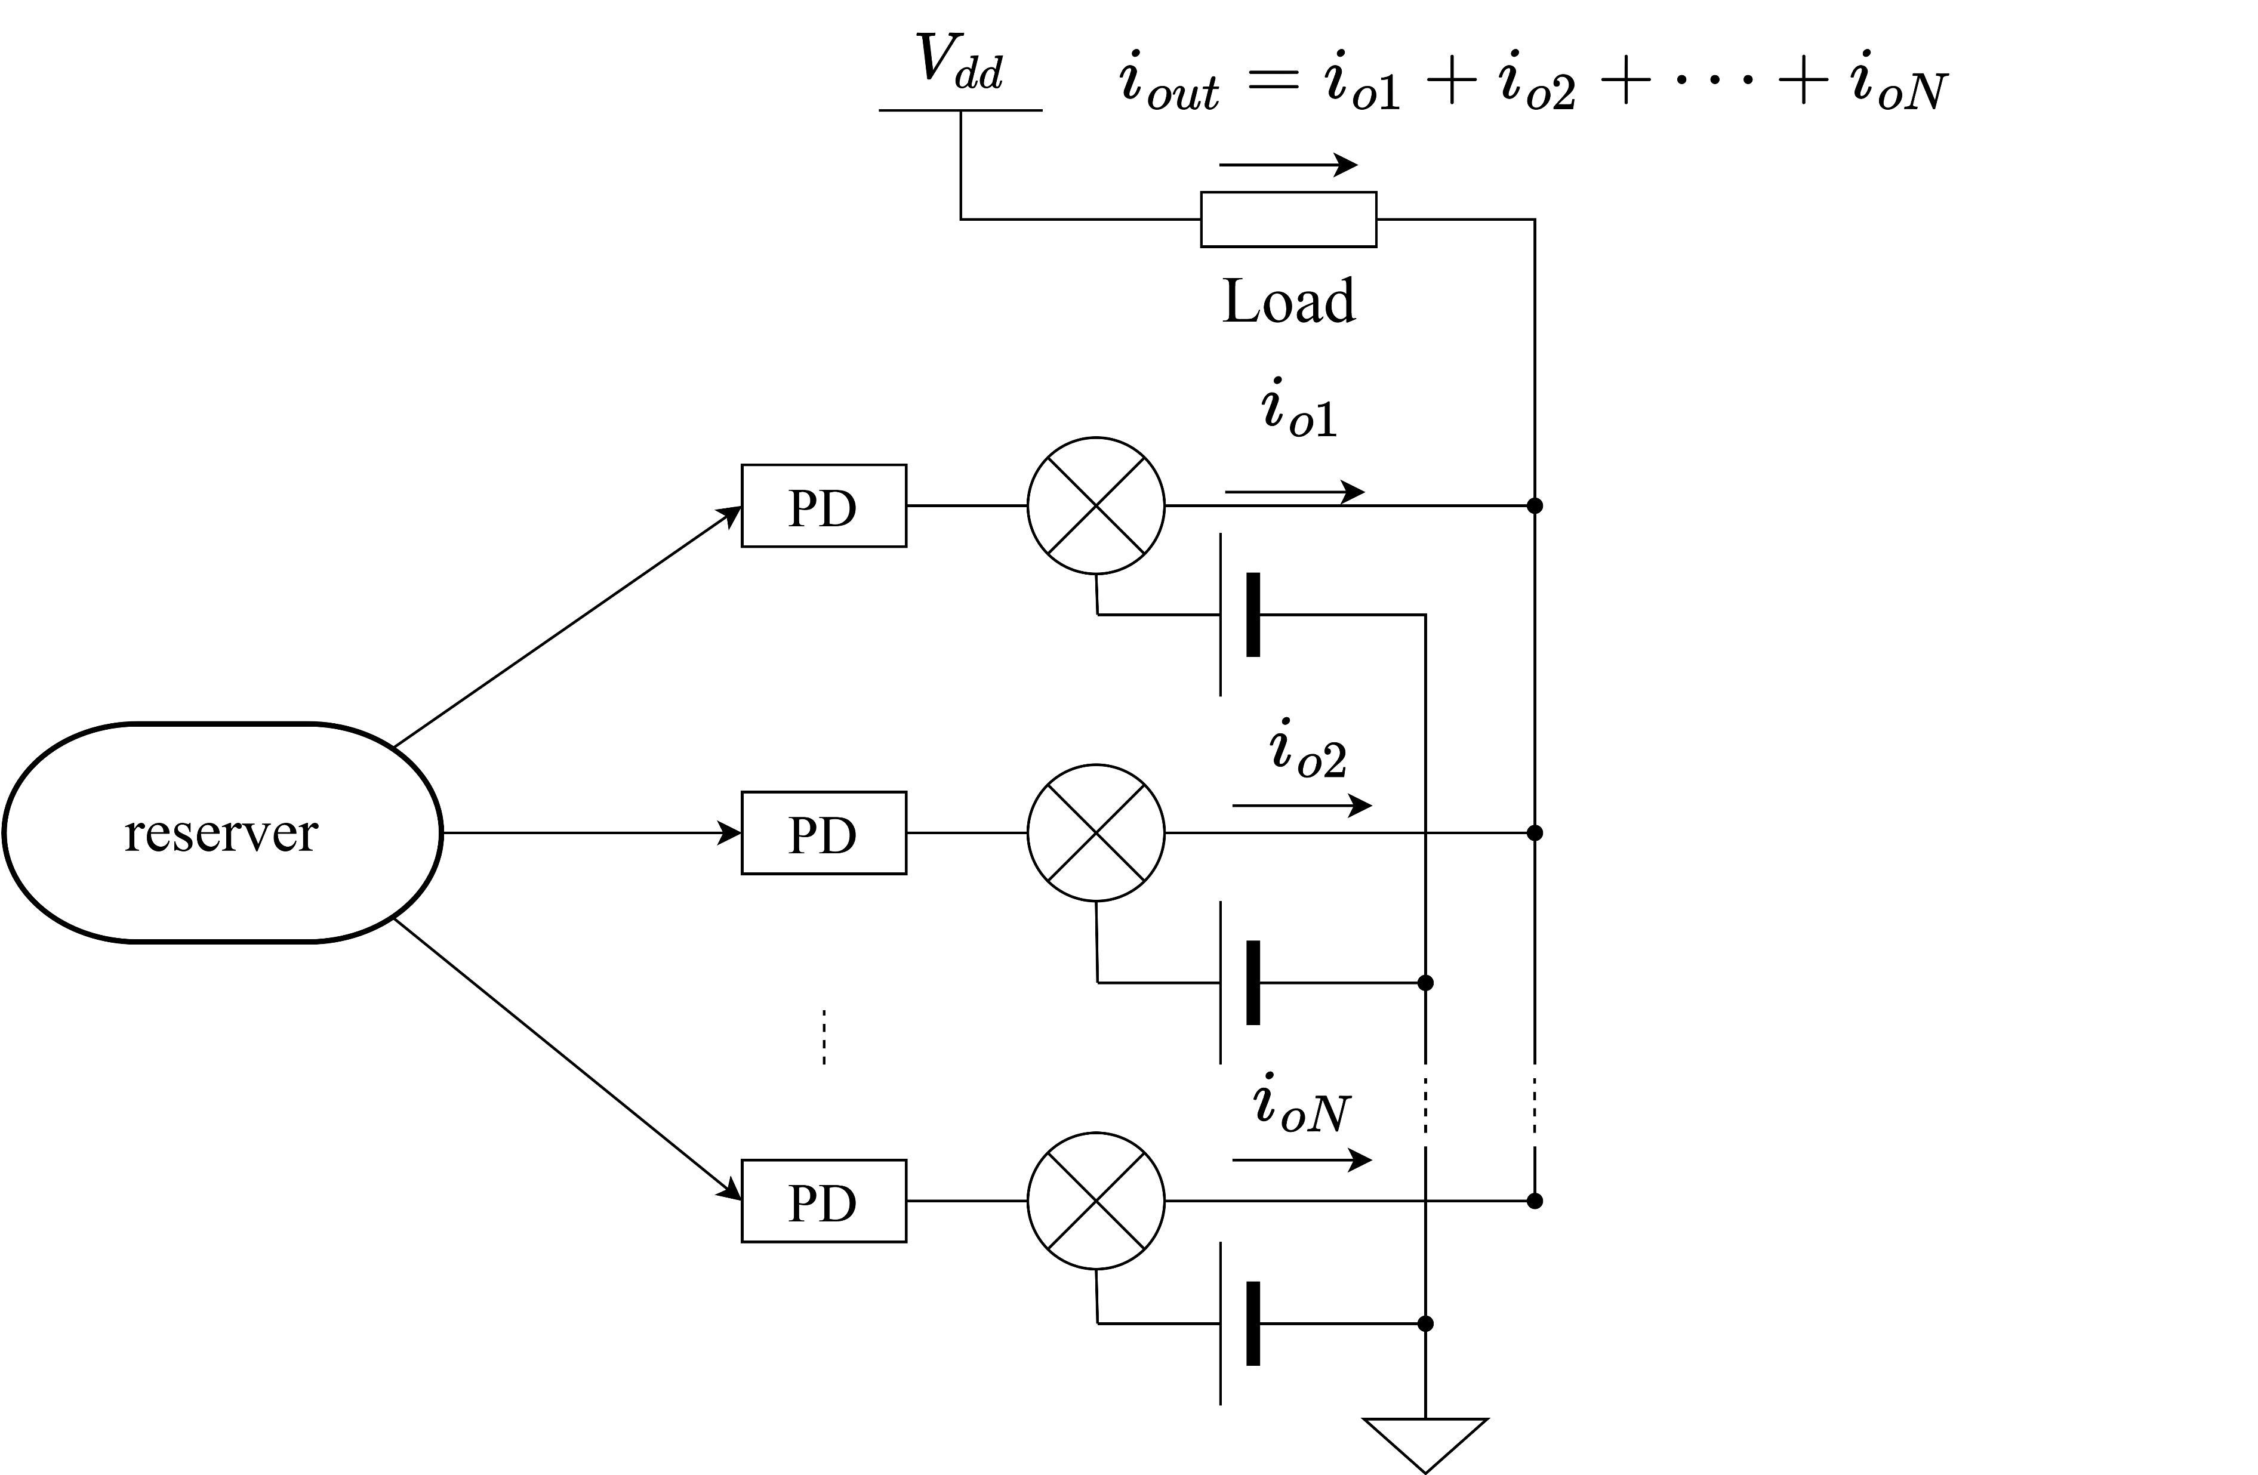
Background
input
output
Reserver is a device that work as a neural network by physical phenomenon.
Reflecting and interfering input light in the photonic reserver made that it store the state of a short time ago.
It seems that photonic reserver can predict chaotic-signal
and real-time graphic processing.

Slide 4
Background
Reserver’s output is sum-of-product.
Reserver’s learning is only learning of weight of sum-of-product.
So reserver’s learning cost is fewer than machine learning.
However, it is difficult for light to calculate sum-of-product.
⇒only this part, calculate in electronic circuits.

Slide 5
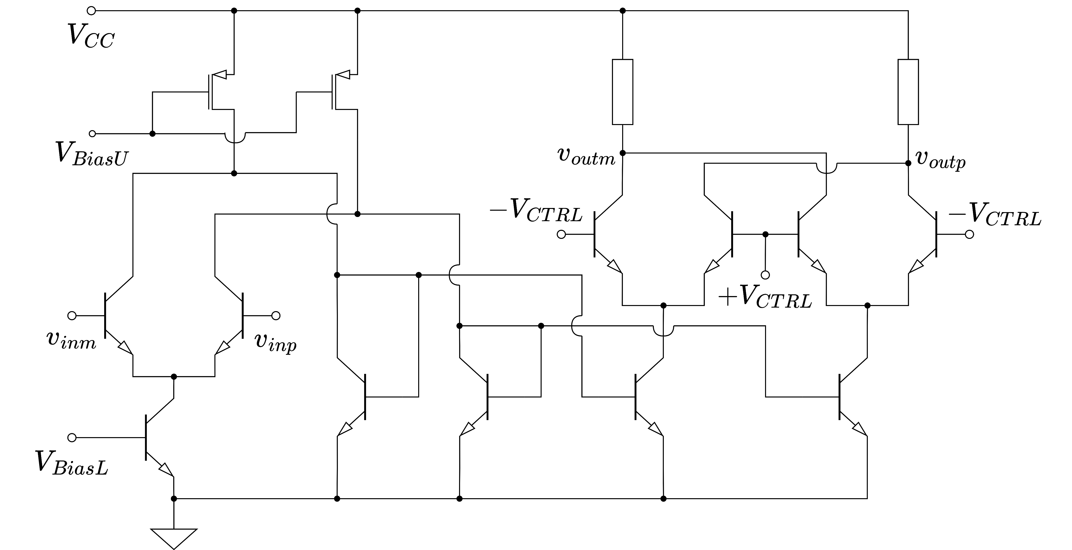
Background
This is a proposing analog multiplying circuit.
It modified gilbert multiplier for expand output amplitude.

Slide 6
Purpose
Photonic reserver output by light and multiplier’s input is voltage.
So, we need photo-diode. But the output amplitude is smaller than multiplier’s input.
⇒It is necessary to photonic-electronic translator and amplifier that have dimension of resister.
This name is TIA(Trans-Impedance Amplifier)

Slide 7
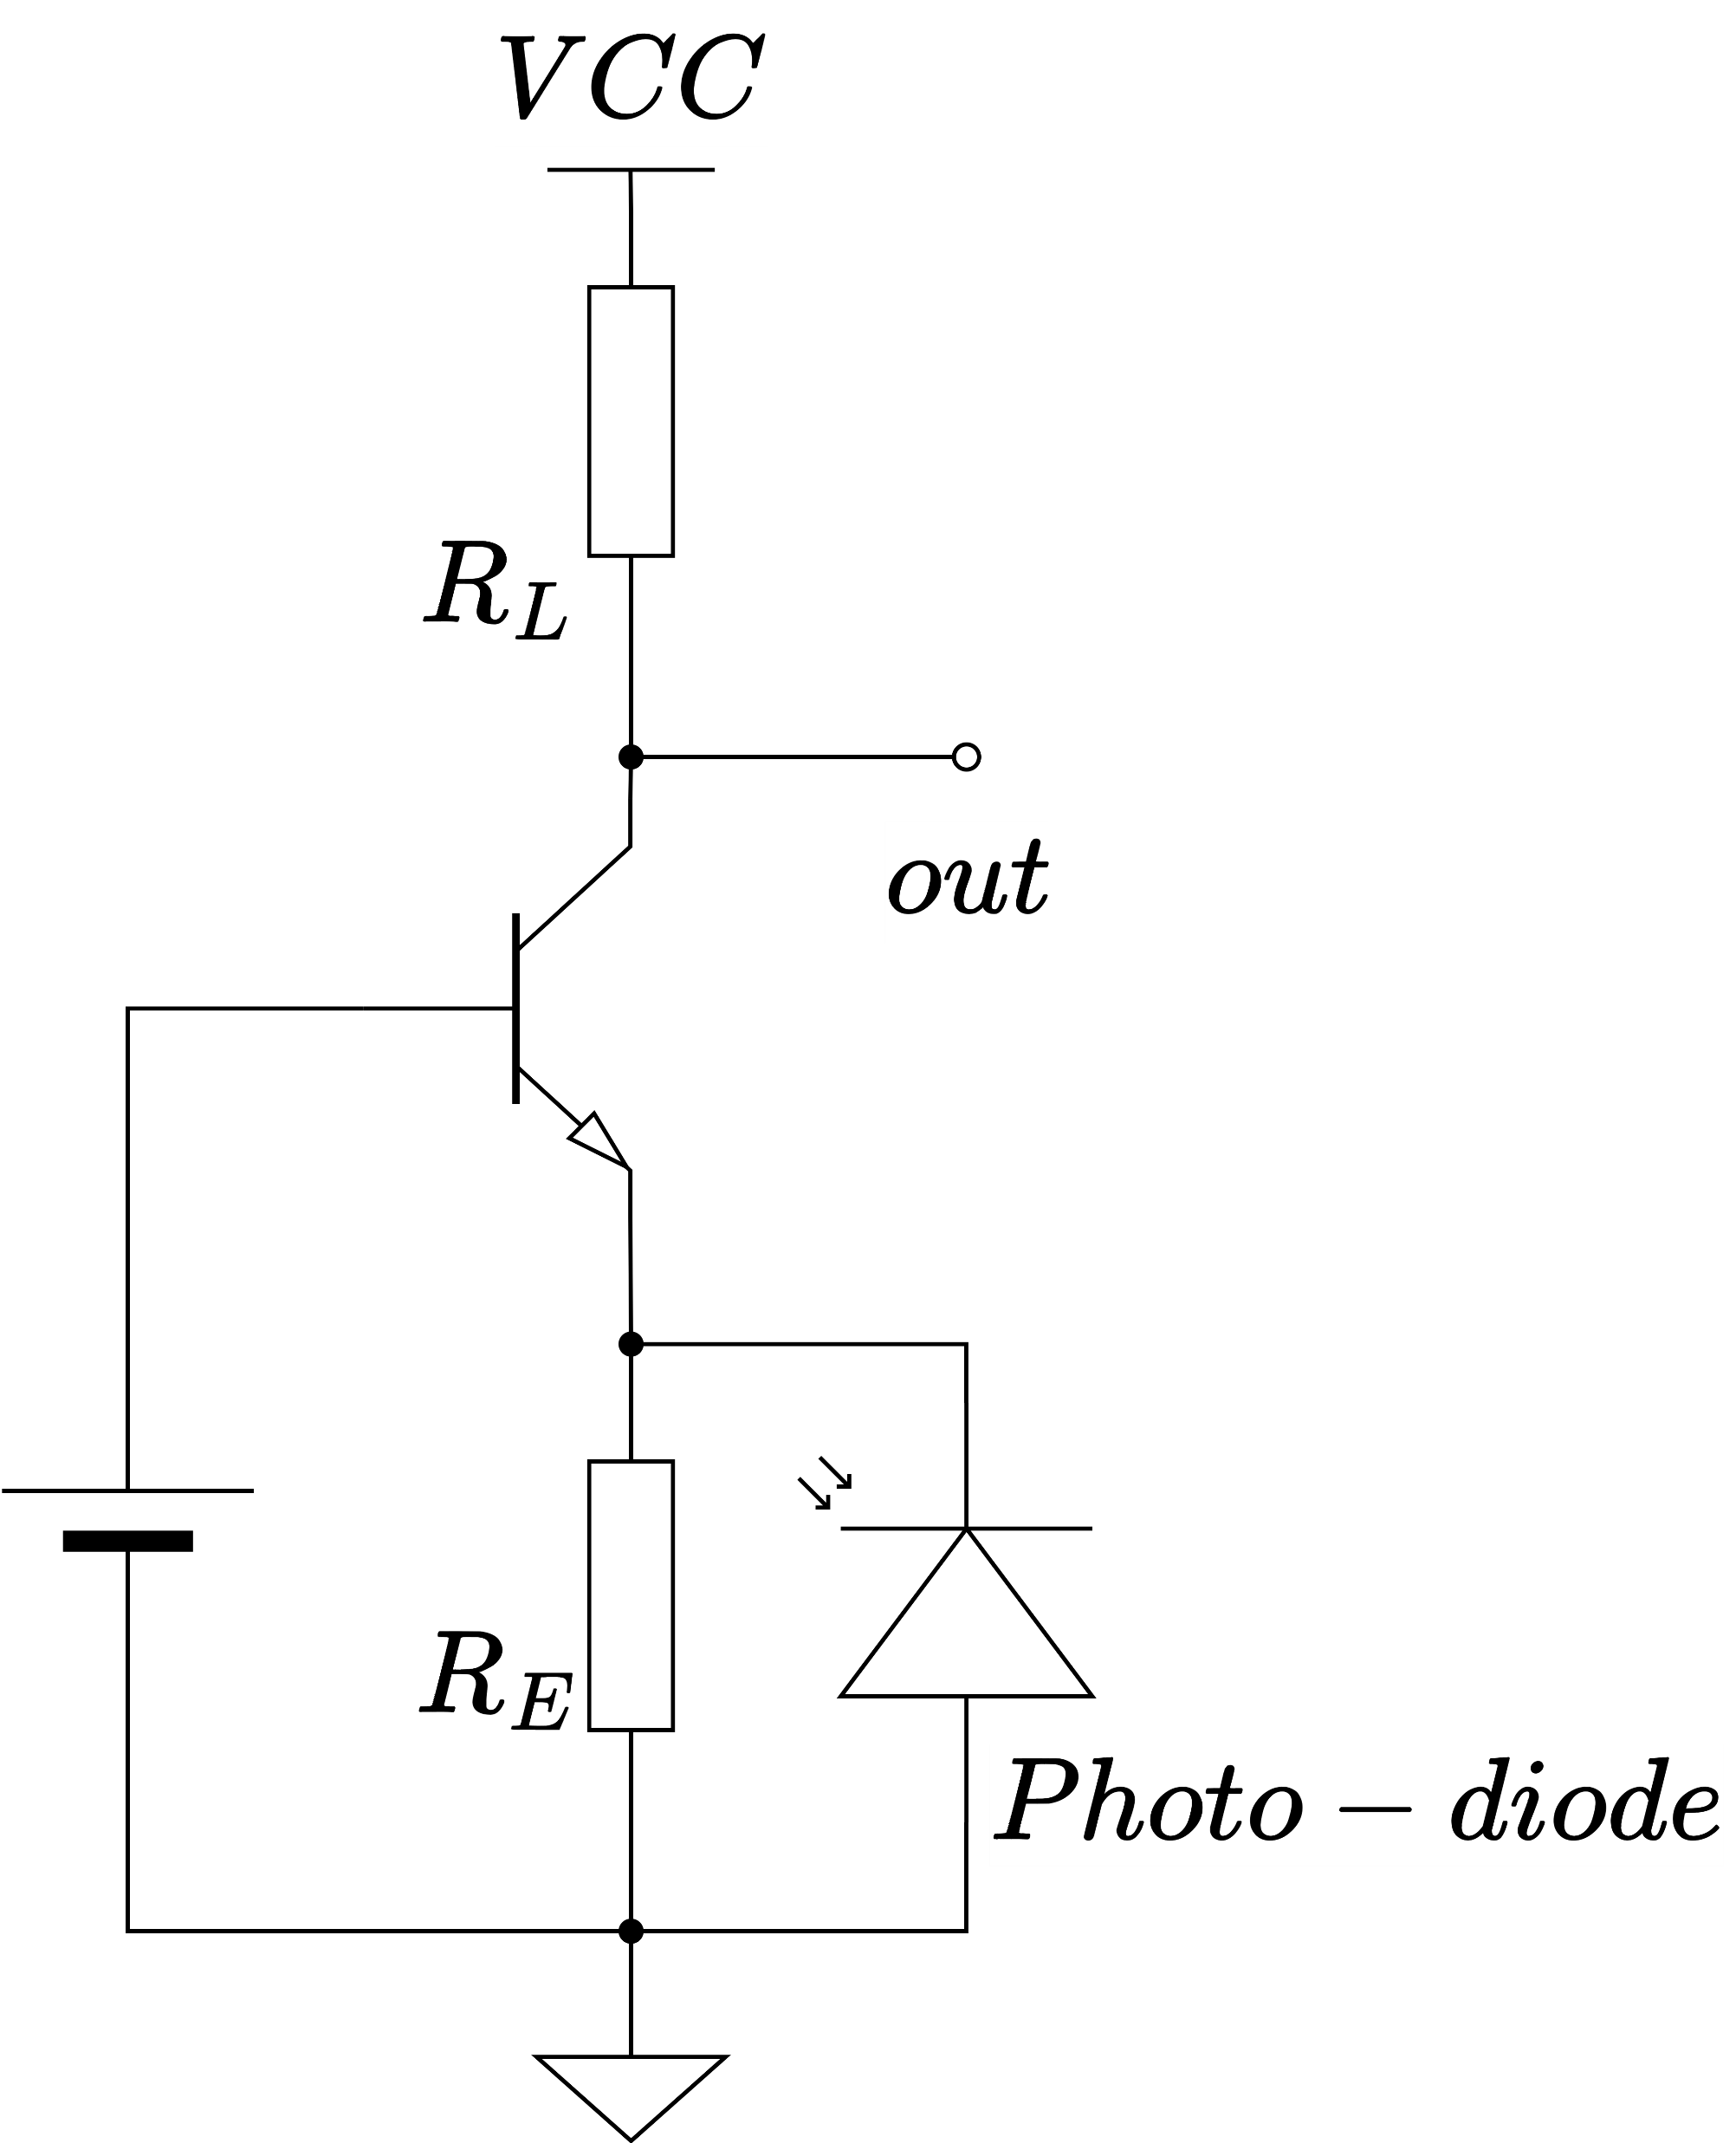
Single stage TIA
Photo-diode is a device of current output and multiplier’s input is voltage, so TIA needs current input and voltage output.
That is a reason why common-base amplifier is used for TIA.
But this topology is trade-off between trance-impedance and bandwidth.

Slide 8
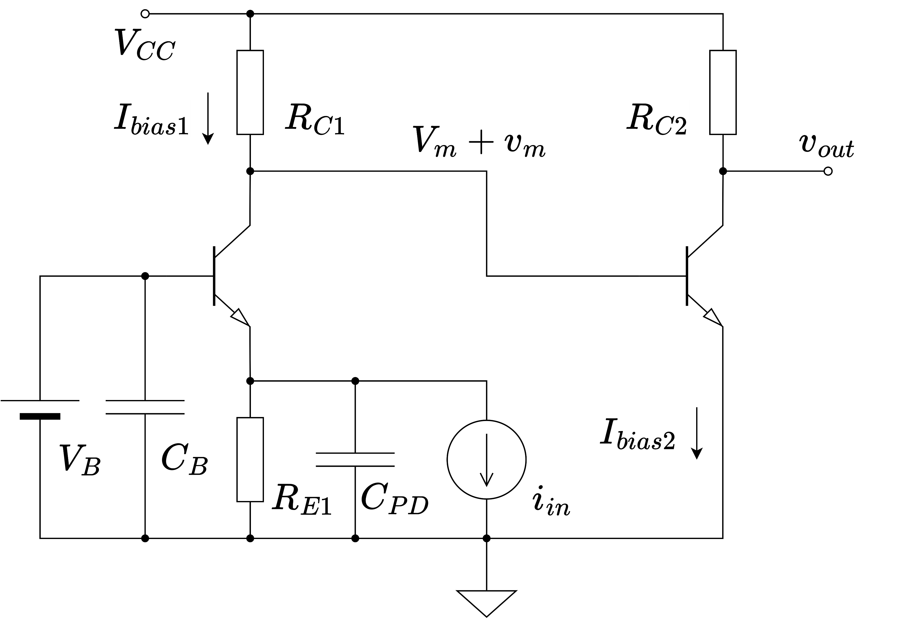







Double Stage TIA
$$870 Ω$$
$$540 Ω$$
To avoid the tread-off, I examining double stage TIA.
This topology dividing gain between two stage, I attempt high trans-impedance and large bandwidth.
$$0.9 V$$
$$1.2 V$$
$$1.5 V$$
$$0.6 V$$
$$650 Ω$$

Slide 9
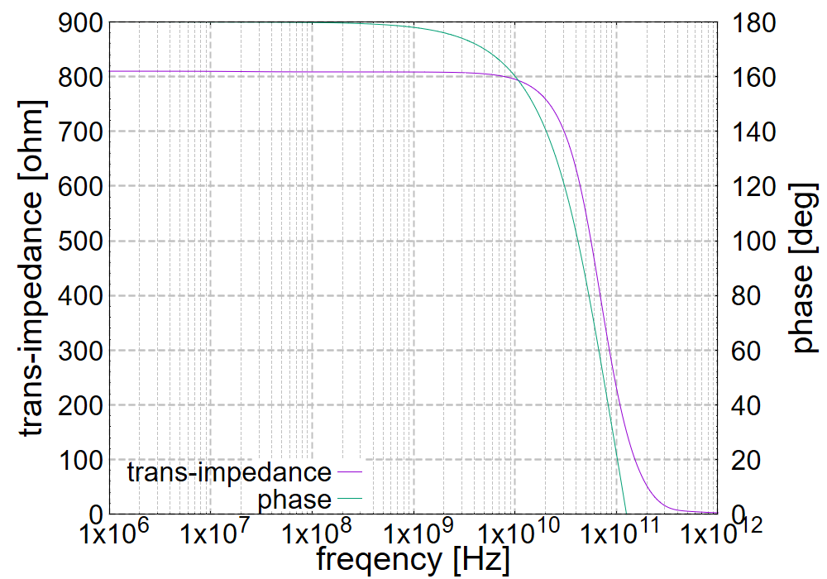
Double Stage TIA
$$870 Ω$$
$$540 Ω$$
$$0.9 V$$
$$1.2 V$$
$$1.5 V$$
$$0.6 V$$
$$650 Ω$$
This is a first stage of frequency characteristic.
This cutoff frequency is 10 GHz ordered.

Slide 10
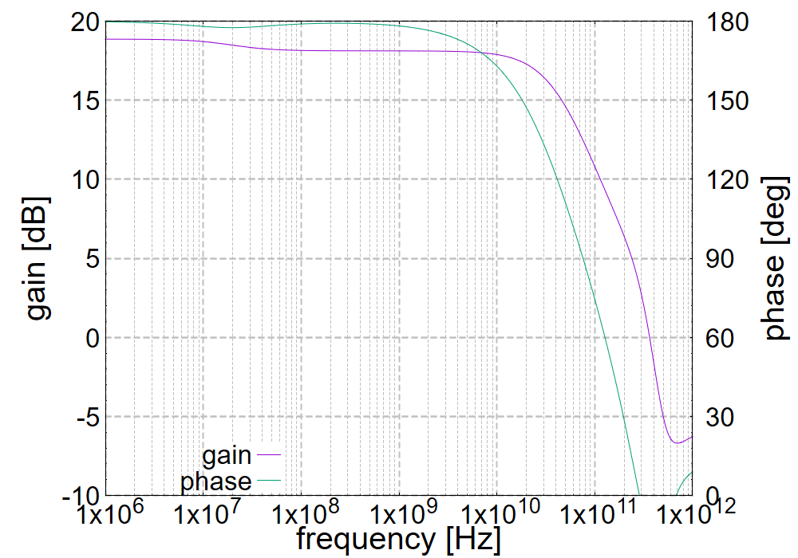







Double Stage TIA
VCC
$$870 Ω$$
$$540 Ω$$
$$0.9 V$$
$$1.2 V$$
$$1.5 V$$
input
$$0.6 V$$
$$650 Ω$$
GND
This is a second stage of frequency characteristic.
This cutoff frequency is 10 GHz ordered.

