Slide 1
Big Data Applications Symposium - Spring 2019
Project Name: Yelp restaurant recommendations
Team:
Kumar Mehta
Yashvee Desai
Abstract: Provide a web interface for users to search restaurants in a specific locality and get restaurant recommendations

Slide 2
Yelp restaurant recommendations
Motivation
Who are the users of this application?
Restaurant customers and restaurant owners
Who will benefit from this application?
Restaurant customers and restaurant owners
Why is this application important?
Simplify search for your next restaurant experience! Get list of potential restaurants that you may like in a particular area.

Slide 3
Yelp restaurant recommendations
Goodness
What steps were taken to assess the ‘goodness’ of the analytic itself?
We filtered out restaurants from all types of businesses in the dataset.
Researched about how collaborative filtering algorithm can be used for recommendations.

Slide 4
Yelp restaurant recommendations
Remediation
What actuation(s) or remediation actions are performed by the application?
Get map of recommended restaurants (on tableau), top rated restaurants and popular cuisines from a particular locality.
Update recommendations based on new user ratings

Slide 5
Yelp restaurant recommendations
Data Sources
Name: Yelp users
Description: Dataset containing information about 1,637k users. Size of data: 2.43 GB
Name: Yelp reviews
Description: Dataset containing information about 6,685k reviews by users.
Size of data: 5.23 GB
Name: Yelp businesses
Description: Dataset containing information about 190k businesses.
Size of data: 135 MB

Slide 6
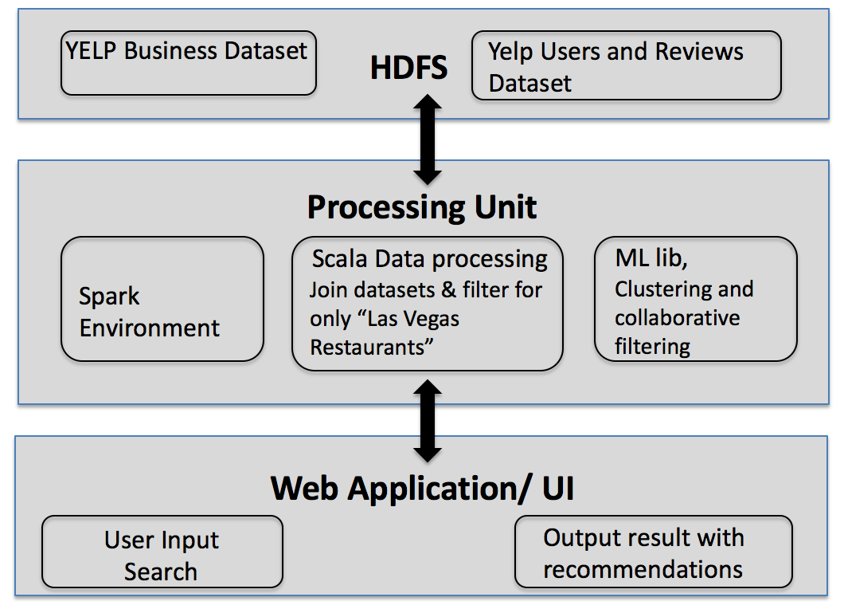
Yelp restaurant recommendations
Design Diagram
Platform(s) on which the application runs:
NYU HPC cluster (Dumbo)

Slide 7
Yelp restaurant recommendations
Insights
1. <Result 1>
<Tell us about insights, or other key observations.>
2. <Result 2>
3. <Result 3>

Slide 8
Yelp restaurant recommendations
Obstacles
1. Figuring out the design of how to connect the different parts of the application.
2. Extracting useful information from the dataset for the scope of the project.
3. Some scala functions (agg, groupby) were not supported on hdfs on Dumbo. How to overcome that?

Slide 9
Yelp restaurant recommendations
Summary
Our application recommends restaurants to users based on how they reviewed restaurants. We limit this functionality to the city of Las Vegas and search can be done only on a particular zip code.
Acknowledgements
Thanks to Yelp for the dataset
Thanks to professor Suzanne McIntosh for continuous guidance on the project

Slide 10
Yelp restaurant recommendations
References
Sumedh Sawant and Gina Pai. 2013. Yelp food recommendation system
Badrul Munir Sarwar, George Karypis, Joseph A Konstan, John Riedl, et al. 2001. Item-based collaborative filtering recommendation algorithms. Www1:285–295
Nabiha Asghar. 2016. Yelp dataset challenge: Review rating prediction. arXiv preprint arXiv:1605.05362

Slide 11
Yelp restaurant recommendations
Thank you!

