Slide 1

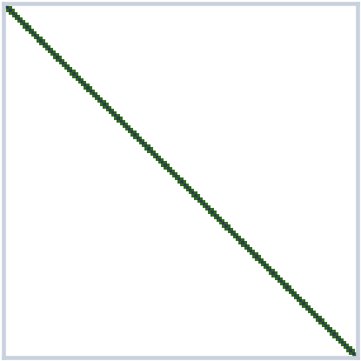
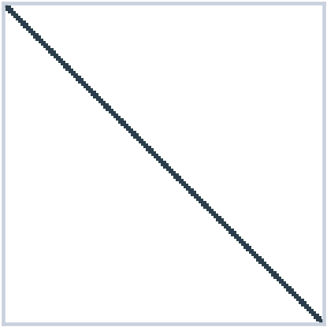
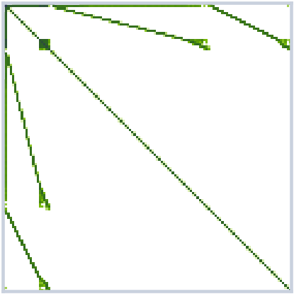
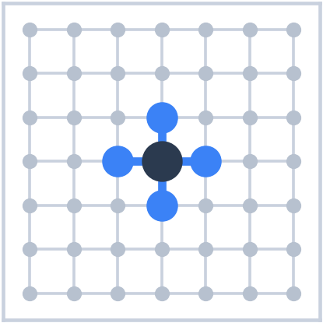
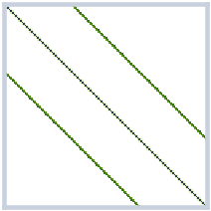
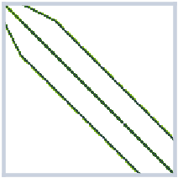
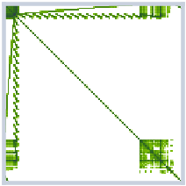
What limits GPU kernels on real matrices?
NUMERICAL LIBRARIES MINI-HACKATHON · GEFORCE RTX 5090 · CUDA 12.9 · CUPY 13.6.0
Five inputs, three kernels — is each one limited by arithmetic, by memory bandwidth, or by latency?
A · GEMM
B · SpMV
B · SpMV
B · SpMV
C · CG
Dense n × n
Grid stencil*
FEM shell
Circuit
2-D Poisson
n = 128 … 16,384
1M rows · 5.0 nnz/row
90k rows · 53 nnz/row
18k rows · 7.1 nnz/row
n = 256 … 4.2M
FP64 · FP32 · TF32 · FP16
2-D 5-point grid · SPD
cylindrical shell · SPD
irregular, up to 574 per row
5-point stencil · SPD
A
GEMM How much speed does lower precision buy?
B
SpMV How close to the memory bandwidth, vs one CPU core?
C
CG From which size on does the GPU win, copies included?
* Grid stencil: synthetic stand-in (SuiteSparse unavailable) · FEM shell, Circuit: real, NIST Matrix Market · tiles: non-zero density, inset = first 3,000 rows
Notes:
PURPOSE OF THIS SLIDE: define the problem and show exactly what we multiply.
THE QUESTION. Every kernel on a GPU is limited by one of three things: arithmetic throughput (FLOP/s), memory bandwidth (bytes/s), or latency (the fixed cost of launching work and synchronising). Which one applies is predicted by the arithmetic intensity I = FLOP / bytes moved. On this RTX 5090 we measured a best FP64 GEMM of 1.74 TFLOP/s and a streaming bandwidth of 1.58 TB/s, so the balance point ("ridge") is about 1.1 FLOP per byte. Kernels below it are bandwidth-bound; kernels above it are compute-bound; any kernel whose work is too small is latency-bound.
THE INPUTS (left to right).
- A, dense GEMM: square n×n matrices, n = 128 to 16,384. Intensity grows like n/12 in FP64 because every loaded element is reused n times. Expectation: compute-bound.
- B, three sparse matrices for SpMV, drawn as non-zero density maps; the inset zooms into the first 3,000 rows to show the local pattern. FEM shell (dataset s3dkq4m2): 90,449 rows, 4,820,891 stored entries, 53.3 per row on average (max 54); Grid stencil (dataset ecology2): 1,000,000 rows, 4,996,000 stored entries, 5.0 per row on average (max 5) — synthetic stand-in; Circuit (dataset memplus): 17,758 rows, 126,150 stored entries, 7.1 per row on average (max 574). SpMV does 2 FLOP per stored entry but reads 12 bytes (value + column index), so I ≤ 1/6. Expectation: bandwidth-bound.
- C, the 2-D Poisson problem (5-point stencil, SPD) that we scale from 256 to 4,194,304 unknowns for conjugate gradient; we also run CG on the SPD sparse matrices. Expectation: latency-bound when small, bandwidth-bound when large.
DATA SOURCES. FEM shell (s3dkq4m2) and Circuit (memplus) are real matrices from the NIST Matrix Market. Grid stencil is a synthetic stand-in with the same size and sparsity class, because the SuiteSparse file server returned HTTP 403 during the run.
METHOD (applies to every number in the talk). Warm-up first; GPU kernels timed with CUDA events and a synchronize; medians of several batches; host-device copies timed separately and reported as "end-to-end" where relevant; SpMV timed with the L2 cache flushed before each call. Why it matters: timing the same 4096³ FP32 GEMM without a synchronize gave 1,955 TFLOP/s instead of 62.7 TFLOP/s — 31× too fast, because only the launch was timed. The CPU baseline is SciPy CSR on one core.

Slide 2
Compute-bound: precision is the lever
A · cuBLAS GEMM
cublasGemmEx, n × n × n, data on the GPU — FP16 tensor cores reach 216 TFLOP/s, 124× FP64
Accuracy cost (relative error vs FP64)
FP32 2.6×10⁻⁷ ≈ 7 correct digits
TF32 2.9×10⁻⁴ ≈ 4 correct digits
FP16 3.6×10⁻⁴ ≈ 3 correct digits
Why: tensor cores for TF32/FP16 · FP64 at 1:64 on GeForce
Notes:
WHAT WE COMPARED. The same square GEMM (C = A·B, n×n×n) for n = 128 … 16,384 in four precisions, all through cublasGemmEx with explicit compute types: FP64; FP32 (strict FP32 accumulate); TF32 (FP32 data, tensor-core multiply); FP16 (FP16 data, FP32 accumulate). Data stays on the GPU; timing is CUDA events after warm-up, median of batches. Accuracy is the relative Frobenius error against an FP64 reference at n = 1024.
KEY RESULTS.
- Best throughput at n = 16,384: FP64 1.74, FP32 66.3, TF32 116.9, FP16 216.0 TFLOP/s.
- Ratios: FP32/FP64 = 38×, TF32/FP32 = 1.8×, FP16/FP32 = 3.3×, FP16/FP64 = 124×.
- Accuracy: FP32 2.6×10⁻⁷, TF32 2.9×10⁻⁴, FP16 3.6×10⁻⁴ (about 7, 4 and 3 correct digits).
- Small sizes: TF32/FP16 calls with n ≤ 512 all take ≈ 11 µs regardless of size; throughput saturates from roughly n = 4096.
CONCLUSIONS AND REASONS.
1) GEMM is compute-bound. Its intensity is about n/12 FLOP/byte in FP64 — already above the 1.1 FLOP/byte ridge at n = 128 and three orders of magnitude above it at n = 16,384 — because every loaded element is reused n times. Memory bandwidth is not the limit; arithmetic units are.
2) Throughput rises with n and then flattens. Small matrices cannot fill the 170 SMs and pay a fixed ≈ 11 µs launch cost; this latency floor reappears in SpMV on small matrices and in CG.
3) Precision is the biggest lever. TF32 and FP16 use the tensor cores (1.8× and 3.3× over FP32). FP64 is exceptionally slow because the GeForce RTX 5090 executes FP64 at 1/64 of its FP32 rate — a data-centre GPU would narrow this gap dramatically.
4) The price is accuracy, and it follows the mantissa width: FP32 keeps 23 mantissa bits (~10⁻⁷); TF32 and FP16 keep only 10 (~10⁻⁴). FP16 is no worse than TF32 because accumulation is done in FP32, so the error is dominated by rounding the inputs.
Take-away: for compute-bound kernels, choose the lowest precision your error budget allows.
TIMING NOTE (if asked). The first-ever GEMM call ran at 1.2 TFLOP/s because it includes cuBLAS initialisation and kernel selection — another reason to warm up.

Slide 3
Bandwidth-bound — unless the matrix is tiny
B · cuSPARSE SpMV + ROOFLINE
cusparseSpMV (CSR, FP64), L2 flushed before every call · CPU = SciPy on one core
58–65%
37–47×
16 µs
of measured bandwidth (FEM shell, Grid stencil*)
faster than one CPU core on the large matrices
per call on Circuit (1.8 MB): 7% of bandwidth, 5.2×
Notes:
WHAT WE COMPARED. y = A·x in CSR / FP64 for the three sparse matrices, with cuSPARSE's generic cusparseSpMV (descriptors built once, so we time the library kernel and not Python overhead) against SciPy's CSR SpMV on one CPU core. Each GPU call is timed with the L2 cache flushed beforehand ("cold"); back-to-back calls are reported as "warm". Bandwidth uses the minimum-traffic model: 12 bytes per stored entry (8 B value + 4 B column index) plus row pointers and one read of x and one write of y. Results were checked against the CPU (relative error ~1e-16). Right chart: the measured roofline — the sloped part is 1,575 GB/s × intensity, the flat part the best DGEMM rate — with DGEMM (n = 128 … 16,384) and the SpMV points.
KEY RESULTS.
- FEM shell: 56.9 MB per SpMV, GPU 65.5 µs = 911 GB/s (58% of STREAM), warm 1,264 GB/s; CPU 2.44 ms = 24.4 GB/s; speed-up 37×; the host→GPU copy is repaid after 15.7 SpMVs.
- Grid stencil (synthetic): 76.2 MB per SpMV, GPU 77.8 µs = 1,027 GB/s (65% of STREAM), warm 1,500 GB/s; CPU 3.68 ms = 21.7 GB/s; speed-up 47×; the host→GPU copy is repaid after 3.0 SpMVs.
- Circuit: 1.8 MB per SpMV, GPU 16.4 µs = 114 GB/s (7% of STREAM), warm 167 GB/s; CPU 0.08 ms = 22.0 GB/s; speed-up 5.2×; the host→GPU copy is repaid after 11.5 SpMVs.
- On the roofline, SpMV sits at I ≈ 0.12–0.16 FLOP/byte and uses only 0.9–8.4% of DGEMM's FLOP/s.
CONCLUSIONS AND REASONS.
1) SpMV is bandwidth-bound. Each stored entry costs 12 bytes for 2 FLOP, so I ≤ 1/6 — far left of the 1.1 FLOP/byte ridge. Faster arithmetic cannot help; only moving fewer bytes can (compressed indices, lower-precision values, or multiplying several vectors at once with SpMM).
2) The GPU wins by bandwidth, not by FLOPs: 37–47× over one core on the large matrices because the GPU streams ~1.58 TB/s while one core manages ~22–24 GB/s.
3) Why only 58–65% of STREAM, not 100%: CSR needs index decoding, the reads of x are indirect (gathers), and uneven row lengths unbalance the threads.
4) Warm-cache numbers (167–1500 GB/s) are inflated: the matrices (2–76 MB of traffic) fit in the 96 MB L2, so they measure cache, not DRAM. That is why the cold numbers are the honest ones.
5) Tiny matrices are latency-bound: Circuit moves only 1.8 MB, so a call lasts 16 µs — close to the ~10 µs launch floor seen in GEMM — and reaches just 7% of bandwidth and 5.2× over the CPU. Its point falls far below the roof. Small problems do not benefit much from the GPU.
6) Transfers: the pageable host→GPU copy runs at only 9.8 GB/s (~160× slower than device memory), so the matrix has to be reused for several SpMVs before the GPU pays off — which is exactly the situation in iterative solvers like CG.

Slide 4
The GPU wins above n ≈ 8,000
C · CONJUGATE GRADIENT ON THE GPU
CG = cuSPARSE SpMV + cuBLAS dot/axpy · 2-D Poisson, 100 iterations per size · vs SciPy/NumPy on one core
n* ≈ 8.0×10³ measured
Flat ≈ 80 µs GPU floor vs ≈ 16 GB/s on one core → model predicts ≈ 6.8×10³
FEM shell: residual 2.3×10⁻⁵ after 500 its · Grid stencil: residual 2.8×10⁻⁷ after 500 its → needs a preconditioner
Notes:
WHAT WE COMPARED. Unpreconditioned CG built from exactly the operations in the brief: one cusparseSpMV, two cuBLAS dot products, three cuBLAS axpy and one scal per iteration. The same algorithm in SciPy/NumPy on one CPU core is the baseline. Size sweep: 2-D Poisson from 256 to 4,194,304 unknowns, a fixed 100 iterations so both sides do identical work. "Kernels only" keeps A and b resident on the GPU; "with copies" frees GPU memory and then times copy A and b up + solve + copy x back. Both solvers were validated against a direct solve first. Then CG on the SPD matrices (FEM shell, Grid stencil (synthetic)) with tolerance 10⁻⁸ and a cap of 500 iterations.
KEY RESULTS.
- GPU time per iteration is flat at ≈ 80 µs from n = 256 up to 65,536; the CPU grows from 10 µs to 152,891 µs.
- Crossover: 8,000 unknowns kernels-only, 9,300 with copies. Model prediction ≈ 6,800.
- At n = 4.2M: 390× kernels-only and 161× with copies; copies are 58% of the end-to-end GPU time (vs 2% at n = 256).
- SPD matrices, 500 iterations: FEM shell 29× → 29× (copies 11%, residual 2.3e-5); Grid stencil 99× → 86× (copies 12%, residual 2.8e-7).
CONCLUSIONS AND REASONS.
1) Small problems are latency-bound on the GPU. Each iteration issues about nine GPU operations and twice waits for a dot-product result on the host (to compute α and β). That costs ≈ 80 µs no matter how small the vectors are — the same ~10 µs-per-call floor we saw in GEMM, multiplied by the number of calls.
2) The CPU is bandwidth-bound and scales with n: each iteration moves about 192 bytes per unknown (SpMV 80 B + vector updates and dots), and one core streams ≈ 16 GB/s.
3) Crossover model: GPU wins when 192·n / B_CPU > τ₀, i.e. n* ≈ τ₀ / (192 B · (1/B_CPU − 1/B_GPU)) ≈ 6,800; measured 8,000. The simple two-parameter model explains the crossover to within ~15%.
4) Large problems: the GPU becomes bandwidth-bound too, but with ~97× the bandwidth of one core. The extreme 390× at 4.2M is partly a CPU effect: going from 1M to 4.2M unknowns (4×) made each CPU iteration 12.5× slower because the working set left the CPU caches — treat it as an upper bound.
5) Transfers are a one-time tax. PCIe runs at 9.8 GB/s, so one host→GPU copy costs about 84 GPU iterations at n = 4.2M. With only 100 iterations the copy share grows with n; with 500 iterations it is amortised (11%, 12%). Move data once, keep it resident.
6) The GPU makes each iteration faster but does not reduce the number of iterations. FEM shell, Grid stencil did not converge in 500 iterations because it is very ill-conditioned (condition number ~10¹¹ for the FEM shell); unpreconditioned CG converges at a rate set by the condition number. A preconditioner (Jacobi, IC0) is the next step — something synthetic test matrices would never have revealed.

Slide 5
FLOP per byte decides what to optimise
SUMMARY
bandwidth-bound
ridge ≈ 1.1 FLOP/B
compute-bound
SpMV
CG
GEMM n = 128 → 16,384
10⁻²
10⁻¹
1
10
10²
10³
10⁴
arithmetic intensity [FLOP per byte moved, log scale]
A
GEMM
B
SpMV
C
CG
124×
58–65%
n ≈ 8,000
FP16 tensor cores vs FP64
of bandwidth · 37–47× one core
GPU wins · 390× at 4.2M unknowns
Compute-bound
Bandwidth-bound
Latency, then bandwidth
I ≈ n/12 ≫ 1.1; tensor cores for TF32/FP16; FP64 at the 1:64 GeForce rate. Each step down costs ≈ 3 digits.
12 bytes per 2 FLOP (I ≤ 1/6). Tiny circuit matrix: 16 µs calls, latency-bound (7%).
≈ 80 µs floor per iteration (≈ 9 launches + 2 syncs). PCIe ≈ 160× slower than DRAM. Ill-conditioned FEM matrix does not converge.
→ Lowest precision the error budget allows
→ Move fewer bytes · batch vectors (SpMM)
→ Fewer launches · resident data · precondition
Notes:
ONE-SENTENCE SUMMARY. The number of floating-point operations per byte moved tells you which hardware ceiling applies, and therefore what to optimise.
THE NUMBER LINE. On this GPU the FP64 ridge is ≈ 1.1 FLOP/byte (1.74 TFLOP/s ÷ 1.58 TB/s). SpMV (I ≈ 0.12–0.16) and CG (≈ 0.11) sit an order of magnitude to the left; GEMM sits one to three orders to the right.
A — GEMM is compute-bound. Evidence: throughput saturates at 1.74 / 66.3 / 116.9 / 216.0 TFLOP/s for FP64/FP32/TF32/FP16, independent of memory bandwidth. Reason: data reuse grows with n (I ≈ n/12). Lever: precision — tensor cores give 1.8× (TF32) and 3.3× (FP16) over FP32, 124× over FP64 on this GeForce card (FP64 at 1:64), at the cost of ~3 correct digits (10⁻⁷ → 10⁻⁴).
B — SpMV is bandwidth-bound. Evidence: 911–1027 GB/s = 58–65% of measured bandwidth on the large matrices, but only 0.9–8.4% of DGEMM's FLOP/s. Reason: 12 bytes per 2 FLOP. The 37–47× over one core comes from bandwidth (~1.58 TB/s vs ~16–24 GB/s). Exception: the 1.8 MB Circuit is latency-bound (16 µs per call, 7% of bandwidth, 5.2×). Lever: fewer bytes — compressed indices, lower-precision values, several right-hand sides at once.
C — CG is latency-bound when small and bandwidth-bound when large. Evidence: flat ≈ 80 µs per GPU iteration up to 66k unknowns; crossover with one CPU core at ≈ 8,000 (model ≈ 6,800); 390× / 161× at 4.2M unknowns. Reason: ≈ 9 GPU operations and 2 host synchronisations per iteration, plus a PCIe link ~160× slower than device memory. Levers: fuse BLAS-1 kernels and keep scalars on the device (or CUDA Graphs) to lower τ₀; copy once and iterate; precondition ill-conditioned systems (the FEM shell stalled at a residual of 2.3e-5).
CAVEATS. Grid stencil is a synthetic stand-in (SuiteSparse unavailable); the CPU baseline uses 1 of 208 cores, so speed-ups are per core, not node vs node; efficiency percentages are relative to the measured ceilings because the RTX 5090's datasheet peaks were not in our lookup table; device→host copies used pageable memory (1.5 GB/s) — pinned memory would help.

